Slide 1
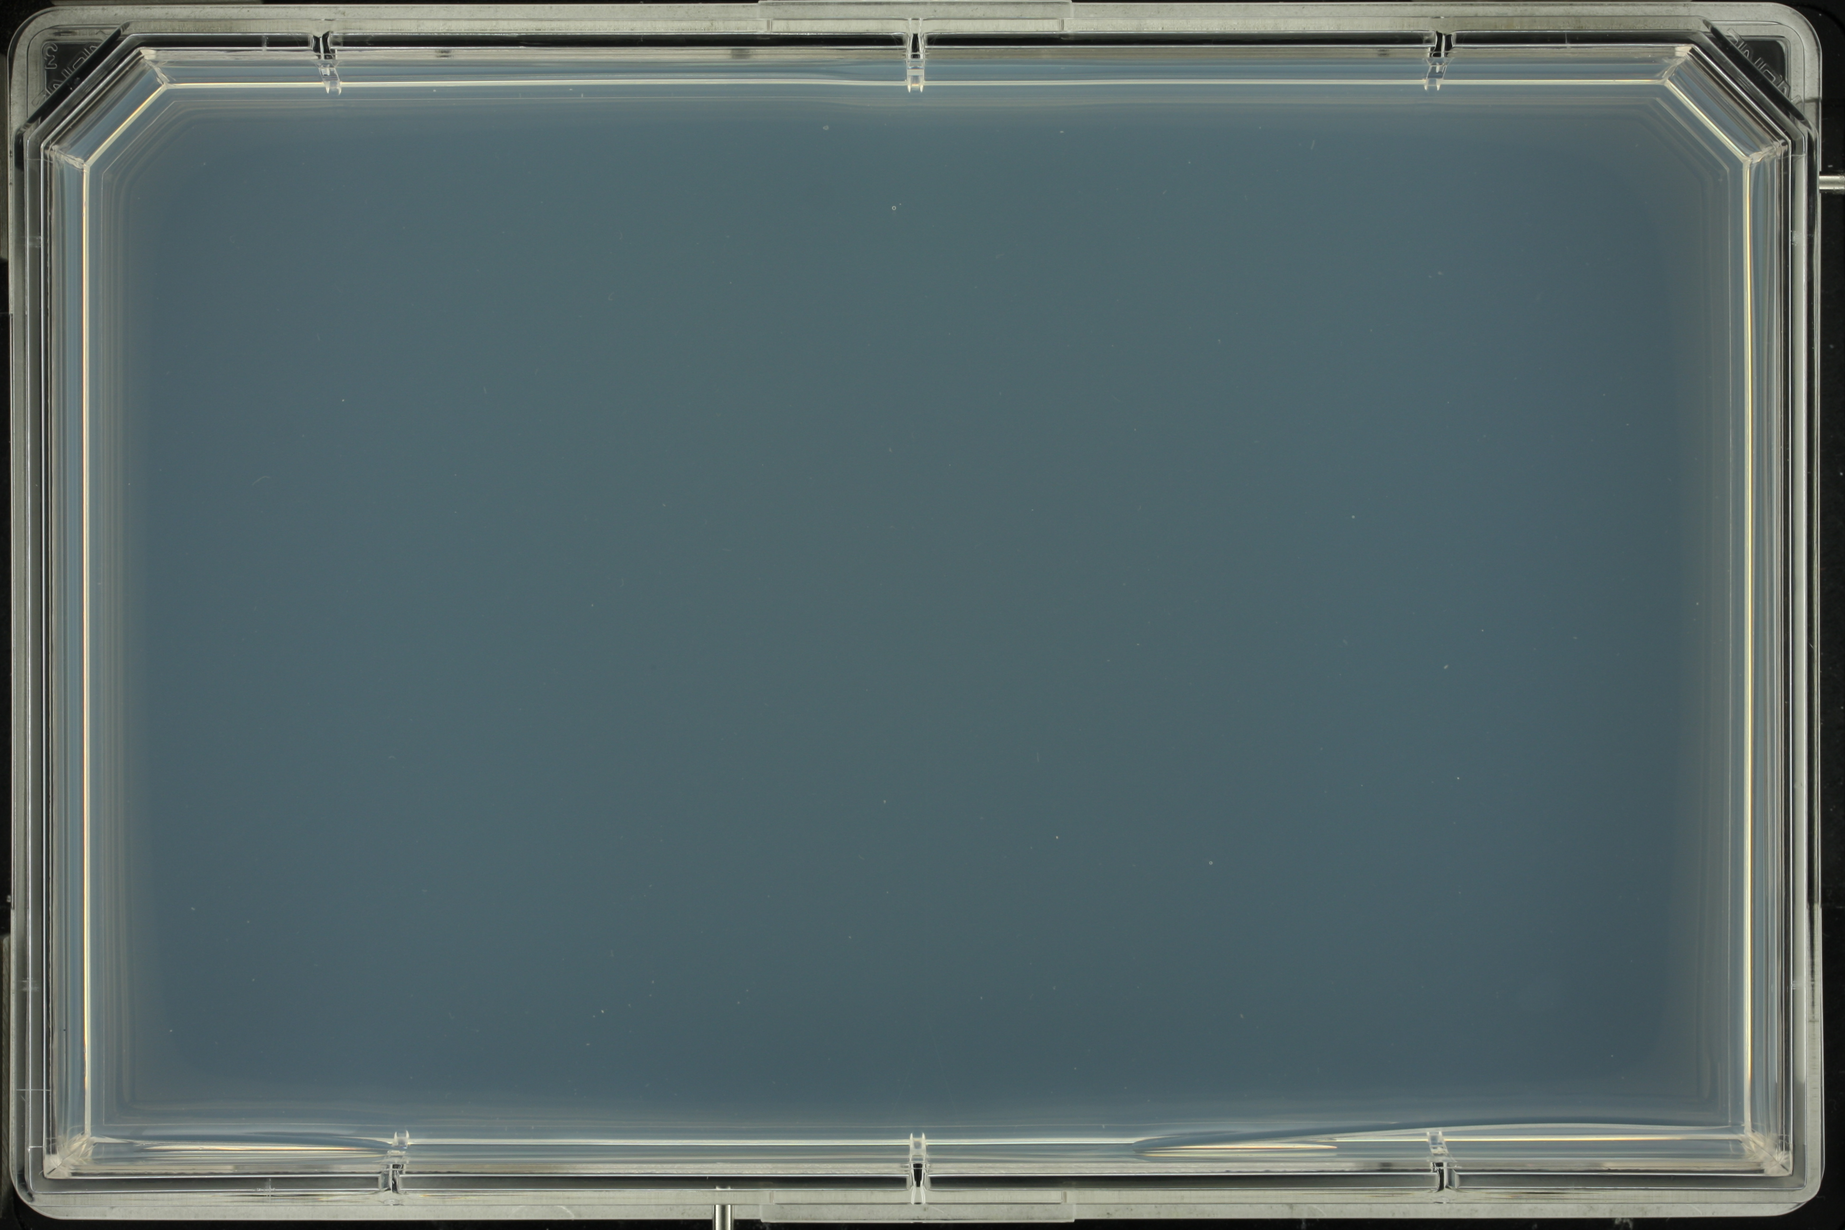
Modelling competition for nutrients between QFA spots
Daniel Boocock
Supervisor: Conor Lawless
25/07/2016

Slide 2
- Microbial cultures are inoculated in a grid on a solid agar surface
- Repeatedly photographed
- Analysed to get cell density estimates
- Growth curves are fit with the logistic model
- Fits are used to derive fitness estimates
Quantitative Fitness Analysis (QFA)

Slide 3
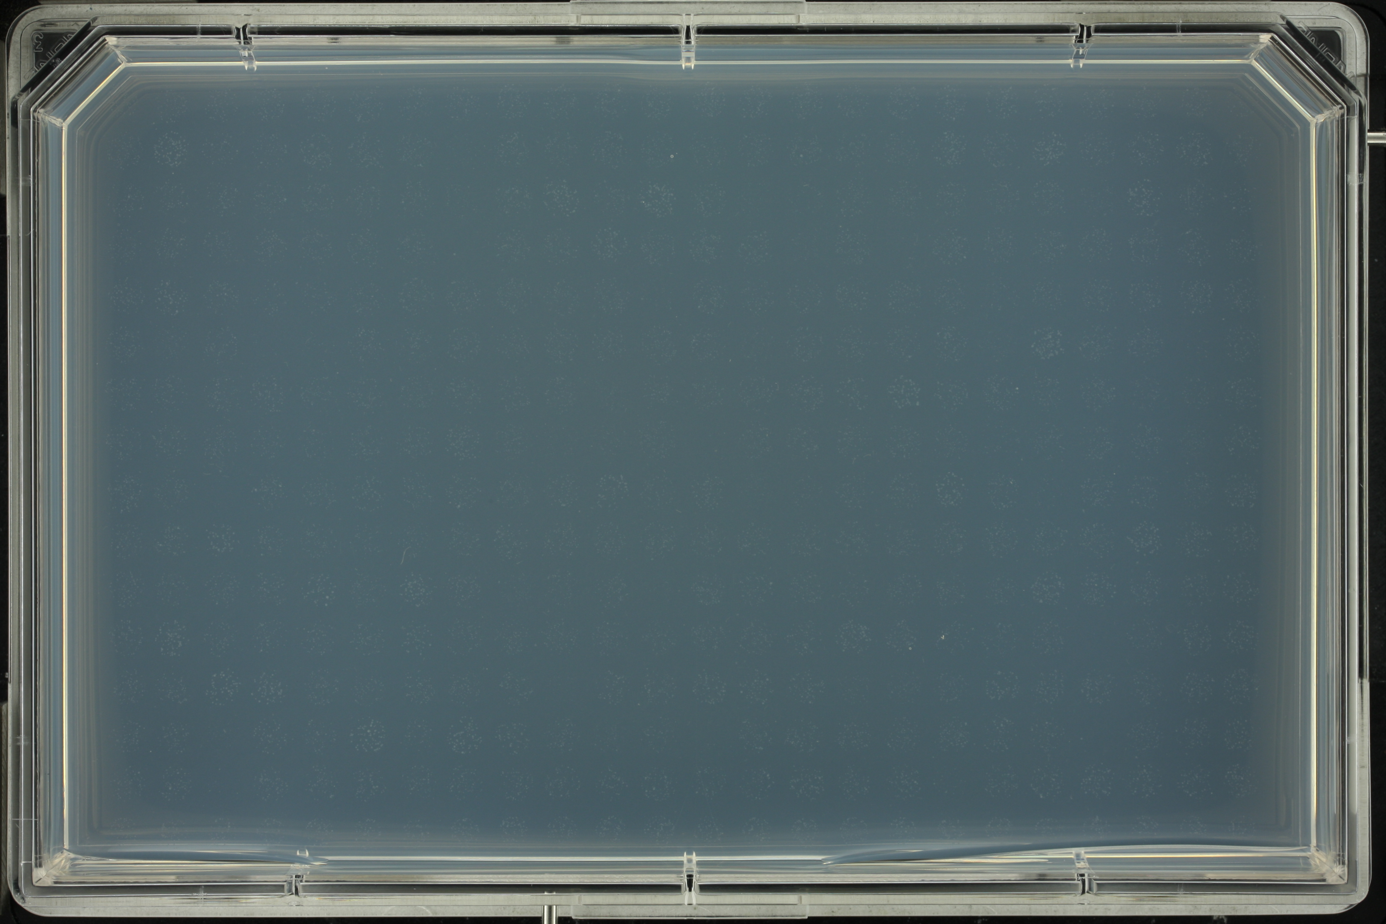

Slide 4
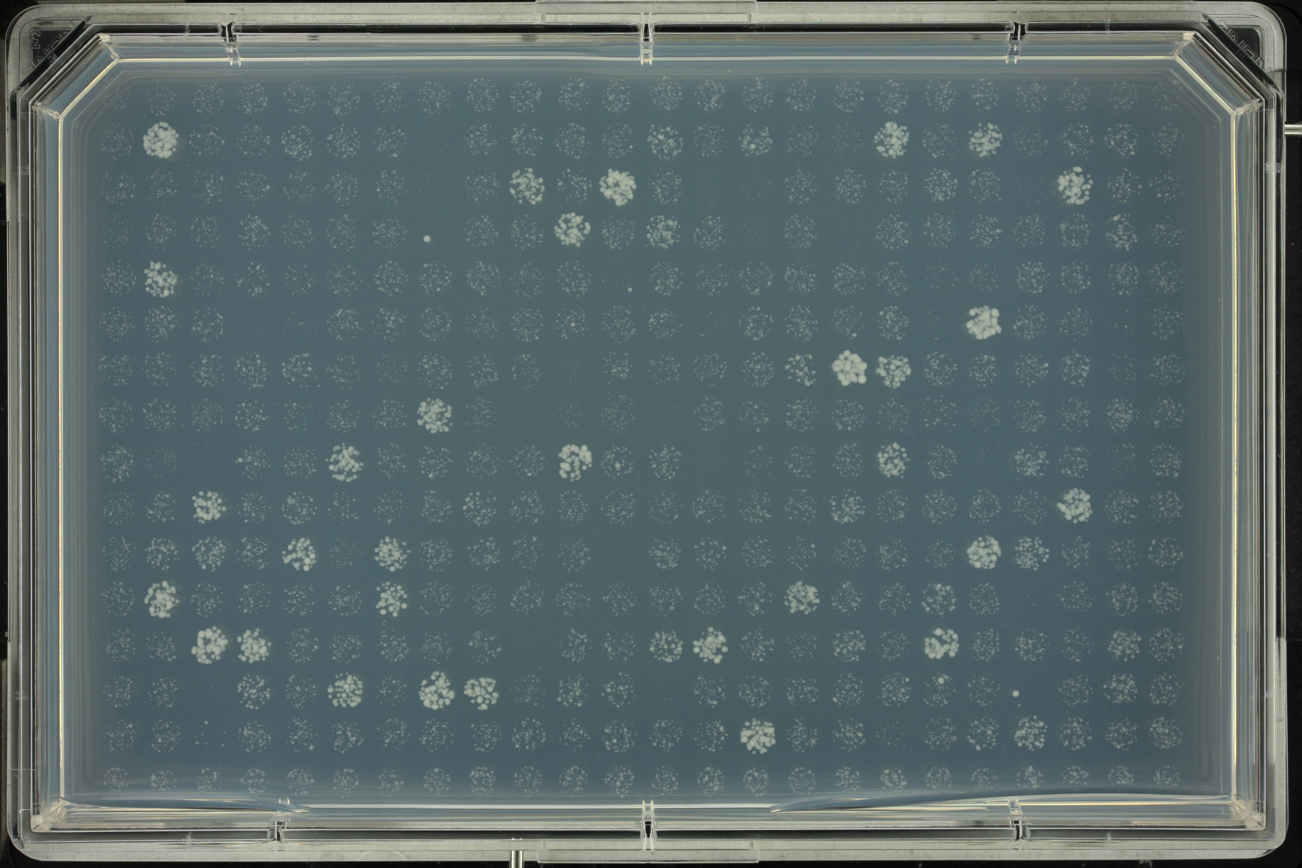

Slide 5
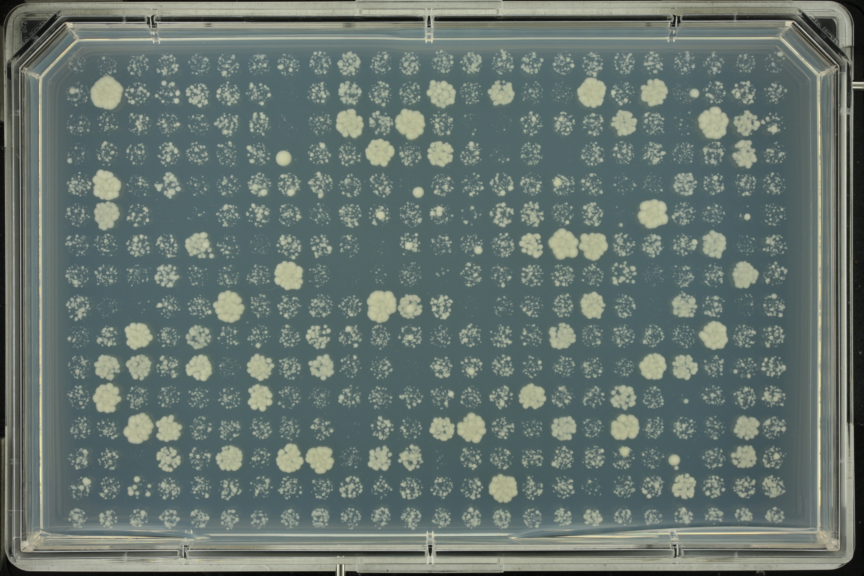
Can we improve fitness estimates by modelling competition?

Slide 6
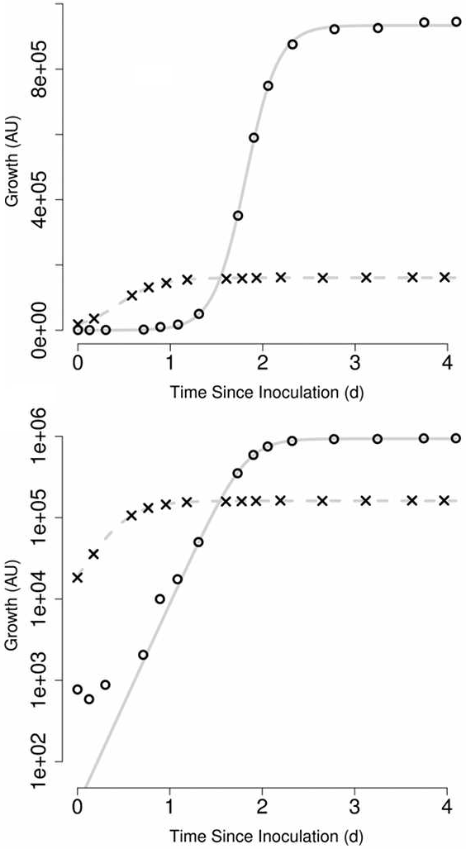
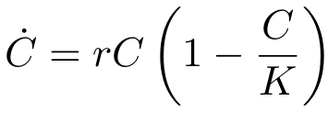
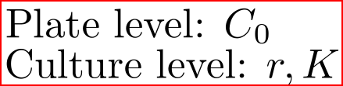

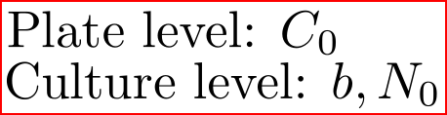
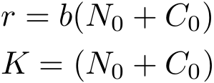
QFA fits the logistic model to summarise data
From r and K we can define fitness measures
MDP: no. of doublings undergone from the inoculum density (C0) to carrying capacity (K)
MDR: inverse of the doubling time at the beginning of the experiment
One fitness measure is MDR*MDP
We can obtain the same shape curve using a more mechanistic model
Conversion:
Lawless et al. (2010)

Slide 7
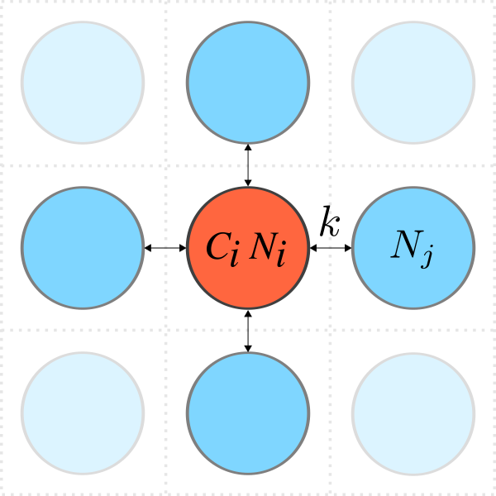
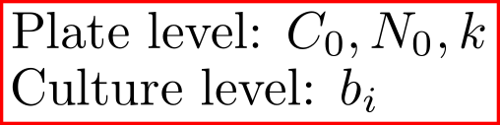
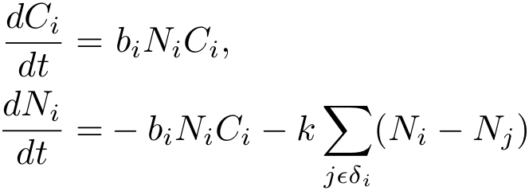
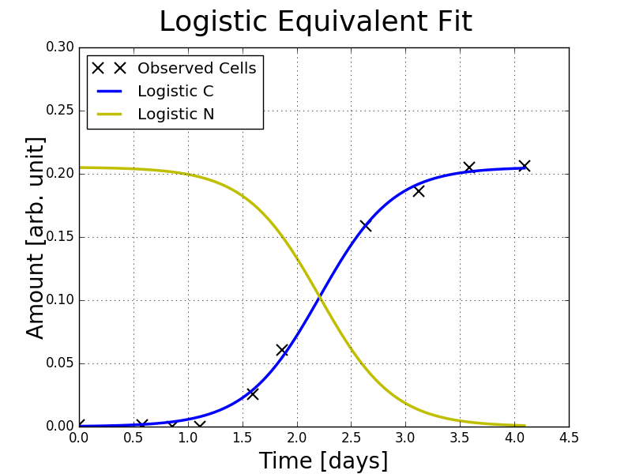
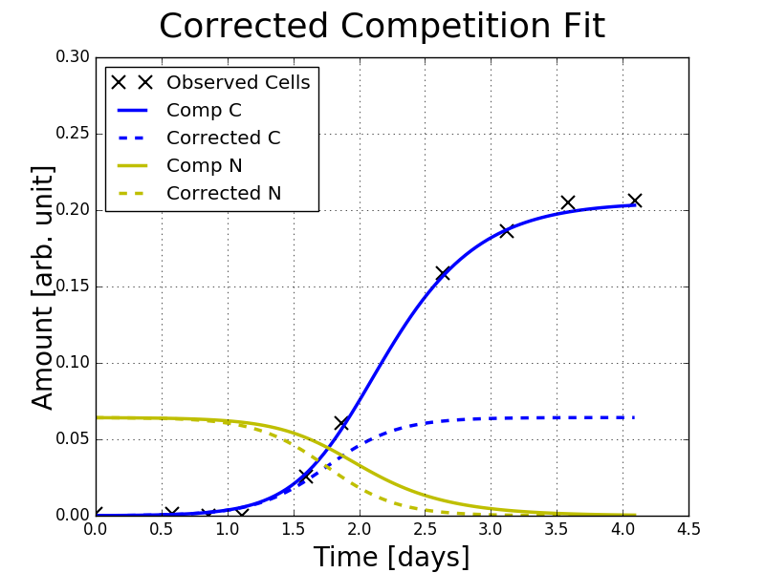
Can we improve fitness estimates by modelling competition?
We use a network diffusion model and mass action kinetics
If we set k = 0 we return to the logistic equivalent model.
Can be thought of as a correction
Cell arrest, metabolism, or signalling could also be modelled
(384)
rl, Kl→MDR*MDP
k > 0
b→rc, Kc
→ MDR*MDP
k = 0

Slide 8
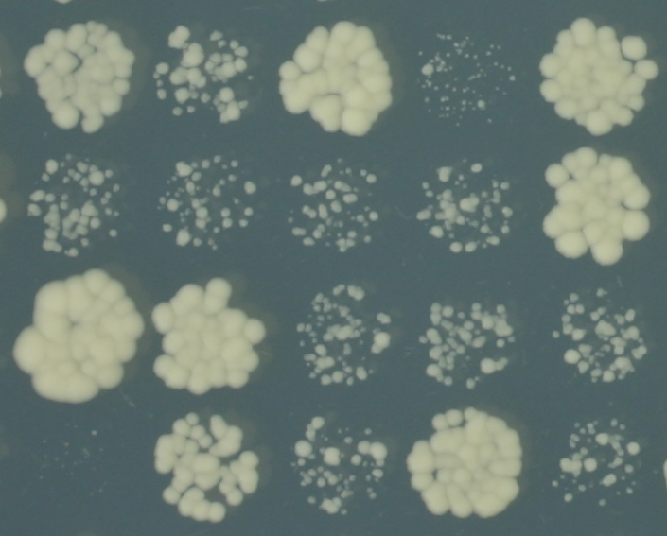
We study plate 15 from a cdc13-1 screen at 27C
Yeast cells
15th plate in a standard deletion library
cdc13-1 is background mutation
CDC13 is a gene important for telomere stability
~50 deletions chosen for relevence to telomere biology
Why did we choose this data set?
  Biology of many strains on this plate is well understood
  Lots of replicates (6 per deletion)
  Large variation in fitness of strains (suppress or enhance defect associated with cdc13-1)
  We would like to test for effects of competition for nutrients between fast-growing and slow-growing

Slide 9
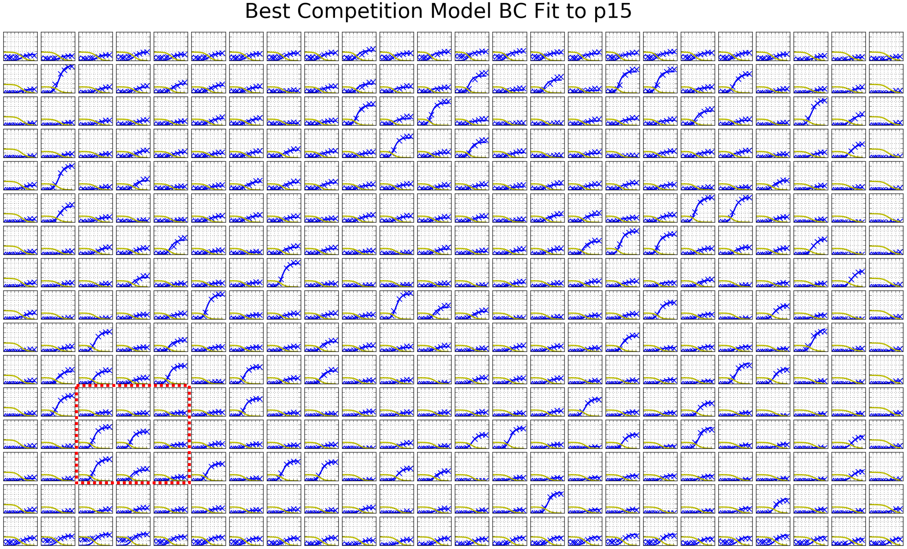
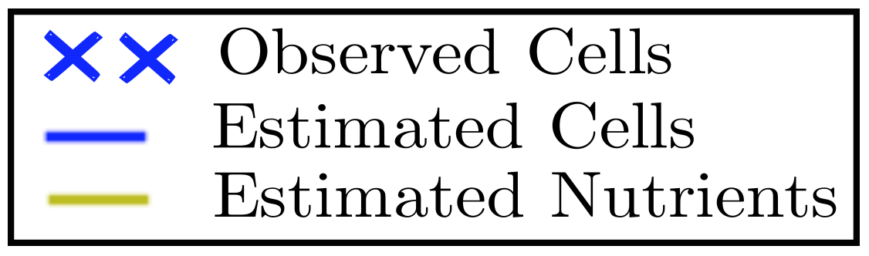
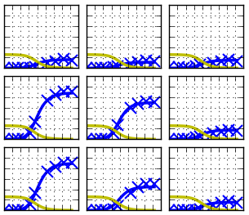
Competition Model Fit to cdc13-1 P15 Data
It takes ~ 3 hours for estimates to converge for a 384 format plate
We cannot yet find global minima. Confounding effect between b and C0. Can we directly measure C0?
However, the rank order of genotypes is fairly consistent among the best estimates

Slide 10
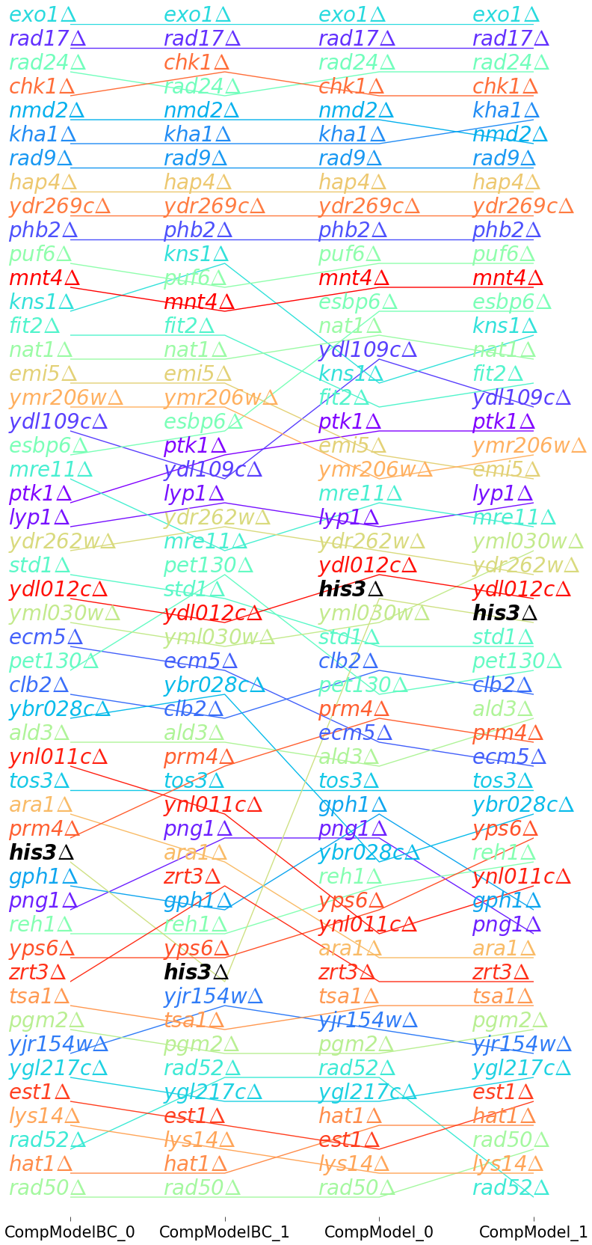
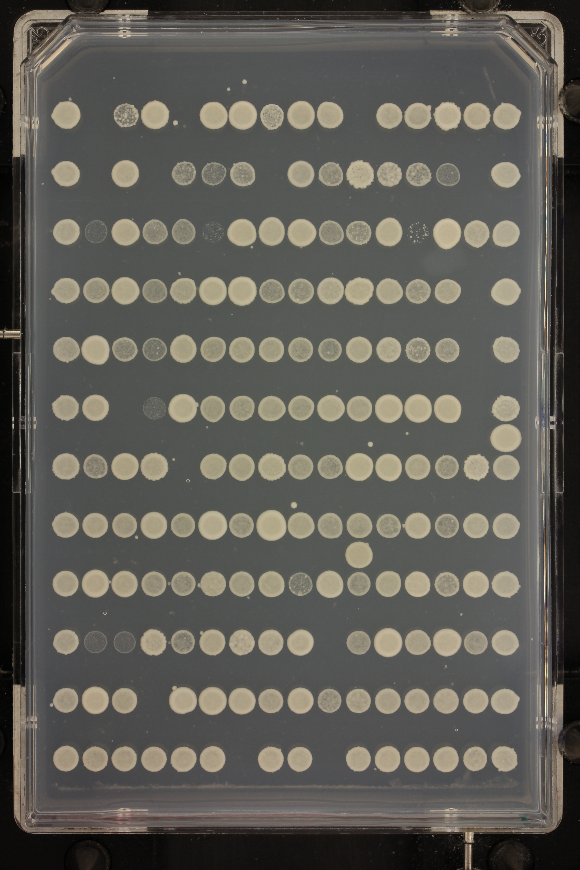
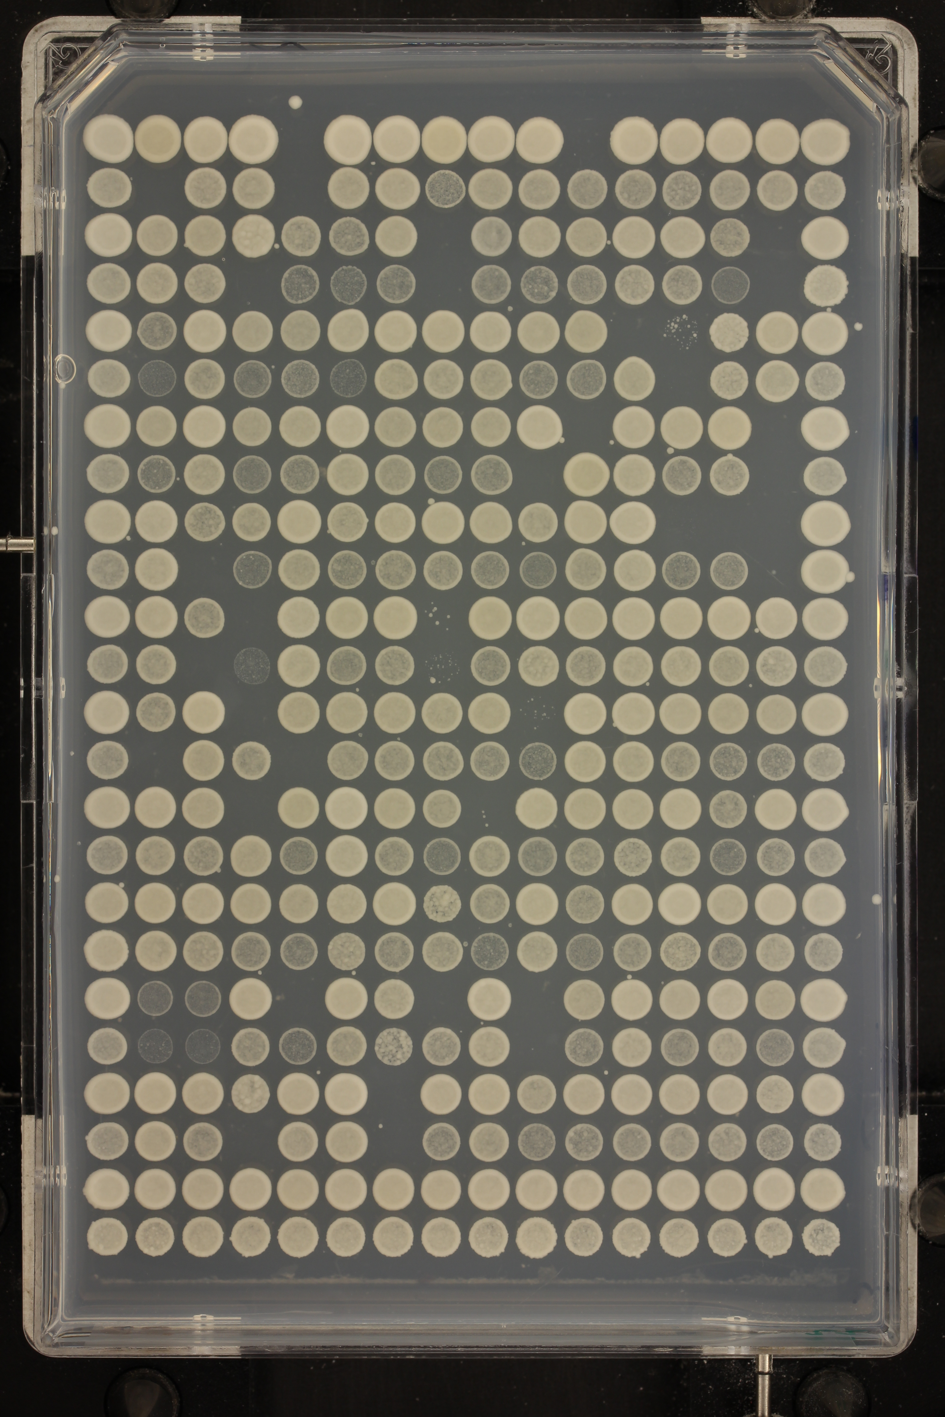
How can we asses the Competition Model?
Competition model b is proportional to MDR*MDP
  Do the rankings on the left agree with know biology?
How do they compare to logistic model fits?
  We will compare variances
  Are fitness estimates more reliable?
We also plan to compare between plates using miniQFA.
b rankings for top four competition model fits

Slide 11
Further Work
We still need to work on finding global minima
Can we decide whether it is worth doing so now?
  Agreement with biological knowledge
  Compare variance in fitness estimates with the logistic model
  Cross-plate comparison of b
Could experiments start to measure C0?
  Make fitting easier
  Reduce computation time
Could we validate the independent limit?
  Do all cultures really reach the same final cell level?
  Should we model metabolism?
Fitness estimates should be judged based on their predictions
Where can I find references for validation based on existing knowledge?

Slide 13
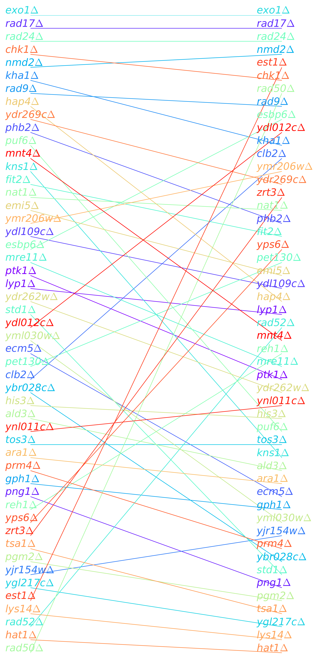
Comparison of Competition and Logistic model MDR*MDP rankings
There is some agreement but many ranks are very different
Logistic eq. fitted C0 = 2.2x10⁻⁷. Too low?
Not sure we are finding the global minimum for the logistic equivalent model either
Could heterogeneity require culture level C₀? Need to think about this
Or has C₀ lost its meaning?
May be better off fitting the standard logistic model with Colonyzer
Fitting very slow growing cultures such as rad50Δ difficult due to noise
Below plot best logistic model fit

Slide 14
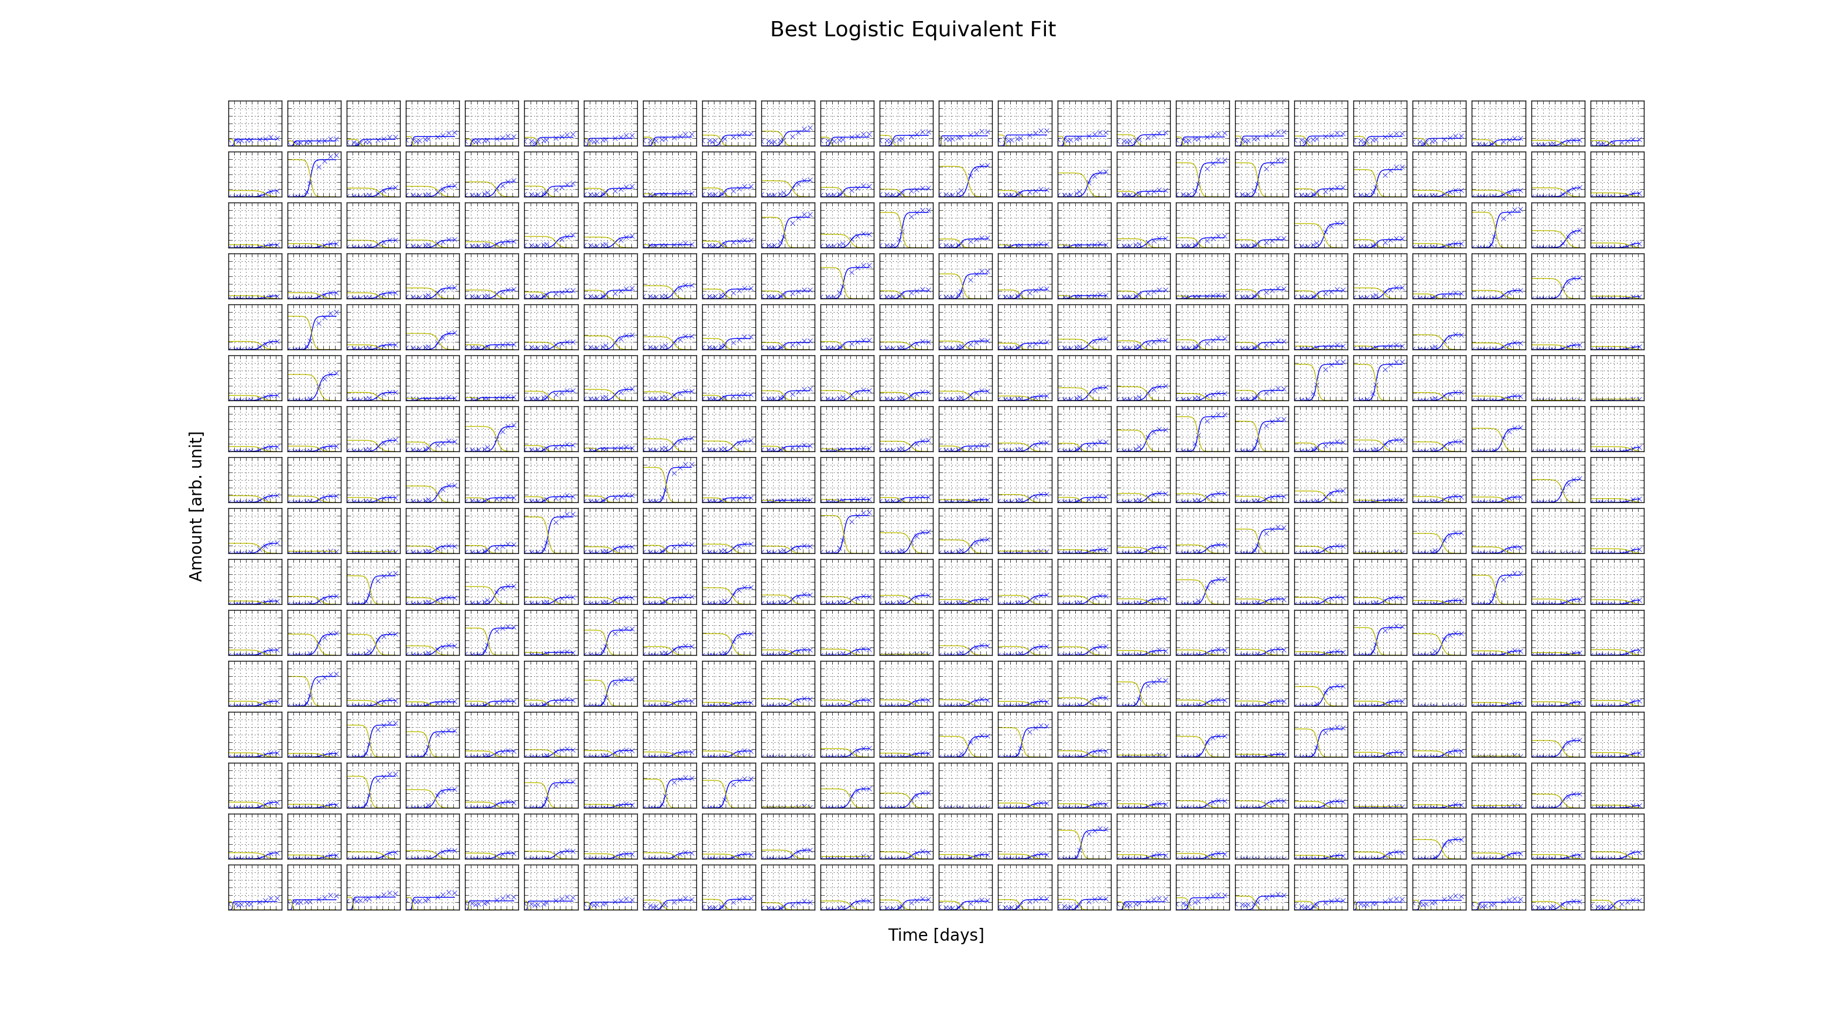
Best Logistic Equivalent Fit (Plate Level C0)

Slide 15
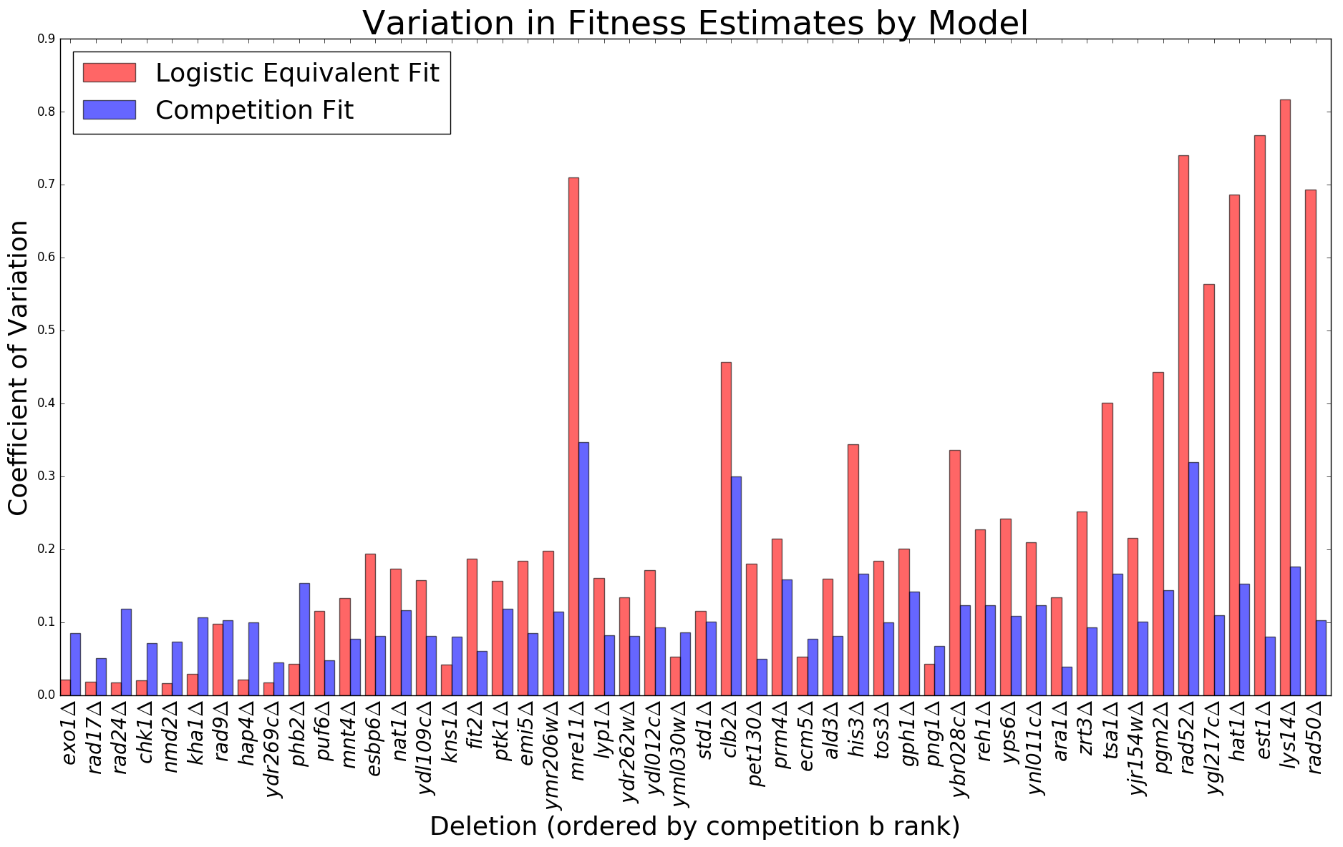
(no bc)
Variation in MDR*MDP is less for the logictic equivalent model
Logistic equivalent fits for slow growing strains not yet accurate
Use Colonyzer
Notes:
Competition model: b rank = r_c rank = MDR*MDP rank for a plate.
Coefficient of variation

Slide 16
Think about bias when using biological knowledge.

