Slide 1

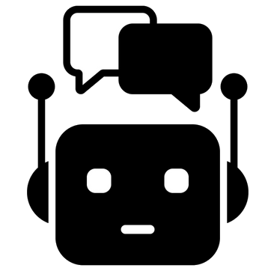
Artificial Intelligence
Any program that does something that we would think of as intelligent in humans.
AI is defined by the application of the technology rather than the technology itself. What is considered AI may change over time.
Cognitive Computing
Specifically simulating the perception and reasoning aspects of human intelligence:
Natural-Language Processing
Text or speech
Chatbots
Artificial image or video
Machine Learning
Any program that improves its performance through experience rather than explicit programming.
Technologies
Generative
Supervised
Unsupervised
Reinforcement
Cat
Not Cat
Deep Learning
Machine learning based on multi-layer neural networks
Generate new text or visuals
Learn specific patterns
Discover new patterns
Learn by reward / mistake

