Slide 1
Application of ML results
are not clearly related
to explicit business objectives
in a well defined process
 |  |  |  |  | Training data
 |  |  |  |  | Re-training data
No concensus of "Ethical/Fair", "ML transparency" and "ML accountability"
ML
Rules
Engine
Result
Action
Business objectives and processes may be proprietary intellectual property
Data may be protected by data governance and privacy
Biased data hidden
in the details of
training data
Machine Learning algorithm selected to
produce corrupt results
The ML systems or statistical models may be secret IP
Parsing
transactional data
No legal context or enforcement
Transaction
D | A | T | A
No definition of
"AI misuse of entrusted power for private gain"

Slide 2
 |  |  |  |  | Training data
Business objectives are not
clearly understood, and the
decisions are impossible to
measure and verify.
Bias hidden in
the details of
training data
 |  |  |  |  | Re-training data
Algo-rithm
Rules
Engine
Result
Action
Parsing
transactional data
Transaction
D | A | T | A
Machine Learning algorithm selected to
produce corrupt results

Slide 3
 |  |  |  |  | Training data
Data used to train or
re-train the Artificial
Intelligence Systems
 |  |  |  |  | Re-training data
Algo-rithm
Rules
Engine

Slide 4
The AI systems are build with a selection
of information technology tools like
algorithms, rules engines and code using
IT development processes.
Algo-rithm
Rules
Engine

Slide 5
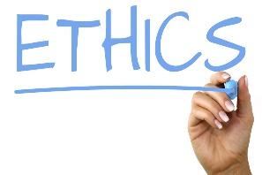
Algo-rithm
Rules
Engine
Parsing
transactional data
Transaction
D | A | T | A

Slide 6
Business objectives determine
what decisions should be made
and what actions should be
performed.
Algo-rithm
Rules
Engine
Result
Action

Slide 7
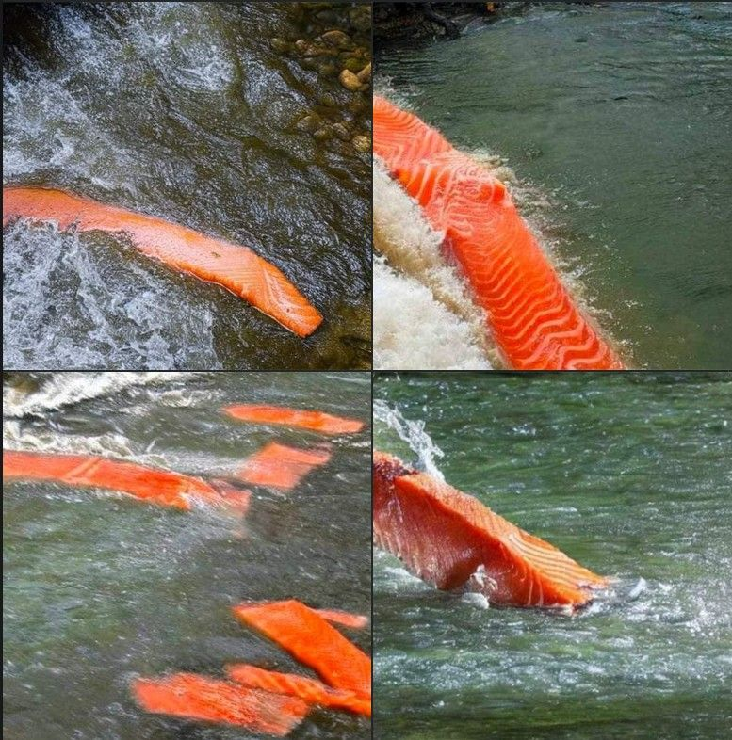
AI is as good as their training.
One AI was asked to generate a picture of
Salmon swimming up a stream

Slide 8
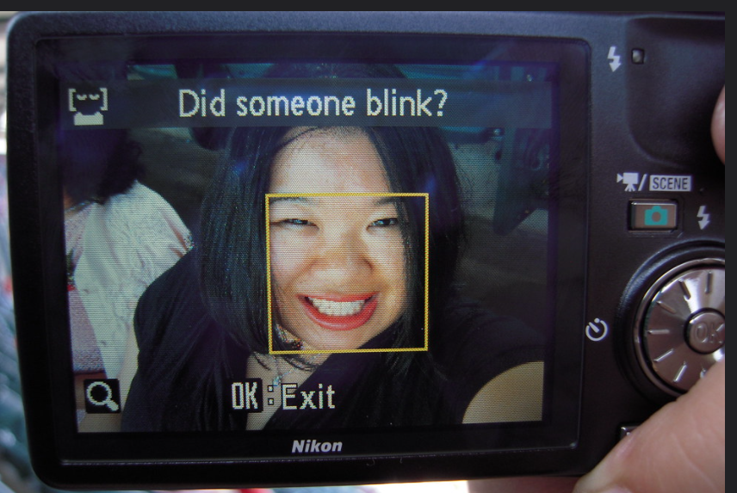

Oops
One more story.
Takes time and is not needed.
Can be used to show unintended bias in a product.

Slide 9


Chocolate Factory
Chris
Will Chris meet tomorrow?
Boss

Slide 10


Workday | Weather | Hangover | Met at work
Yes | Rain | No | Yes
No | Sun | Heavy | No
Yes | Rain Snow | Light | No
No | Sun | No | Yes
... | ... | ... | ...
Workday after day off
Yes / No
Will Chris meet tomorrow?
Training
20%
Rules Engine
Weather
Sun /
Rain /
Snow
ML
If > 0.95
then YES
else NO
Yes
No
30%
0,0 - 1,0
50%
Setup
Programming
Hangover
No /
Light / Heavy
Probabilistic
You have no idea how
Deterministic
You know how

