Slide 1

Notes:
Welcome Visitors, Introduce yourself

Slide 2
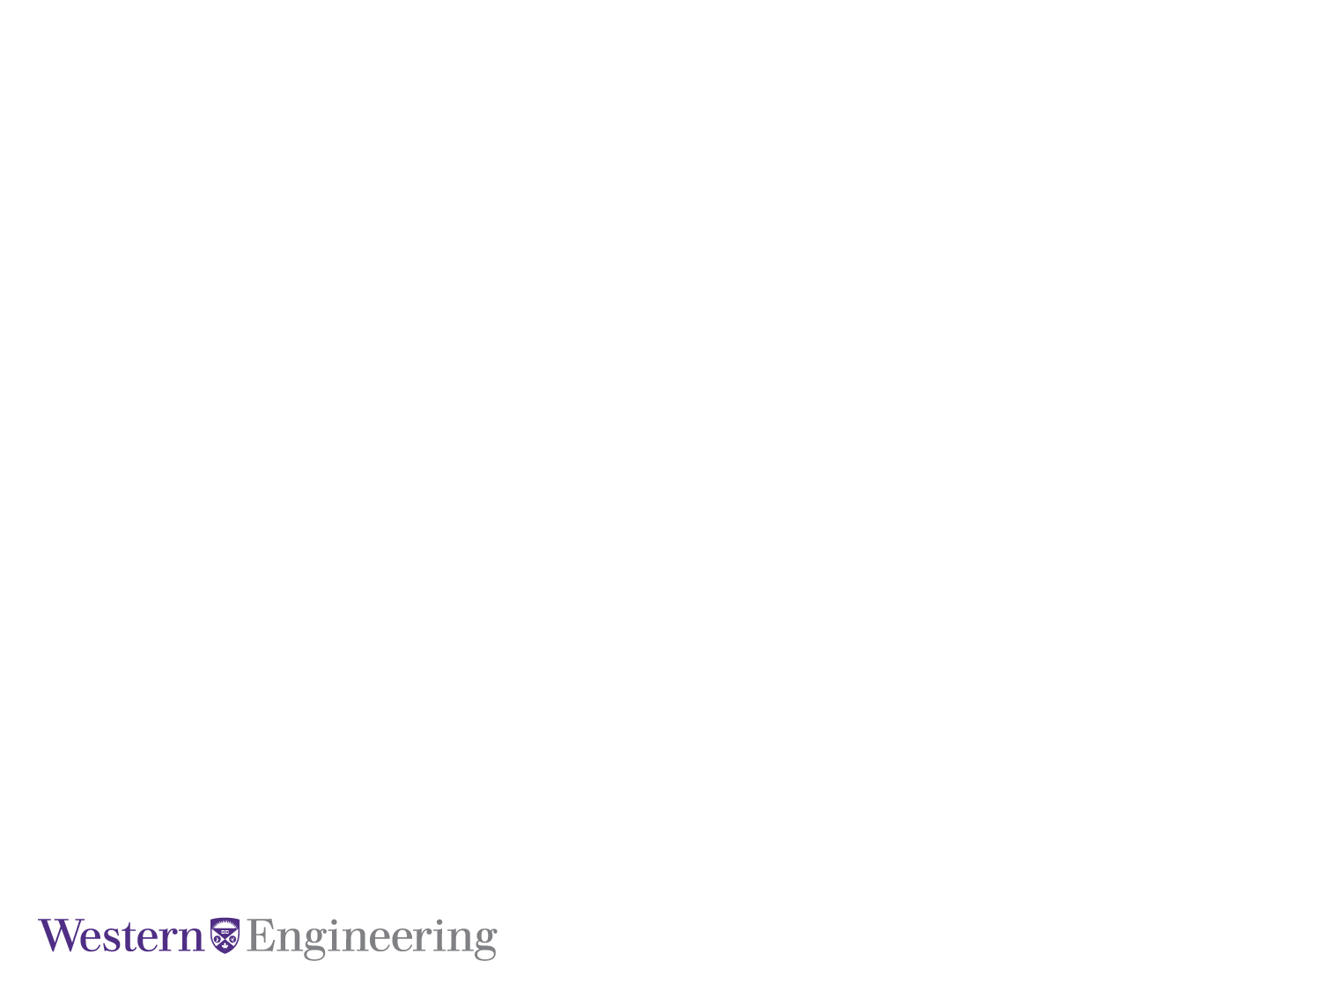
Deep Autoencoder Clustering of Anthropogenic Seismicity
August 25, 2022
Civil and Environmental Engineering
Notes:
Introduce title of project.

Slide 3
August 25, 2022
Today’s Agenda
Introduction
Methods
Results
Analysis/Conclusion
Notes:
Intro: will disseminate the goal of the project and what I hoped to accomplish
Mehtods: will outline how I did my project, and how it works (on a high level)
Results: I will share my results, and
Analysis: will analyze the results, and what I learned while conducting this research

Slide 4
What is the problem
Hydraulic fracturing can be a blunt and dangerous process to extract oil
It is difficult to determine the area that was affected by the fracturing
Sometimes dangerous anomalies are undetected, resulting in fracturing near volatile fault lines

Slide 5
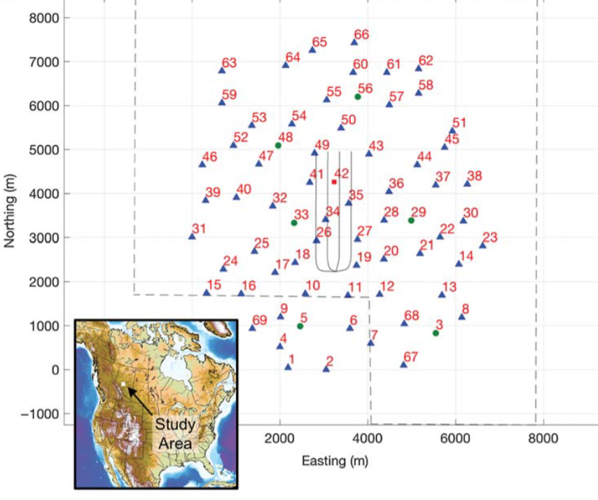
Tony Creek, Alberta
Experiment was conducted to monitor seismic events in the region
69 stations spread over multiple km
Over 4Tb of data (281, 658 events)

Slide 6

This is Well Suited for Machine Learning!

Slide 7
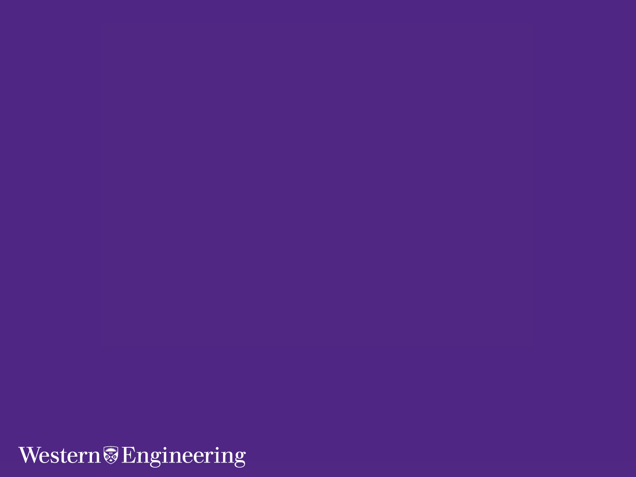
What is Machine Learning?
Notes:
Computer methods that ‘learn’ by leveraging data to improve performance on a specific task (subset of AI) (meant to imitate human behavior/pattern recognition)

Slide 8
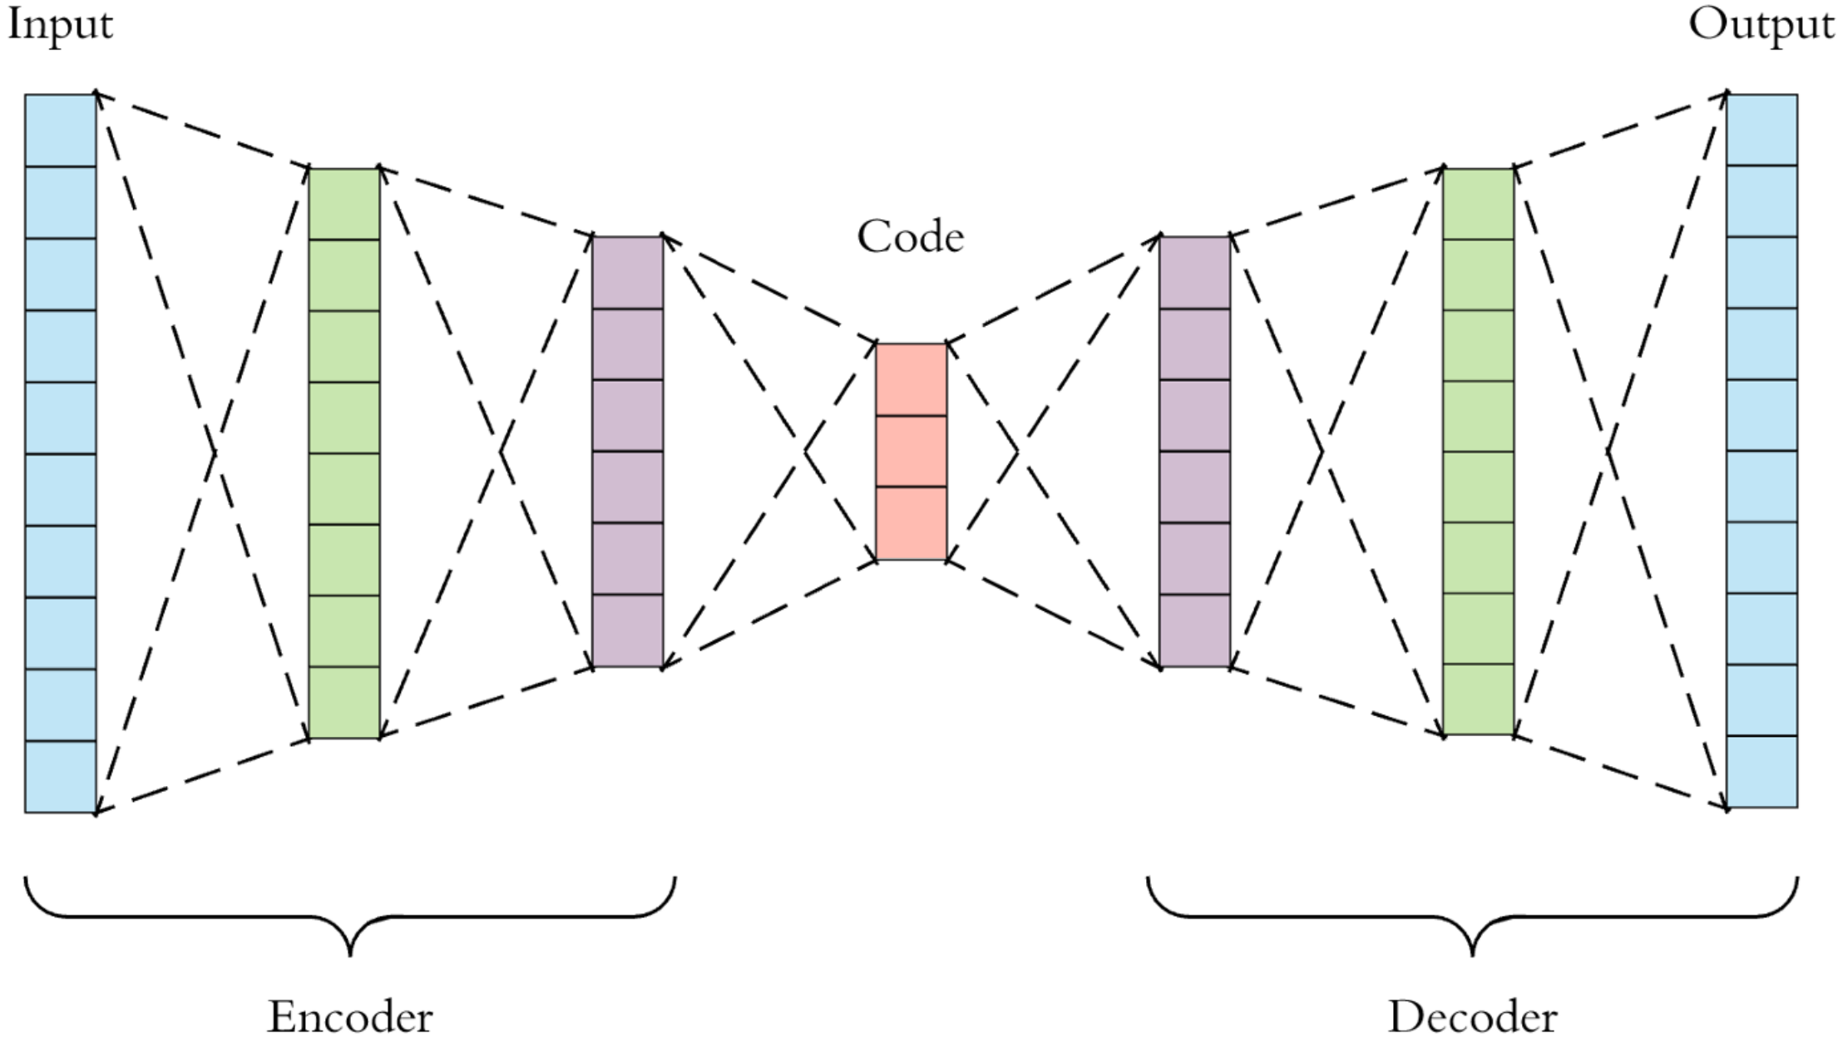
Autoencoders
Takes an input, reduces its parameters, then tries to reconstruct it
Forces the machine to choose which parameters are important

Slide 9
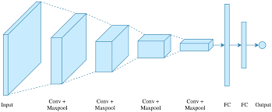
Convolutional Neural Network (CNN)
Well suited for processing data with grid patterns (images)
Each layer extracts features from the input and reduces overall parameters

Slide 10
How do we use a CNN with Waveform Data?

Slide 11
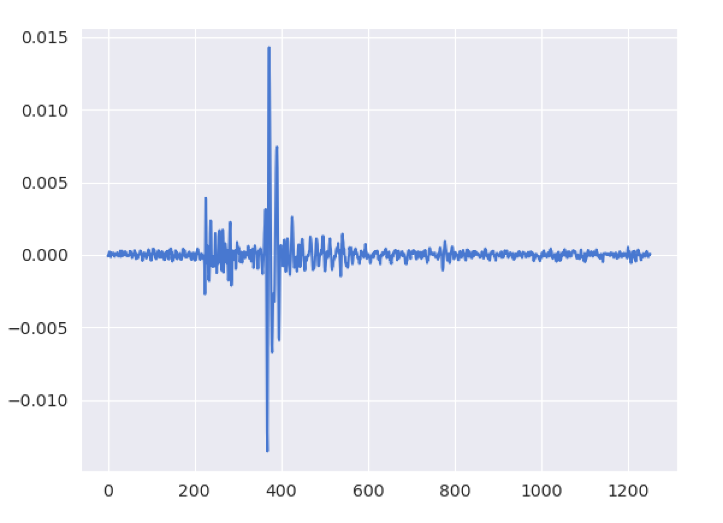
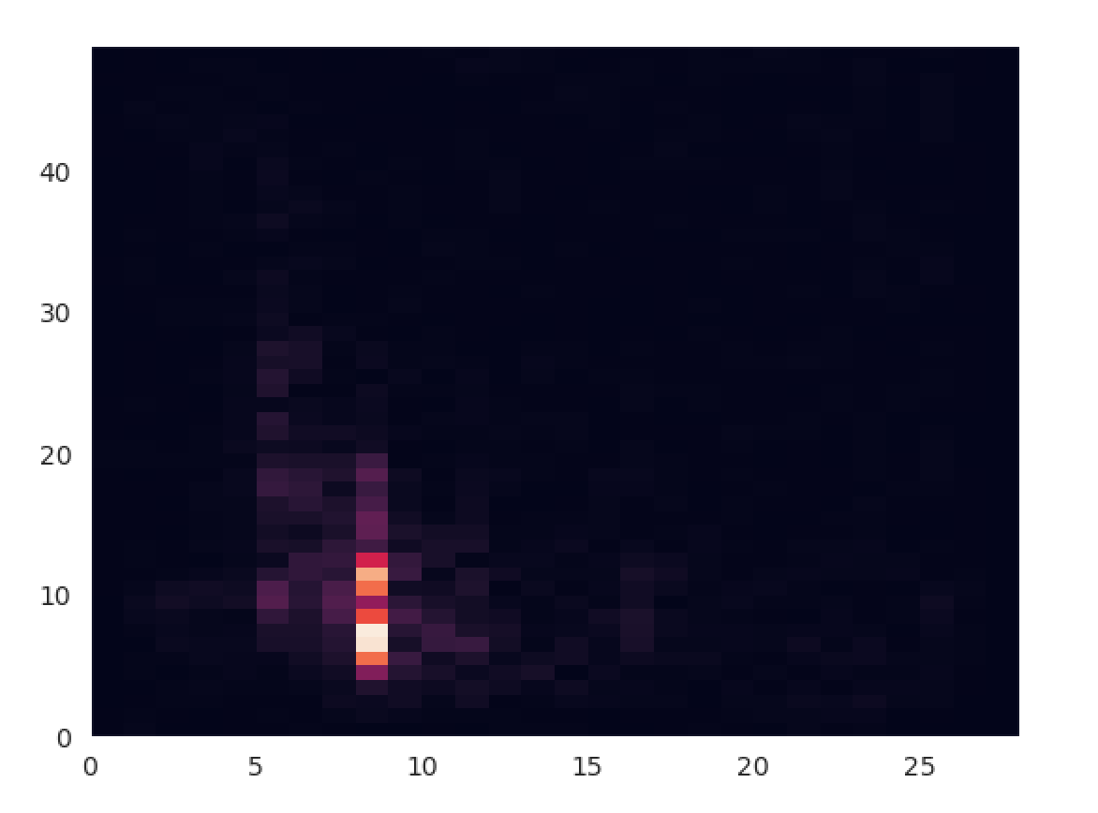
Time-Frequency Domain
Converts the waveform into a 2D grid-like image
Reduces the size of the parameters, making the data easier to process
displacement
frequency
time
time

Slide 12
My Autoencoder Design
6 Convolutional Layers
2 Maxpooling layers
Tanh Activation function
Convolution/
LeakyReLU
Maxpool
Convolution/
LeakyReLU
Maxpool
Convolution/
LeakyReLU
Convolution Transpose/
LeakyReLU
Convolution Transpose/
LeakyReLU
Convolution
Tanh

Slide 13
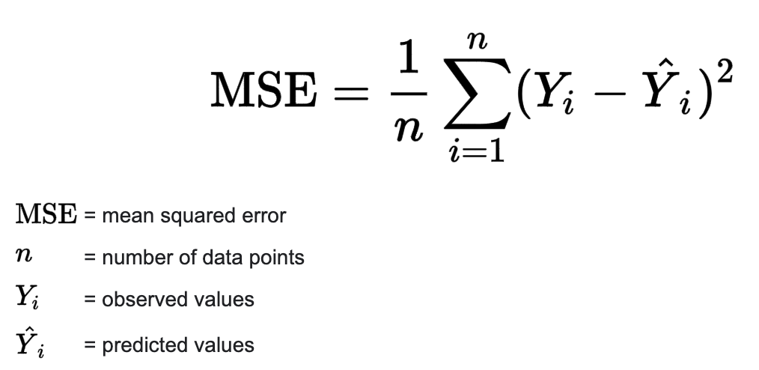
Loss Function
The program utilized mean squared error (MSE) as the loss function
Punishes large errors more than small ones

Slide 14
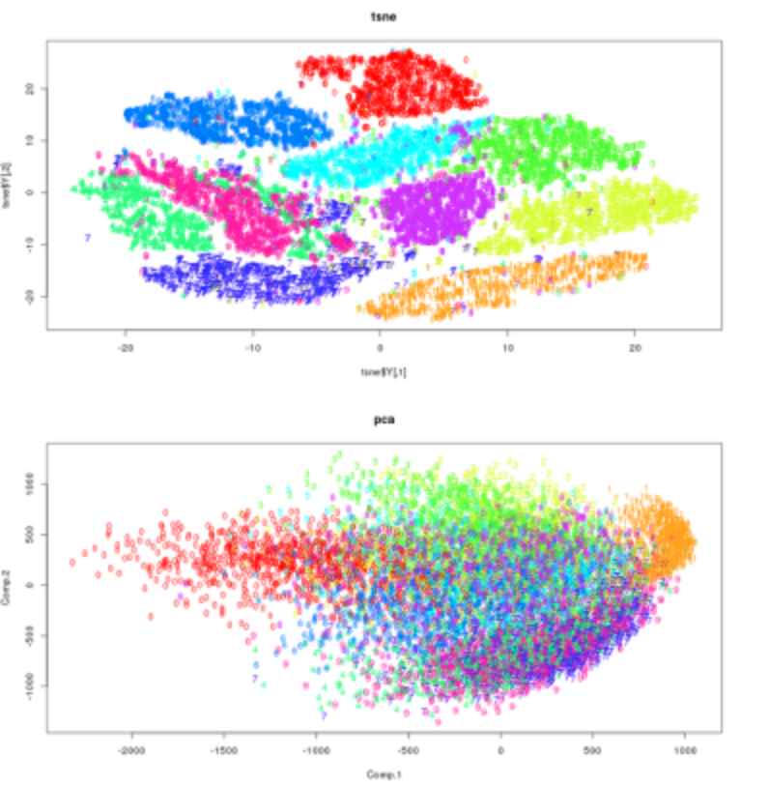
Visualization Method
T-distributed stochastic neighbor embedding (TSNE)
Is great for visualizing non-linear, high dimensional data
Easier to discover clusters than principal component analysis (PCA)

Slide 15
Results

Slide 16
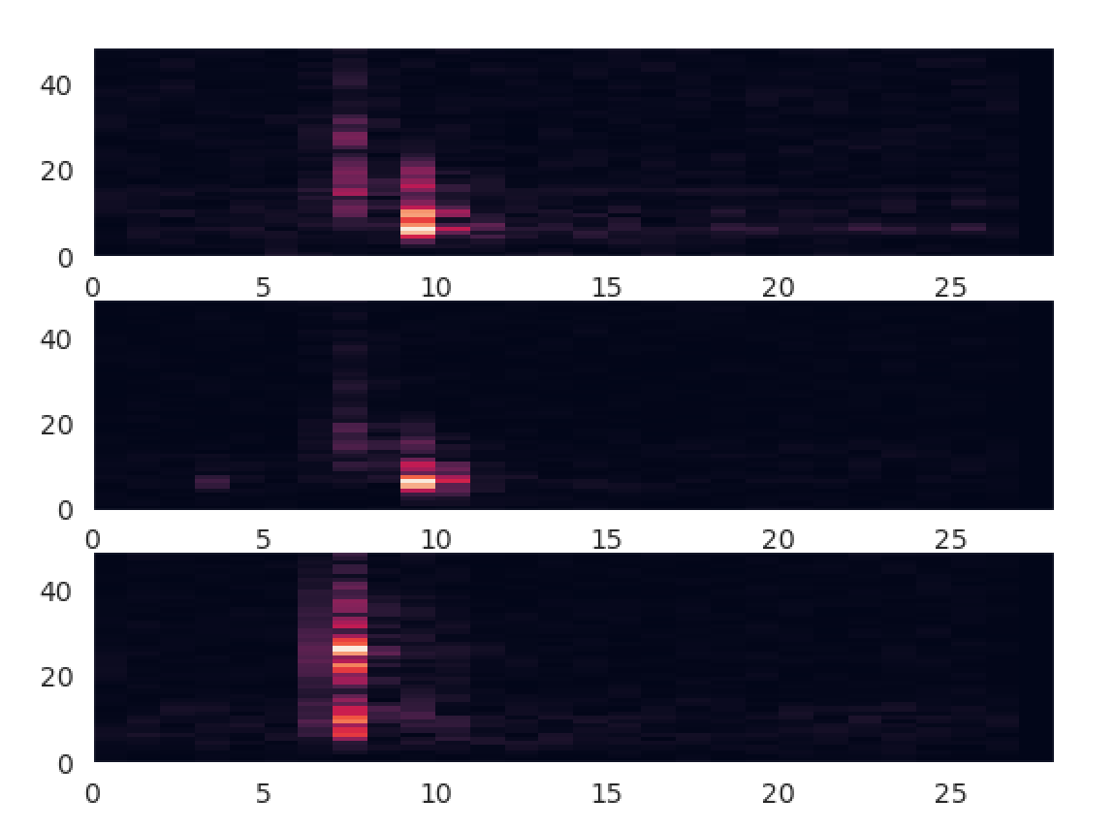
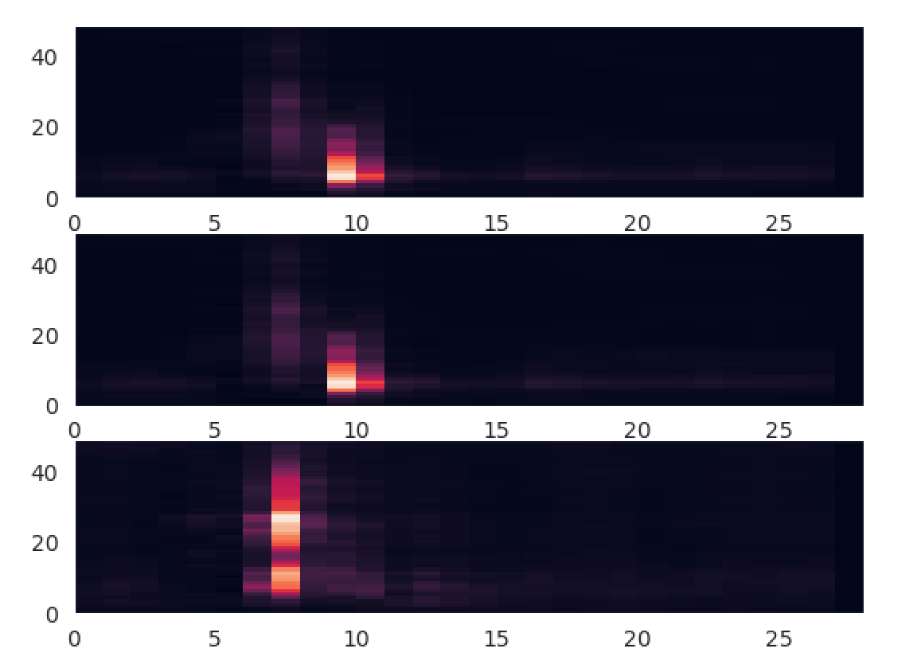
Sample Comparison
Original
Reconstructed

Slide 17
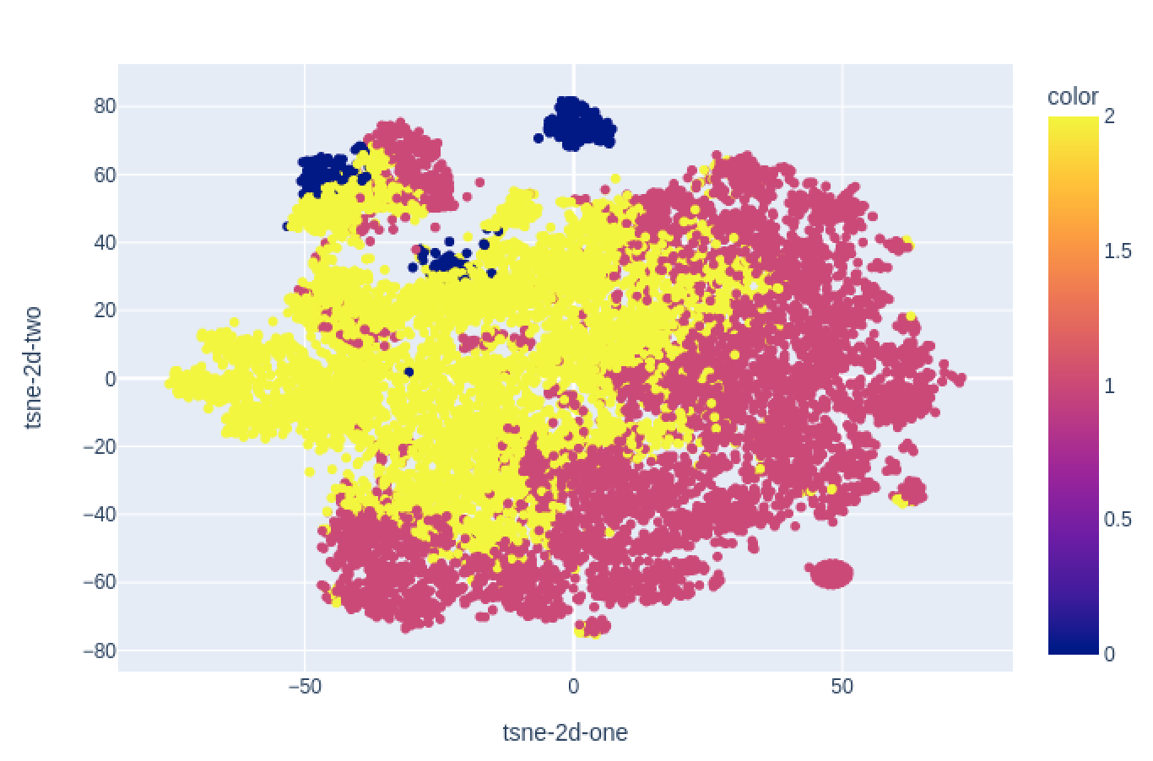
TSNE Output

Slide 18
Outcome
Autoencoder was able to successfully reconstruct seismic waveforms
TSNE output showed 3 clusters, with an interesting blue outlier
Further analysis is needed to decode the TSNE output and identify similar waveform patterns within each cluster

Slide 19
Implications
Algorithm could be used to better distinguish between different types of seismic waves at fracturing sites
Can provide early alerts to dangerous seismic activity in order to increase safety
Faster pinpointing of waves caused by fracking can improve efficiency in extracting oil reserves

