Slide 1

ThinkItThru
By Jensen Schmidt, Zachary Travis, and Levi Wright

Slide 2

Discussion Outline
Introduction
Block Diagram
Message and Storage (Server Interaction)
Component diagram and Feature List
Storyboard

Slide 3

Introduction
ThinkItThru! motivates users to organize their day and satisfy academic deadlines
Users may accomplish this by:
Creating tasks for themselves
Which will be scheduled into goals
Enjoy their rewards for accomplishing their goals!

Slide 4
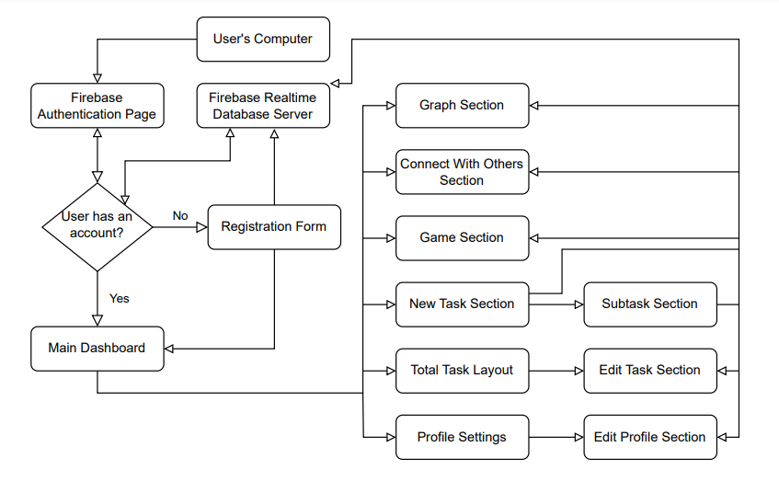
Block Diagram

Slide 5
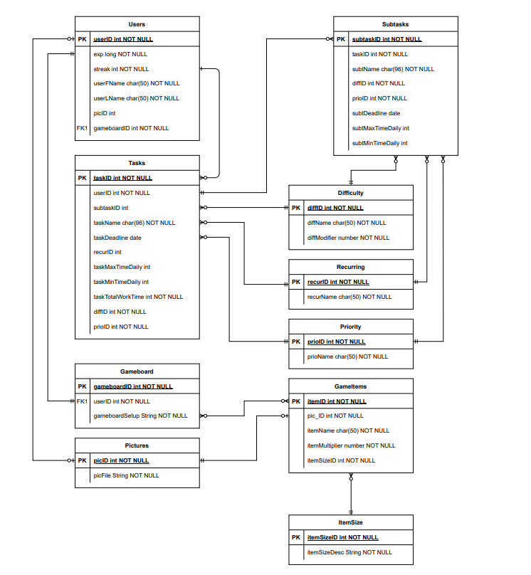
ERD Diagram

Slide 6
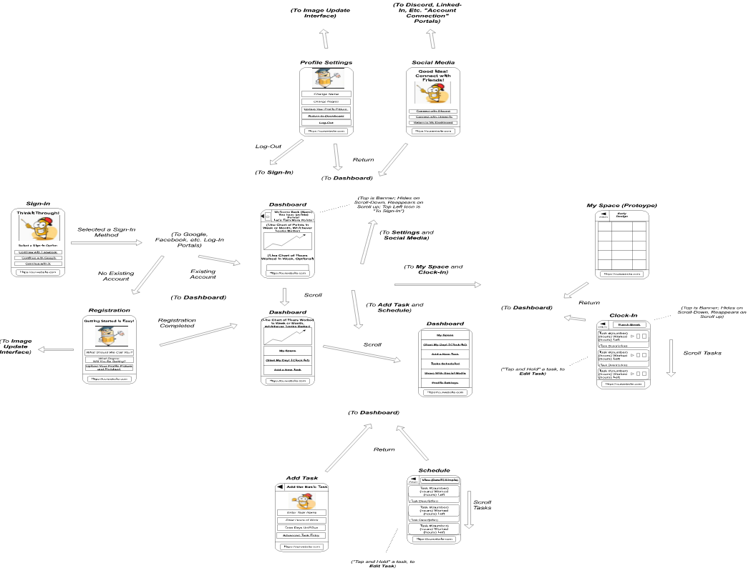
Storyboard

Slide 7
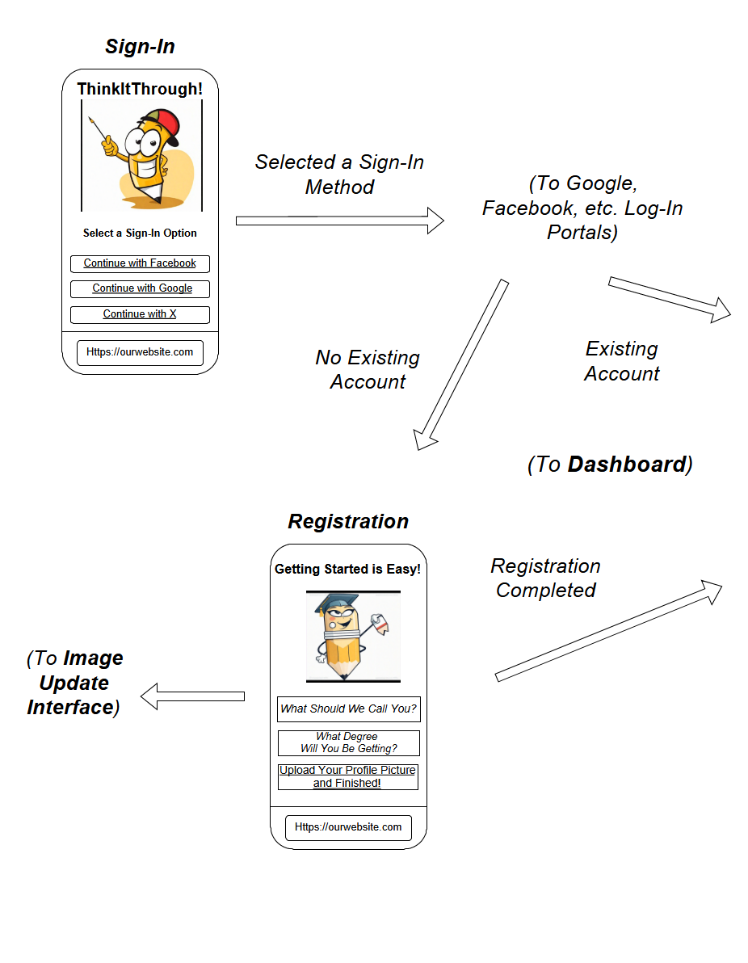
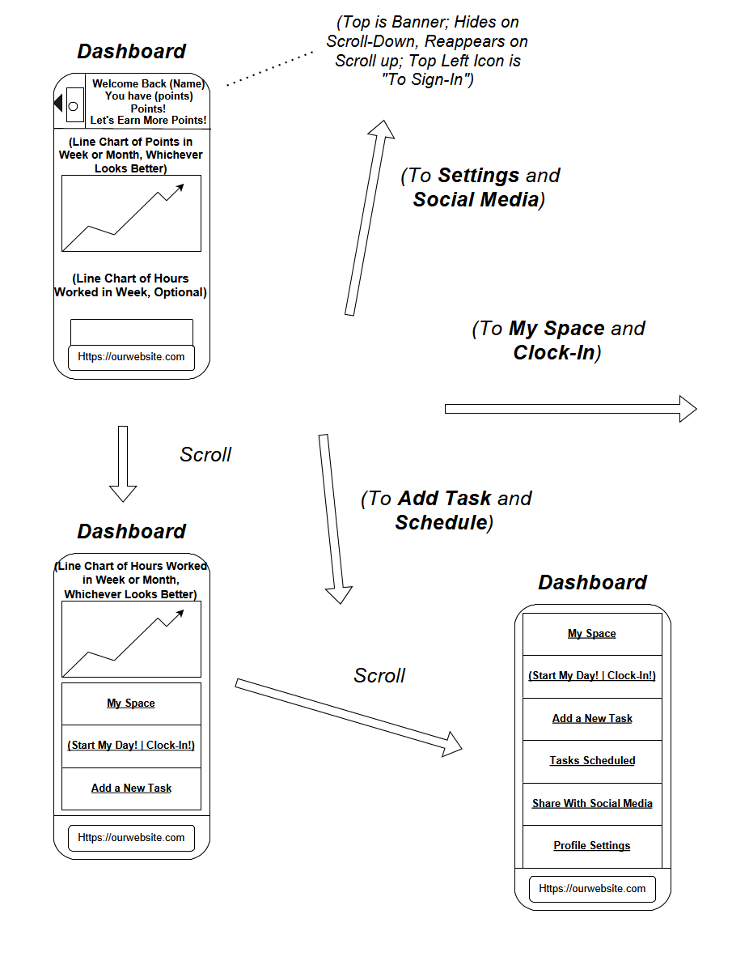

Slide 8
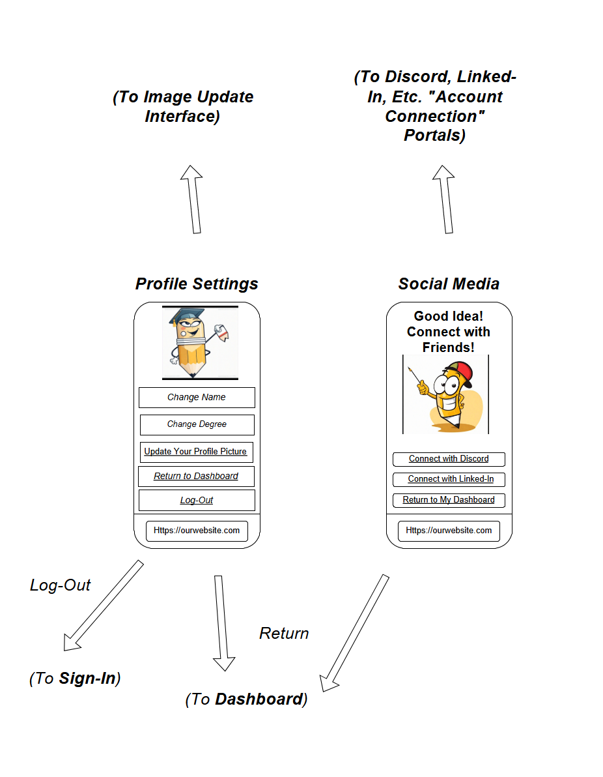
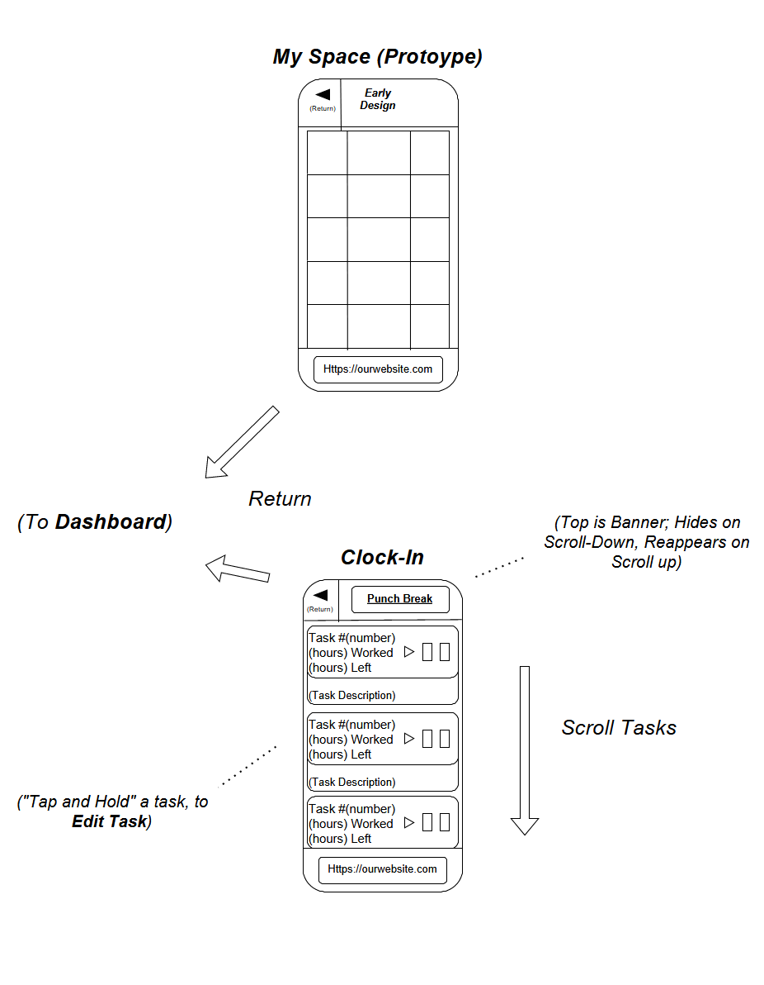
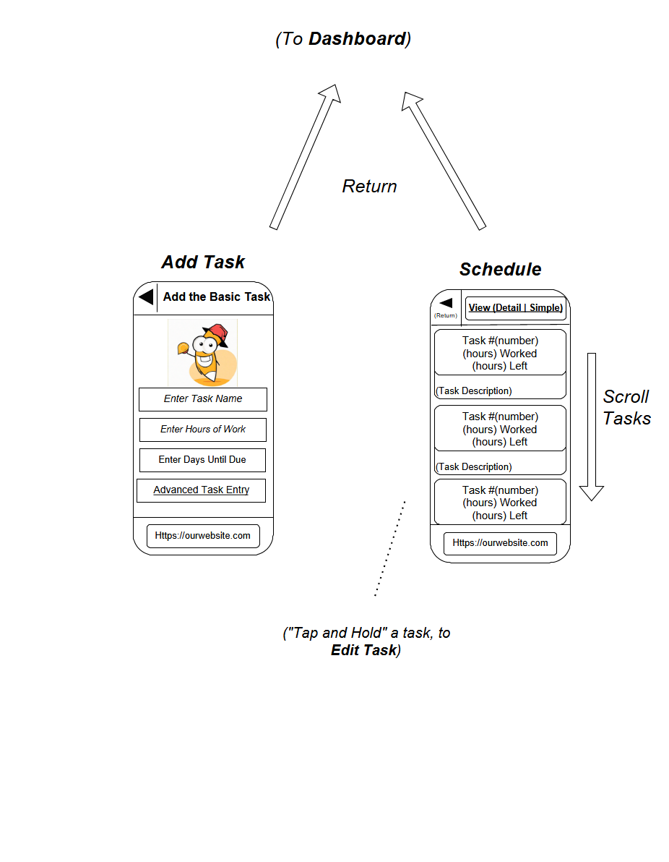
Storyboard Cont.

Slide 9
Functionality

Slide 10
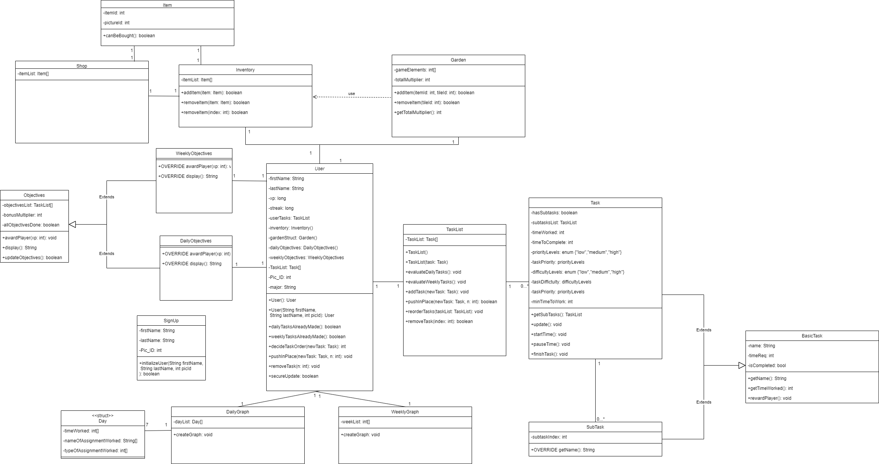
Component Diagram

Slide 11
Component Diagram
User
TaskList
Objectives
Inventory
Garden
Graphs

Slide 12
Component Diagram
TaskList
taskList
Task
SubTask
Automatic ordering

Slide 13
Component Diagram
Graphs
Daily Graph
Specific items and types
Displays info over last 7 days
Weekly Graph
Amount of time worked per week
Displays info over past 52 weeks

Slide 14
Component Diagram
Objectives
Weekly Objectives
Daily Objectives

Slide 15
Component Diagram
Garden
Inventory
Garden display
Xp multiplier

