Slide 1


ThinkItThru!
By: Jensen Schmidt, Zachary Travis, Levi Wright

Slide 2


Presentation Outline
Introduction
Technology
Design
Work-In-Progress

Slide 3

ThinkItThru?
Busy people balance lots of tasks
Who enjoys setting a calendar or reminders?
ThinkItThru! is dynamic, fun, and free!

Slide 4
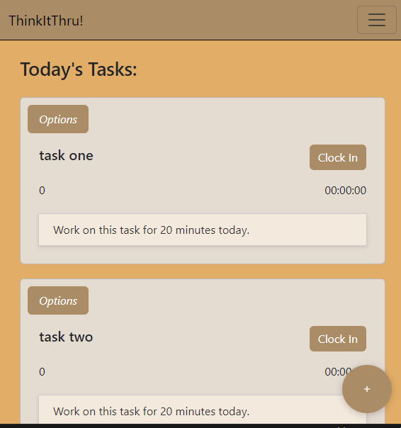
ThinkItThru!
Users input their goals as “Tasks” with a due date and total time required to complete
All Tasks are compiled into a dynamic schedule
Today's Tasks are given

Slide 5
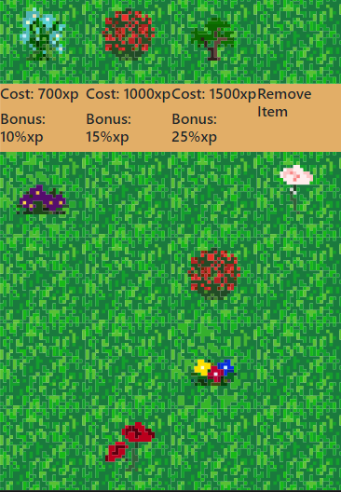
MindYourGarden!
Time Working = Experience
Spend Experience on planting your XP Garden
Earn Bonus XP

Slide 6

Technology

Slide 7

HTML 5
CSS (Bootstrap 5 and Semantics)
JavaScript
Visual Studio Code
Coding

Slide 8

Server
Firebase
Hosting
Authentication
Cloud Firestore Database (JSON)
Late Implementation, Lesson Learned

Slide 9
Server
Cloud Firestore is a great system
Initially easy-to-grasp; idea is sound
Subcollections are a major issue
Not initially obvious until you run into it
Outside of that, storing basic user data was great
Query system built into firebase console

Slide 10
What We Learned
CSS Frameworks are Invaluable
NoSQL Data Structure, Firebase's Storage Format, and Structuring Data For Use
Dynamic content generation and HTML/CSS Manipulation with JavaScript

Slide 11
What We Learned (Part 2)
General Workload Involved in a Website/Web Application
The Challenges of Incorporating a Database (Particularly, Cloud Firestore)
The Schedule Necessary and Proper Steps Involved in Developement

Slide 12
Design

Slide 13
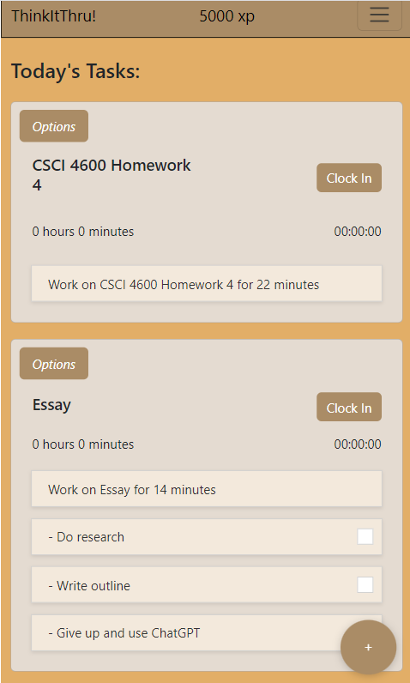
Dashboard
Objectives List created
Tasks from Objectives List displayed
Time worked added to original Task
Completing Objective updates Objective and rewards user

Slide 14
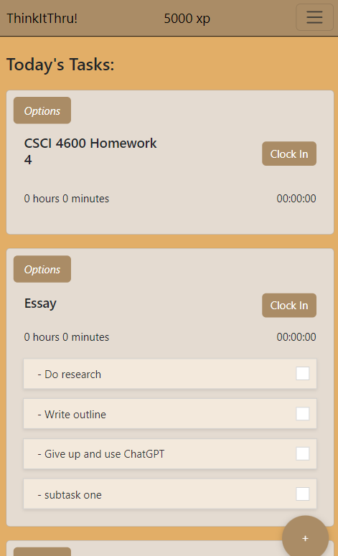
Total Task Layout
All Tasks shown
Shorter and more simple display
Objectives not shown

Slide 15
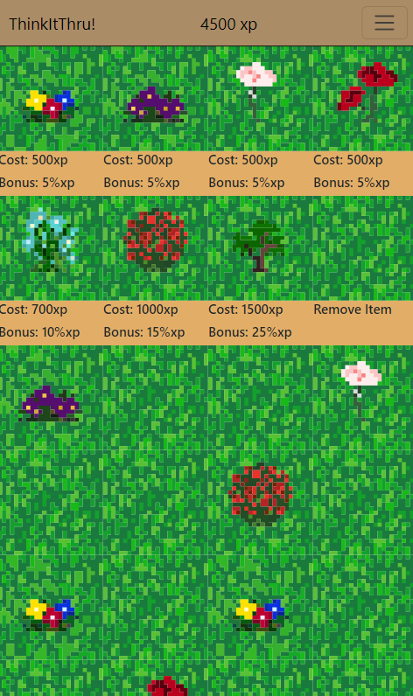
Mind Your Garden
Clicking on Shop Item updates item to purchase
Clicking on tile
Spends xp
Updates garden String in User
Updates xp bonus
JS updates screen from String

Slide 16
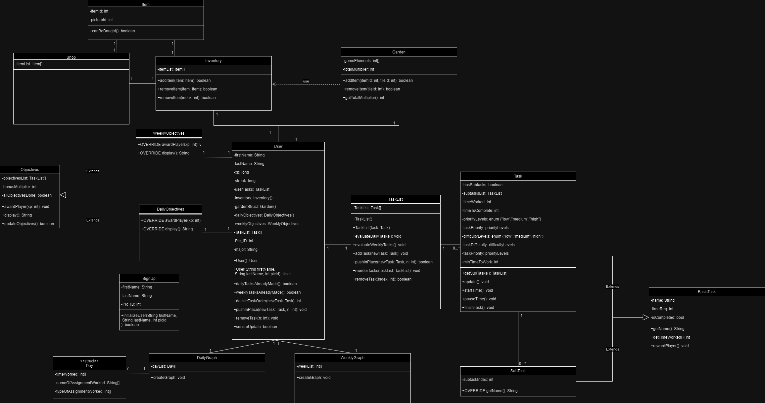
Old Design

Slide 17
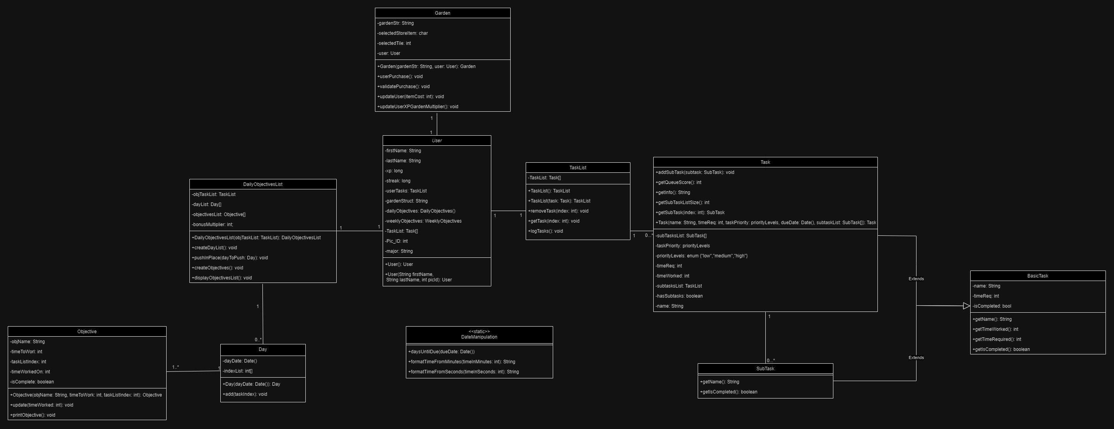
New Design

Slide 18
Class Design Changes
Objectives Changes
Garden Changes
Logs
Overall OOP Transition to Page Files

Slide 19
Objectives Changes
Switched Objectives system to Dashboard page
Weekly Objectives redundant
Objectives divided into Days
Necessary for finalized calculations

Slide 20
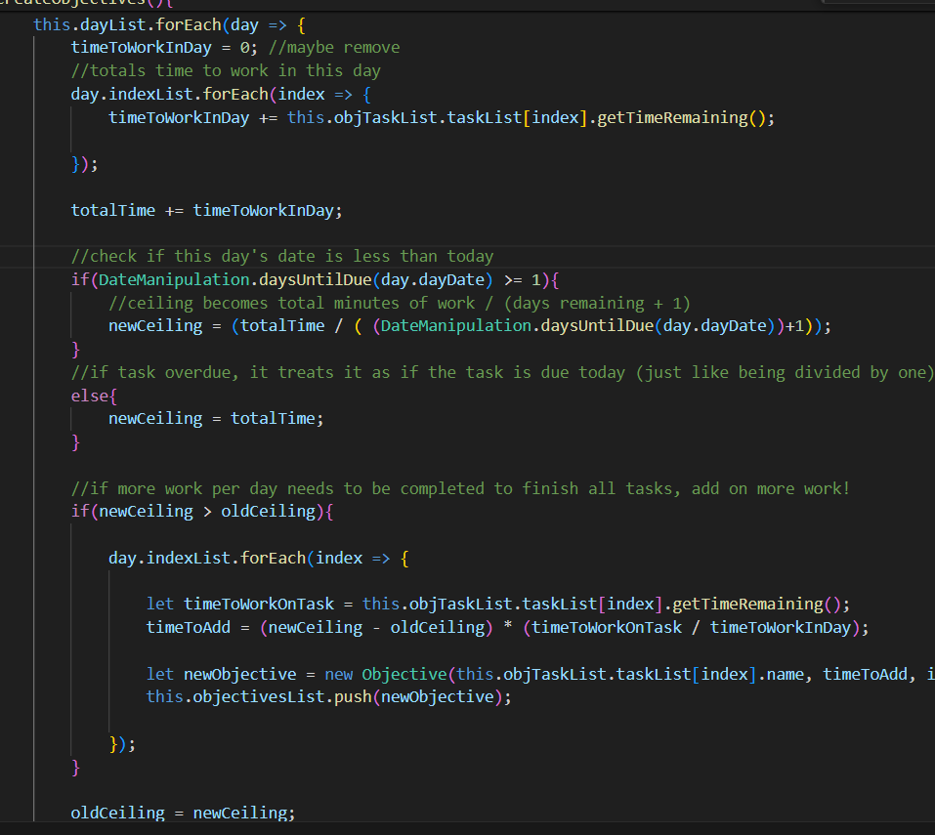
New Objective Calculations
Tasks divided into Days due
For each day, find time needed to do all work until then divided by days left to do that work
"ceiling" of work
For today, that means do all work due today
If another day has a higher ceiling, add more work
Difference in height is divided among Tasks due by their proportion of work time remaining

Slide 21
Garden
No need for shop and inventory
Garden state saved as String in User object
Acts as "inventory" of items
updates xp multiplier
Shop is set in html
each item in Shop has information in function call
Switch statements digest String info

Slide 22
User Logs
Difficult to make in prototype
Proved more of a difficult task to implement
Way to store proved a little more complicated
Time was of the essence
We wanted to get something working, first

Slide 23
Deployment
Hosted site through Firebase
https://thinkitthru-f4db6.firebaseapp.com/
Proved far more difficult than it seemed
Issues with npm, realization of its non-necessity
Implementation issues that were introduced only in initialization

Slide 24
Work-in-Progress
Given more time to work, we could get it fully functional
Deployment and Integration of the Database introduced a lot of issues at the late stage
If done again, we would have a whole new light on what it requires

Slide 25
Thank You, Questions?

