Slide 1

ThinkItThru
By Jensen Schmidt, Zachary Travis, and Levi Wright

Slide 2

Discussion Outline
Introduction
Block Diagram
Message and Storage (Server Interaction)
Component diagram and Feature List
Storyboard

Slide 3

Introduction
ThinkItThru! motivates users to organize their day and satisfy academic deadlines
Users may accomplish this by:
Creating tasks for themselves
Which will be scheduled into goals
Enjoy their rewards for accomplishing their goals!

Slide 4
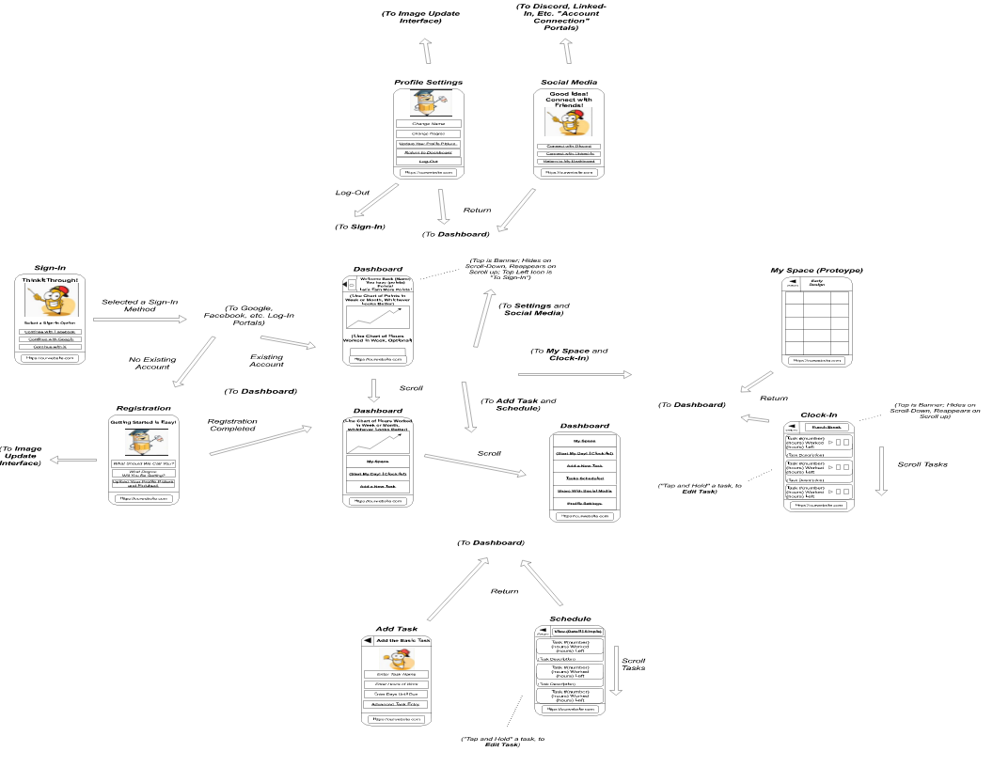
Storyboard

Slide 5
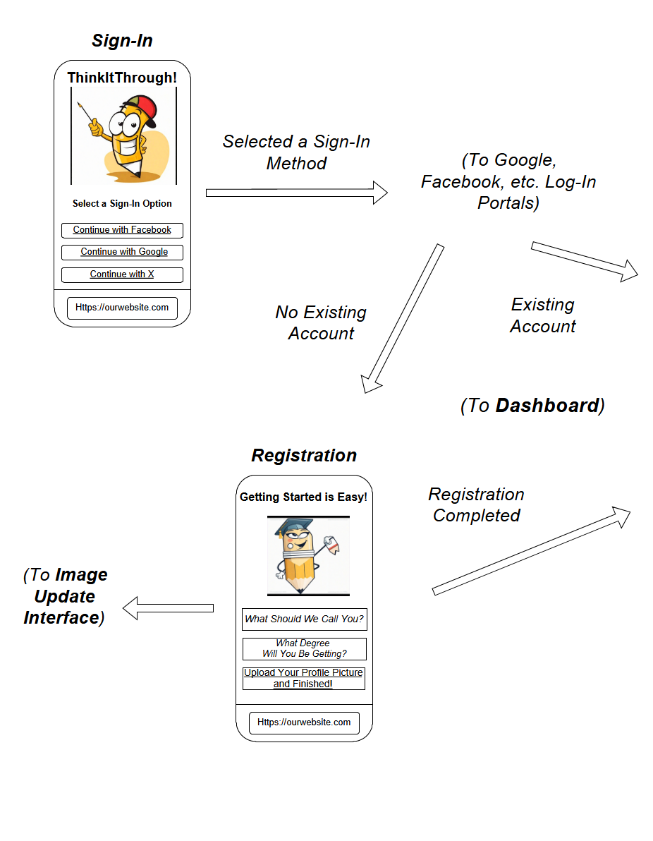
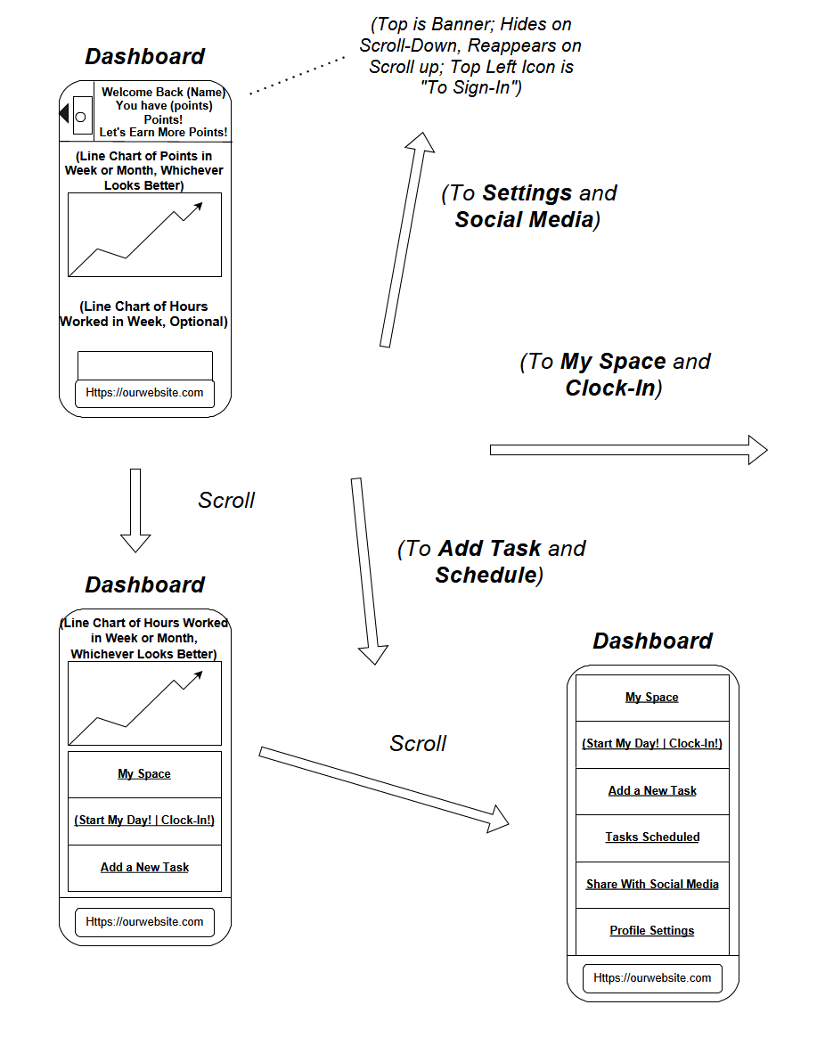

Slide 6
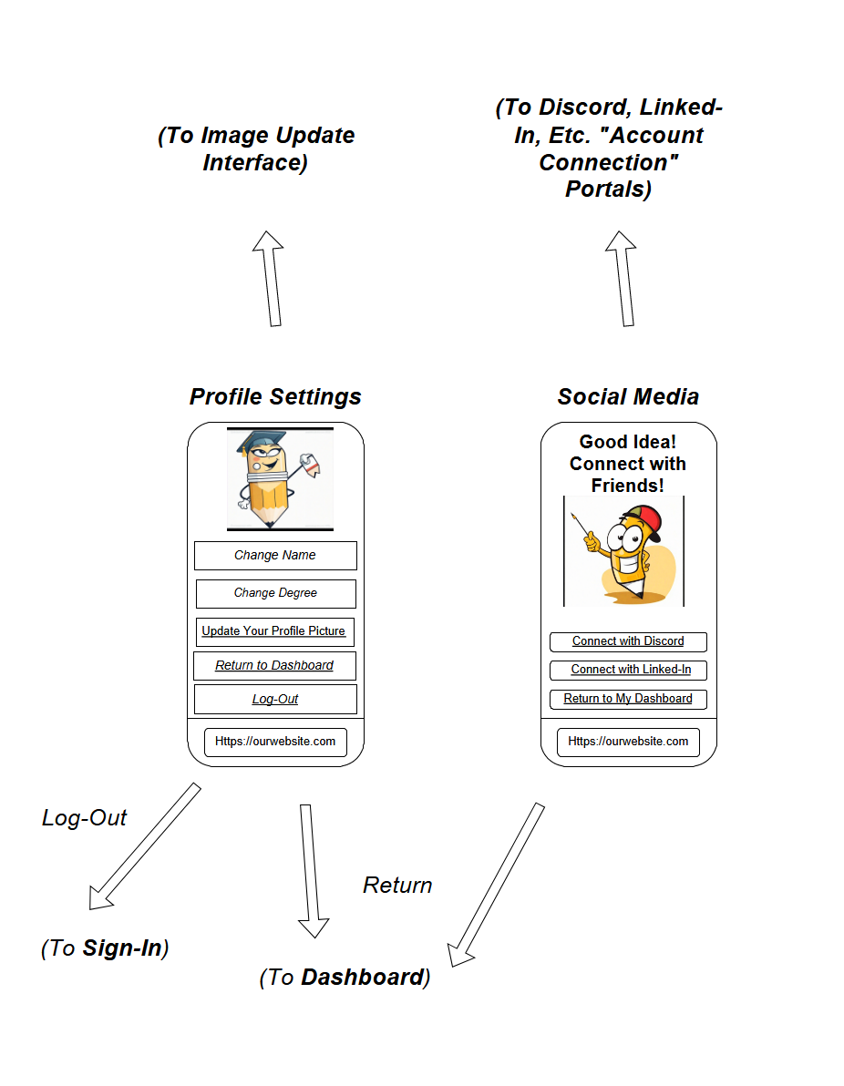
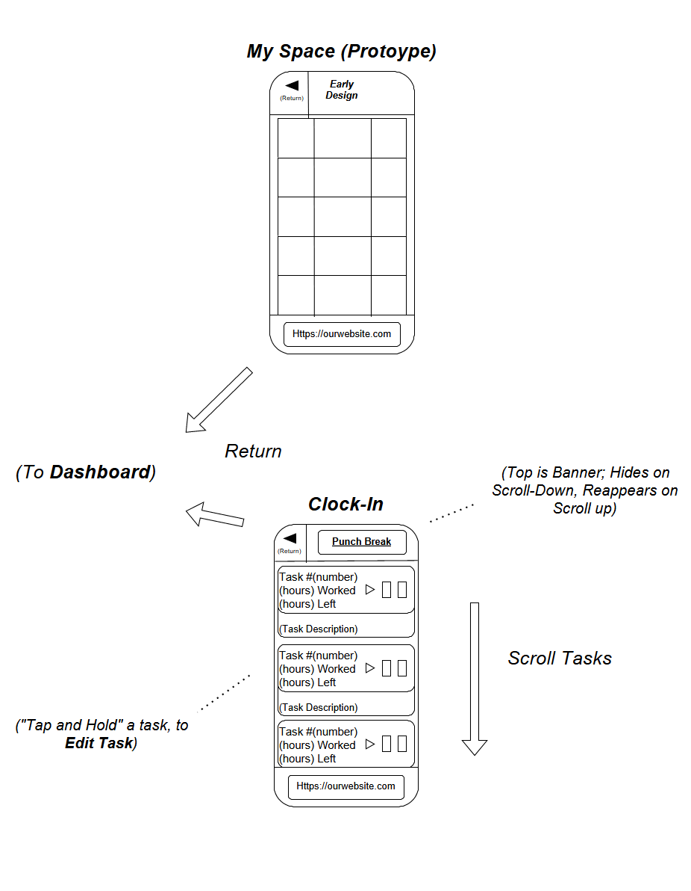
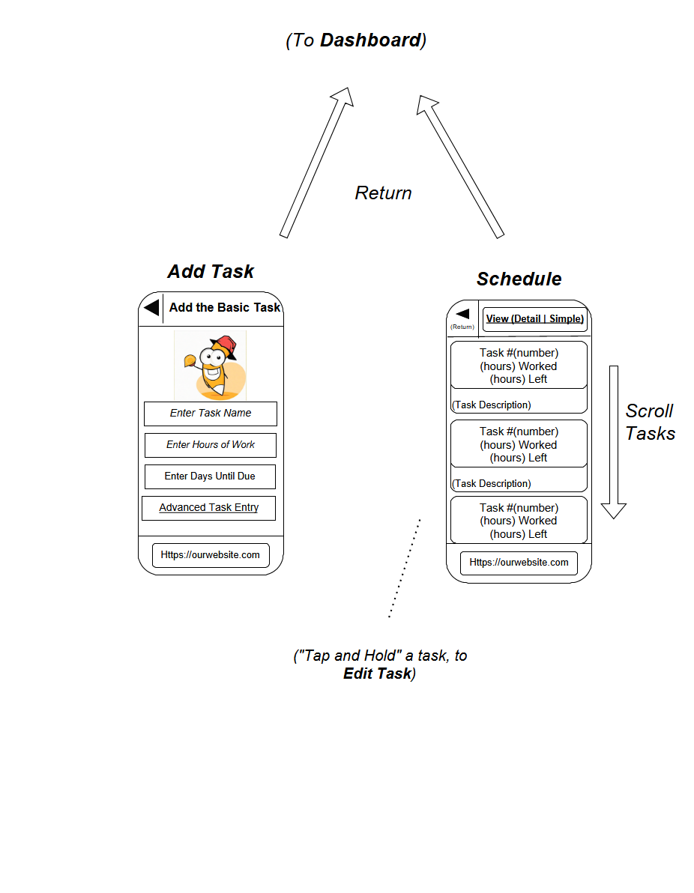
Storyboard Cont.

