Slide 1

ThinkItThru Update
By: Jensen Schmidt, Levi Wright, Zach Travis

Slide 2
Agenda
Database Design Updates
Task and Objective Updates
Design Updates

Slide 3

Database Design Updates

Slide 4
Firebase Realtime Database
Not a relational database
We knew this, but the difficulties have appeared
In the process of a re-structure
Possible De-normalization
New structure idea soon
The ERD will change when we commit to the change

Slide 5

New Data
We forgot some components
New data for users to input
Free time
Overall time worked
Daily time worked separate
We plan to store data in minutes
Easier for our intended use
Experience
Records

Slide 6
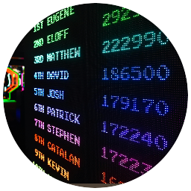
Old Data
Removal of some data
Minimum time
User Discretion
We will keep Maximum time
Users need it for some tasks
A provided message will now be given
Not enough time
Bonus ideal time frames

Slide 7
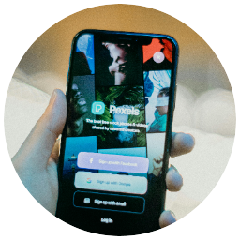
Hosting and Authentication
Firebase is now hosting!
We have a URL
No deployment yet
Database situation
JavaScript updates
Implementation into Task Logic
Authentication/login will match site
We are now opting to use a different design

Slide 8

Tasks and Objectives Updates

Slide 9
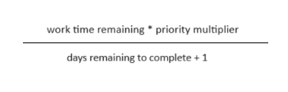
Tasks
Task creation
Name, time, priority, difficulty, due date
Optional subtasks
Queue Score
Used to automatically order tasks

Slide 10

TaskList
Contains array of Tasks
Adding Tasks
Queue score order
Get Task
Based on index
Task can be edited from reference

Slide 11
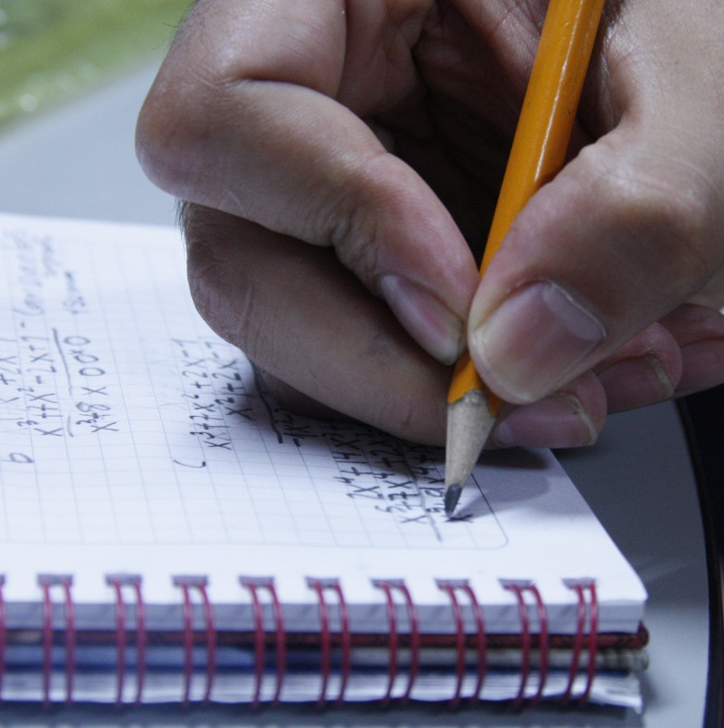

Daily Objectives
Orders by due date
Iterates through each Day
Creates "ceiling" for each Day
Adds objective as Task

Slide 12
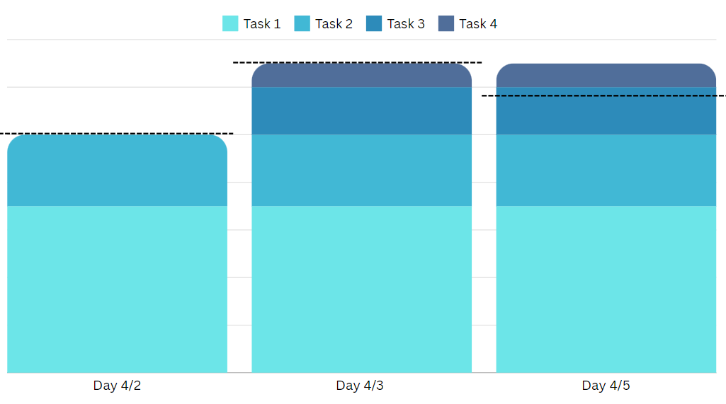

Slide 13
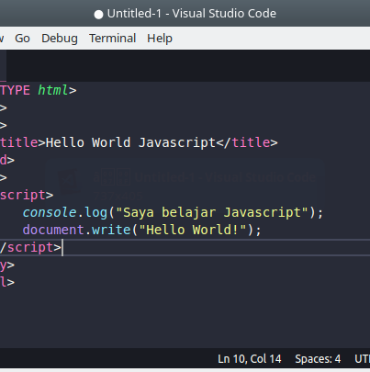
JavaScript Model
Creates TaskList
Adds Tasks
Ordered by queue score
Modifies Task from index
Creates Objectives List
Creates Daily Objectives
This Photo by Unknown author is licensed under CC BY.

Slide 14

Design Updates

Slide 15
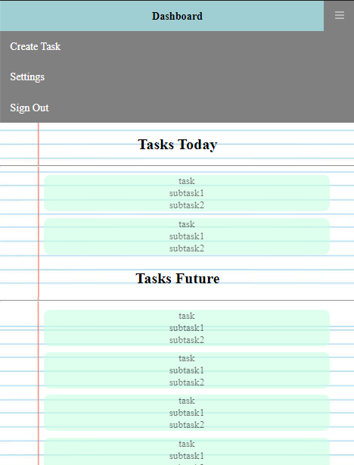
Dashboard Interface
Now features:
a Title bar at the top, with an expandable hamburger navigation menu
2 "flexbox" of sections of "Taskbox" containers (Tasks Today, Tasks Future)

Slide 16
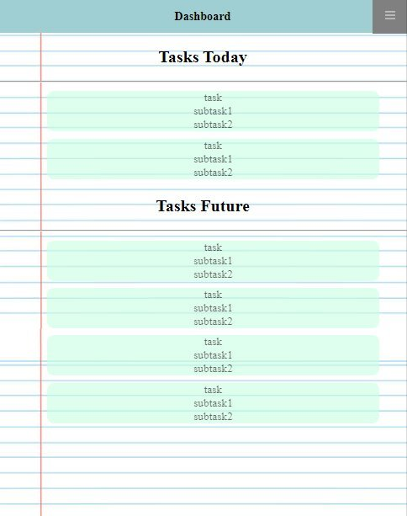
Taskboxes
Are also flexbox containers
Holding the "tasks" (main task view, subtasks, etc.)
Tasks are a "grid" of dynamic properties

Slide 17
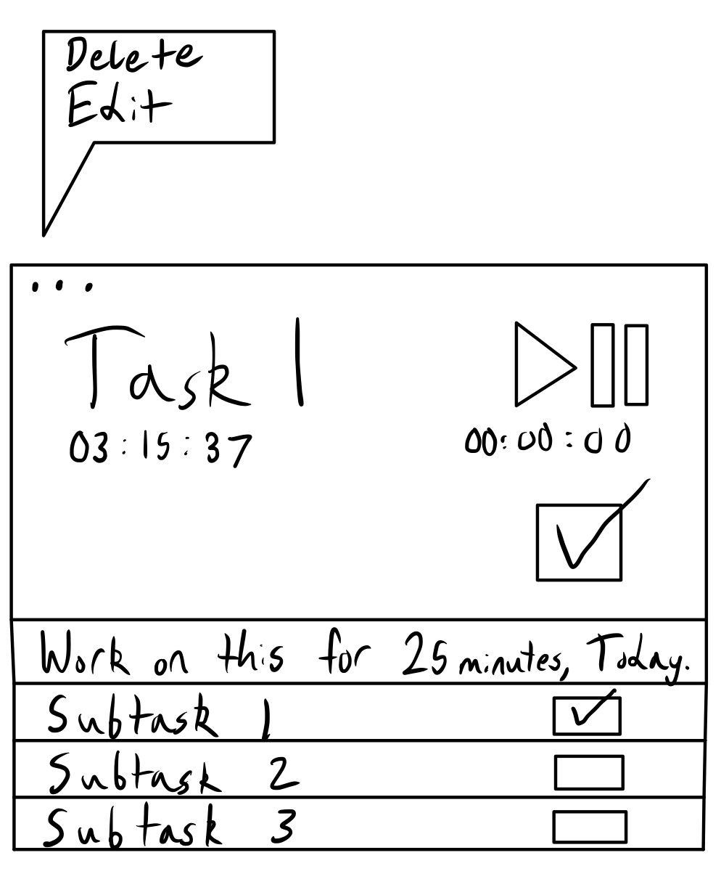
Daily Tasks
Subtasks are not as individual
Now just names and checks
Total Task Time addition
Current Task Time addition
Reduced item options menu

Slide 18
Overall List of Items Completed:
Initial dashboard
Relational version of Database
Hosting
Task Logic/JavaScript

Slide 19
Items in Progress:
Database Decisions Finalized (rework or not)
JavaScript Database Update/Create Functions finalized
Dashboard integrated with task logic and database
User Logs
Weekly Objectives
Game images
Game store
Gameboard
Connection page (just discord links)

Slide 20
Thank you

