Slide 1

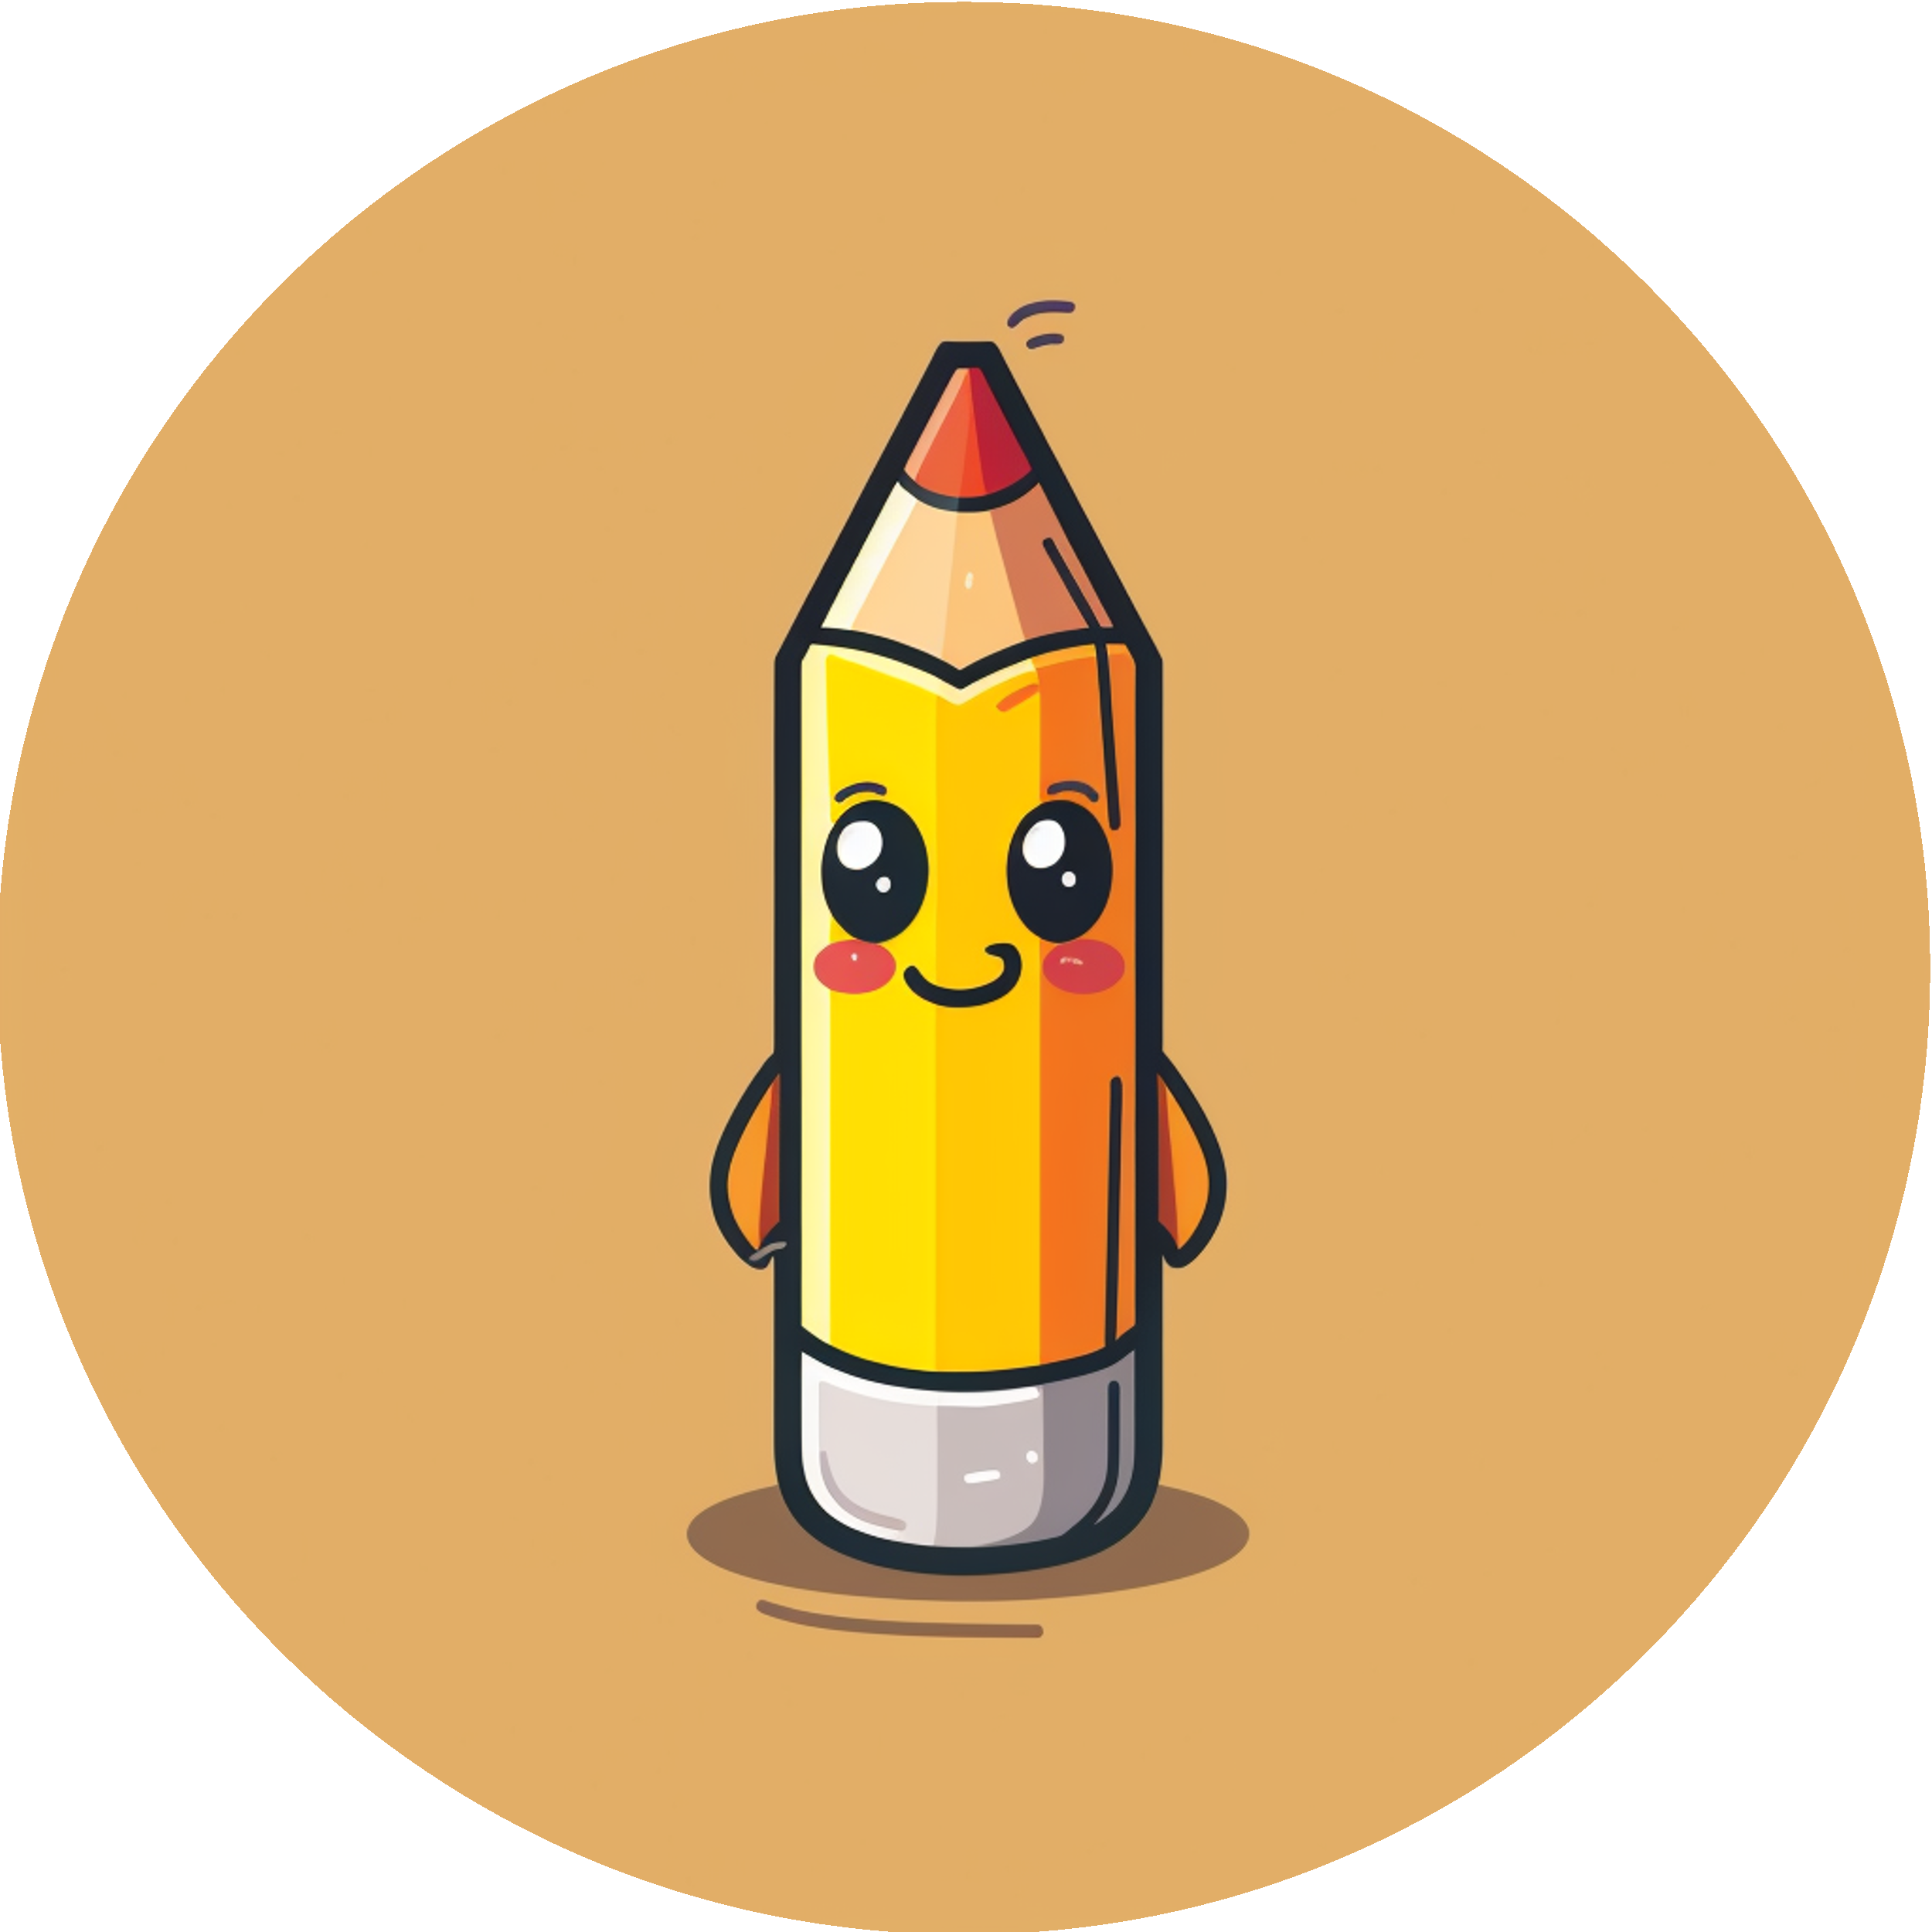
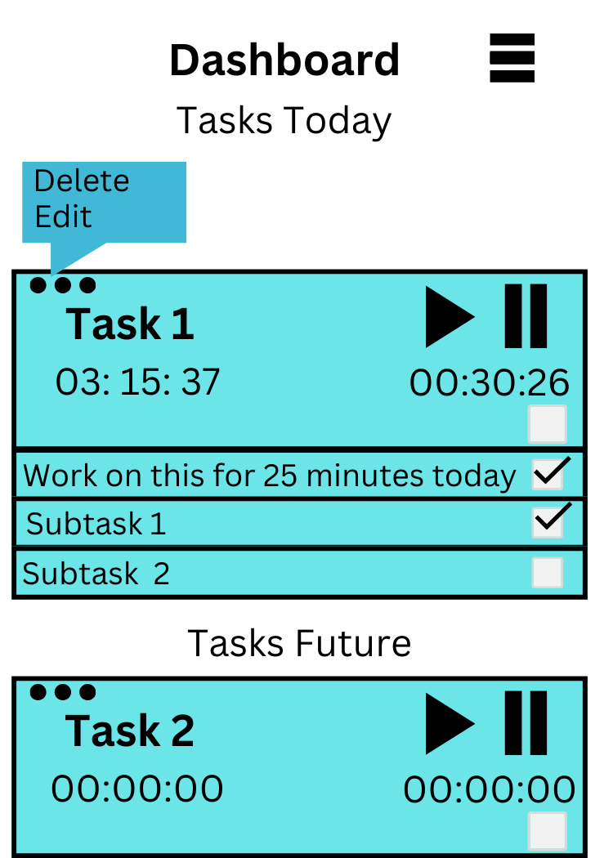
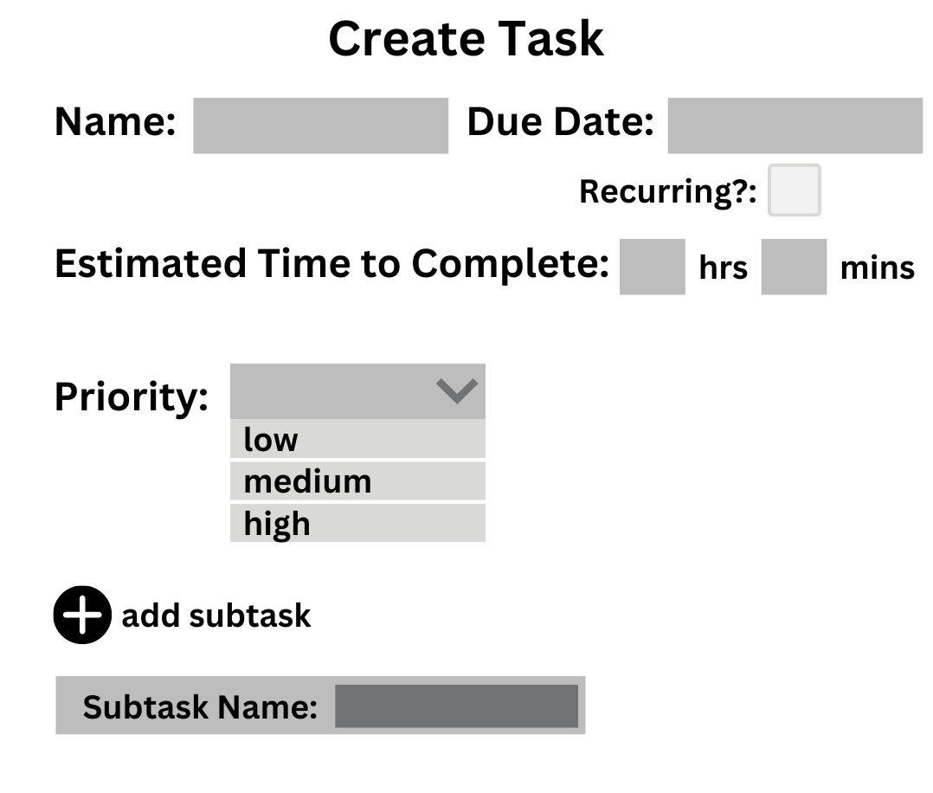
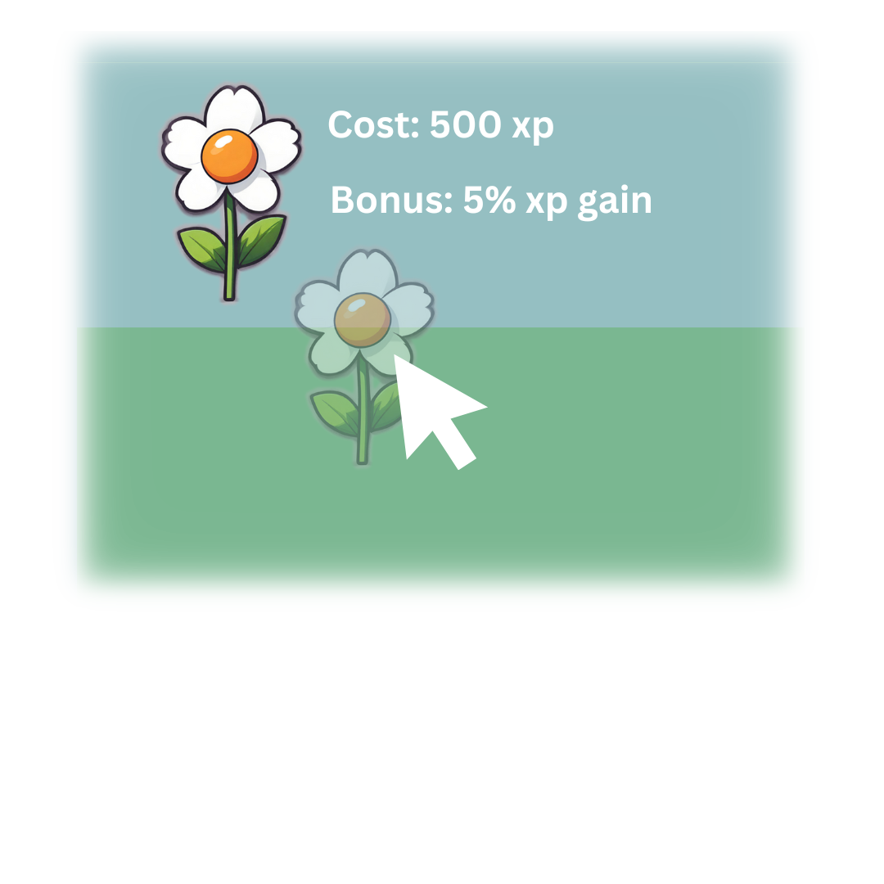
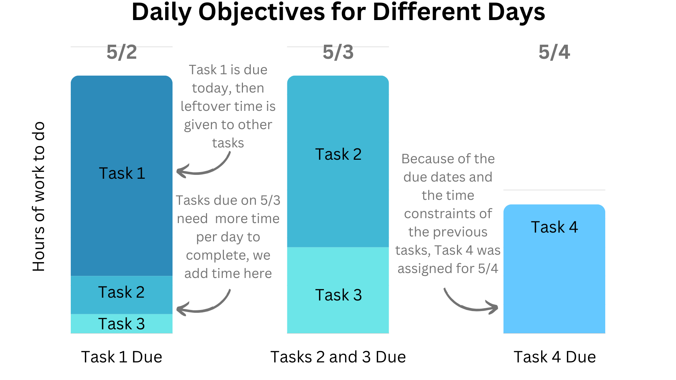
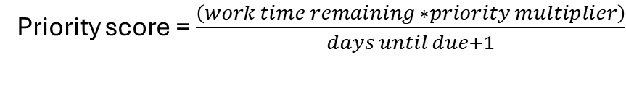
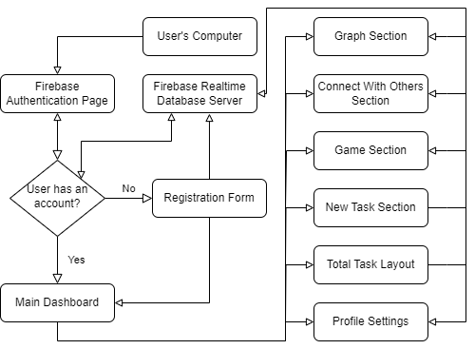
ThinkItThru!
Jensen Schmidt, Zachary Travis, Levi Wright
Dept. Of Computer Science and Information Technology
Abstract
Figure 1: Simplified dashboard design displayed upon login, displaying the intended layout of the user's task information.
Figure 2: Task Creation Menu design. Users will input the following information so the Task is organized and Objectives for the Task can be displayed.
Figure 3: Our mini-game, "Mind Your Garden", intended to gamify the experience you receive upon completing tasks and logging in consistently. Game Items modify your experience gain through consumable and permanent items
College students struggle with high workloads during their academic careers. It is common to find students performing “all-nighters” and developing unhealthy habits due to poor time management and lack of motivation, contributing to an overall lifestyle of chronic stress. ThinkItThru!’s primary goals are to help students build better study habits through visual representations of the work they must complete to stay on track, along with the gamification of their work using the “XP” they gather. Tasks will be organized by priority and the user will “clock in” to a task to record the time they spent on it, as well as mark when a Task is complete. Experience, or “XP”, may be earned through time spent on a Task, completing the Task, and completing Daily and Weekly Objectives designed to keep the user on track to complete all goals. This XP may be used to purchase rewards that increase future XP gains. One-time-use items may multiply XP gains for a short period, or permanent items may be purchased and placed in the user’s Garden to decorate the site and give their XP gain a constant multiplier (Fig. 3).
Technology
Design
Our project utilizes a few key pieces of technology to function:
Firebase Realtime Database: ThinkItThru! uses Firebase Realtime database for storing all its user data; much of what it stores involves the Experience points of each user, the gameboard setup, the Tasks of each user, and the profile settings.
Firebase Hosting: ThinkItThru! is also hosted through Google's Firebase service, where changes can be deployed easily and effectively. It works well with the database and authentication functions.
Firebase Authentication: Our website also uses Firebase's authentication, taking advantage of Google's professional security measures while still allowing us to identify user's and their data.
Visual Studio Code: Visual Studio Code is our preferred Integrated Development Environment (IDE), allowing us to code in a plethora of programming languages and quickly update our GitHub files.
Tasks are the backbone of ThinkItThru!. Users will create Tasks using the Task's name, estimated time required to complete, priority, due date (or optionally recurring weekly), and an optional list of subtasks. (Fig. 2)
Users will be able to add Tasks to their TaskList, which organizes the dashboard (Fig. 1) screen's display by priority based on the following calculation:
Based on these Tasks, Daily and Weekly Objectives will be created, calculating how long a user needs to work in that day or week to complete all Tasks on time (Fig. 4). By completing all Objectives, the user should be on track to complete all their Tasks on time and will receive a bonus XP reward!
Time worked, completing Tasks, and completing Objectives awards XP, which will be used in the Mind Your Garden game. Players will be able to invest XP to add plants and other items to tiles in their garden, which will multiply XP gained later on! (Fig. 3)
Users will be able to track the amount of time they have worked each day of the past week, as well as track the amount of time worked per week for up to a year. We hope this motivates users to clock in more hours in work on their projects and track their progress in their own personal habits in reaching their life goals!
Depending on the major of the student that has signed in to the app (gathered at the registration form page) (Fig. 5), the student will be able to see different discord communities and other connected social media relating to their major.
Figure 4: Our Daily Objective system organizes Tasks into the Days they are due and iteratively finds the highest average time a user must work each day. This creates an artificial cap on the total amount of work a user should complete each day, to avoid overwhelming them and to efficiently spread the work out. By following the Daily Objectives each day, a user should be able to complete all Tasks on time.
Future Work
Socials: In addition to more types of social information input into a "Connections" page, we would also like to allow users to look at the gardens and progress of their friends within the gamified portion of the site.
Helpful Advice: Our biggest goal is to help the user stay on track and build healthy habits. In the future, we would like to find ways to offer healthy advice to users and aid in developing good habits.
References
Acknowledgements
Figure 5: A block diagram representing the various components of our site, following a path from the user's computer and to the systems involved in our structure. You can also see the various pages of our application
https://code.visualstudio.com
https://github.com
https://firebase.google.com
We would like to thank Dr. Karen Meisch for her support of students in the College of Science, Technology, Engineering & Mathematics, and Dr. Leong Lee for his support of students in the Department of Computer Science and Information Technology.

