Slide 1
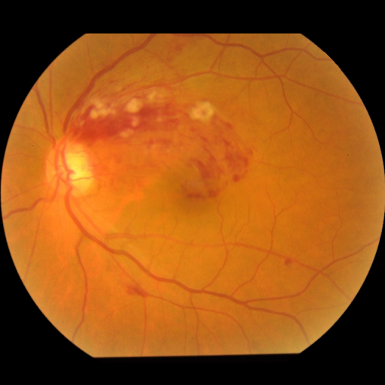
Layer
Scale
Layer
Scale
Layer
Scale
Layer
Scale
Patch Embed
Position Encoder
RMSNorm
CP-Mamba
Block
×
L1
RMSNorm
CP-Mamba
Block
×
L2
RMSNorm
CP-Mamba
Block
×
L3
RMSNorm
CP-Mamba
Block
×
L4
RMSNorm
Pool
Head

