Slide 1
Paper Reading Report: LipsNet: A Smooth and Robust Neural Network with Adaptive Lipschitz Constant for High-Accuracy Optimal Control
participants： 齐修远 陈欣禾 刘文婷

Slide 2
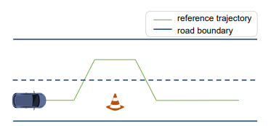
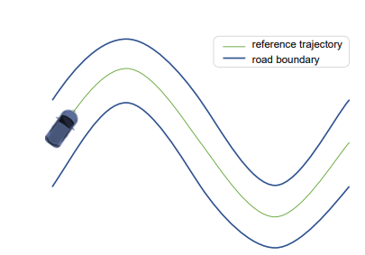
Problem Statement
Background
MLP has great performance in many Deep Learning simulation environments, however, we must take more issues into consideration.
For example:
mechanical wear out
Noise
Inertia related mechanical fault
Transformation of problem
These problems are partially caused by action fluctuations.
LipsNet aims to solve the problem by restricting Lipschitz constant, thus providing a smooth action function.
Figure: two examples of DL application. In real-word scenarios, both robustness and fast reaction are necessary.
Review of Article
Discussion of Key Points
Extension Analysis
Notes:
In recent years, Deep Learning is widely used in real-world applications, this also lift the veil that surrounds us in simulation environment. Mechanical wear out, for example, could be much more apparent with sudden movement or direction change. Moreover, noise in reality may worsen the problem. Small perturbations near the decision boundary could result in highly fluctuated function output.
The pictures give two examples of DL application. For an unrobust and sensitive action function, the direction of car may swing rapidly, making the passenger uncomfortable, car wear and bring risk of accident.

Slide 3
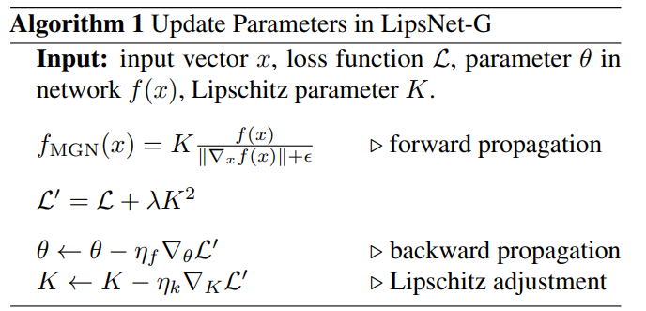
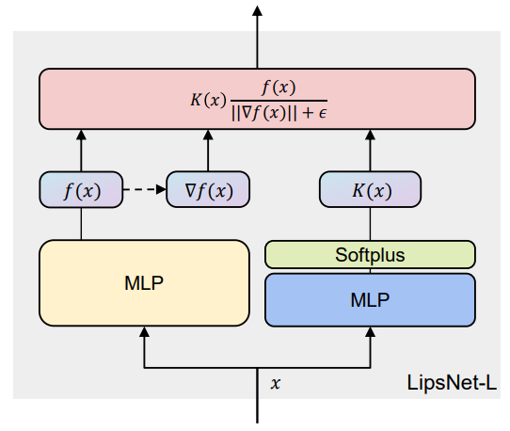
Methodology & Contribution
Based on MGN method, LipsNet adds an extra layer after MLP output.
Lipschitz constant K as regularization term in loss function
Instead of direct optimize, obtain K with another MLP
The structure of LipsNet :
It allows a flexible K and local Lipschitz continuous and offer a balance between Smoothness and Performance
Review of Article
Discussion of Key Points
Extension Analysis
Notes:
In the paper, based on MGN, which is a method that can restrict a layer of MLP to be Lipschitz continues. The author improved the method and obtained global Lipschitz continues, which may suffer less performance loss.
The pseudocode shows training phase of LipsNet:
First, it process the output of network f(x) and meets requirement of Lipschitz continues.
Then they combine the original loss with Lipschitz constant K and apply backward propagation to optimize both original network(MLP in the second graph) parameter θ and the new network(φ) for choosing K.
Note that the Softplus layer in the second graph promises K(x) to be a positive value, which is requirement of Lipschitz constant.

Slide 4

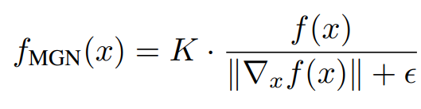
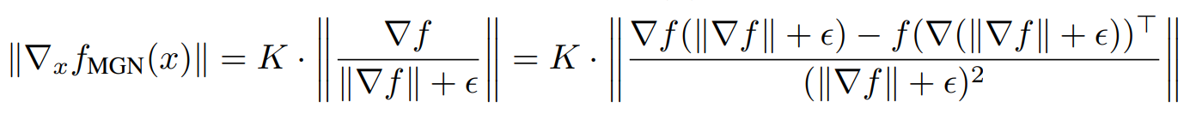
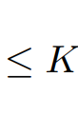

Discussion of Key Points
Convert the question to optimizing Lipschitz constant K
Transformation of the Output Function
Use Activation Functions to Adjust the Output Range
Review of Article
Discussion of Key Points
Extension Analysis
Notes:
文章的三个关键点
第一个关键点：将问题转换为优化Lipschitz常数K。我们知道，如果函数f的梯度范数被K限制，即∥∇xf(x)∥≤K\| \nabla_x f(x) \| \leq K∥∇x​f(x)∥≤K，我们可以通过一个积分表达式将函数变化量的控制问题转化为关于Lipschitz常数的优化问题。具体来说，通过对积分进行变换，我们可以得到：
∥f(y)−f(x)∥=∥∫01∇f(x+t(y−x))dt⋅(y−x)∥≤K∥y−x∥\| f(y) - f(x) \| = \left\| \int_0^1 \nabla f(x + t(y - x)) dt \cdot (y - x) \right\| \leq K \| y - x \|∥f(y)−f(x)∥=​∫01​∇f(x+t(y−x))dt⋅(y−x)​≤K∥y−x∥这表明我们可以用Lipschitz常数K来控制函数值的变化。
第二个关键点：输出函数的变换。我们对MLP的输出函数进行了如下变换：
fMGN(x)=K⋅f(x)∥∇xf(x)∥+ϵf_{MGN}(x) = K \cdot \frac{f(x)}{\|\nabla_x f(x) \| + \epsilon}fMGN​(x)=K⋅∥∇x​f(x)∥+ϵf(x)​这种变换可以将输出控制在一个K-Lipschitz连续的范围内。通过对变换后的函数梯度进行2-范数计算，我们得到：
∥∇xfMGN(x)∥=K⋅∥∇f∥∇f∥+ϵ−f(∇(∥∇f∥+ϵ))T(∥∇f∥+ϵ)2∥≤K\| \nabla_x f_{MGN}(x) \| = K \cdot \left\| \frac{\nabla f}{\| \nabla f \| + \epsilon} - \frac{f(\nabla(\| \nabla f \| + \epsilon))^T}{(\| \nabla f \| + \epsilon)^2} \right\| \leq K∥∇x​fMGN​(x)∥=K⋅​∥∇f∥+ϵ∇f​−(∥∇f∥+ϵ)2f(∇(∥∇f∥+ϵ))T​​≤K这一步骤确保了经过变换后的输出函数仍然满足Lipschitz连续性。
第三个关键点，使用激活函数来调整输出范围。由于在强化学习测试环境中，动作输出范围通常较有限，我们选择使用tanh激活函数来控制输出范围。tanh函数的导数在元素上都在0和1之间，这意味着：
0<∇tanh≤10 < \nabla \text{tanh} \leq 10<∇tanh≤1因此，对于任意函数g，我们有：
∥∇xg(x)∥≤1⋅∥∇xfMGN(x)∥≤K\| \nabla_x g(x) \| \leq 1 \cdot \| \nabla_x f_{MGN}(x) \| \leq K∥∇x​g(x)∥≤1⋅∥∇x​fMGN​(x)∥≤K这确保了在使用激活函数后，输出函数仍然保持K-Lipschitz连续性

Slide 5
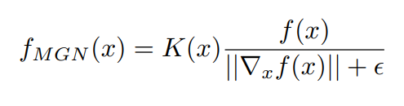
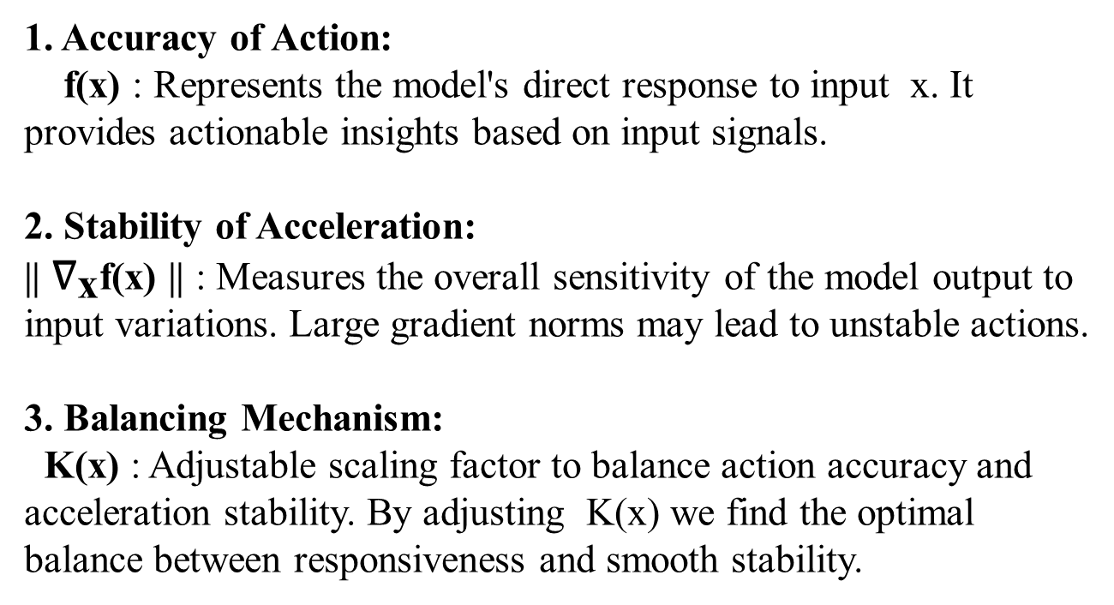
Personal Opinion: Physical Meaning
1. Accuracy of Action:
f(x) : Represents the model's direct response to input x. It provides actionable insights based on input signals.
2. Stability of Acceleration:
|| ${\text{∇}}_{\text{x}}$f(x) || : Measures the overall sensitivity of the model output to input variations. Large gradient norms may lead to unstable actions.
3. Balancing Mechanism:
K(x) : Adjustable scaling factor to balance action accuracy and acceleration stability. By adjusting K(x) we find the optimal balance between responsiveness and smooth stability.
Review of Article
Discussion of Key Points
Extension Analysis
Notes:
原作者只提到了公式的数学变换，但是缺少一些对于公式直观的物理解释，我们将方法拓展如下
这个公式涉及几个关键部分：模型输出相对于输入的梯度，以及这个梯度的范数。梯度告诉我们模型输出对输入变化的敏感程度，基本上就是模型反应的速度和强度。
通过规范化梯度范数，我们达到了以下三个重点：
动作准确性： 原始输出 f(x)是模型对输入 x的直接响应。这意味着模型可以根据输入信号提供相应的动作指令。
加速度稳定性： 梯度范数 ∥∇xf(x)∥测量了模型输出对输入变化的整体敏感性。如果梯度范数很大，模型的输出对输入变化非常敏感，这可能导致剧烈和不稳定的动作。通过规范化梯度范数，公式确保输出的平滑和稳定，避免由于过度敏感导致的不稳定性。
平衡机制： 公式中的 K(x) 作为一个可调的缩放因子，让模型可以根据不同的输入情况调整输出的幅度。这进一步提供了动作准确性和加速度稳定性之间的平衡。通过调整 K(x) 的值，我们可以在提高动作响应速度和保持平滑稳定之间找到一个适当的平衡点。

Slide 6
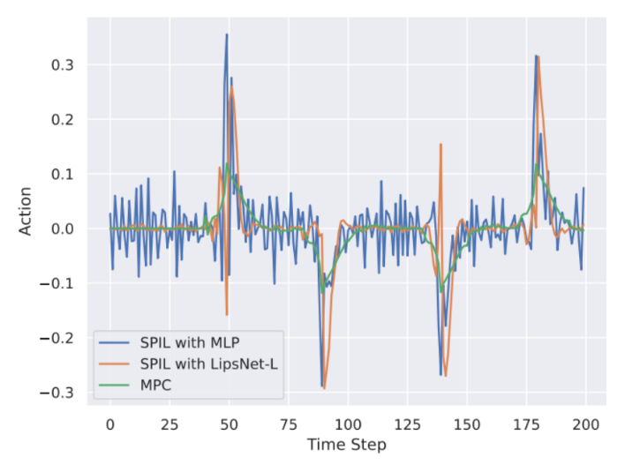
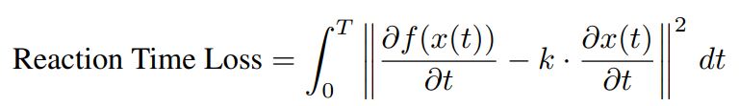
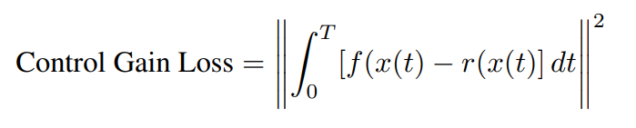
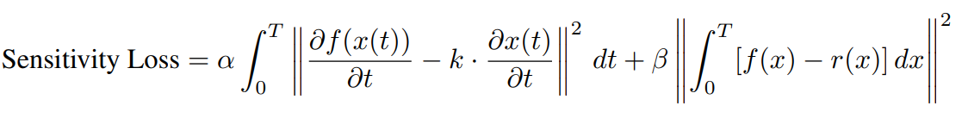
Further Improvement:
Quantifying Sensitivity and Balancing with Smoothness
Our design
Response time:
Intensity:
Comprehensive Loss Function
The problem of article
Vehicle Trajectory Tracking Experiment Results：
Orange line (SPIL with MLP) reacts slower than the blue line (SPIL with LipsNet-L) and green line (MPC).
In practical applications, controlling noise for increased smoothness may lead to insufficient vehicle response sensitivity.
Review of Article
Discussion of Key Points
Extension Analysis
Notes:
这张图展示了车辆轨迹跟踪实验的结果。我们观察到，橙色线（SPIL with MLP）的反应速度比蓝色线（SPIL with LipsNet-L）和绿色线（MPC）都要慢。在实际应用中，例如汽车中的避障和转弯，控制噪声增加了平滑度可能会导致车辆响应灵敏度不足。因此我们想要量化灵敏度，然后与平滑度做一个权衡。通过这种方法，我们可以在保持动作平滑的同时增强系统的反应灵敏度，更好地满足实际应用的需求。
我们可以使用反应时间损失和控制增益损失作为灵敏度的度量标准。
反应时间损失模型：
在自动驾驶中，车辆需要在检测到紧急转向信号时迅速做出反应。为了量化这种反应时间损失，我们定义了如下公式：Reaction Time Loss
在这个公式中，f(x(t))f(x(t))f(x(t)) 表示模型的输出信号，∂f(x(t))∂t\frac{\partial f(x(t))}{\partial t}∂t∂f(x(t))​ 代表输出信号随时间的变化率，∂x(t)∂t\frac{\partial x(t)}{\partial t}∂t∂x(t)​ 代表输入信号随时间的变化率。参数 kkk 是用于匹配两者变化率单位和尺度的缩放因子。通过在时间区间 [0, T] 内对差异平方进行积分，我们得到了模型在反应时间上的总损失。
控制增益损失模型：
为了评估惩罚的变形程度，我们定义了控制增益损失：Control Gain Loss
在这个公式中，f(x(t))f(x(t))f(x(t)) 代表模型的控制信号，r(x(t))r(x(t))r(x(t)) 代表真实模型输出的控制信号。通过计算时间区间 TTT 内信号变化的差异的积分，我们可以得到控制增益损失。
综合灵敏度损失函数：
现在，我们将反应时间损失和控制增益损失结合起来，形成一个综合的灵敏度损失函数：Sensitivity Loss
其中，α\alphaα 和 β\betaβ 是用于调整反应时间损失和控制增益损失在总损失函数中相对重要性的加权参数。
通过结合这两个损失函数，我们可以设计一个能够快速且准确地响应紧急信号（如刹车信号）的模型。

Slide 7
Thank you for your attention!
Review of Article
Discussion of Key Points
Extension Analysis

