Slide 1
Shadow

Slide 2
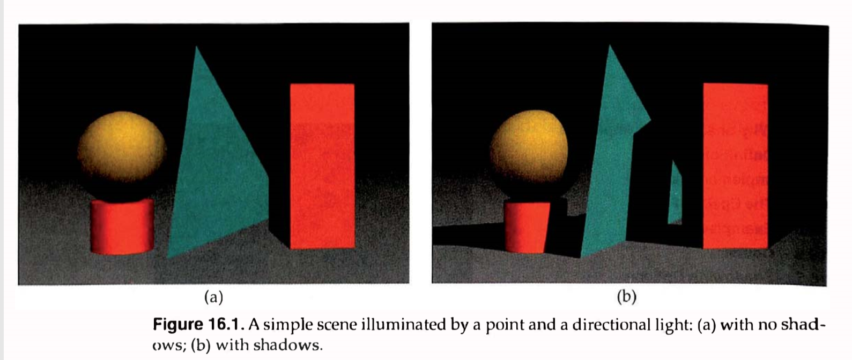

Slide 3
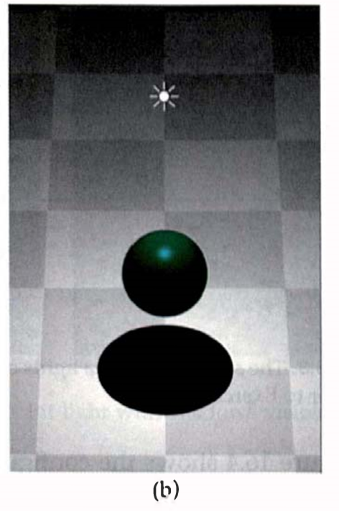

Slide 4
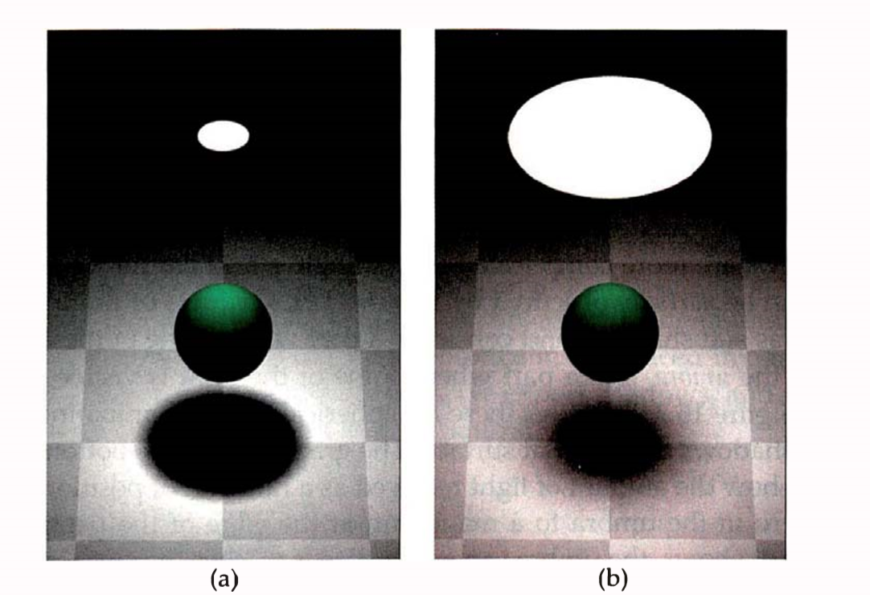

Slide 5
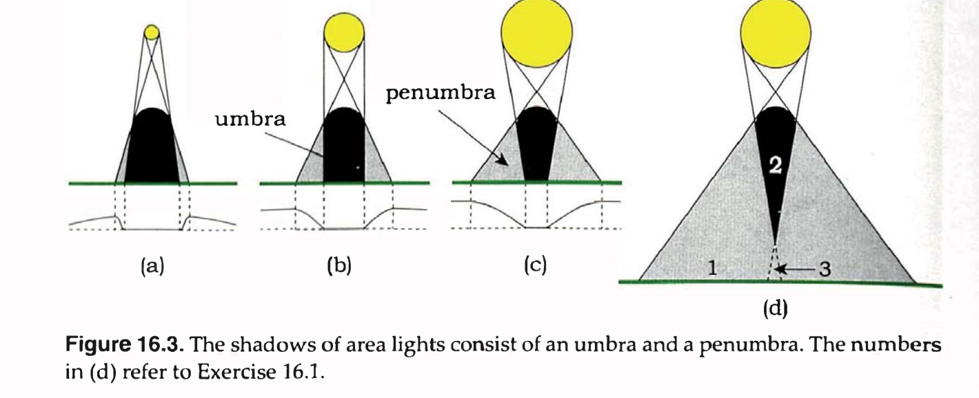

Slide 6
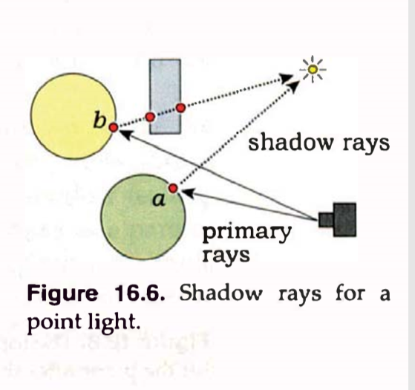
lightPos
6
N
1
ShadowRay
2
pHit
5
3
4

Slide 7
N
pHit

Slide 8
kEpsilon = 1e-5
N
t
P = O + t * d

