Slide 1
OpenGL Programming on Qt Platform

Slide 2
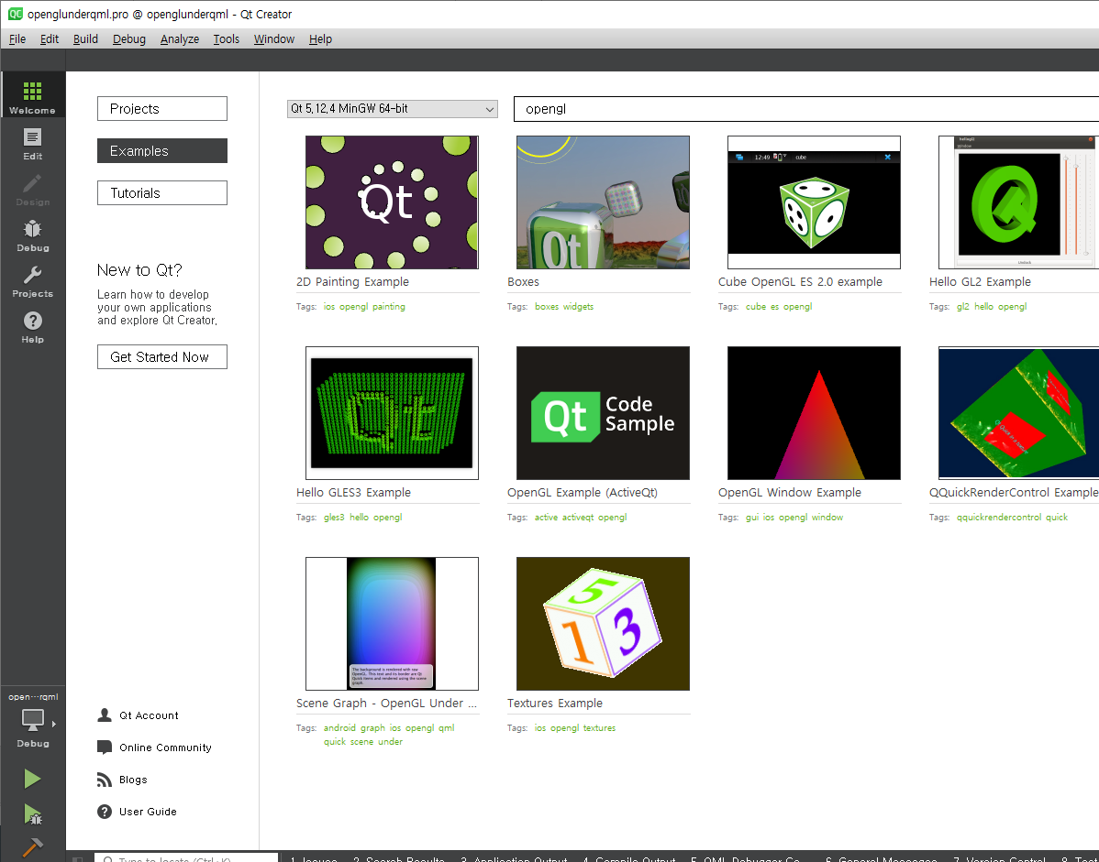
HelloViewport는
“OpenGL Under QML”을 수정한 것

Slide 3
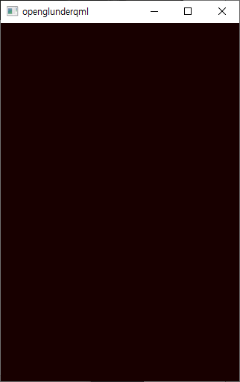
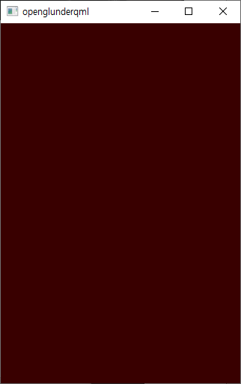
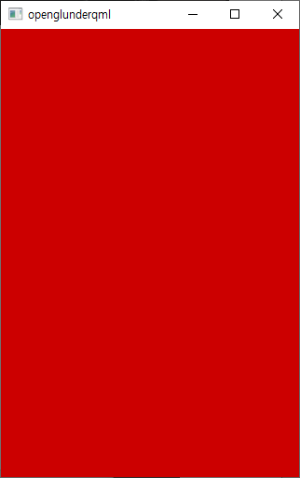
Hello Viewport
목적 : Qt에서 OpenGL 사용하기
- Qt QML에서 사용하기
- 뷰 포트(Viewport)

Slide 4
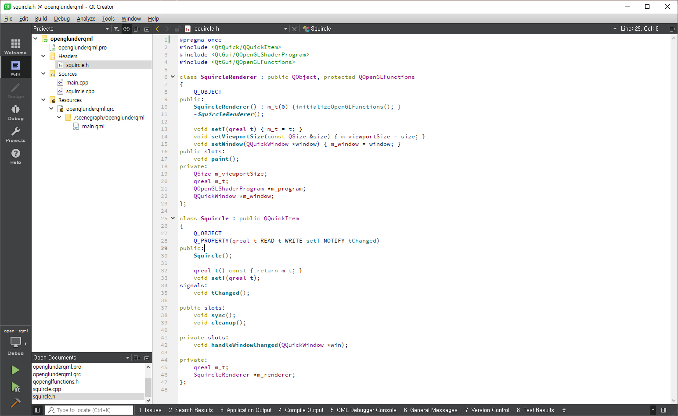
#pragma once
#include <QtQuick/QQuickItem>
#include <QtGui/QOpenGLShaderProgram>
#include <QtGui/QOpenGLFunctions>
class SquircleRenderer : public QObject, protected QOpenGLFunctions
{
Q_OBJECT
public: SquircleRenderer() : m_t(0) {initializeOpenGLFunctions(); } void setT(qreal t) { m_t = t; }
void setViewportSize(const QSize &size) { m_viewportSize = size; }
void setWindow(QQuickWindow *window) { m_window = window; }
public slots:
void paint();
private:
QSize m_viewportSize;
qreal m_t;
QQuickWindow *m_window;
};
class Squircle : public QQuickItem
{
Q_OBJECT
Q_PROPERTY(qreal t READ t WRITE setT NOTIFY tChanged)
public:
Squircle();
qreal t() const { return m_t; }
void setT(qreal t);
signals:
void tChanged(); public slots:
void sync();
void cleanup(); private slots:
void handleWindowChanged(QQuickWindow *win); private:
qreal m_t;
SquircleRenderer *m_renderer;
};

Slide 5
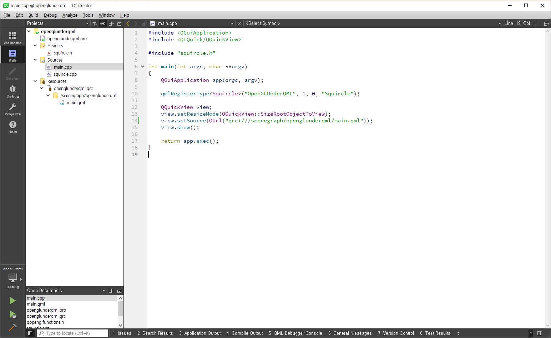

Slide 6
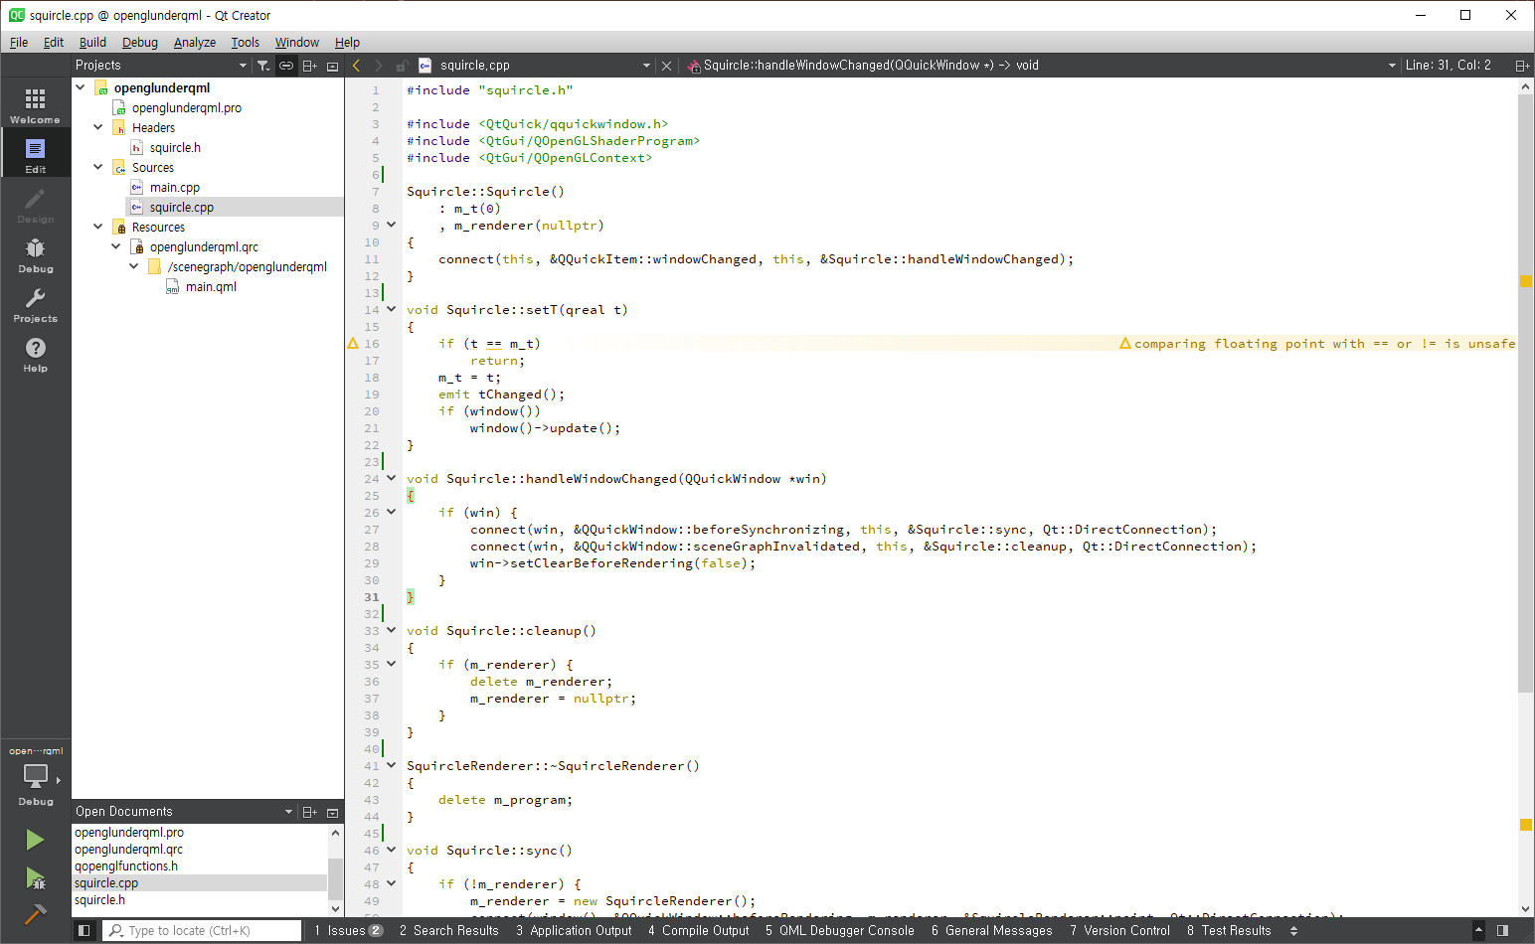

Slide 7
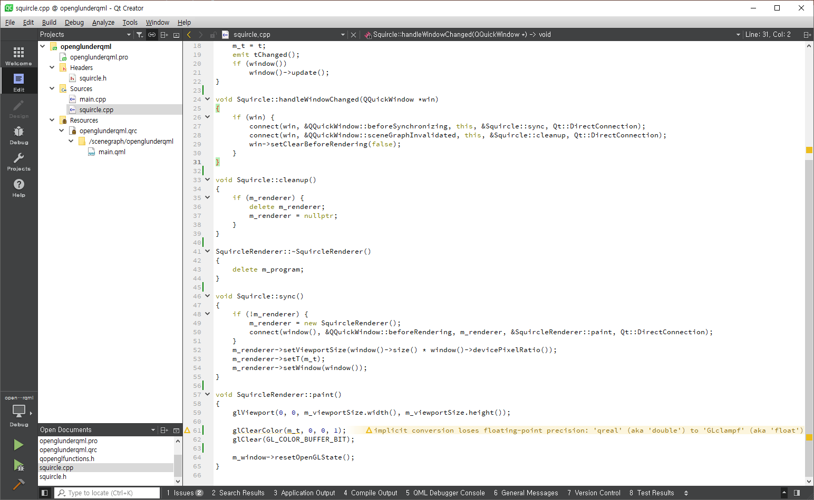

Slide 8
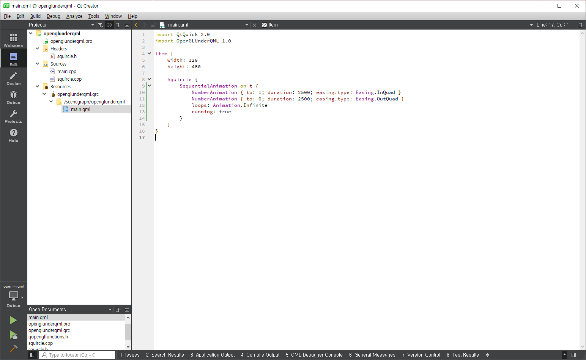

Slide 9
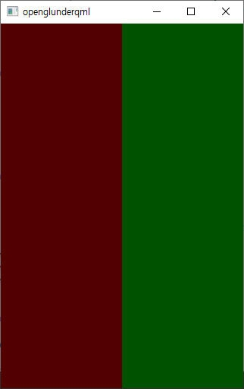
Hello 2 Viewports
목적 :
- Qt QML에서 사용하기
- 뷰 포트(Viewport)
void SquircleRenderer::paint()
{
glEnable(GL_SCISSOR_TEST);
glViewport(0, 0, m_viewportSize.width() / 2, m_viewportSize.height());
glScissor(0, 0, m_viewportSize.width() / 2, m_viewportSize.height()); glClearColor(m_t, 0, 0, 1);
glClear(GL_COLOR_BUFFER_BIT);
glViewport( m_viewportSize.width() / 2, 0, m_viewportSize.width() / 2, m_viewportSize.height());
glScissor( m_viewportSize.width() / 2, 0, m_viewportSize.width() / 2, m_viewportSize.height()); glClearColor(0, m_t, 0, 1);
glClear(GL_COLOR_BUFFER_BIT);
m_window->resetOpenGLState();
}
glScissor
glEnable

Slide 10
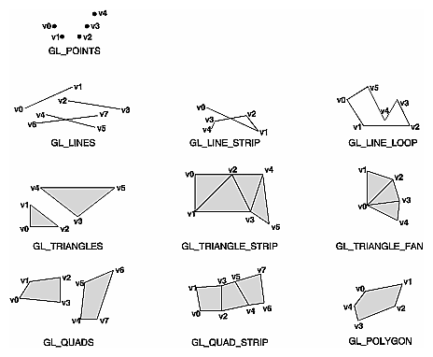
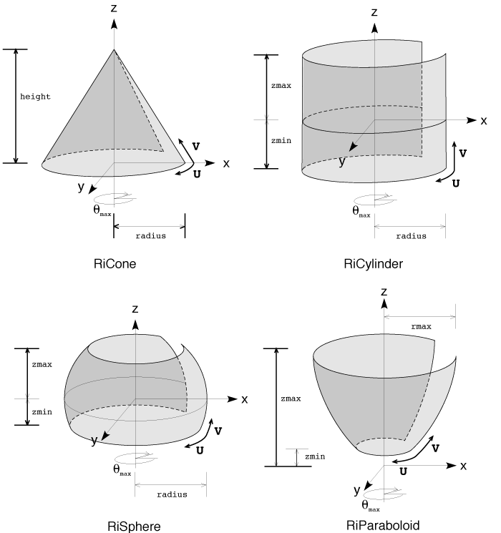
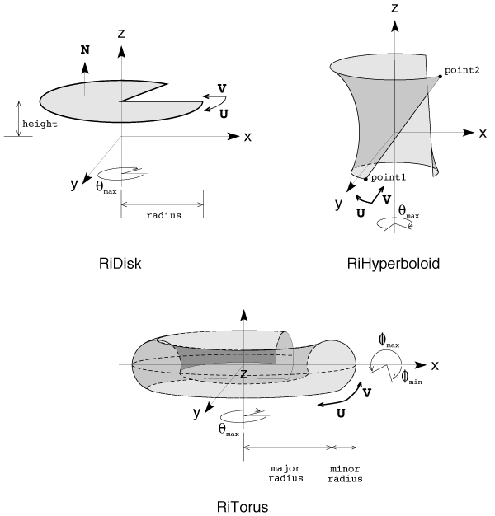
Drawing Primitives
목적 :
- Winding Rule
- Shader 소개

Slide 11
Draw call
목적 :
- glDrawArrays, glDrawElements
- GL_POINTS, GL_LINE_STRIP, GL_LINE_LOOP, GL_LINES, GL_LINE_STRIP_ADJACENCY,
GL_LINES_ADJACENCY, GL_TRIANGLE_STRIP, GL_TRIANGLE_FAN, GL_TRIANGLES,
GL_TRIANGLE_STRIP_ADJACENCY, GL_TRIANGLES_ADJACENCY and GL_PATCHES

Slide 12
Transformation(변환)
목적 :
- Winding Rule
- Shader 소개
void SquircleRenderer::paint()
{
glEnable(GL_SCISSOR_TEST);
glViewport(0, 0, m_viewportSize.width() / 2, m_viewportSize.height());
glScissor(0, 0, m_viewportSize.width() / 2, m_viewportSize.height()); glClearColor(m_t, 0, 0, 1);
glClear(GL_COLOR_BUFFER_BIT);
glViewport( m_viewportSize.width() / 2, 0, m_viewportSize.width() / 2, m_viewportSize.height());
glScissor( m_viewportSize.width() / 2, 0, m_viewportSize.width() / 2, m_viewportSize.height()); glClearColor(0, m_t, 0, 1);
glClear(GL_COLOR_BUFFER_BIT);
m_window->resetOpenGLState();
}
glScissor
glEnable

