Slide 1
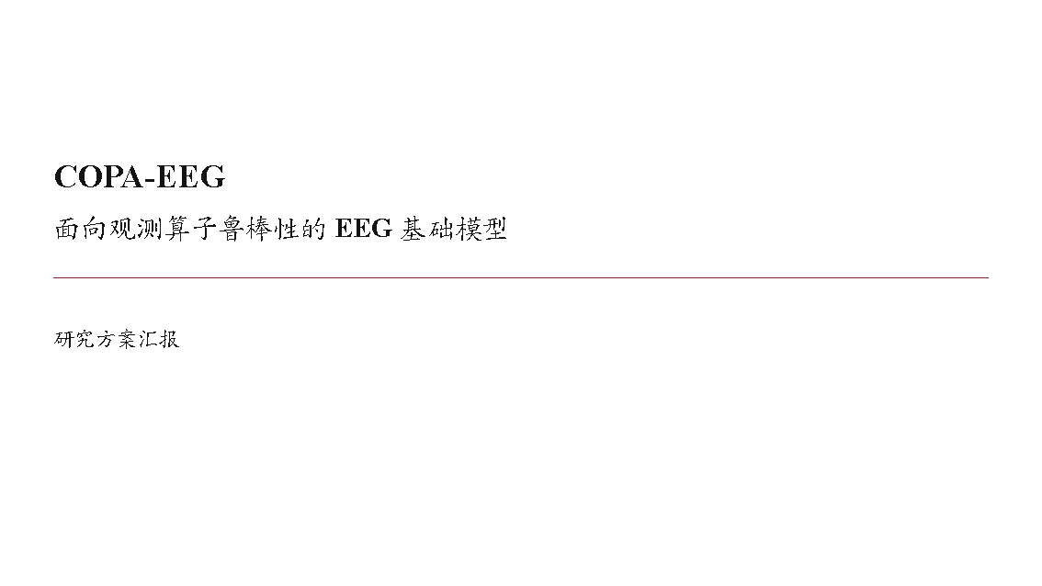
Notes:
[Sources]
- /Users/liuxiang/EEG/report/COPA-EEG_汇报概述.md
[/Sources]

Slide 2

Notes:
[Sources]
- /Users/liuxiang/EEG/report/COPA-EEG_汇报概述.md
[/Sources]

Slide 3
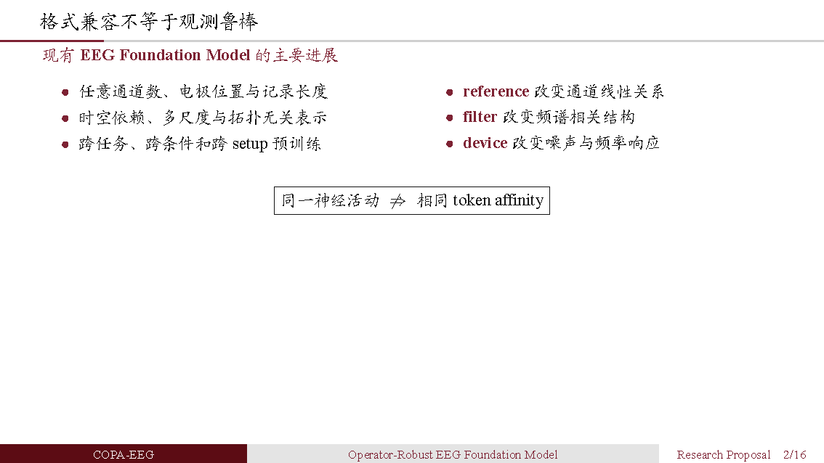
Notes:
[Sources]
- /Users/liuxiang/EEG/report/COPA-EEG_汇报概述.md
[/Sources]

Slide 4
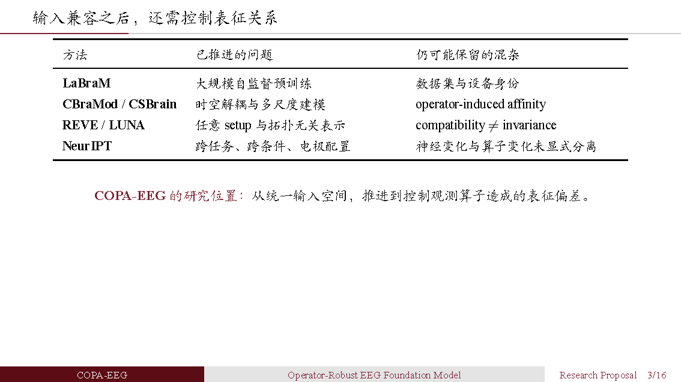
Notes:
[Sources]
- /Users/liuxiang/EEG/report/COPA-EEG_汇报概述.md
[/Sources]

Slide 5
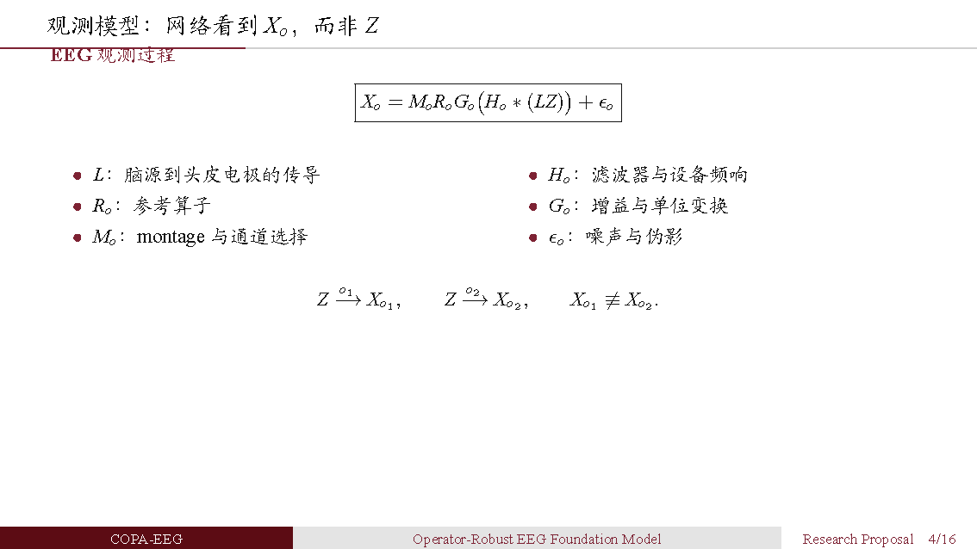
Notes:
[Sources]
- /Users/liuxiang/EEG/report/COPA-EEG_汇报概述.md
[/Sources]

Slide 6
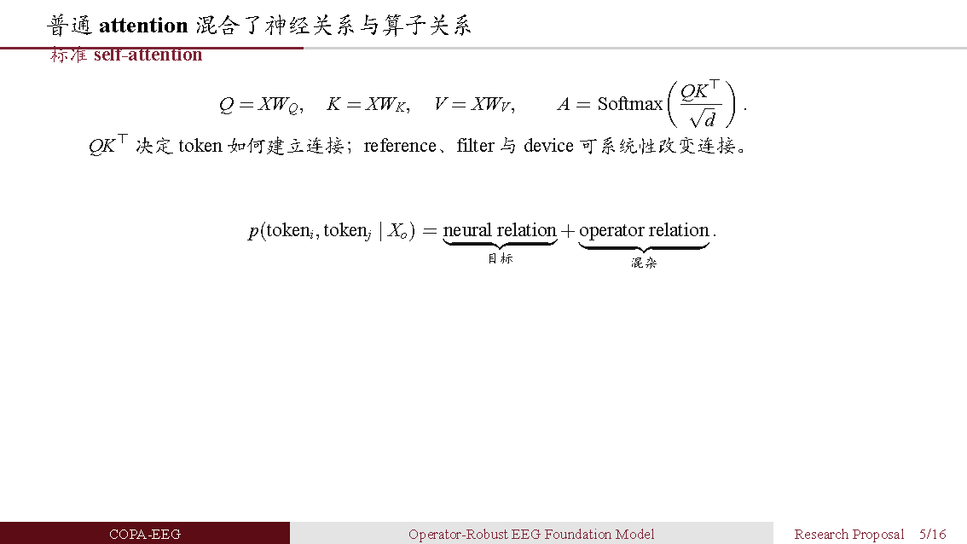
Notes:
[Sources]
- /Users/liuxiang/EEG/report/COPA-EEG_汇报概述.md
[/Sources]

Slide 7

Notes:
[Sources]
- /Users/liuxiang/EEG/report/COPA-EEG_汇报概述.md
[/Sources]

Slide 8
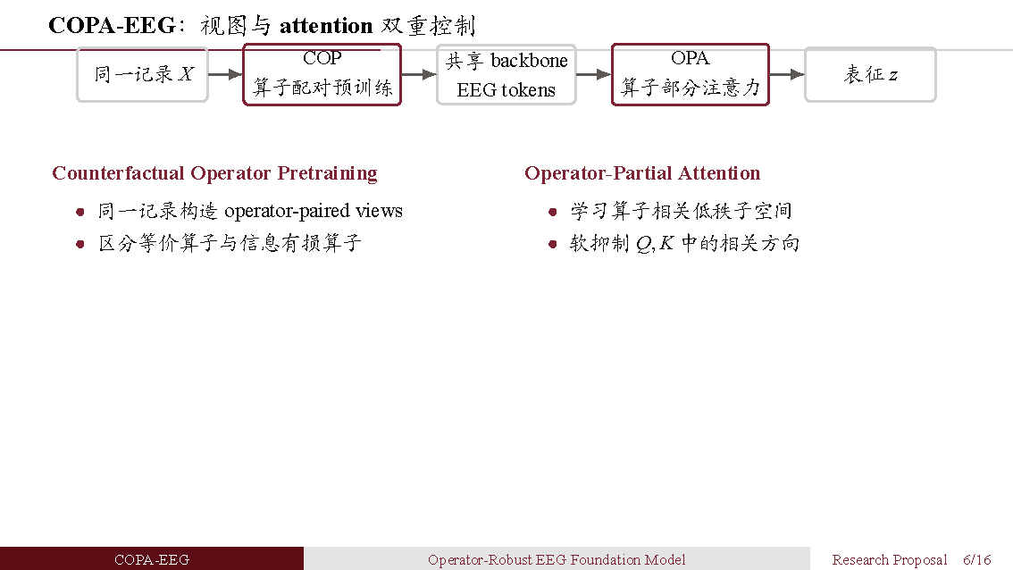
Notes:
[Sources]
- /Users/liuxiang/EEG/report/COPA-EEG_汇报概述.md
[/Sources]

Slide 9
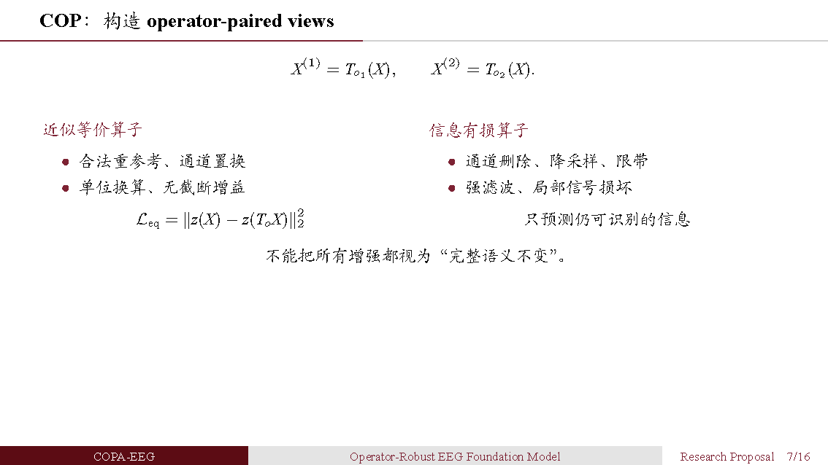
Notes:
[Sources]
- /Users/liuxiang/EEG/report/COPA-EEG_汇报概述.md
[/Sources]

Slide 10
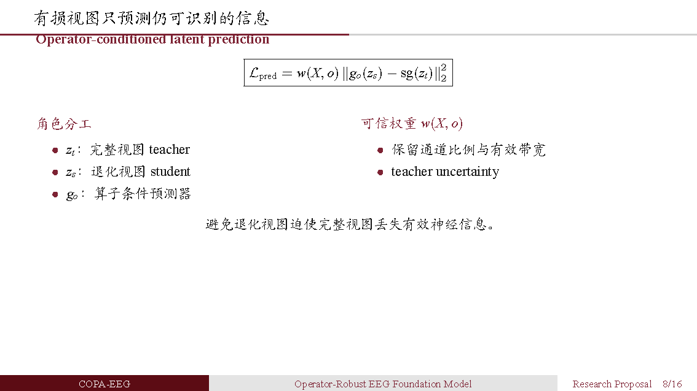
Notes:
[Sources]
- /Users/liuxiang/EEG/report/COPA-EEG_汇报概述.md
[/Sources]

Slide 11
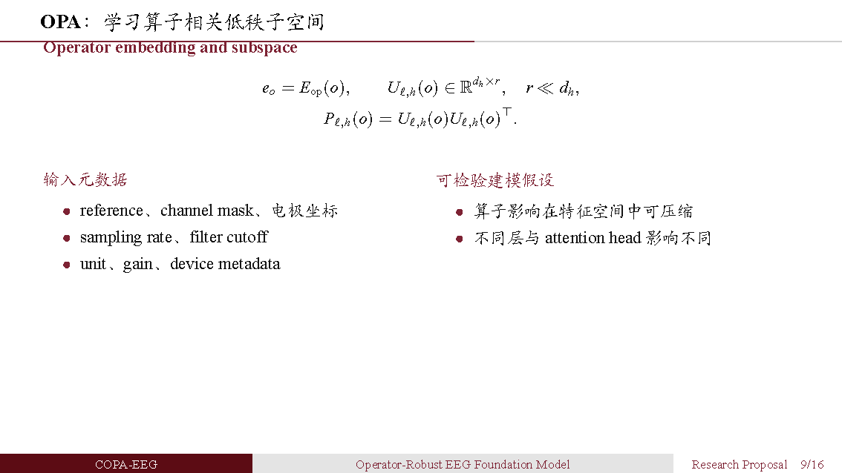
Notes:
[Sources]
- /Users/liuxiang/EEG/report/COPA-EEG_汇报概述.md
[/Sources]

Slide 12
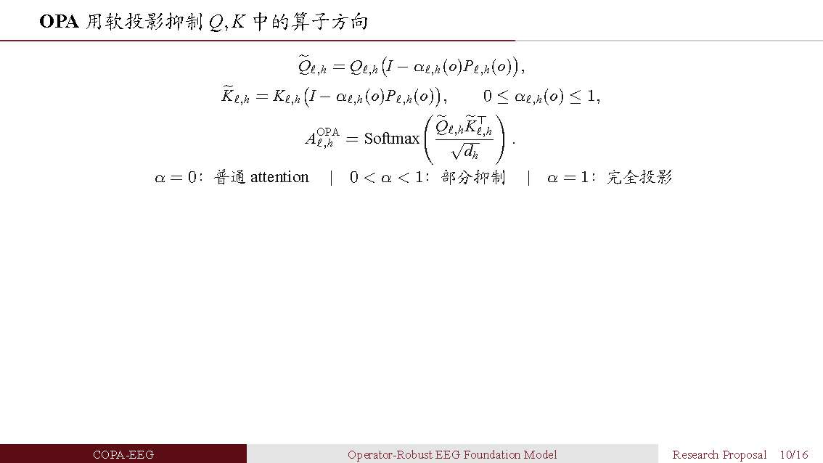
Notes:
[Sources]
- /Users/liuxiang/EEG/report/COPA-EEG_汇报概述.md
[/Sources]

Slide 13
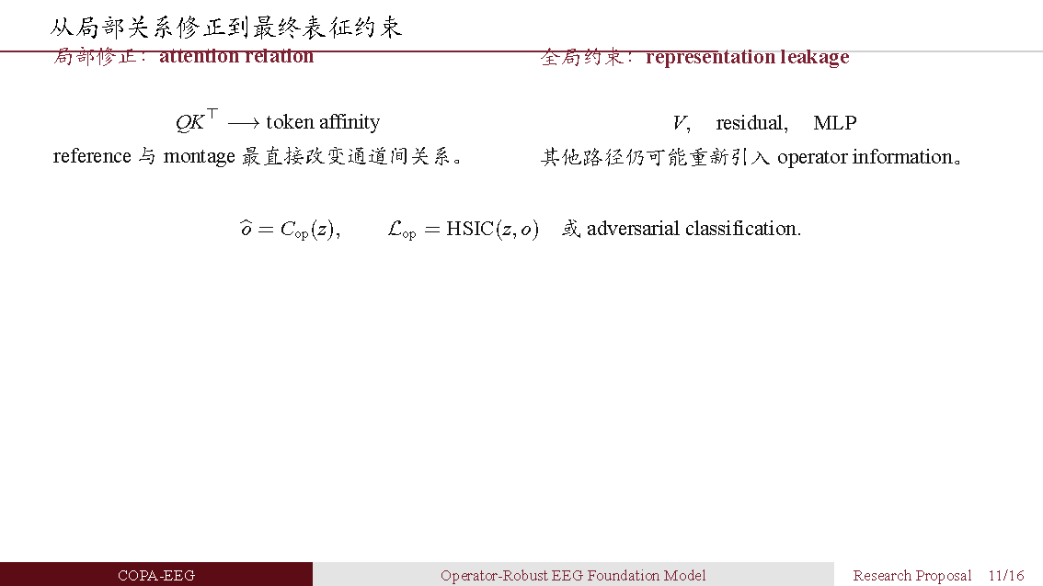
Notes:
[Sources]
- /Users/liuxiang/EEG/report/COPA-EEG_汇报概述.md
[/Sources]

Slide 14
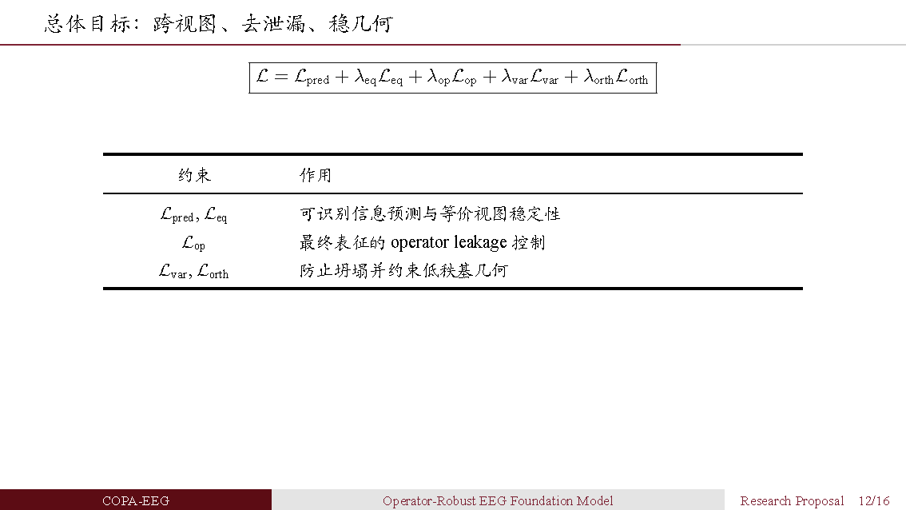
Notes:
[Sources]
- /Users/liuxiang/EEG/report/COPA-EEG_汇报概述.md
[/Sources]

Slide 15

Notes:
[Sources]
- /Users/liuxiang/EEG/report/COPA-EEG_汇报概述.md
[/Sources]

Slide 16
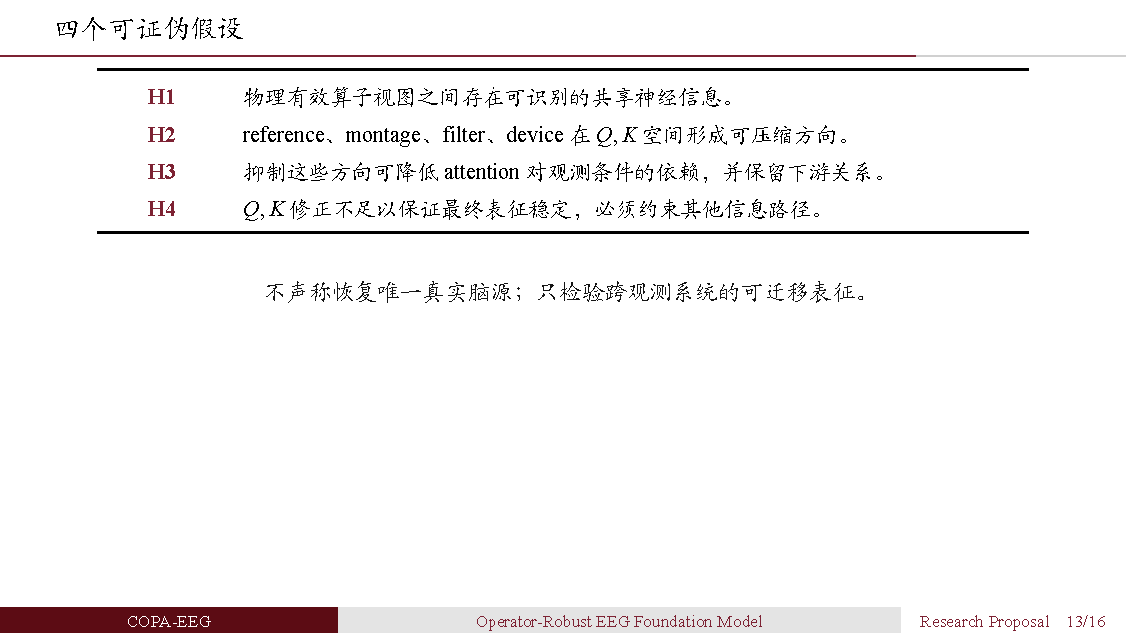
Notes:
[Sources]
- /Users/liuxiang/EEG/report/COPA-EEG_汇报概述.md
[/Sources]

Slide 17
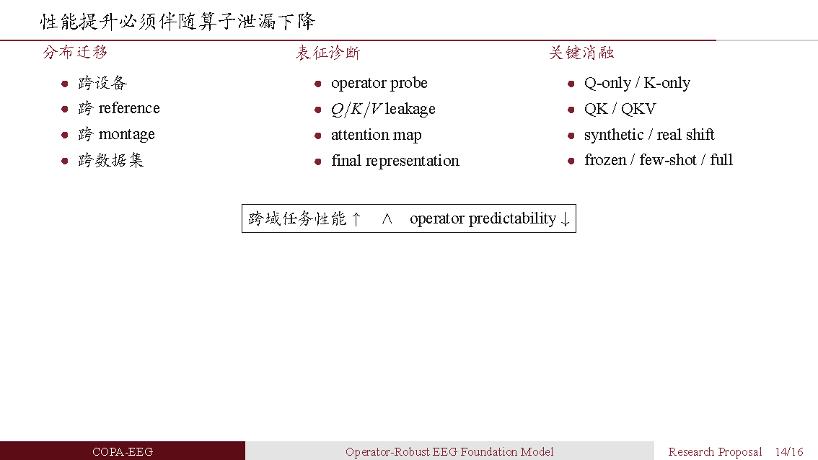
Notes:
[Sources]
- /Users/liuxiang/EEG/report/COPA-EEG_汇报概述.md
[/Sources]

Slide 18

Notes:
[Sources]
- /Users/liuxiang/EEG/report/COPA-EEG_汇报概述.md
[/Sources]

Slide 19
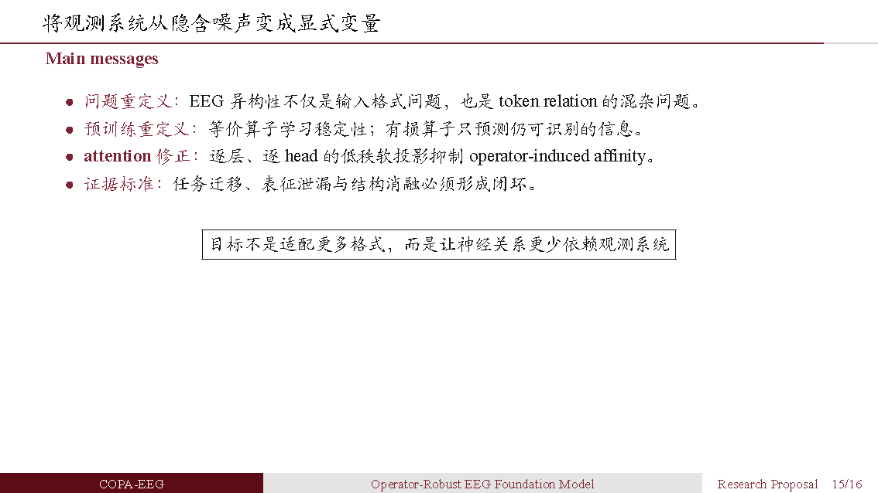
Notes:
[Sources]
- /Users/liuxiang/EEG/report/COPA-EEG_汇报概述.md
[/Sources]

Slide 20
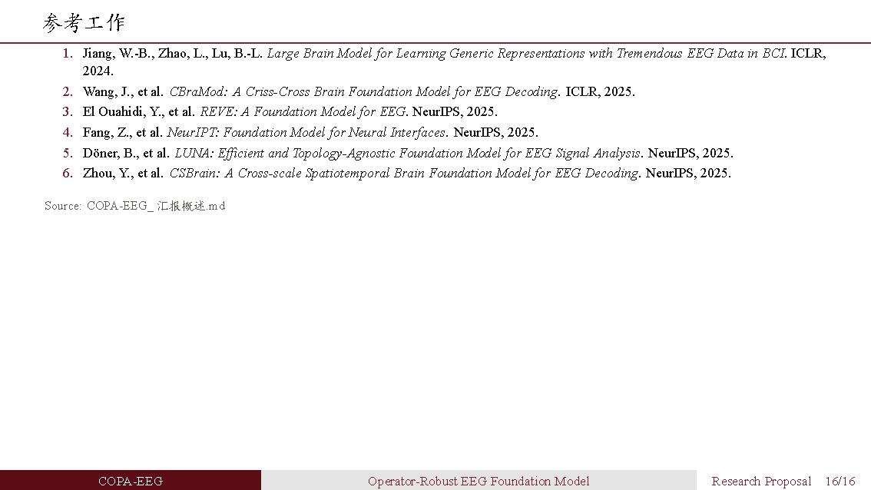
Notes:
[Sources]
- /Users/liuxiang/EEG/report/COPA-EEG_汇报概述.md
[/Sources]

