Slide 1
大数据时代的
发展战略
Introduction

Slide 2
Big
data
Spark
strategy
IOT
Data
sharing

Slide 3
物联网(Internet Of Things)

Slide 4
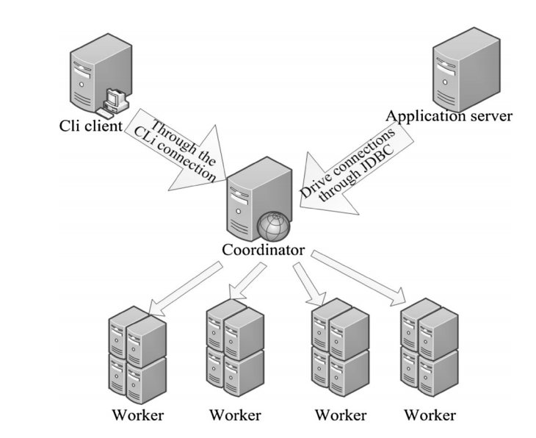
分布式系统(Distributed System)

Slide 5
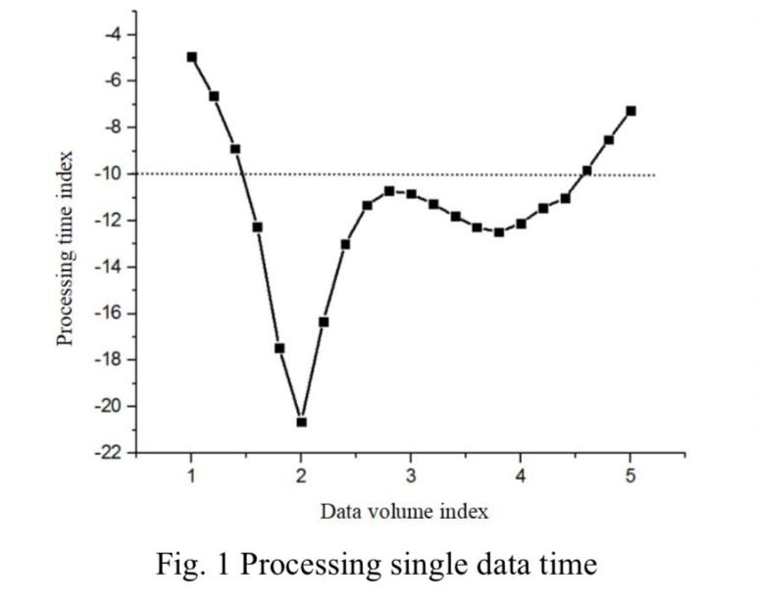
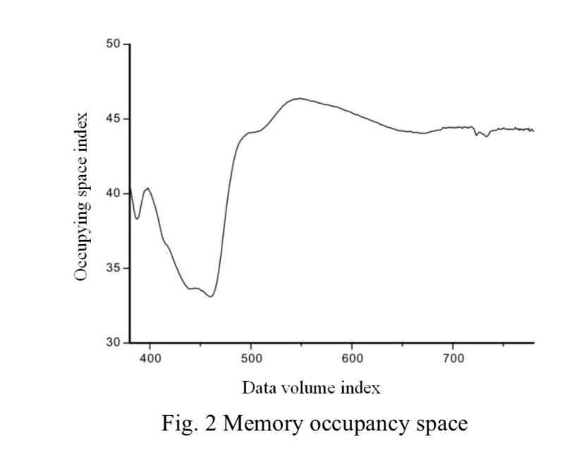
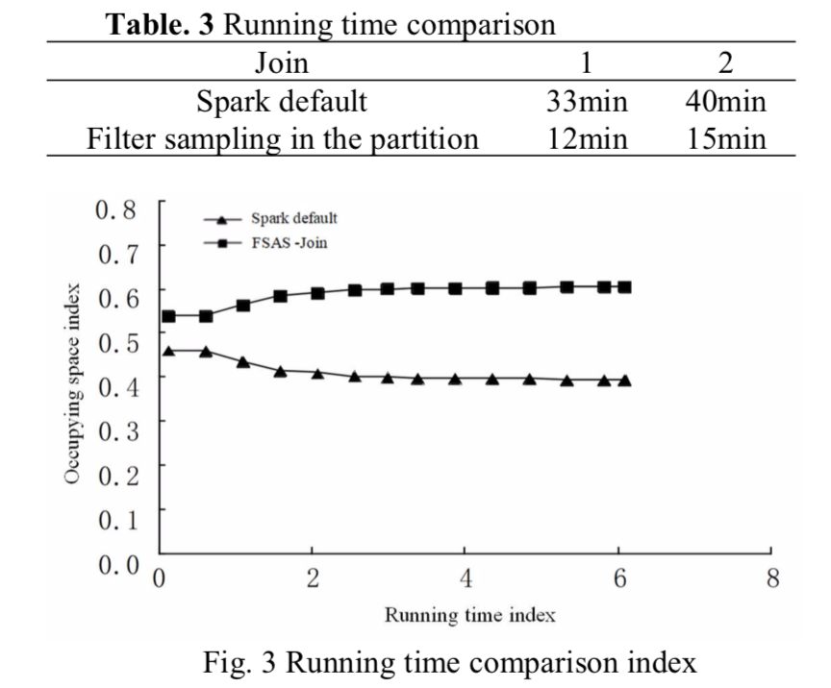
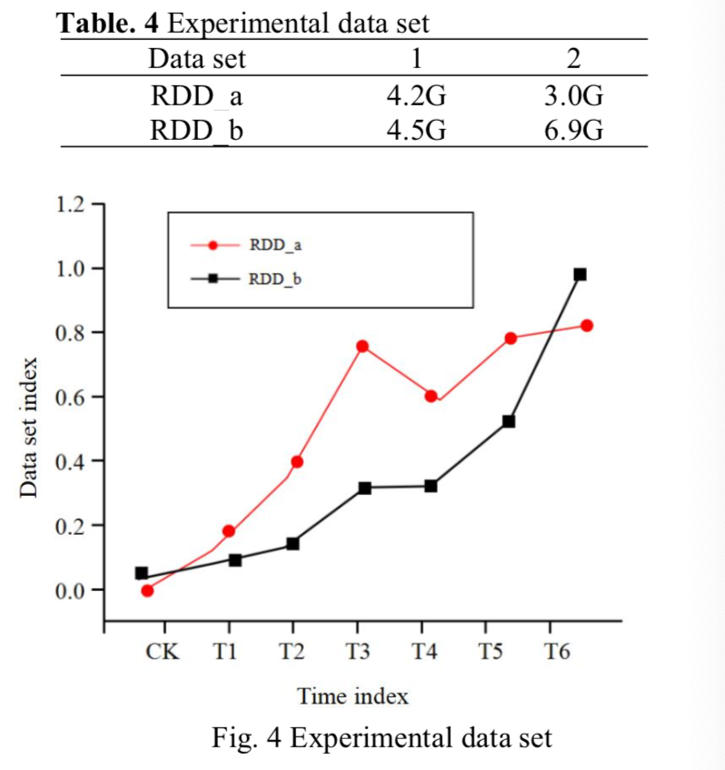
可行性分析(Feasibility analysis)

Slide 6
用户行为分析建模
Grey Data Fusion Prediction Algorithm
Other Cultural Industry
k-NearestNeighbor
Convolutional Neural Networks

Slide 7
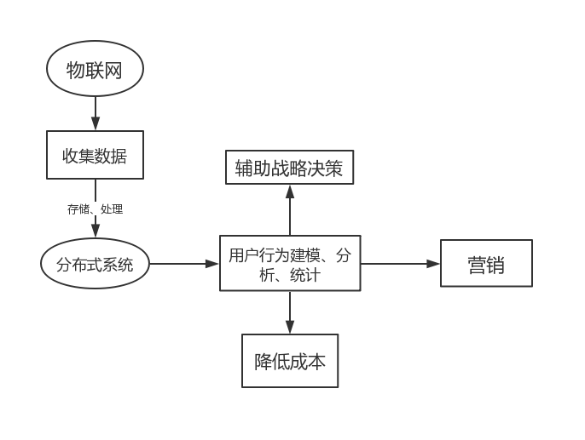
总结

Slide 8
Reference
《E-commerce big data computing platform system based on distributed computing logistics information》 Springer Science+Business Media, LLC, part of Springer Nature 2018， Junmin Hu
《Big Data Information Technology and the Development of E-commerce in Cultural Industry 》School of Economics, Northwest Minzu University, Lanzhou 730124, People’s Republic of China ，Yuxia Hu1,2 and Haiying Ma1,2(&)
《Big Data Analysis of E-commerce Bases on the Internet of Things》Hohhot Minzu College, Hohhot 010051, China Peilu-Feng

Slide 9
Thank You!

