Slide 1
Machine Learning On
Yelp Dataset
The study on recognition of suspicious Five Stars reviews
and
optimization of Yelp Elite system
Team Members: Cheng Hou, Le Xu, Xiaomeng Dong

Slide 2

Outline
Dataset Introduction
Analysis
Interesting Findings
Limits

Slide 3
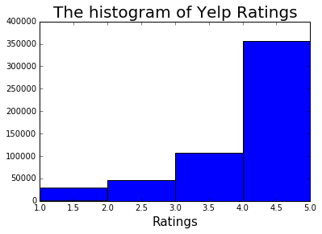
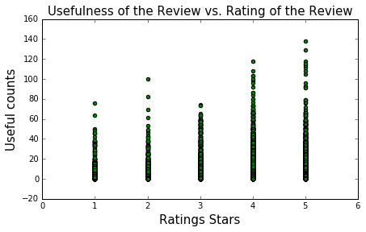
Yelp Dataset Challenge
Two Datasets We Used:
* Reviews text
* User information
Original size:
2,685,066 reviews, 686,556 users
Manageable size:
Users who made more than 50 reviews,
which leads to 538,407 reviews, and 4,751 active users.

Slide 4
Why Yelp Datasets
Network of people in urban lives
Reflection of urban information in small businesses
Containment of both numeric data and text data
Equipment of both labeled and unlabeled data.

Slide 5
Our Goal
Background:
According to Yelp, there isn't really a specific benchmark a reviewer has to meet to be considered an Elite, and each member has to be re-approved by the Council each year.
Goal:
Developing algorithm to find potential elite users based on the datasets and interpret the important features.

Slide 6
Data Processing
Collected Original data from the website
Select users who made over 50 reviews
Calculate FRE score of each text
Group all features by users
Supervised Learning Approaches

Slide 7
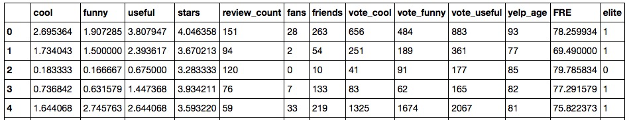
Glance to Our Cleaned Data
Ratings that users are given from others
Ratings that users give to others
The months of accounts being used
Whether the user is elite or not

Slide 8
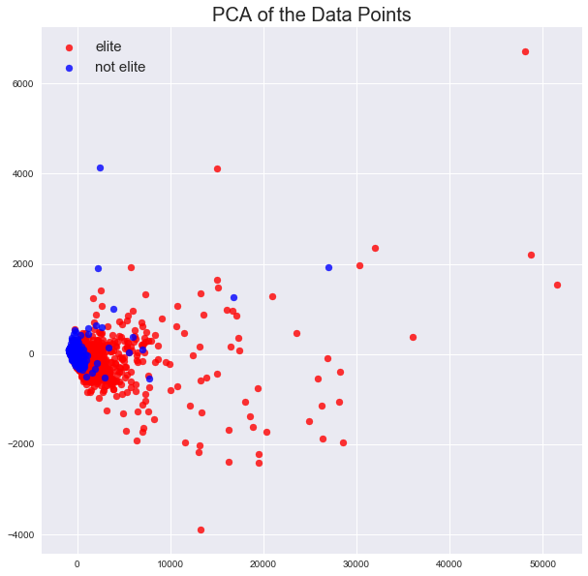
Notes:
Really good job guys!!!

Slide 9
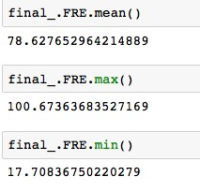
Text Data Analysis
Flesch Reading Ease statistics (FRE)
is a measurement of linguistic complexity. It is a function of total sentences, total words and total syllables of the text.
From Scale 0 to 100+
The higher the rating, the easier the text is to understand, but the less detail listed in the text.

Slide 10
Review Examples:
FRE SCORE = 23.5
“ Citing a mix of Mediterranean and Northern African influences with a bargain Piccola Gusto Menu ... the option for indoor or al fresco dining it seemed as if Casbah was a can’'t miss option…things don’'t turn out quite as you expect - almost everything that transpired from the moment we arrived until the moment we left was a failure. When our server who would prove quite inept and inefficient from start to finish, finally did arrive our menus were delivered with a brief hello before she wandered away - another server later stopped by to fill our water and drinks were never even offered...”
FRE SCORE = 97
“a must in vegas.. 24 hr pho.. cant beat that”

Slide 11
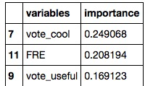
Our Models
Top
3 important features
 | SVM (Linear) | SVM (Poly) | SVM (RBF) | Decision tree | Decision tree with top 3 important features | Random Forest
OS ACC | 79.94% | 82.89% | 78.61% | 77.14%
ROC AUC |  |  |  | 71.88% | 77% | 79%

Slide 12
Our Findings
We developed several models with highest 83% OS accuracy (SVM w. Poly Kernel), which can be used to predict if a reviewer is qualified to be considered as an Elite member.
We conducted anomaly detection using Gaussian Mixture and Isolation Forest Methods. We trained models with the elite subgroup and tested models on general group. We were able to find out 6 identical users appeared on the top 10 abnormal users for both models.

Slide 13
Limits and Future Study
Data is such big that it is computationally expensive to perform machine learning algorithms. We have to focus on small subsets.
Even Elite members can provide fraudery reviews which could affect our model.
Using document term matrix as features would give us more information about the texts but it requires more computation resource.

