Slide 1
the impact of earning report on stock price --Financial Computing
Zhijie Gao
Xiao Li
Ran Xu
Xiaoran Hao

Slide 2
Content
How we design the project
How we launch the project
- Select the stock and data collection
- Process the data
- Calculation
- Mulithreading
Conclusion
Reference

Slide 3
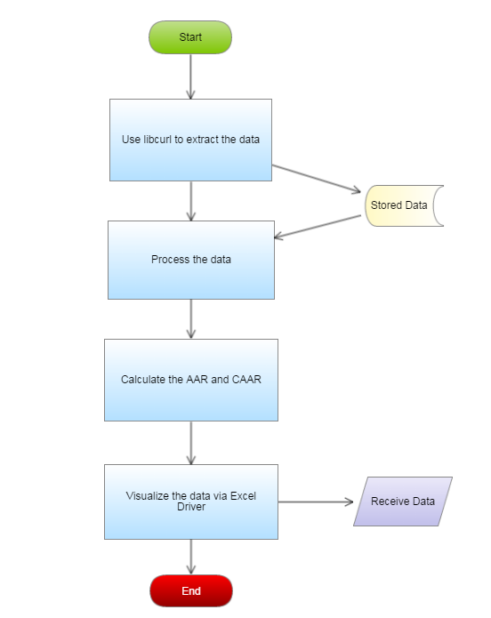
How to design the program
For every group:
Data retrieval
Data Processing
Calculation
Visualize the data

Slide 4
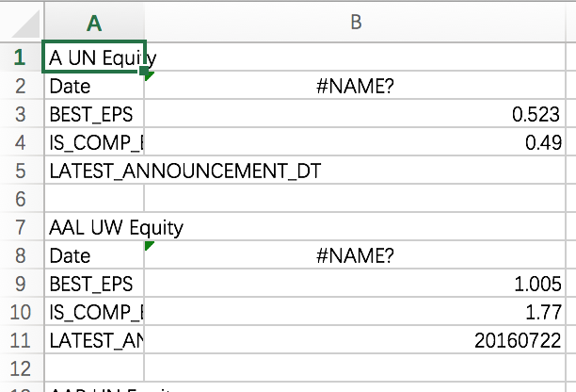
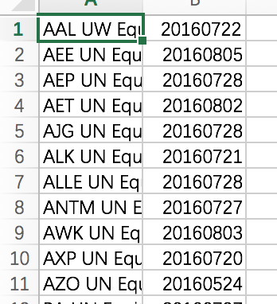
Select Stocks
Use Bloomberg plug-in in Excel
Select securities
S&P 500
Select lists
BEST_EPS
IS_COMP_EPS_ADJ
LATEST_ANNOUNCEMENT DATE
Select time period and interval
Second quarter
Use Excel to select our stocks.
use IF function and reorder.

Slide 5
Get the name of stocks
We read the csv file line by line to get the name and the releasing date. In the Readstock function, we input the group name and stacks by refrence to store the releasing date, the date of two month ago and the date of two month later;
In addition, we return a vector to store the name of each stock,so that we can put them into ‘pool’ and read them then to download stock information.

Slide 6
Save Data into Memory
Use struct to store the data
struct MemoryStruct {
char *memory;
size_t size;
}
struct MemoryStruct chunk;
Use libcurl to save data into memory
curl_easy_setopt(curl, CURLOPT_WRITEFUNCTION, WriteMemoryCallback)
//send all data to this function
curl_easy_setopt(curl, CURLOPT_WRITEDATA, (void*)&chunk);
//pass ‘chunk’ struct to the callback function
//all data are stored in chunk.memory

Slide 7
Data Process
All the data are stored in chunk.memory, so we
need to split it and save the useful parts into
stack.
Main thought:
Record one row’s end position by str.find (“\n ”,startposition)
Use the end position to find where is the first/last comma
Cut out the string and put it into a stack
Make start position equals end position
……
Until start position equals the length of data
In this process, We need to mark the step N when we put the announcement date into stack.

Slide 8
stack<string> split2(string str, string dateby)
{
string pattern = "\n";
string pattern2 = ",";
string::size_type pos;
string::size_type pos1;
string::size_type pos2;
stack<std::string> Date;
int size = str.size();
int n = 0;
for (int i = 0; i<size; i++)
{
n++;
pos = str.find(pattern, i);
if (pos<size)
{
pos1 = str.find(pattern2, i);
string s = str.substr(i, pos1 - i);
Date.push(s);
if (!strcmp(s.c_str(), (dateby.substr(0, 4) + s.substr(4, 1) + dateby.substr(4, 2) + s.substr(4, 1) + dateby.substr(6, 2)).c_str()))
{
find_date = n;
}
i = pos + pattern.size() - 1;
}
}
find_date = find_date -1;
return Date;
};

Slide 9
For Data collection
We delete the days that 30 days after the releasing date(because they are on the top), and then choose 61 days before that day. At the same time, we invert the stack of price.
stack<double> Price2;
int temp = Price.size();
for (int k = temp; k > find_date + 30; k--)
Price.pop();
for (int k = 0; k <61; k++)
{
Price2.push(Price.top());
Price.pop();
}

Slide 10
Data Process
String split and concatenation, eg: 20160801
should be split into different parts such as the month is August, the year is 2016.
Data ReadUrl(string s, string bm, string bd, string by, string am, string ad, string ay, string dateby)
{
int tempb = atoi(bm.c_str());
strstream ss1;
string bmm;
ss1 << tempb - 1;
ss1 >> bmm;
string s1 = "http://ichart.yahoo.com/table.csv?s=";
string s2;
size_t iPos = s.find(" ");
s2 = s.substr(0, iPos);
string s3 = "&a=";
string s4 = bmm;
string s5 = "&b=";
string s6 = bdd;
string s7 = "&c=";
string s8 = by;
string s9 = "&d=";
string s10 = amm;
string s11 = "&e=";
string s12 = add;
string s13 = "&f=";
string s14 = ay;
string s15 = "&g=d&ignore=.csv";
s1 = s1 + s2 + s3 + s4 + s5 + s6 + s7 + s8 + s9 + s10 + s11 + s12 + s13 + s14 + s15;
char *p = const_cast<char*>(s1.c_str());
bmm = "0" + bmm;
int tempa = atoi(am.c_str());
strstream ss2;
string amm;
ss2 << tempa - 1;
ss2 >> amm;
amm = "0" + amm;
int tempbd = atoi(bd.c_str());
string bdd;
strstream ss3;
ss3 << tempbd + 0;
ss3 >> bdd;
int tempad = atoi(ad.c_str());
strstream ss5;
string add;
ss5 << tempad + 0;
ss5 >> add;

Slide 11
Operator Overloading
We overloading the “minus”, to do the minus calculation of the Rit, the data member of data class, in order to simplify the calculation.
Vector_new operator-(const Data& V)
{
Vector_new W;
for (unsigned int i = 0; i < this->Rit.size(); i++)
W.push_back(this->Rit[i] - V.Rit[i]);
//cout << W.size()<<endl;
return W;
}

Slide 12
Calculation
Function AARt_Calculate :
Input: Matrix of Stock Price;
Nested Loop on time and stocks;
Calculate running average for stocks;
Function CAARt_Calculate:
Input: AAR_t;
Cumulative Sum for AAR_t;

Slide 13
Vector_new AARt_Calculate(Matrix_new M)
{
Vector_new V(M[0].size());
double *ave=new double;
for (int t = 0; t < M[0].size(); t++)
{
*ave = 0;
for (int i = 0; i < M.size(); i++)
*ave = *ave*i / (i + 1) + M[i][t] / (i + 1);
V[t]=*ave;
}
delete ave;
return V;
}
Vector_new CAARt_Calculate(Vector_new V)
{
Vector_new C(V.size());
C[0] = V[0];
for (int i = 1; i < V.size(); i++)
C[i]=C[i-1]+V[i];
return C;
}

Slide 14
Visualize the Data
Use Function Vector_newtoV to convert Vector into
specific type used in Excel Driver function
Put the result into a list
Define printInExcel_new to get graph in excel, call Function printInExcel

Slide 15
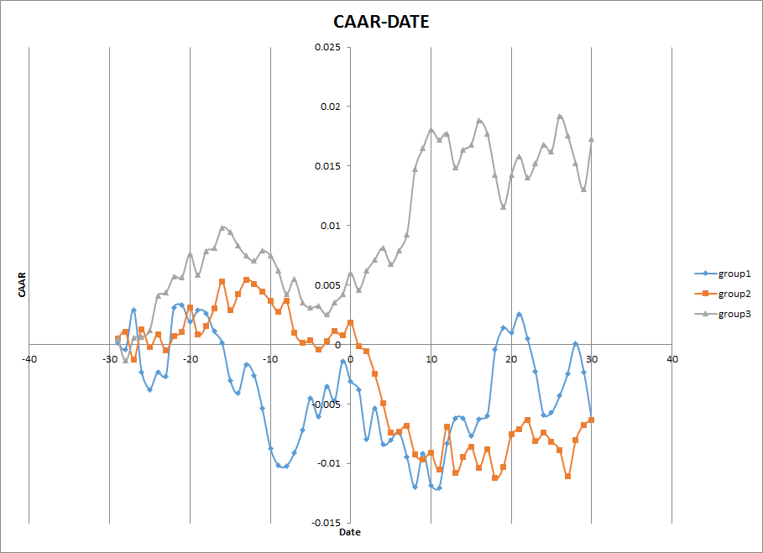

Slide 16
Conclusion
For the “miss” group, the CAAR decreases after the stock launches the earning report.
For the “meet” group, the CAAR increases after the stock launches the earning report.
For the “beat” group, the CAAR doesn’t change too much after the stock launches the earning report.

Slide 17
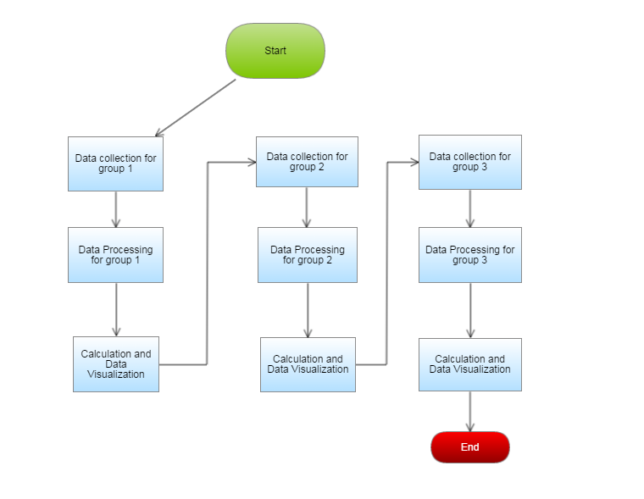
Enhancement: Multithreading
The whole process:

Slide 18
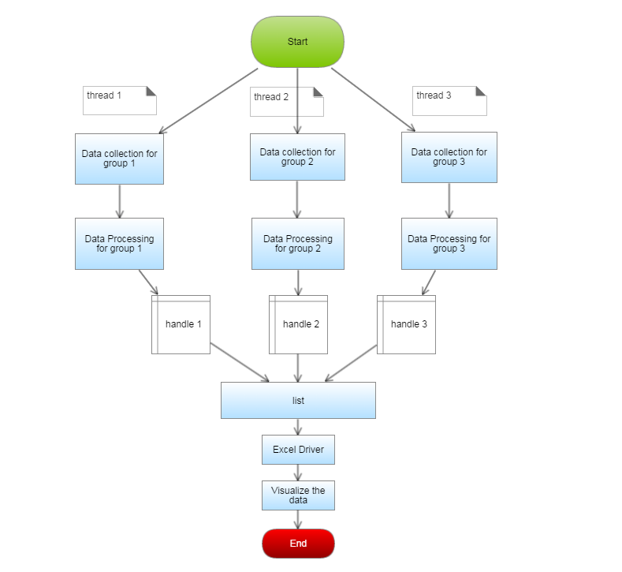
Contd
The data flow
after using
Multithreading
One handle for
one whole process
from data collection
to calculation

Slide 19
Contd
Then join the
handles to one
list
Visualize the
data via Excel
Driver
Advantage: largely
decrease the running
time

Slide 20
Group
Zhijie Gao: Co-work on program design; Process the data; Debug the codes; Apply Multithreading
Xiao Li: Co-work on program design; Process the data; Calculate AAR and CAAR; Debug the codes
Ran Xu: Data collection; Calculate AAR and CAAR; Debug the codes; Visualize the data
Xiaoran Hao: Data collection; Process the data; Debug the codes

Slide 21
Reference
C++ Primer
www.cplusplus.com
Stackflow.com

Slide 22
Thank you

