Slide 1
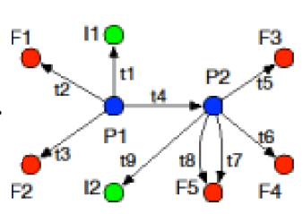

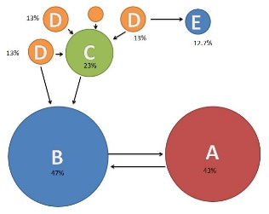




Audit
Build Dependency Graph and Backtracking from POI event
CPR
Graphsplit
PageRank

