Slide 1
Automatic Inference of Application Reputation

Slide 2
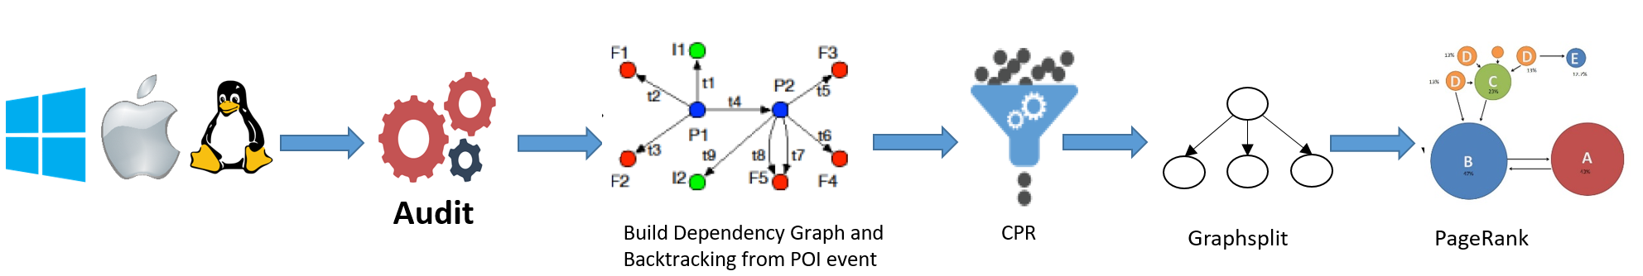
Work Flow

Slide 3
The source of raw data
The kernel auditing tool： Sysdig
The monitored kernel acivities ： clone and execve (process relevent)
read and write (file read/ write)
Send and receive(network communication)

Slide 4
The sysdig command
sudo sysdig -p"%evt.num %evt.rawtime.s.%evt.rawtime.ns %evt.cpu %proc.name (%proc.pid) %evt.dir %evt.type cwd=%proc.cwd %evt.args latency=%evt.latency" evt.type=clone or evt.type=execve or evt.type=read or evt.type=write or evt.type=writev or evt.type=sendto and fd.type!=pipe > fileName.txt

Slide 5
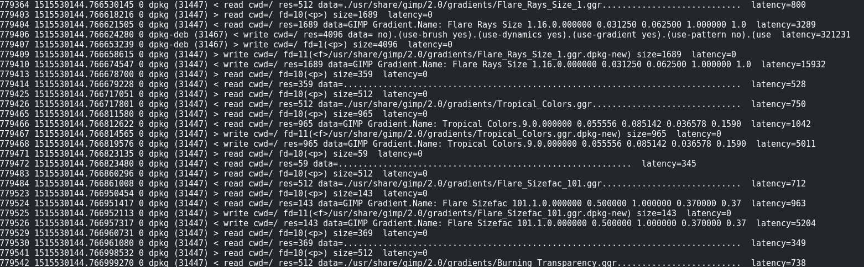
The data format

Slide 6
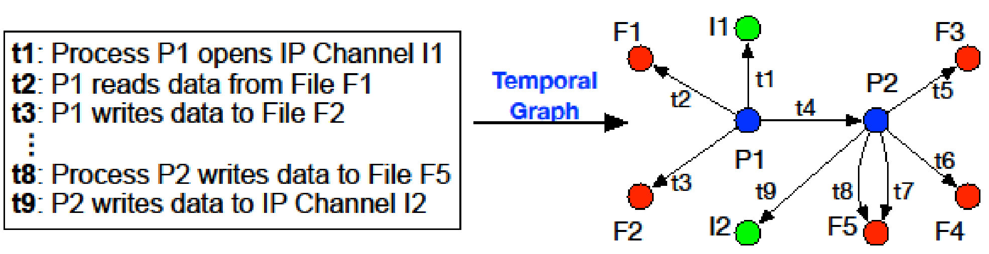
System Monitoring Data
System activities -> Event
Subject, operation, object, e.g., Proc p1 Read File f1
Annotated with time window
System entities
E.g., processes, files, network connections
A global view of system activies
－A huge temporal graph

Slide 7
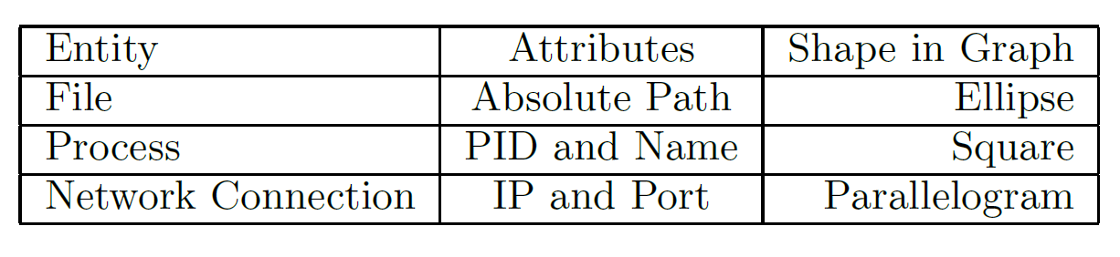
Representation Of System Entities

Slide 8
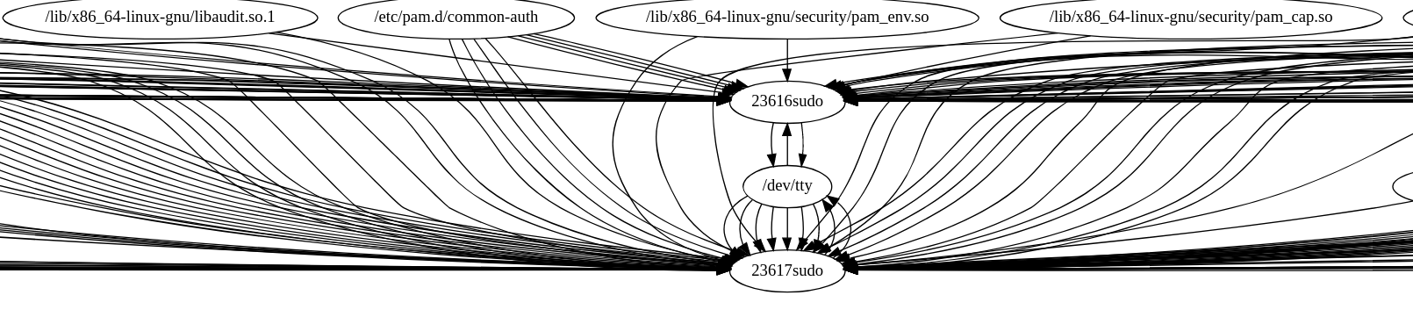
The raw dependency graph based on the log file

Slide 9
Simple introduction of backtracking: algorithm
Find your interesting event
Iterate this graph get all the entities having effect on your chossed event

Slide 10
How to decide whether a vertex has effect on the chooed event or not
Whether there is an edge between these two vertices. If there is an edge, that mean one operation happened between these two vertices.
The relationship should be time logically correct.

Slide 11
Challenges
This graph is too large for the security analysts.

Slide 12
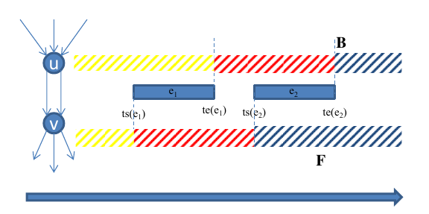
Solution: Graph Reduction
1 Causality Preserved Reduction
Notes:
The time

Slide 13
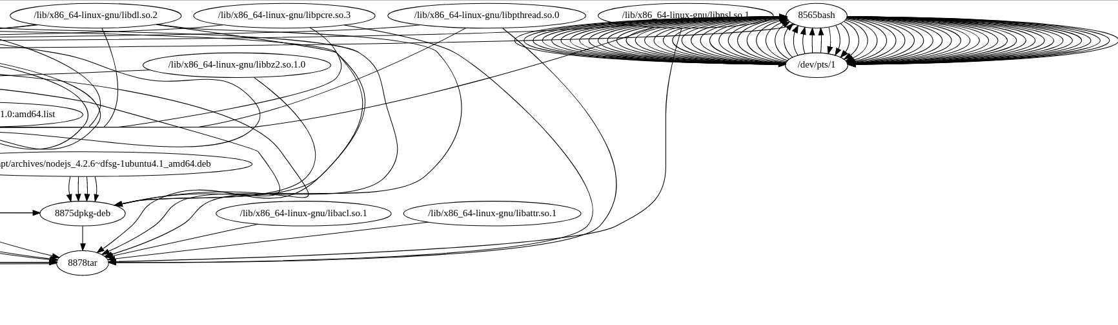
Example reduction before and after

Slide 14
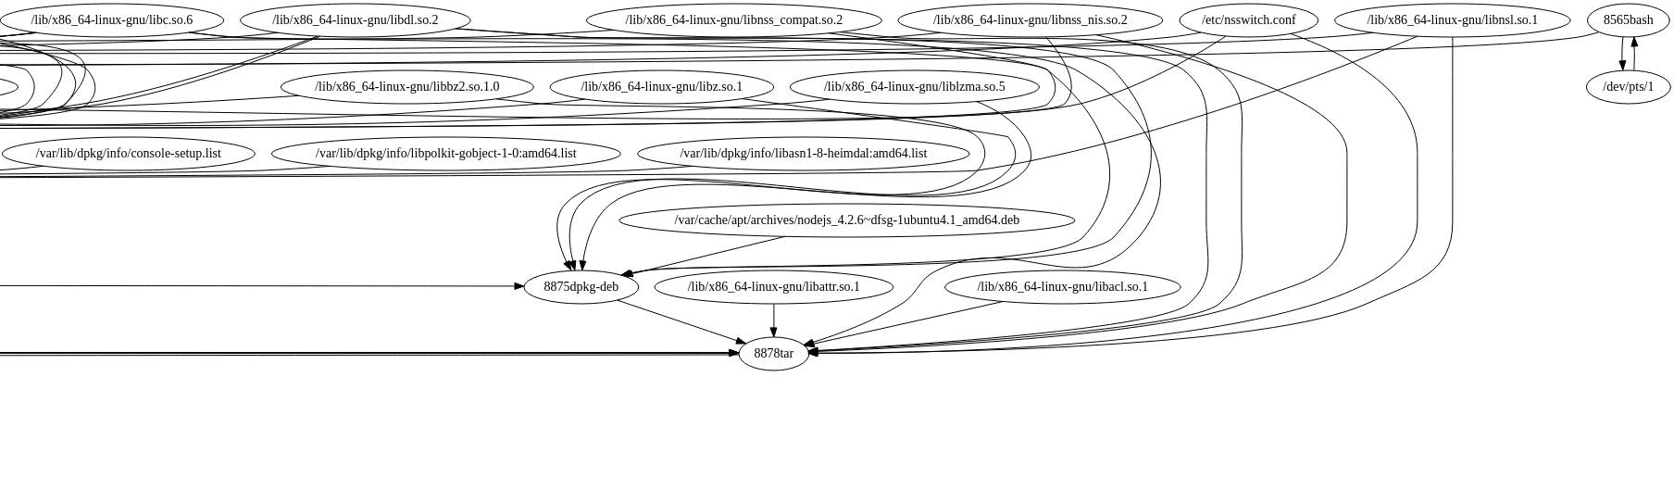
The graph after reduction

Slide 15
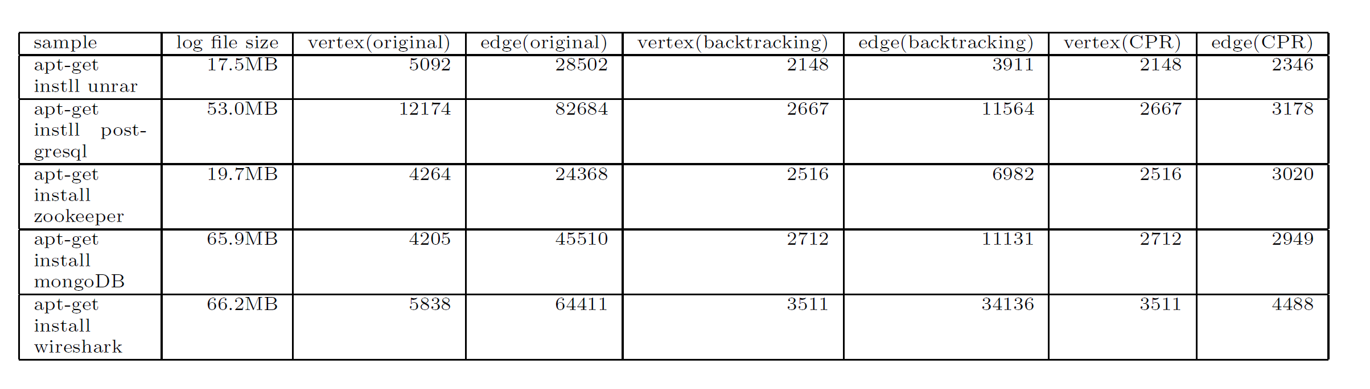
Preliminary Result

Slide 16
Background of page rank
The page rank has been widely used for improving the search quality. PageRank considers the World Wide Web as a set of linked nodes and ranks them based on their importance. The insight of PageRank is that a node is linked by the other import nodes should be more important than the ones linked by uninfluential nodes.

Slide 17
Background of binary reputation
Software applications installed through official channels are more likely to be benign
Software applications installed through unknown channels are more likely to be malicious
Reputation
Backtracking can be leveraged to generate dependency graph
Propagate the reputation through the graph
Problem: many paths lead to the same source
Some are related
Some are irrelevant

Slide 18
The preprocessing for the Page Rank
Graph Split
A’
A’’
A’’’
A
B
B

Slide 19
Why we need preprocessing?
It is impossible for program to infer the reputation of each operation.(The PageRank algorithm doesn’t allow the pair of vertex having multiple edges)

Slide 20
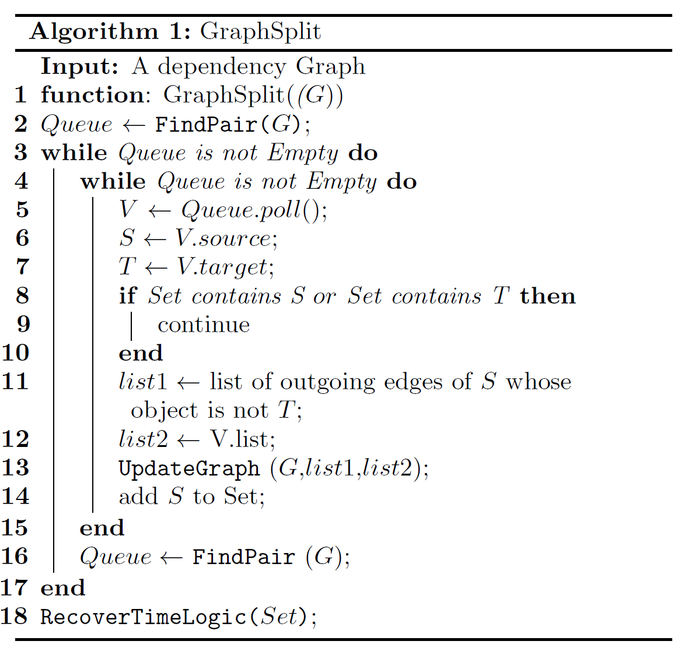
Pseudo Code Of GraphSplit
Algorithm1： GraphSplit

Slide 21
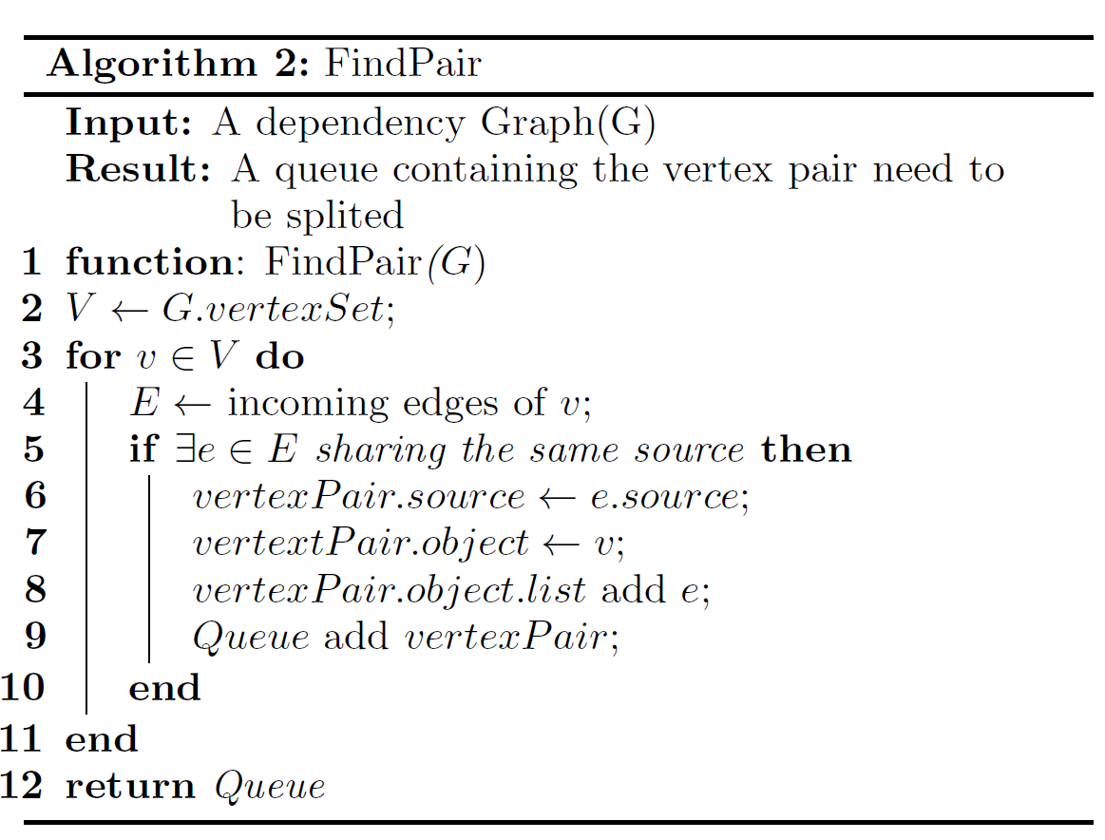
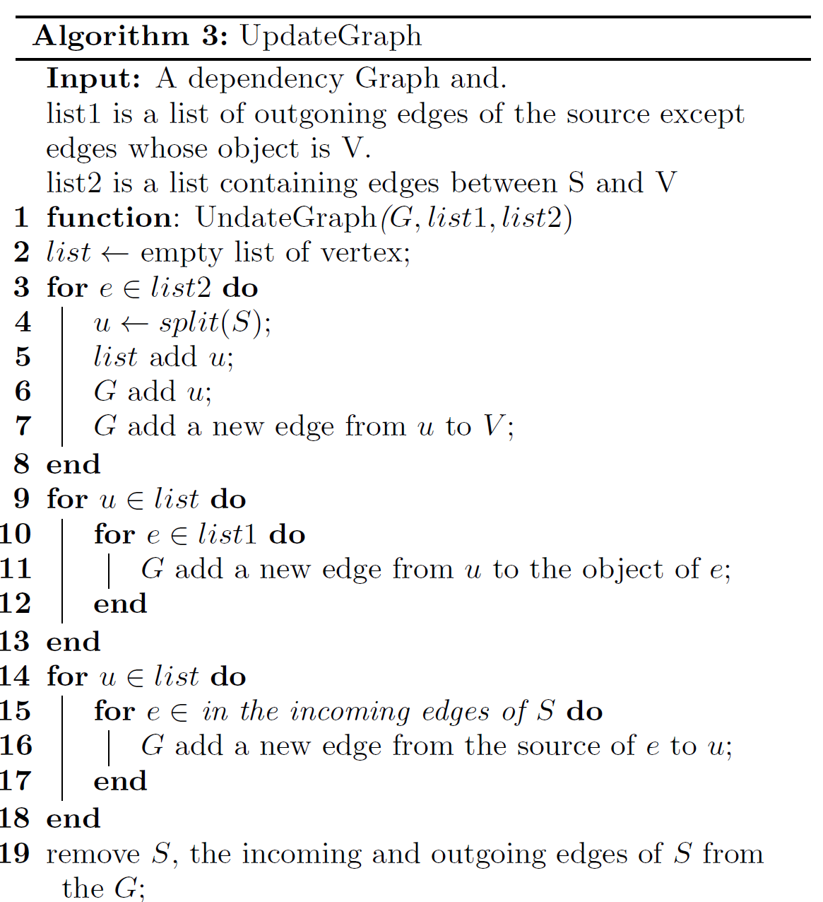
Relevant Functions

Slide 22
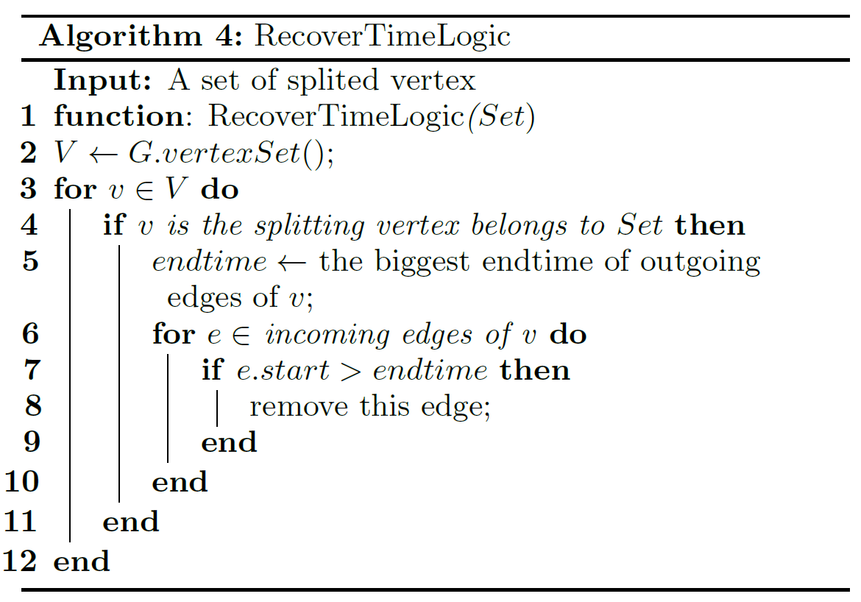
Pseudo code of RecoverTimeLogic

Slide 23
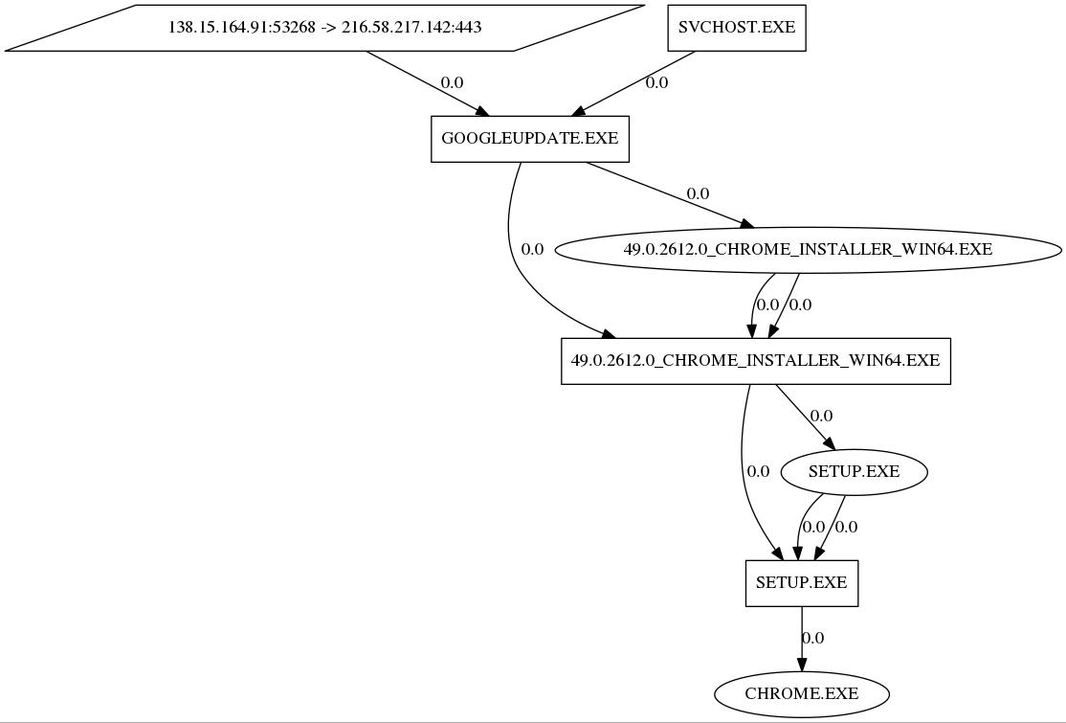
Sample Of GraphSplit

Slide 24
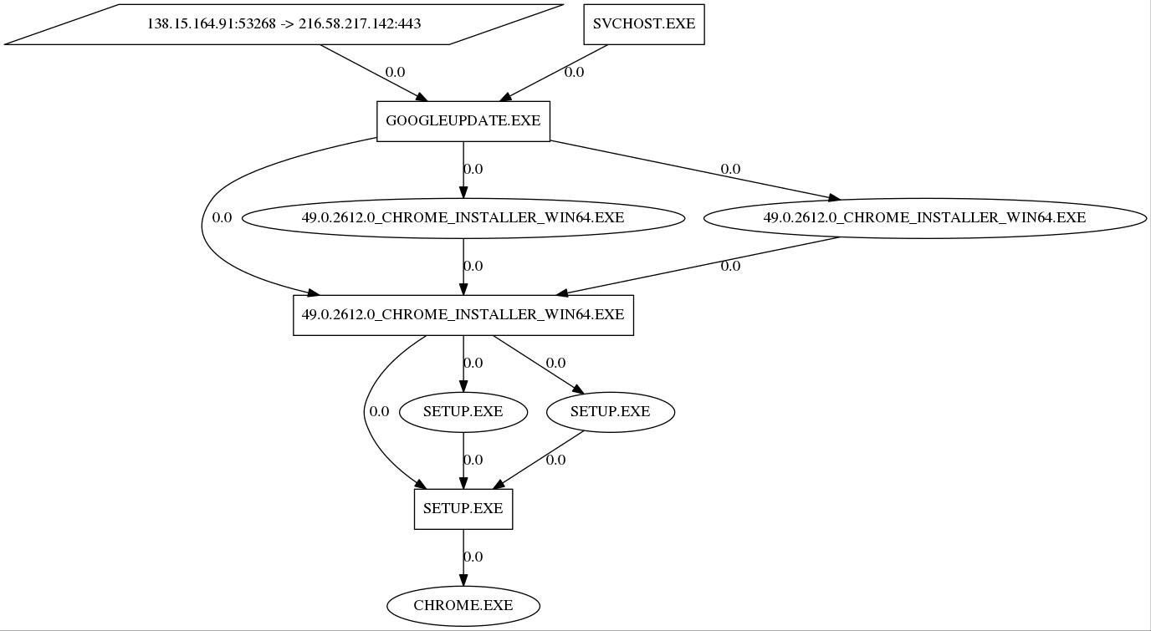
Result Of GraphSplit

Slide 25
The goal of graph reduction
Goal: Each vertex only has one incoming from the specific source.

Slide 26
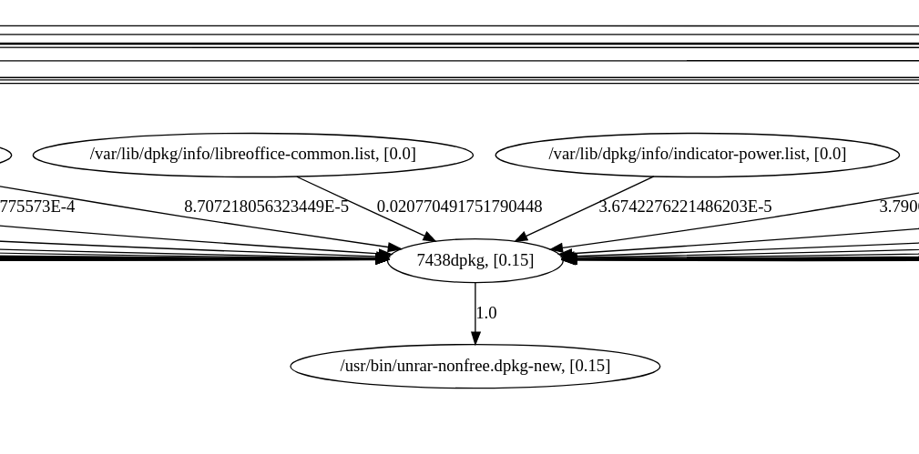
One example of weight and reputation calculation

