Slide 1
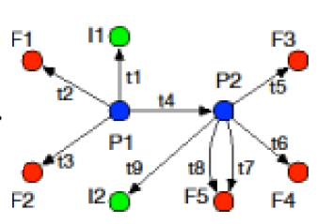

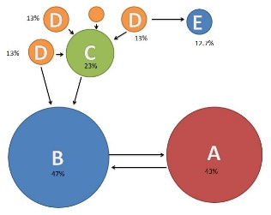




Audit
Build Dependency Graph
Backtracking
CPR
Graphsplit
PageRank

