Slide 1
Visualisierung Medizinischer Daten Direct Volume Renderer
David Pfahler and Andreas Gogel
Institute of Computer Graphics and Algorithms
Vienna University of Technology

Slide 2
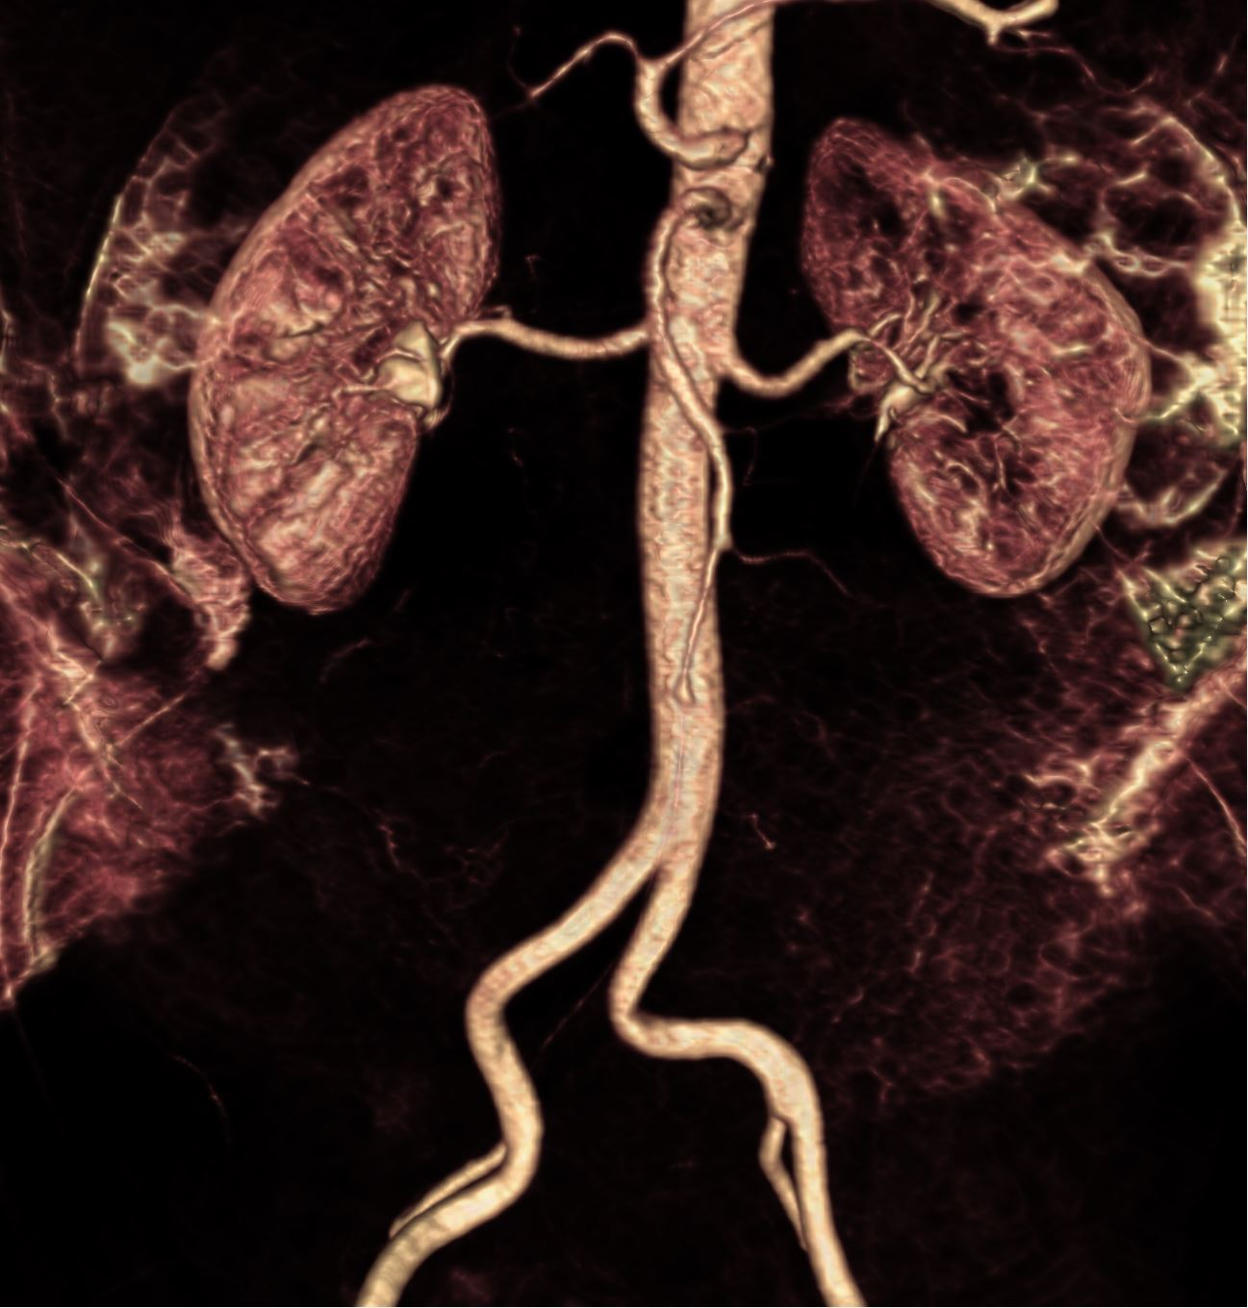
Outline
Transfer Function
Qt Widget
Filter
Gaussian
Bilateral
Median
Gradient
Direct Volume Rendering
VTK
OpenGL

Slide 3
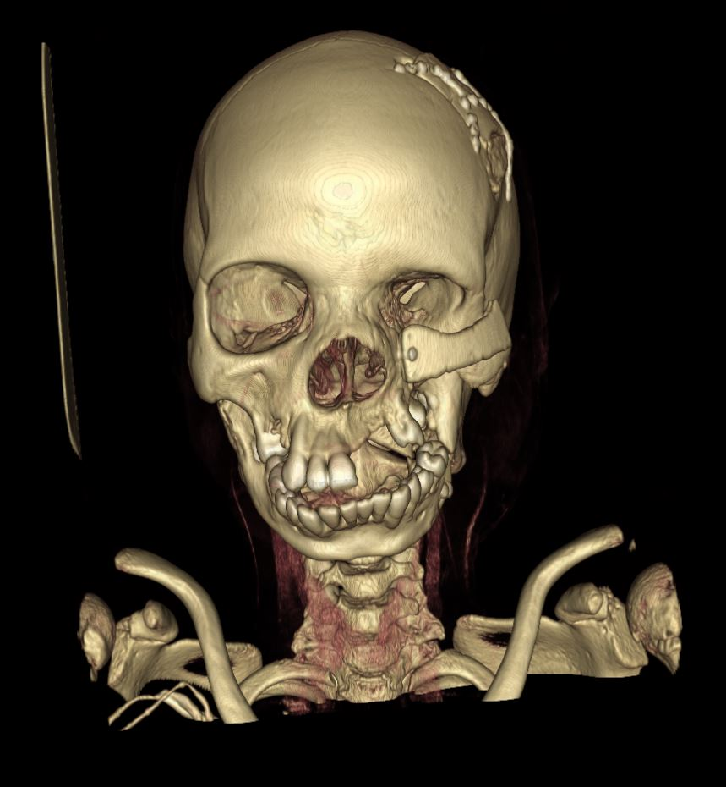
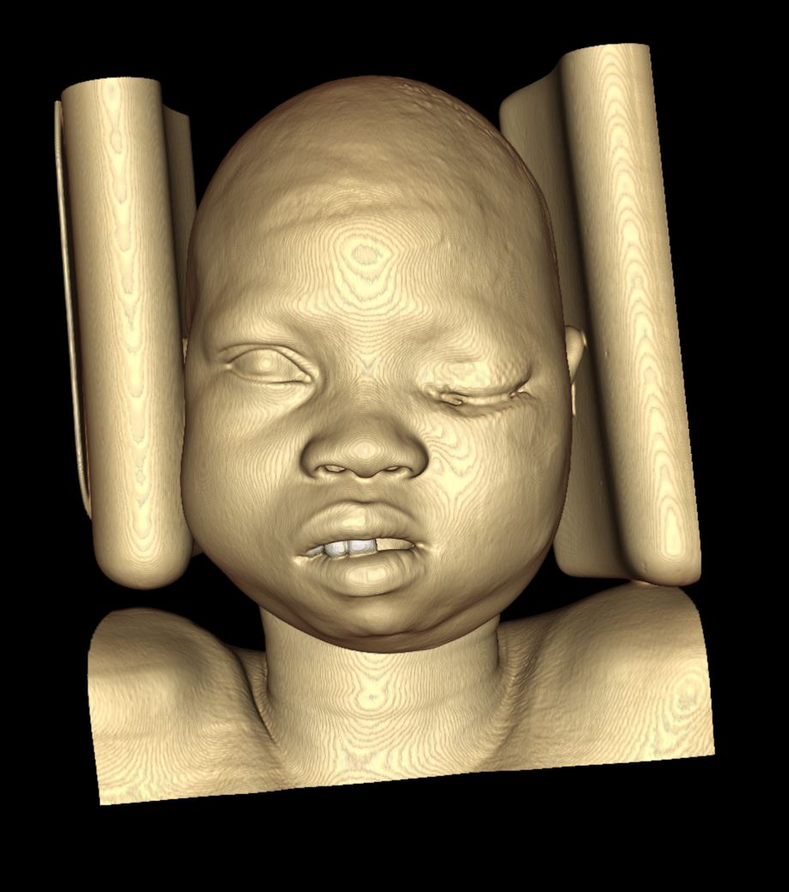
Transfer Function

Slide 4
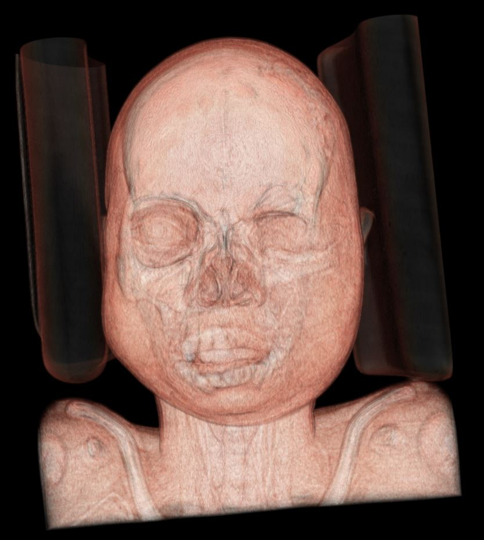
Transfer Function

Slide 5
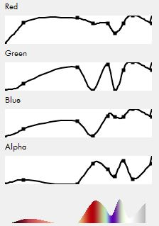
Transfer Function Widget

Slide 6
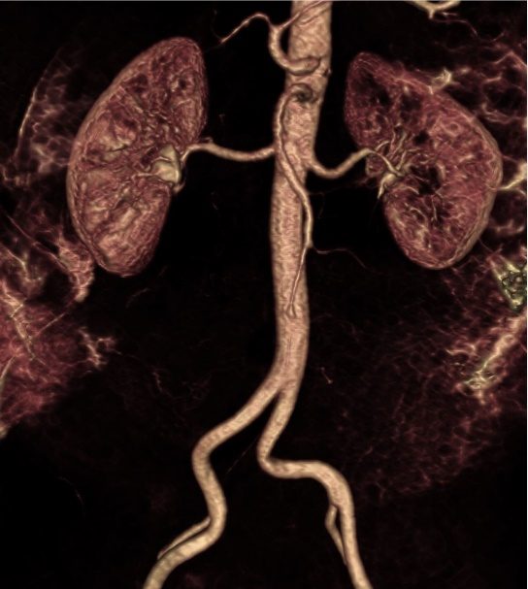
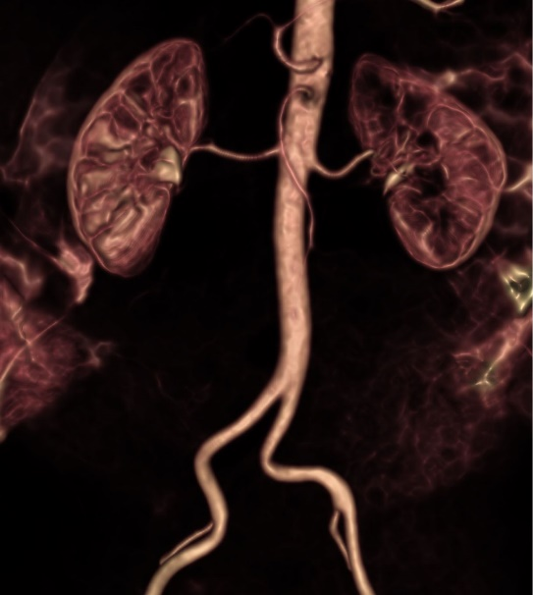
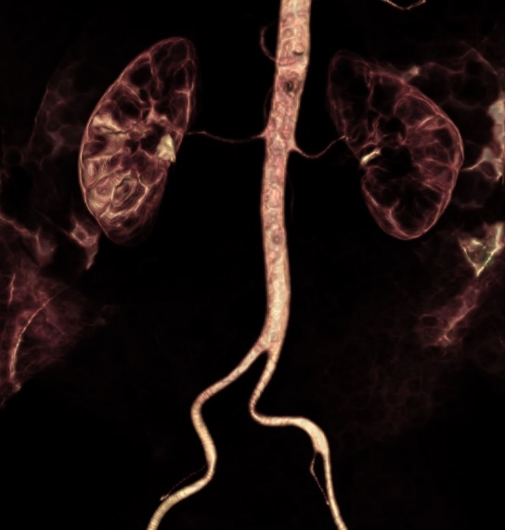
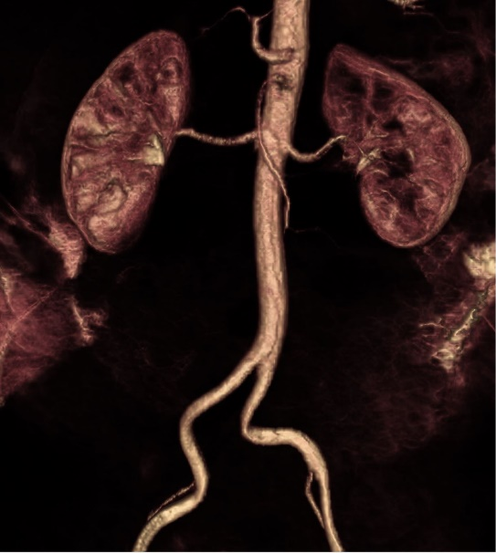
Filter

Slide 7

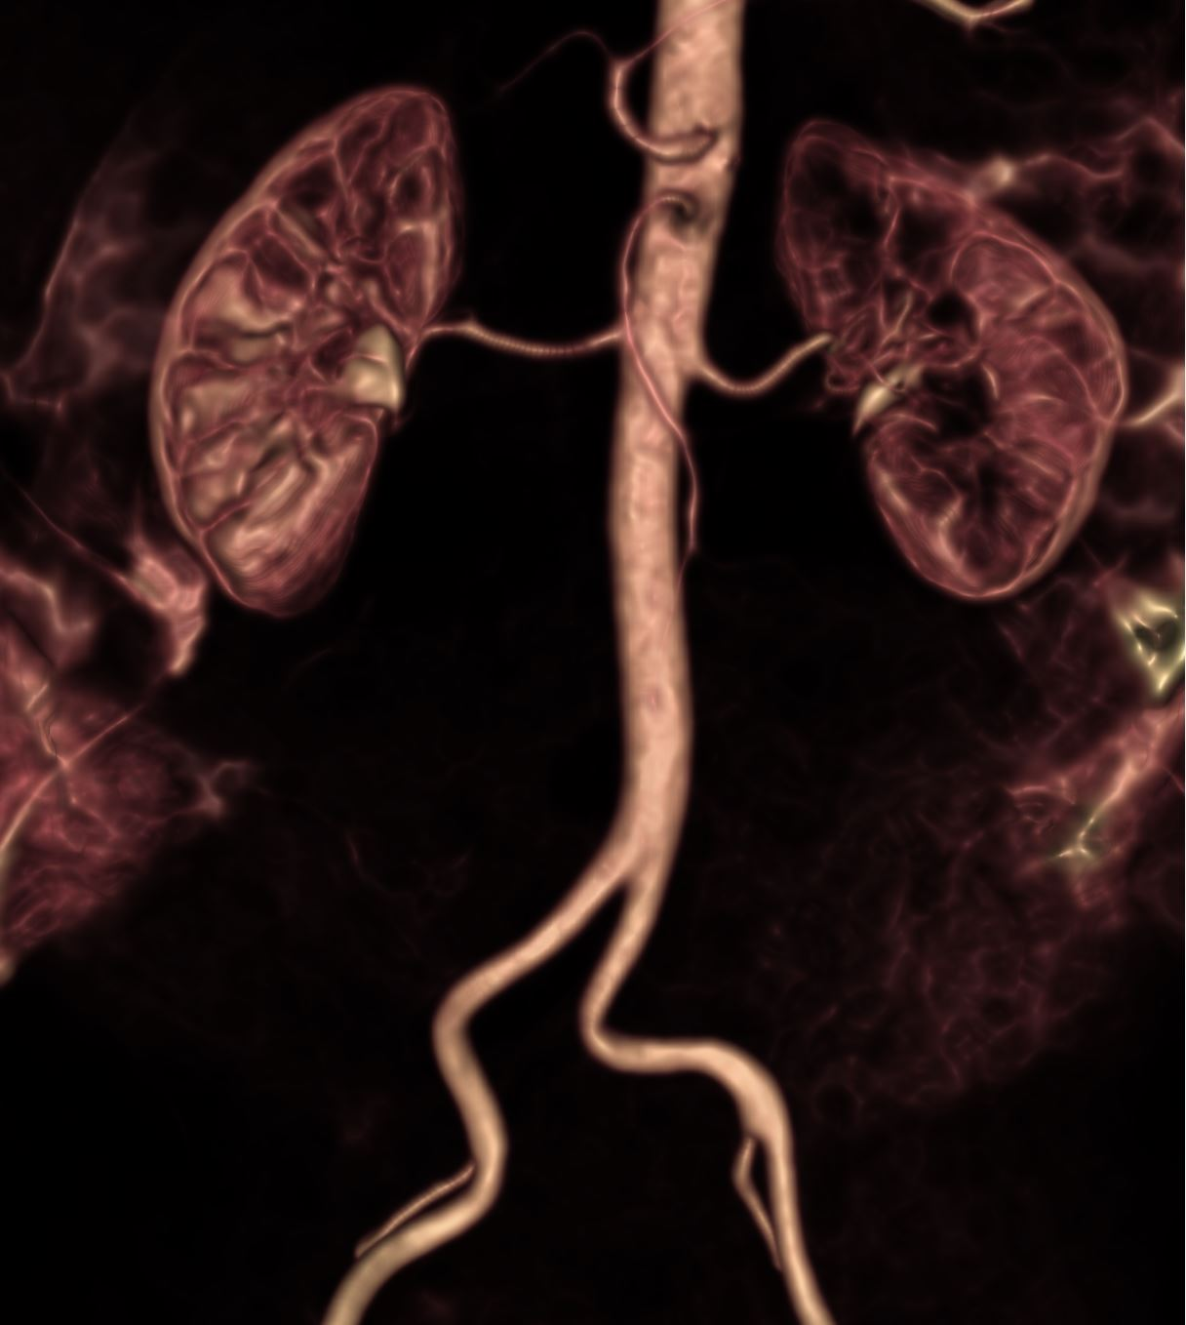
Gaussian Filter

Slide 8

Bilateral Filter

Slide 9
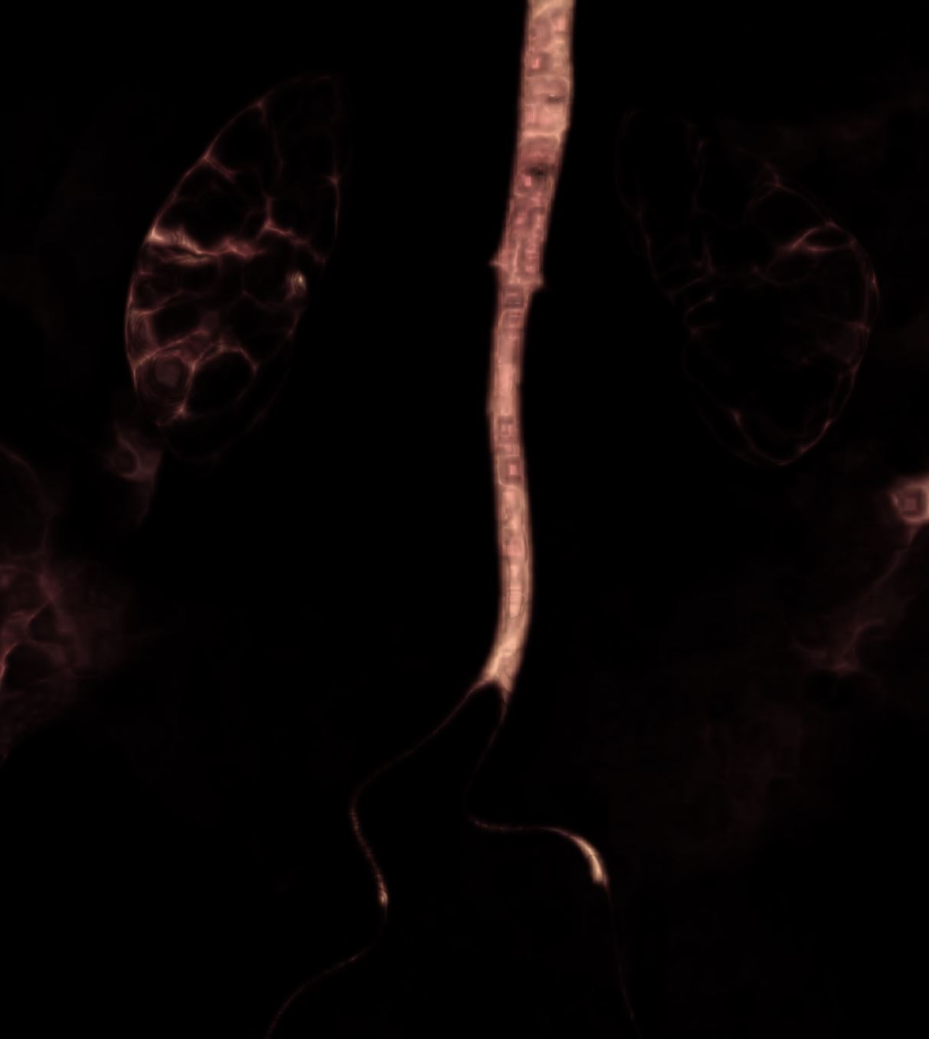
Median Filter 5x5

Slide 10

Median Filter 3x3

Slide 11
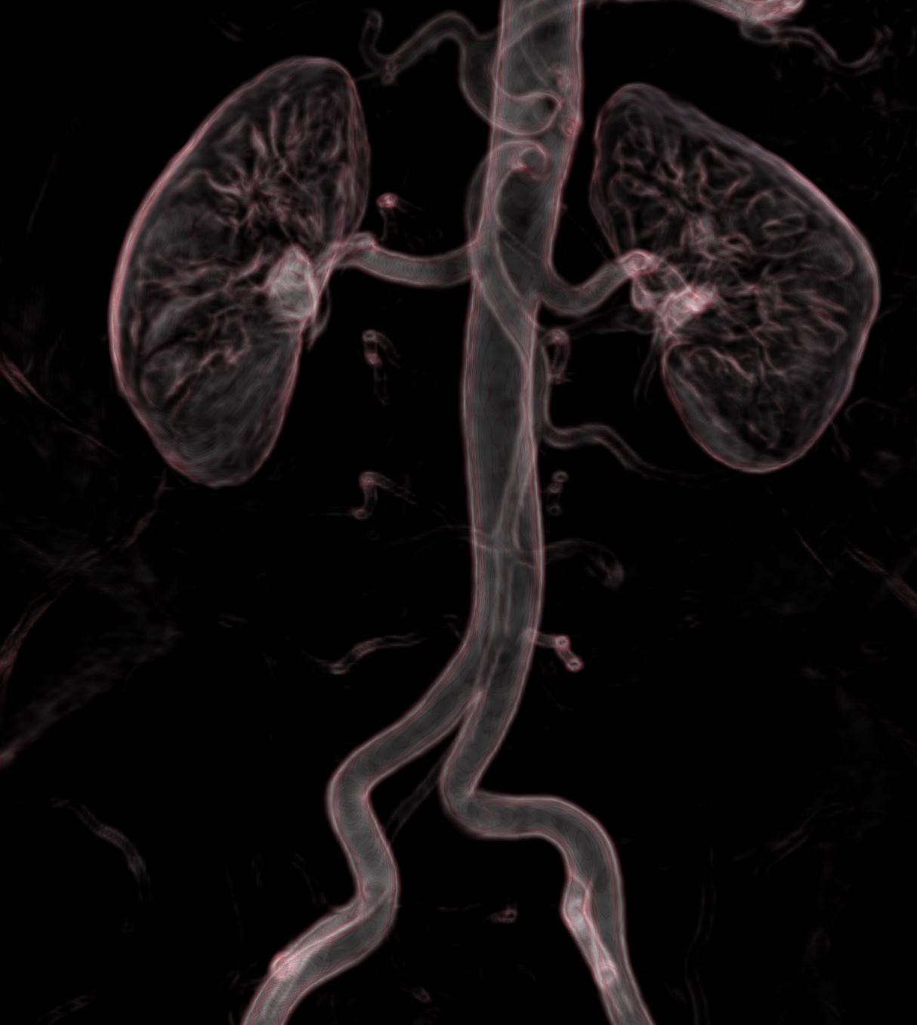
Gradient Filter

Slide 12
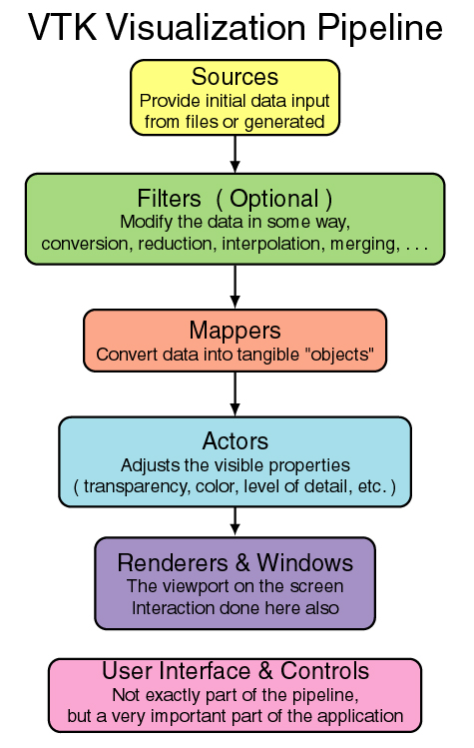
DVR

Slide 13
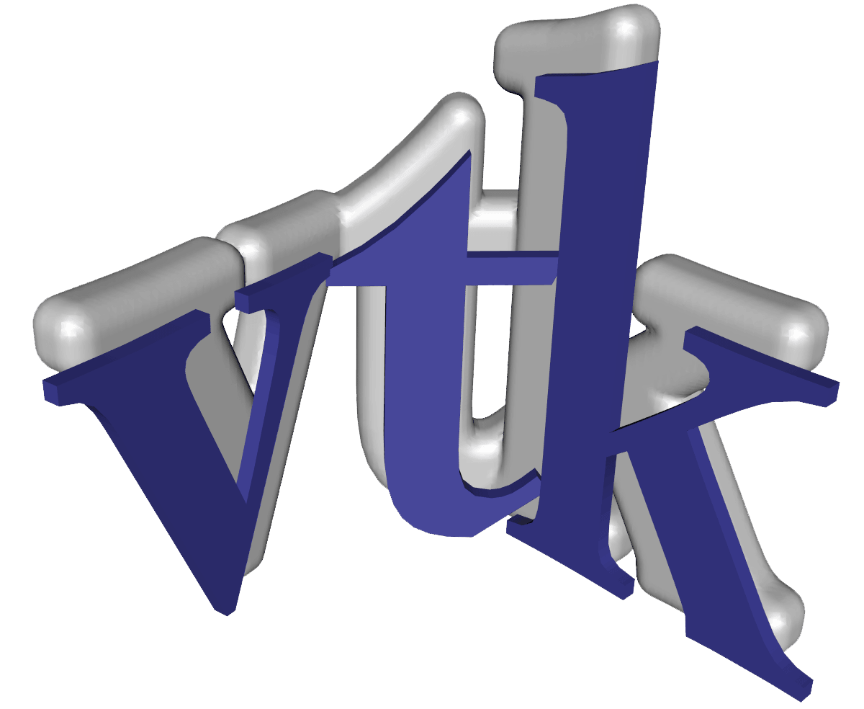
DVR
Great Visualization Tool BUT:
Hard to get it running on windows
Hard to implement abstract classes
Hard to connect with QT

Slide 14
DVR
Lessons Learned:
Great piece of software
Very easy to fulfill easy tasks
Don’t try to add or change something.
It is already somewhere and you just have to find and include it.

Slide 15
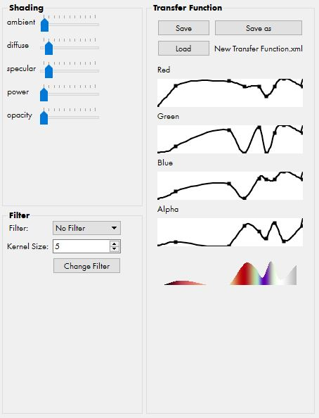
Demo
Real Time
Interactions
Demo

