Slide 1
Visualisierung Medizinischer Daten Direct Volume Renderer
David Pfahler and Andreas Gogel
Institute of Computer Graphics and Algorithms
Vienna University of Technology

Slide 2
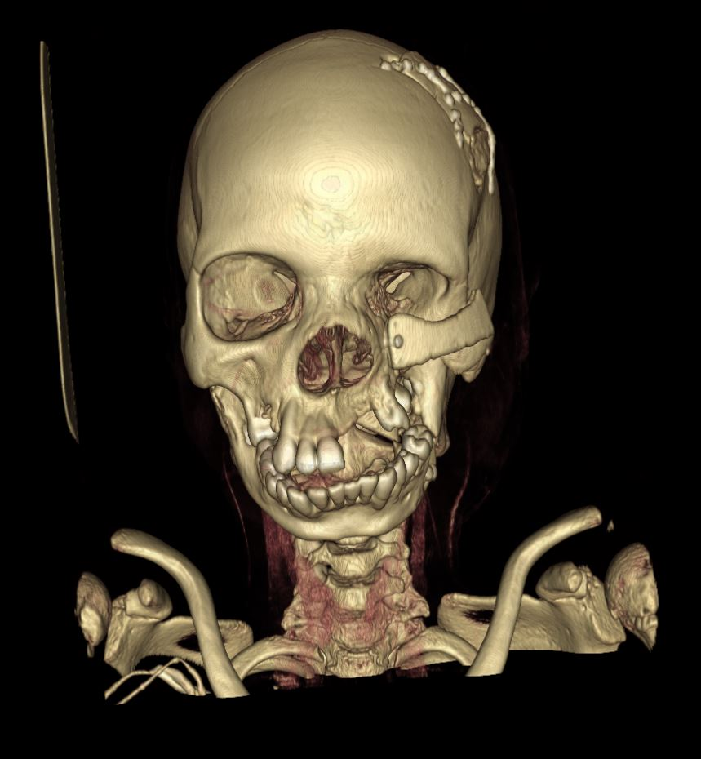
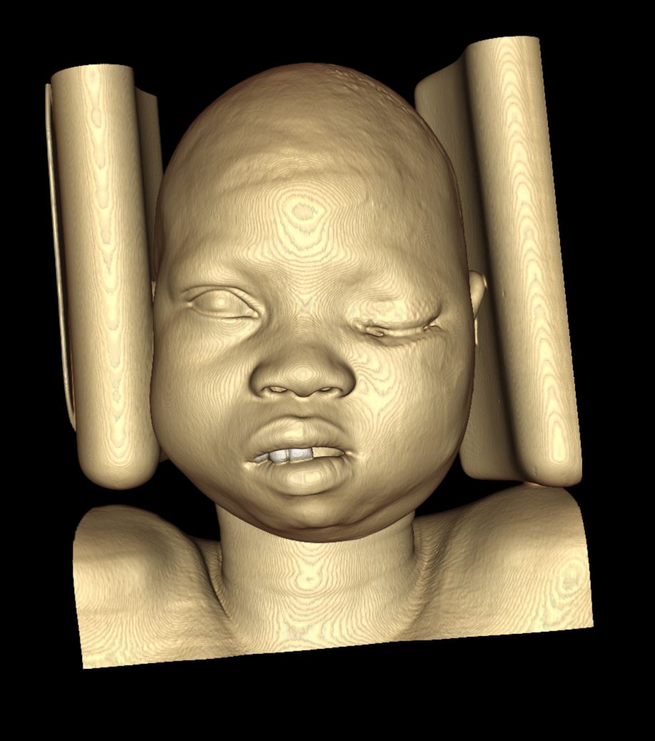
Transfer Function

Slide 3
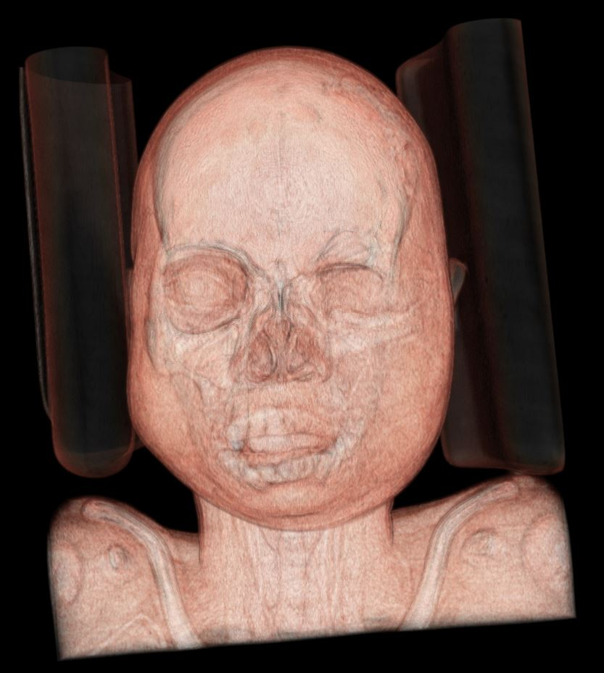
Transfer Function

