Slide 1
Visualisierung Medizinischer Daten Direct Volume Renderer
David Pfahler and Andreas Gogel
Institute of Computer Graphics and Algorithms
Vienna University of Technology

Slide 2
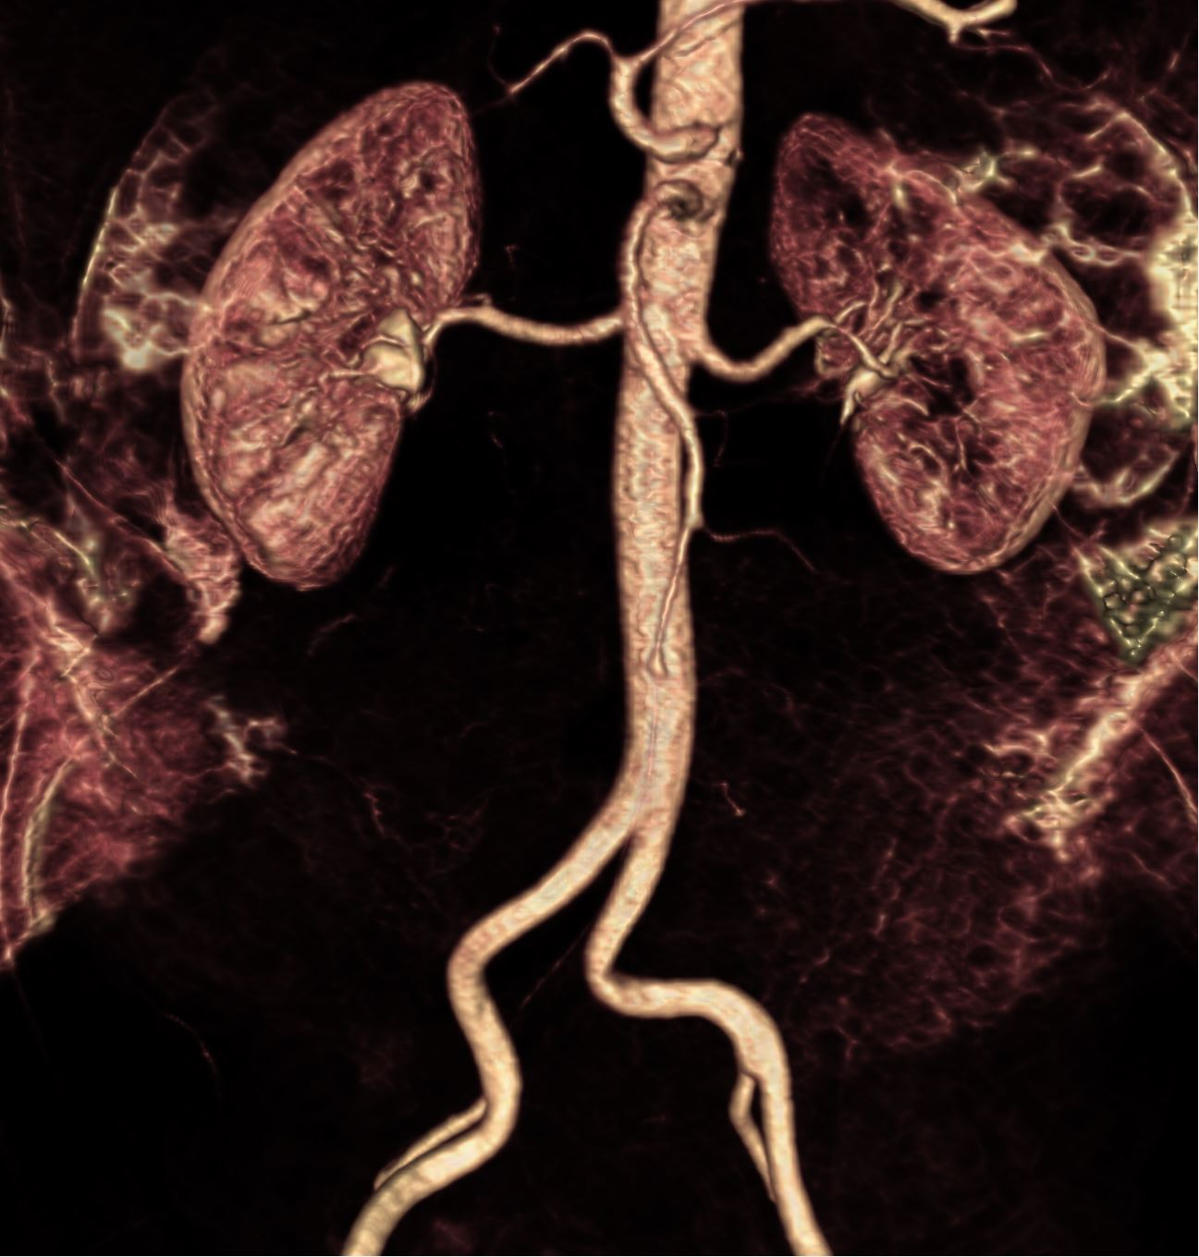
Outline
Transfer Function
Qt Widget
Filter
Gaussian
Bilateral
Median
Gradient
Direct Volume Rendering
VTK
OpenGL

Slide 3
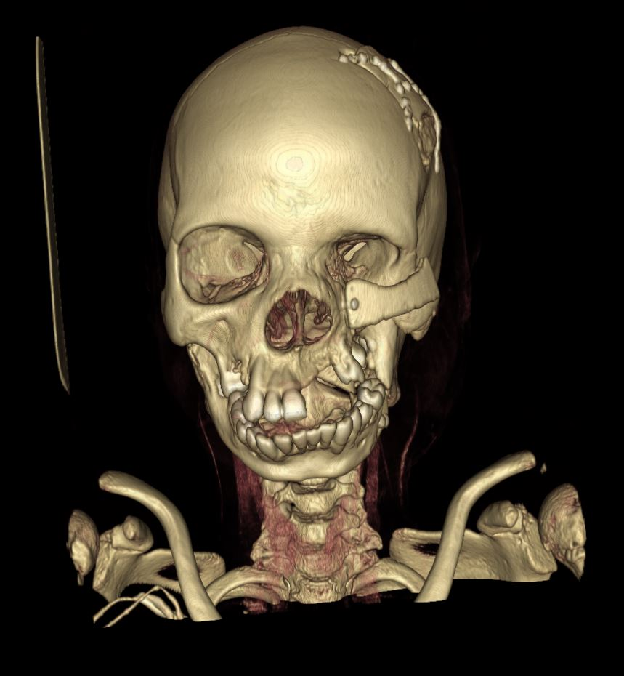
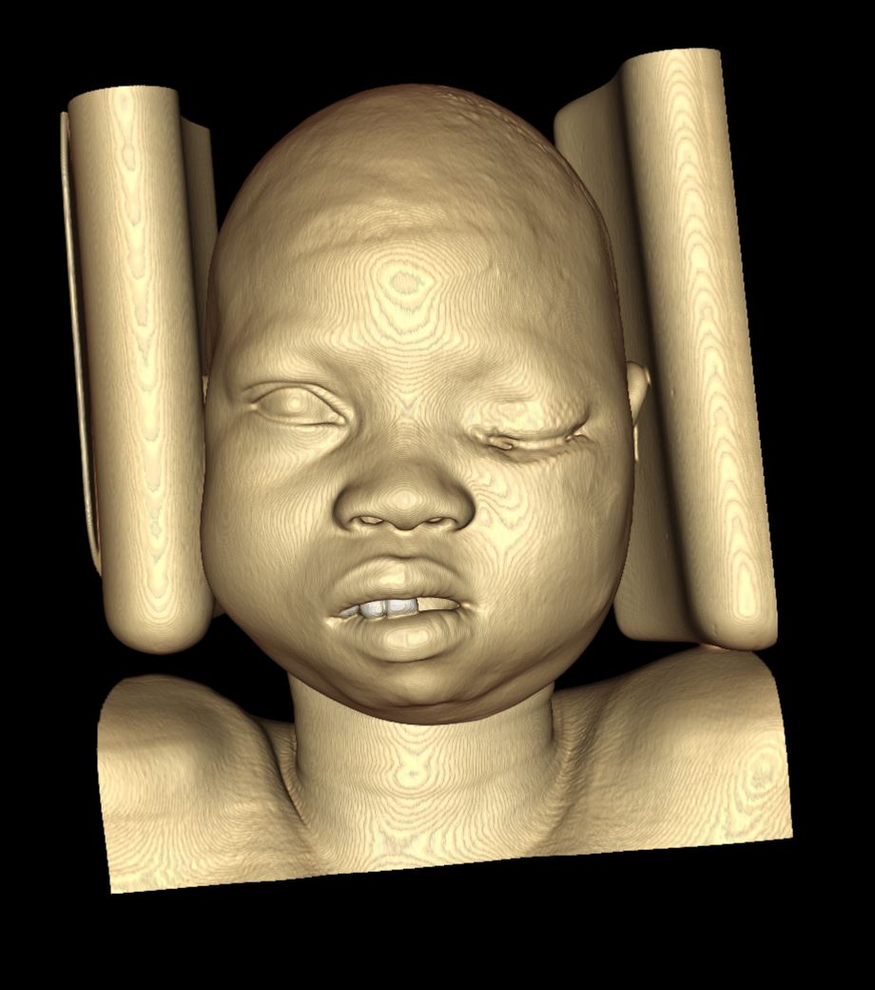
Transfer Function

Slide 4
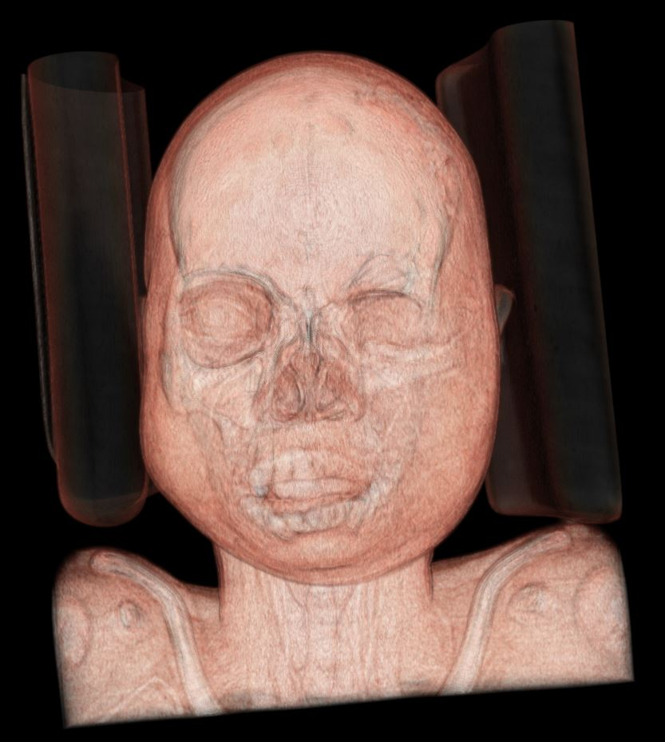
Transfer Function

Slide 5
Transfer Function Widget
TODO Add TF Widget image

Slide 6
Filter
TODO add 4 filter images as teaser

Slide 7
Gaussian Filter
TODO Add nonfilterd
TODO Add filter

Slide 8
Bilateral Filter
TODO add non filtered
TODO add filtered

Slide 9
Median Filter
TODO add non filtered
TODO add filtered

Slide 10
Gradient Filter
TODO add non filtered
TODO add filtered

Slide 11
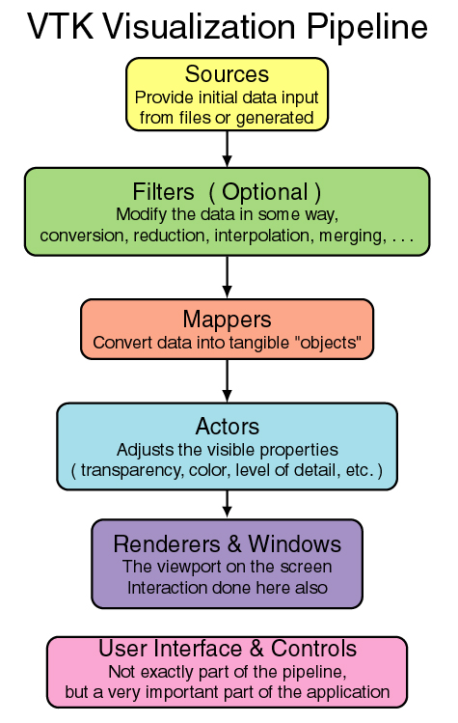
DVR

Slide 12
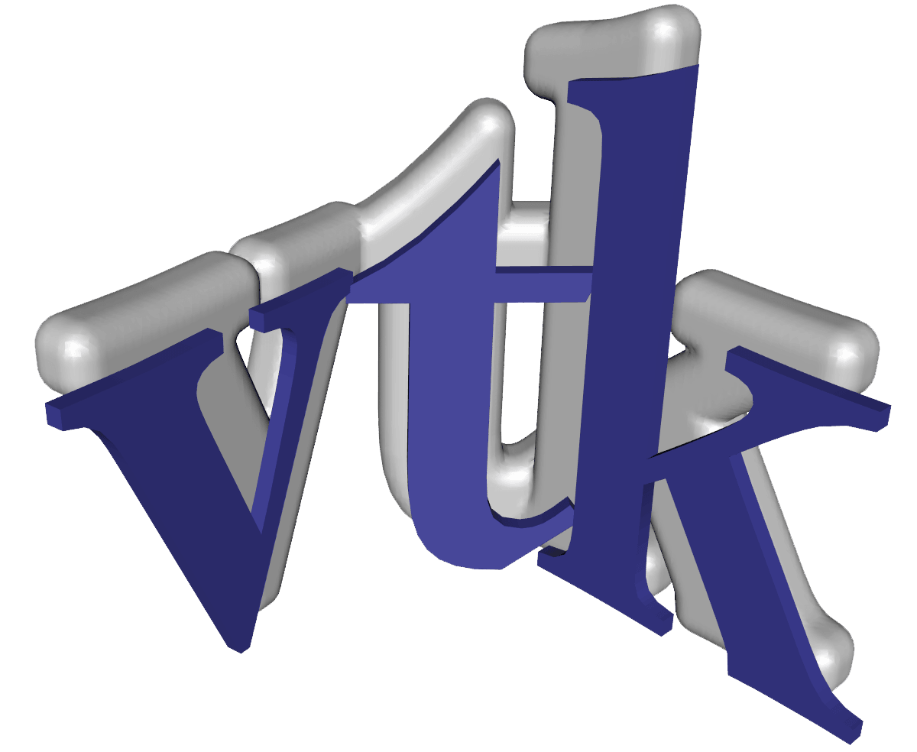
DVR
Great Visualization Tool BUT:
Hard to get it running on windows.
Hard to implement abstract classes
Hard to connect with QT

Slide 13
DVR
Lessons Learned:
Great piece of software
very easy to fulfill easy task
Don’t try to add or change something.
It is already somewhere and you just have to find and include it.

