Slide 1
Demo for week 1
Qiao He

Slide 2
Java tools used in this exercise
JAR Dependencies Management - Maven
Dependency Injection – Google Guice (Reflection)
Code simplify – Lambda and Stream
Get Stock prices from Internet – Call API
Cache Stock values - Jackson

Slide 3
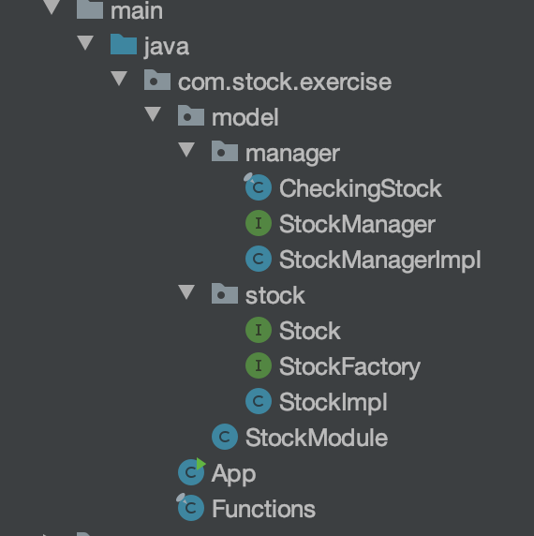
A glance of this exercise
Helper classes for Stock class – Cache and fetching
Stock classes – Methodes and fields to represent a stock
Main class
Some Functions to investigate our stocks

Slide 4









An overview of the relation among all classes
A singleton, contains all cached stock prices in stockValues
isCached(), refresh(), …
Implemented by
Contains(Being Injected by Guice)
Use static methods
stockSymbol, shares, …
Fetch Stock prices from Internet
Implemented by
getValue(),getSymbol(), …
Contains some
Contains the entry point for this exercise
Modules required by Guice
Get top five valuable stocks, …
Use functions in

Slide 5
App.java – Main class
Main class

Slide 6
App.java – Main class for this exercise
1. Get an Injector
2. Create some stock objects by the injector
3. Buy some stocks
4. Apply some functions to investigate all stocks we have
Go to the code

Slide 7
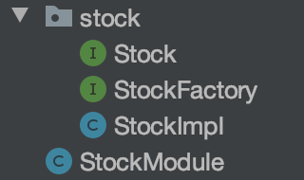
Stock Package and StockModule
Defines an interface for Stock
Stock Factory to create Stock objects
Implement the Stock interface
Used for Guice binding

Slide 8
The Stock Interface and StockImpl Class
Defines an interface for Stock
Implement the Stock interface

Slide 9
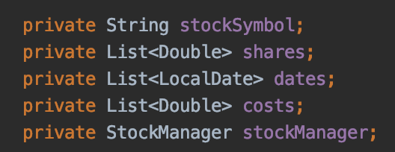
A glance of a StockImpl instance
All Fields in a Stock Class
Stores the Stock ticker
{1 share, 10 shares, …}
{2020-8-1, 2020-8-20, …}
{60$, 100$, …}
StockManager is used to
1. fetch real time Stock prices from the Internet.
2. Cache fetched data to local file
3. Give Stock prices to this object
A singleton object, Being Injected into every Stock Object in constructor by Guice

Slide 10
Stock Interface and StockImpl Class
StockImpl implements the Stock Interface
Go to the code

Slide 11
Stock Package and StockModule
Stock Factory to create Stock objects
Used for Guice binding

Slide 12
StockModule and StockFactory
Both are required by Guice
Inject a StockManager Instance to every StockImpl Object
Follow Guice’s requirements

Slide 13
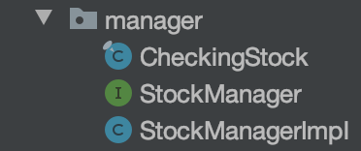
Manager Package
Includes functions to fetch Stock Price from Internet
Defines an interface for StockManager
A Singleton Class implements the StockManager Interface

Slide 14
Manager Package
Includes functions to fetch Stock Price from Internet

Slide 15

CheckingStock.java
Fetching Real time Stock prices from Internet
https://www.alphavantage.co/
One public method
String fetchingData(String tickerSymbol)
Fetch stock prices for the provided ticker

Slide 16
Manager Package
Defines an interface for StockManager
A Singleton Class implements the StockManager Interface

Slide 17
StockManager and StockManagerImpl
StockManagerImpl only contains one field:
This is where we store all stock prices in the memory
This field contains a <Ticker, Prices> pair
Example:
<“FB”, “2020-08-01:10, 2020-08-02:20, …”>
<“AMAZ”, “2020-08-01:20, 2020-08-02:40, …” >

Slide 18
Methods in the StockManager
Go to the code

Slide 19
Functions.java – some functions to investigate our stocks
This class contains some functions to investigate all stocks we have.
For example:
1. Get Top five valuable stocks in all stocks we currently hold
2. Get Top five expense stock we currently hold
3. Get all stocks that bought before a certain date
…
Go to the Code

Slide 20
What’s next
Watch videos for the next step
Use JDBC store stock value to Database
Design RESTful API and start a local service for this exercise
Learn and design Service to service communication

