Slide 1
Demo for week 1
Qiao He

Slide 2
Java Skills used in this exercise
JAR Dependencies Management - Maven
Dependency
. injection – Google Guice (Reflection)
Code simplify – Lambda and Stream
URL – Real time API to get Stock prices
Cache Stock values - Jackson

Slide 3
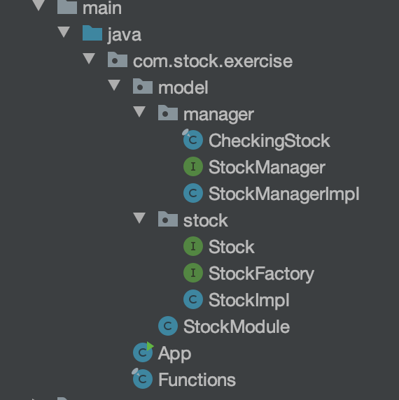
A glance of this exercise
Helper classes for Stock class – Cache and fetching
Stock classes – Methodes and fields to represent a stock
Main class
Some Functions to investigate our stocks

Slide 4
App.java – Main class
Main class

Slide 5
App.java – Main class for this exercise
1. Get a Injector
2. Create some stock objects by the injector
3. Buy some stocks
4. Apply some functions to investigate all stocks we have

Slide 6
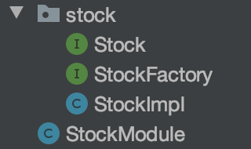
Stock Package and StockModule
Defines an interface for Stock
Stock Factory to create Stock objects
Implement the Stock interface
Used for Guice binding

Slide 7
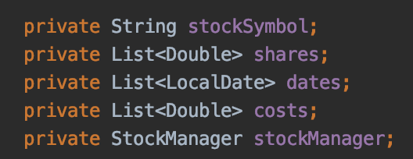
A glance of the Stock Object
All Fields in the Stock Object
Stores the Stock ticker
{1 share, 10 shares, …}
{2020-8-1, 2020-8-20, …}
{60$, 100$, …}
StockManager is used to
1. fetch real time Stock prices from the Internet.
2. Cache fetched data to local file
3. Give Stock prices to this object
A singleton object, Being Injected into every Stock Object in constructor by Guice

Slide 8
Stock Interface and StockImpl Class
StockImpl implements the Stock Interface
Go to the code

Slide 9
StockModule and StockFactory
Both are required by Guice
StockFactory is a Factory Interface being used to create Stock Object
StockModule binds StockManager interface to StockManagerImpl
And installs the StockFactory interface
Need a Factory interface because we have a Assisted annotation in StockImpl’s constructor

Slide 10
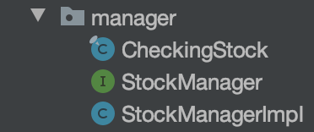
Manager Package
Includes functions to fetch Stock Price from Internet
Defines an interface for StockManager
A Singleton Class implements the StockManager Interface

Slide 11

CheckingStock.java
Fetching Real time Stock prices from Internet
https://www.alphavantage.co/
One public method
String fetchingData(String tickerSymbol)
Fetch stock prices for the provided ticker

Slide 12
StockManager and StockManagetImpl

Slide 13
Functions.java – some functions to investigate our stocks

Slide 14
What’s next
Using JDBC store stock value to Database
Design RESTful API
Start a local service

