Slide 1
Demo for week 2
Qiao He

Slide 2
Some new tools used in this exercise
Used JAX-RS resources which is implemented by Jersey
Implemented some Exception Mappers
Defined some JSON entity & Bean Validation

Slide 3
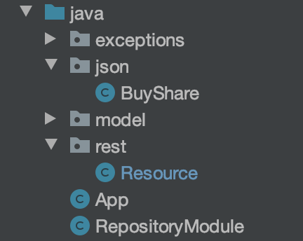
Structure of this exercise
Some self-defined exceptions and their mapper
Hold JSON body in HTTP request
Stock classes copied from last exercise
Resource class of all endpoints
Jersey configure - RestConfig
Bind Repository class for Injection

Slide 4
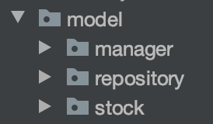
Need a repository (Portfolio) to manage all stocks we have
In last exercise, we store all pointers to Stock in the main method.
However, in a RESTful design we need to hold it somewhere else.
So we need a repository class to hold all these pointers

Slide 5
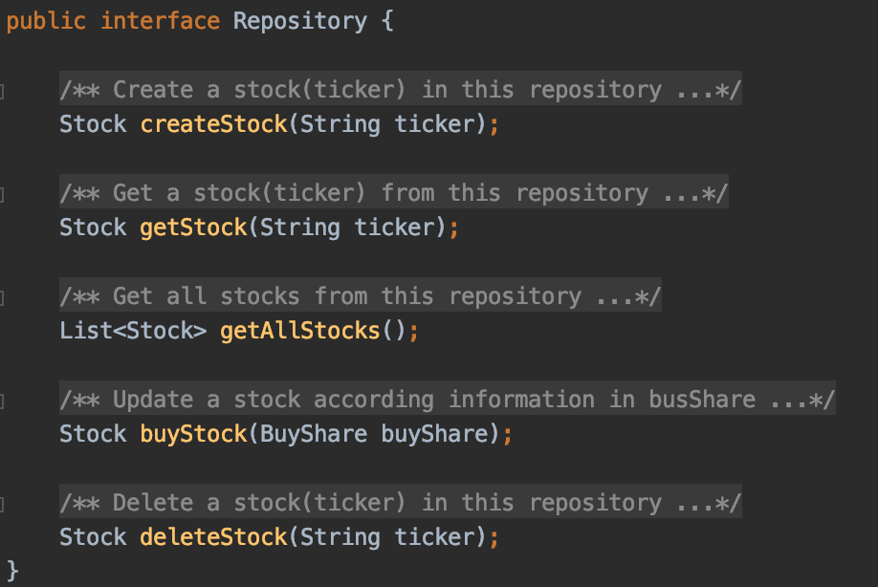
The repository class
A Repository object(Singleton) will be injected into the Resource class.
Endpoints will use these methods from repository class to do CRUD.
Create
Read
Update
Delete

Slide 6
Resource Class
Resource class of all endpoints

Slide 7
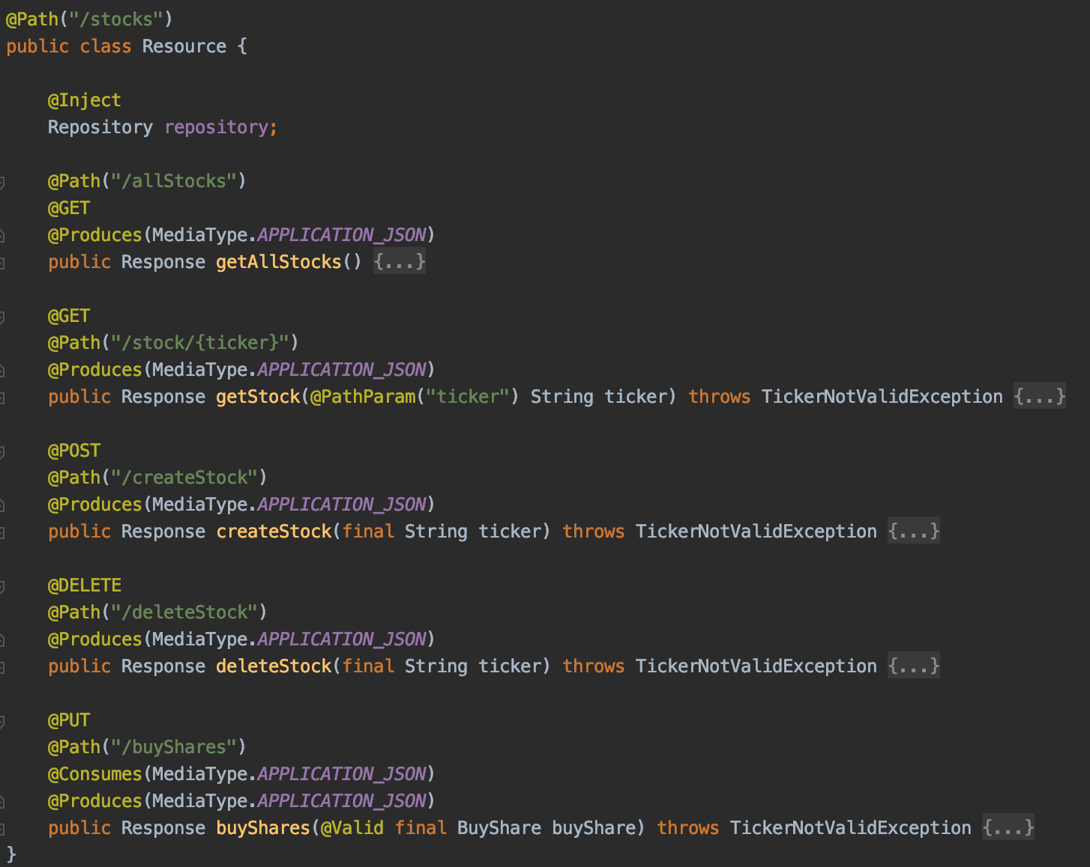
Resource class (Endpoints) - Just call according methods in Repository Object
Singleton Repository object
Read
Create
Delete
Update

Slide 8
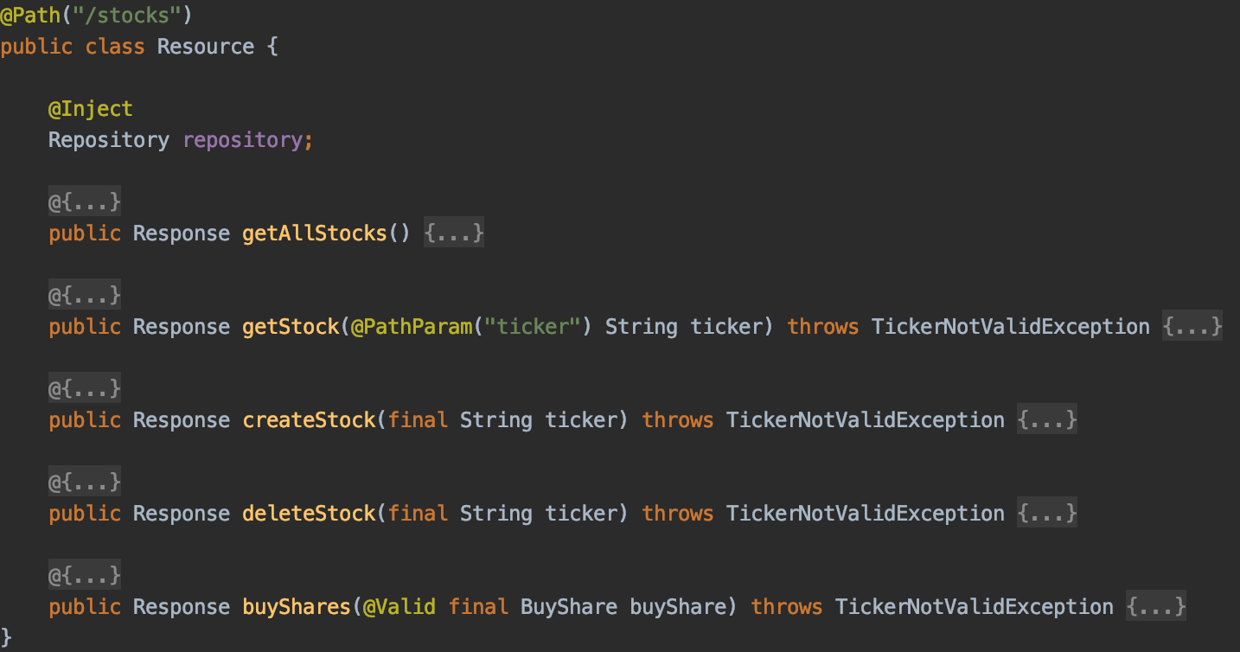
Self-defined Exceptions
These endpoints will throw a TickerNotValidException

Slide 9
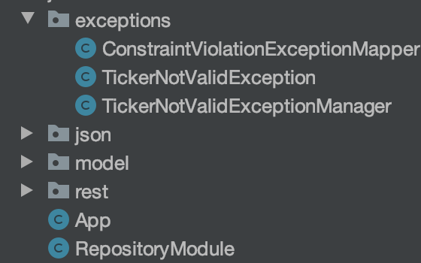
Exceptions
All self-defined exceptions and their managers

Slide 10
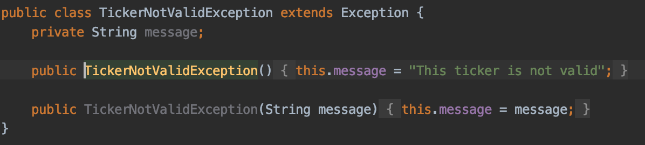
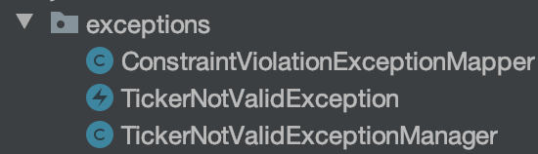
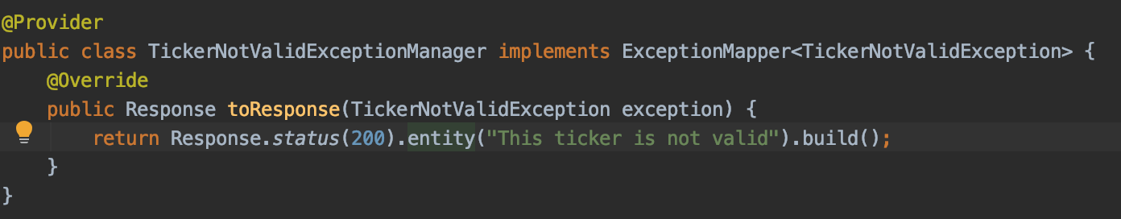
Exceptions
Define this Exception
Mapper for exceptions thrown from Bean validation
Define the exception manager

Slide 11
JSON entity & Bean Validation
Hold JSON body in HTTP request

Slide 12
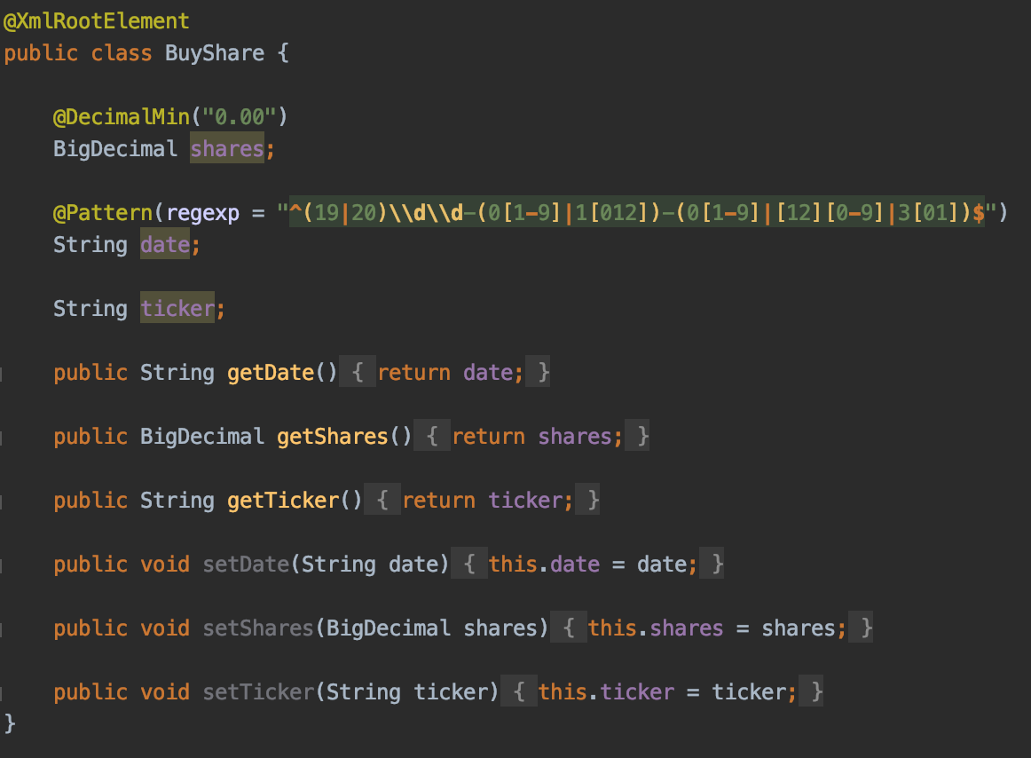
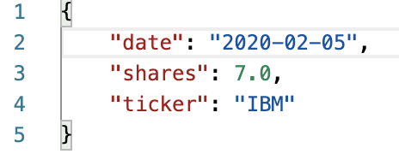
JSON Entity & Bean Validation
The share must be a positive number
Information in JSON structure (Request body) will be converted into a BuyShare Object automatically by Jersey.
A regular expression constrains the date format

Slide 13
This week
Start another Service and communicate with this one
New service should depend on Jersey-client and call REST-API of this service
Build a Database and use JDBC to manage Stock information

