Slide 1
Demo 3 for training
Qiao He

Slide 2
Things done in this week
Divide last exercise into 2 small services
Use Oracle database to store stock information
Use JDBC to connect and manage database

Slide 3
Service to Service Communication
Two services are existed in this project
Stock Service & Cache Service
Stock Service – Contains all endpoints exposed to client.
But it knows nothing about Stock information.
It needs to call Cache Service to get those data
Cache Service – Connect to database and Internet API to cache
and fetch all stock information

Slide 4
Service to Service Communication
The Stock Service Contains all endpoints that exposed to client
But it knows nothing about Stock information like if a ticker is valid or the stock price in a specific date
Whenever it needs those information, it should call endpoints from Cache service
Cache service connects to a local Database and a Internet API to get those data and return them to Stock Service as a Response

Slide 5

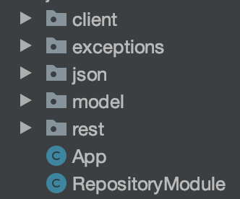
Structure of Stock Service
Contains methods to call APIs from Cache Service
Copied from last exercise

Slide 6
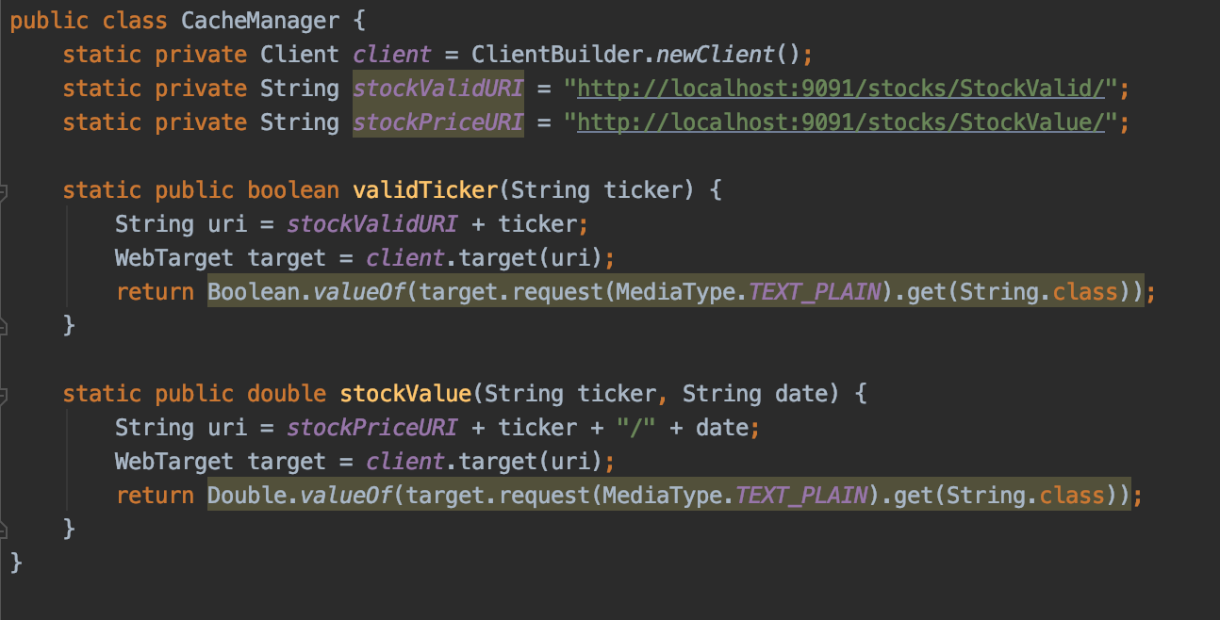
CacheManager.class
URL to Cache Service
Add Ticker to the URL
Send request to Cache Service

Slide 7
Cache Service
Provide stock information to Stock service
Fetch Stock information from local database or Internet API

Slide 8
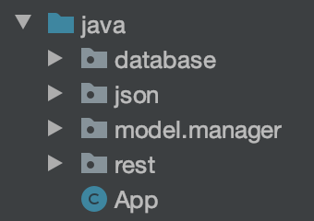
Cache Service
Manage JDBC connections to Database
JSON entities to hold information from Internet API
Model classes to call Internet API and manage all other things
Endpoints exposed to other services

Slide 9
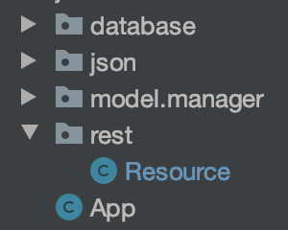
Restful API
Endpoints exposed to other services

Slide 10
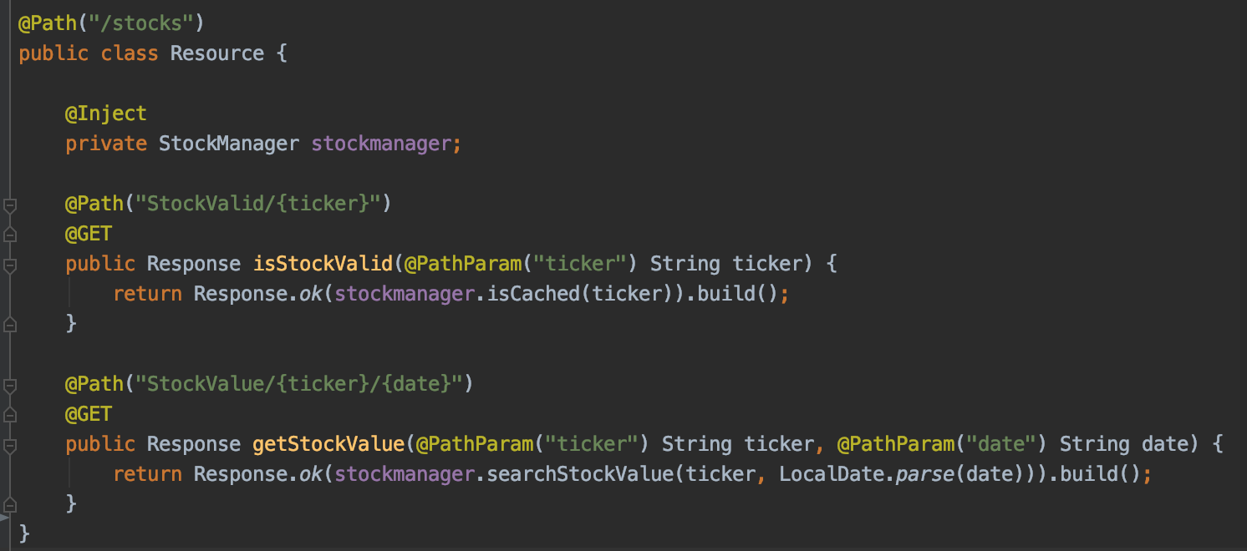
All endpoints of Cache Service
Return True if the ticker is valid otherwise False
StockManager
Return the price of {ticker} at {date} if valid

Slide 11
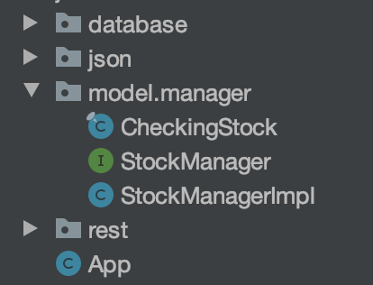
Cache Model – Internet API

Slide 12
Cache Hierarchy
Already created stocks will be stored in a HashMap in memory
All Previously used stock (include deleted one) will be stored in a local database
1st level
Memory
Not exist
Database
2nd level
Store back
Knows nothing about stock information
Three levels Cache
If still not existed
Call API to fetch stock data
Store back
Clients
Stock Service
Cache Service
Internet API
Fetch stock information by calling API of Cache Service
3rd level

Slide 13
Cache Model – Internet API
Being Used to fetch data from Internet API

Slide 14
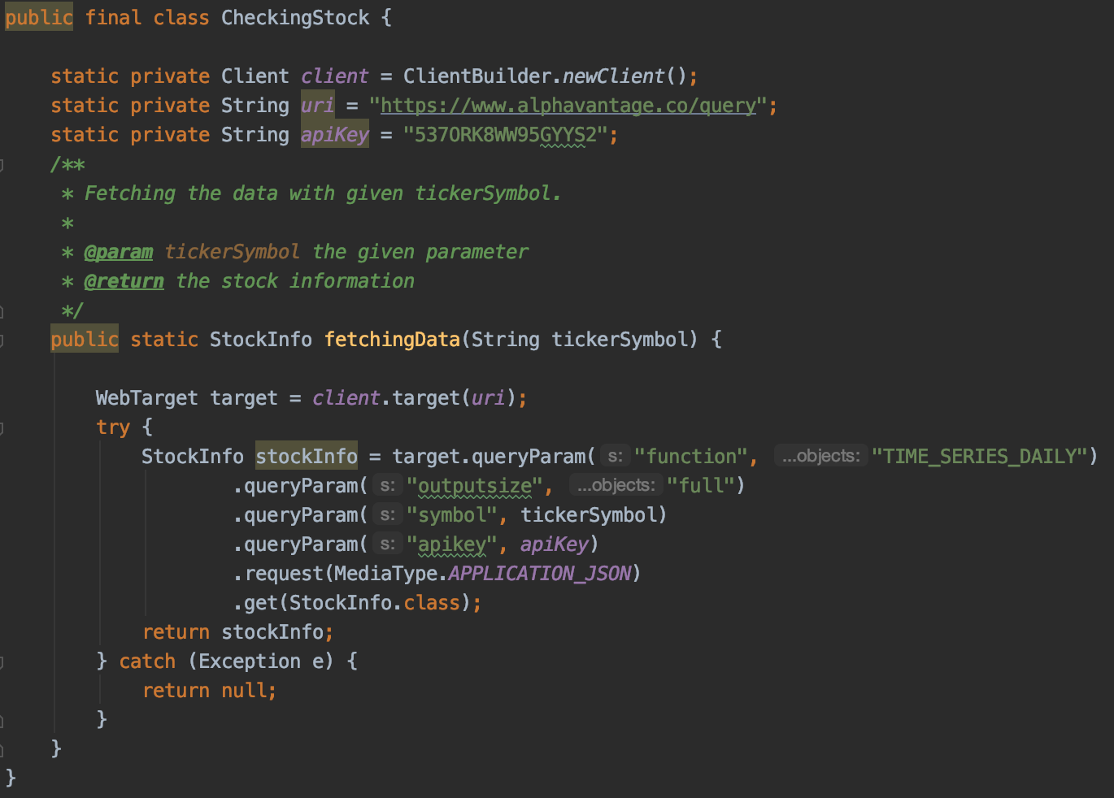
CheckingStock – fetch stock data from Internet
This class is used to hold the JSON format date in response body

Slide 15
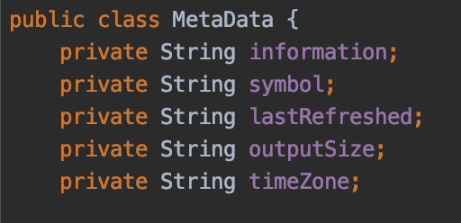
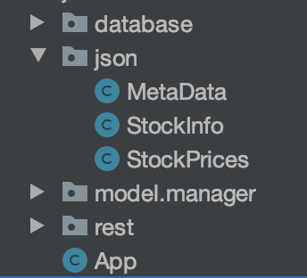
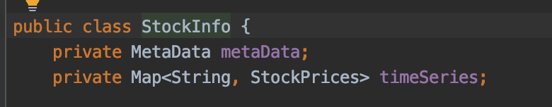
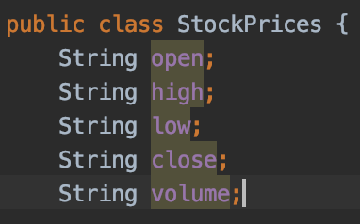
StockInfo –Hold JSON data from Internet

Slide 16
Cache Model – Manager Model
Model to manage three level caching

Slide 17
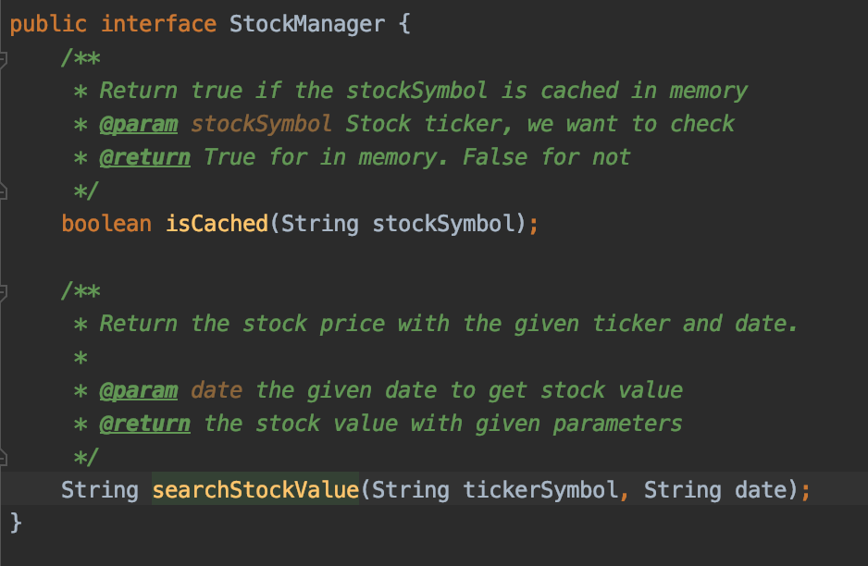
StockManager – Model to manage 3 level caching
Return True if this stock is cached in memory. Otherwise it tries to fetch it from database or Internet to memory. Return false if it is still not exist in the memory
Return the price of {tickerSymbol} at {date}. Return empty String if the ticker is not valid

Slide 18
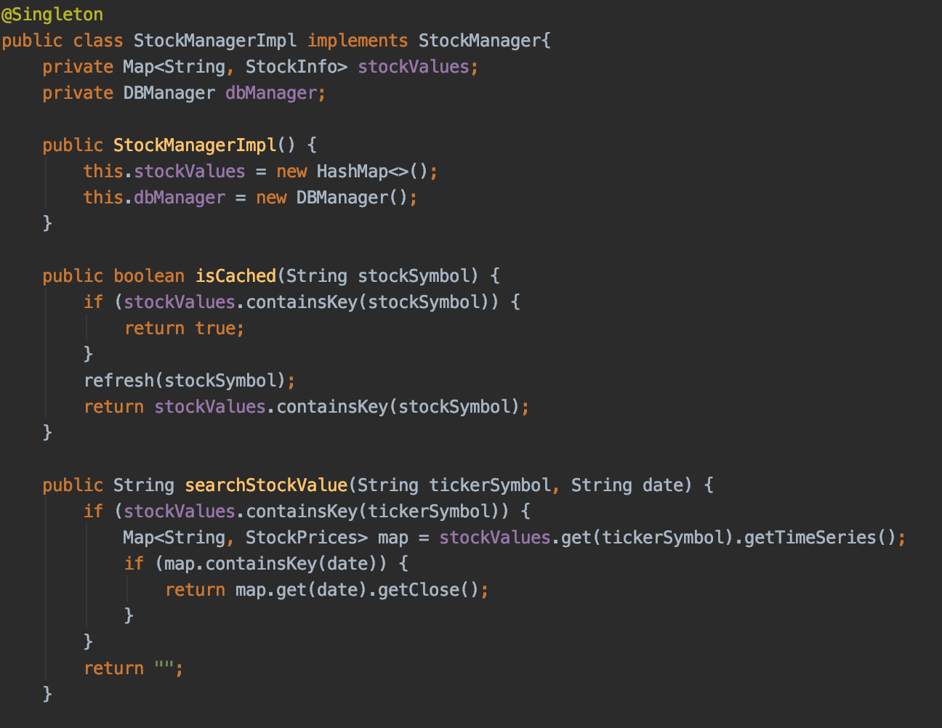
StockManager – Model to manage 3 level caching
This Map is used to cache stock information in memory
Connect to and manage Database
A private method to fetch stock data from database and Internet to memory

Slide 19
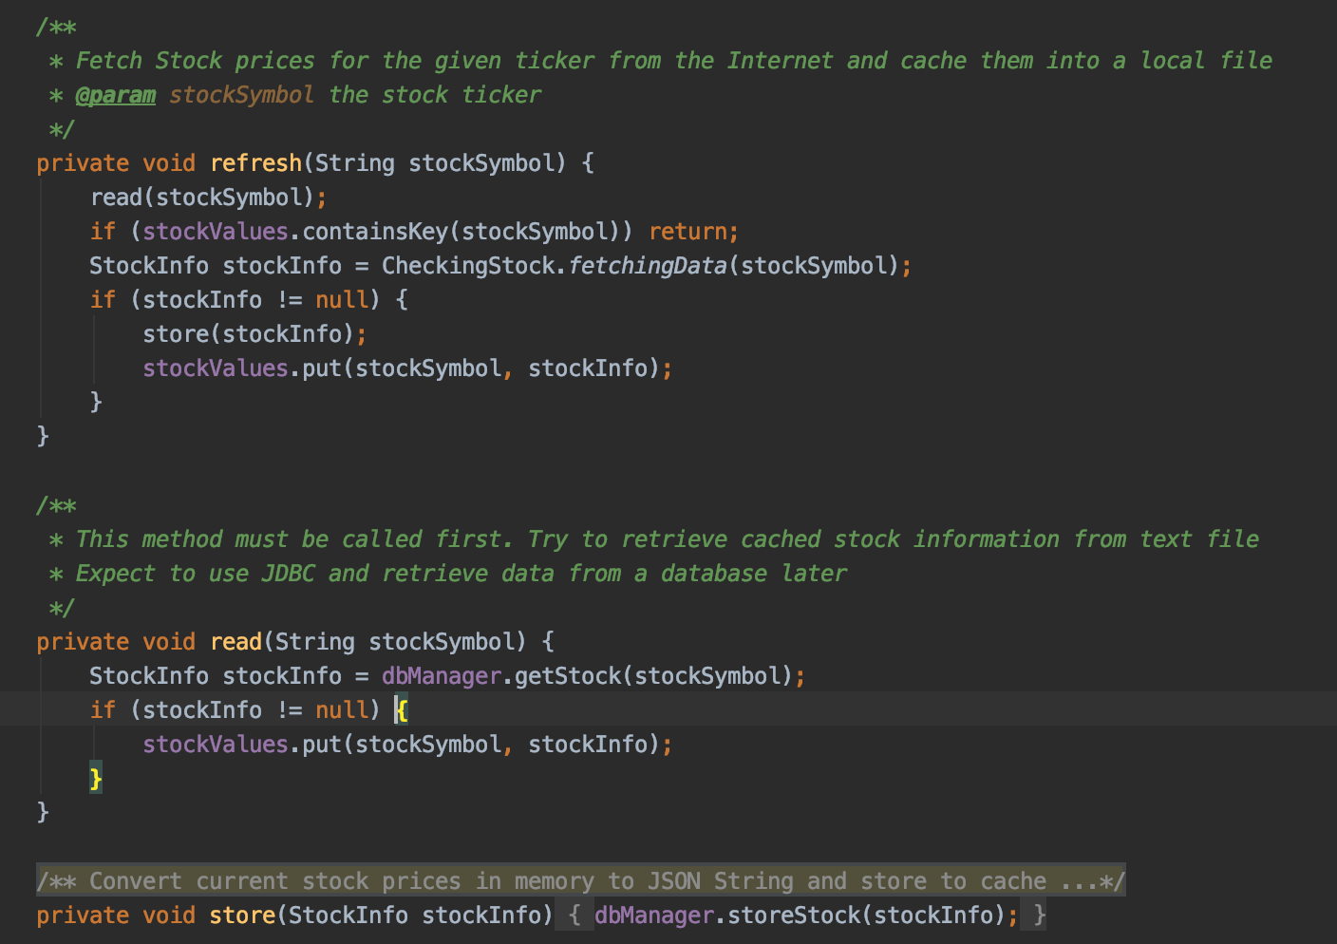
Refresh method to fetch data

Slide 20
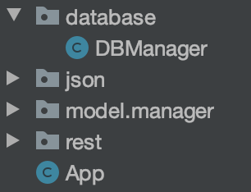
Connect to Database
Manage all things in the database include:
connecting to database,
creating all tables,
Inserting data to tables,
Retrieving data from database.

Slide 21
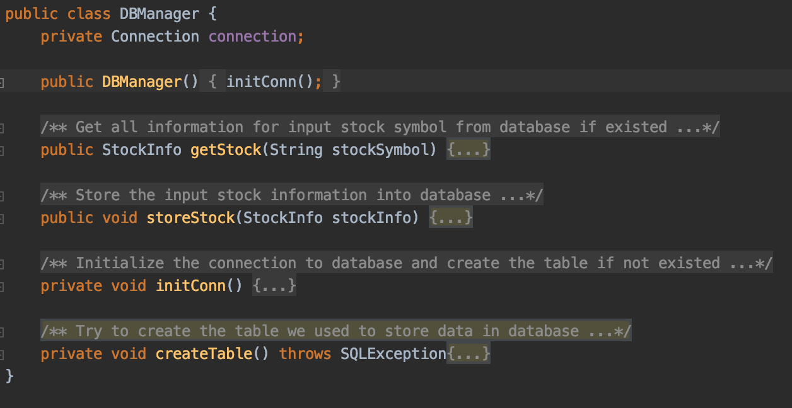
DBManager.class

Slide 22
Conclusion of this training
Learned Java 8 basics include Lambda and stream
Use Maven to manage dependencies of the project
Injection by using Googly Guice(Reflection)
Basic JAX-RS web design(based on Jersey) and use of annotations
Use Jersey(based on Jackson) to convert JSON data between object
Valid annotation in JSON entity class
Use JDBC to connect and manage database
Microservice architecture

