Slide 1
class account {
private int id;
private String name = "";
private double money = 0;
private String pwd = "";
public account(String name) {}
public double add_money(double m) throws LimitExceededException {
throw new LimitExceededException("余额不足");
}
public void changepwd(String old_pwd, String new_pwd) throws AccessDeniedException {
throw new AccessDeniedException("旧密码错误");
}
public boolean checkpwd(String pwd) {}
public String getname() {}
public double getmoey() {}
}
class Bank {
private ArrayList<account> accounts = new ArrayList<>();
public void add_account(String name, String pwd) throws AccessDeniedException {}
public Optional<account> login(String name, String pwd) throws AccessDeniedException {
throw new AccessDeniedException("密码错误");
}
void add_money(account me, double money) throws LimitExceededException {
throw new LimitExceededException("金额不可为负数");
}
void withdraw_money(account me, double money) throws LimitExceededException {
throw new LimitExceededException("金额不可为负数");
}
void transfer_money(account me, String to, double money) throws Exception {
throw new NameNotFoundException("没有此用户");
throw new AccessDeniedException(“不能转账给自己");
}
Optional<account> get_account(String name) {}
}
public class bank_gui extends JFrame {
transient Bank bank = new Bank();
transient Optional<account> now_account = Optional.empty();
}

Slide 2
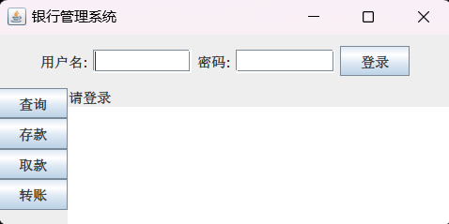
NORTH
northPanel
loginPanel, FlowLayout
north
WEST
center
resultPanel, BorderLayout
CENTER
operationPanel, BoxLayout.Y_AXIS

Slide 3
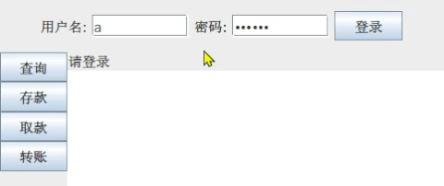
login.addActionListener(e -> {
try {
now_account = bank.login(account_name.getText(), pwd.getText());
} catch (AccessDeniedException e1) {
result.setText(e1.getMessage());
}
if (now_account.isPresent()) {
logoutinfo.setText("welcome, " + now_account.get().getname());
result.setText("登录成功，请选择操作");
account_name.setText("");
pwd.setText("");
northPanel.remove(loginPanel);
northPanel.add(logoutpanel);
northPanel.revalidate();
northPanel.repaint();
} else {
result.setText("用户名或密码错误");
}
});
transfermoney.addActionListener(e -> {
if (now_account.isEmpty())
return;
double m = 0;
String give_to = "";
try {
var temp = input.getText().trim().split("\\s+", 2);
give_to = temp[0];
m = Double.parseDouble(temp[1]);
if (m < 0)
throw new NumberFormatException();
} catch (NumberFormatException e1) {
result.setText("请输入正确的金额");
return;
} catch (Exception e1) {
result.setText("请输入正确的格式：“名称 金额”");
return;
}
try {
bank.transfer_money(now_account.get(), give_to, m);
result.setText("转账成功，当前余额: " + now_account.get().getmoey());
} catch (Exception e1) {
result.setText(e1.getMessage());
}
});
lxl66566/my-college-files

