Slide 1
JAVA面向对象设计心得
2023.03.06

Slide 2
ArrayList<Integer> list = new ArrayList<Integer>();
System.out.print("请输入第一个边长:");
list.add(input.nextInt());
System.out.print("请输入第二个边长:");
list.add(input.nextInt());
System.out.print("请输入第三个边长:");
list.add(input.nextInt());
// this(list);
a = list.get(0);b = list.get(1);c = list.get(2);
}
public void print()
{
if(!isTriangle()){
System.out.println("不能构成三角形！");
return;
}
System.out.println("三角形的周长为:"+getTriangleLength());
System.out.println("三角形的面积为:"+getTriangleArea());
}
}
class Triangle
{
int a,b,c;
public Triangle(){}
public Triangle(int a1,int b1,int c1)
{
a = a1;b = b1;c = c1;
}
public Triangle(ArrayList<Integer> list)
{
a = list.get(0);
b = list.get(1);
c = list.get(2);
}
public boolean isTriangle()
{
return a+b>c && a+c>b && b+c>a;
}
public int getTriangleLength()
{
return a + b + c;
}
public double getTriangleArea()
{
double s = (a+b+c)/2.0;
return Math.sqrt(s*(s-a)*(s-b)*(s-c));
}
public void input(Scanner input)
{

Slide 3
public Triangle(){} // 默认
public Triangle(int a1,int b1,int c1)
{
a = a1;b = b1;c = c1;
}
public Triangle(ArrayList<Integer> list)
{
a = list.get(0);
b = list.get(1);
c = list.get(2);
}
构造函数与重载
public static void main(String[] args)
{
Triangle t1 = new Triangle();
Triangle t2 = new Triangle(1,2,3);
var list = new ArrayList<Integer>(); // 推断
Triangle t3 = new Triangle(list); // 结果？
}
Exception in thread "main" java.lang.IndexOutOfBoundsException: Index 0 out of bounds for length 0
at ……

Slide 4
ArrayList<type>
import java.util.ArrayList;
ArrayList<String> cities = new ArrayList<String>();
cities.add("New York");
String city = cities.get(0);
cities.remove(0);
// 对象而不是基本类型
// compare with Vector

Slide 5
public Triangle(ArrayList<Integer> list)
{
try {
a = list.get(0);
b = list.get(1);
c = list.get(2);
} catch (java.lang.IndexOutOfBoundsException e) {
System.out.println(e);
}
}
java.lang.IndexOutOfBoundsException: Index 0 out of bounds for length 0

Slide 6
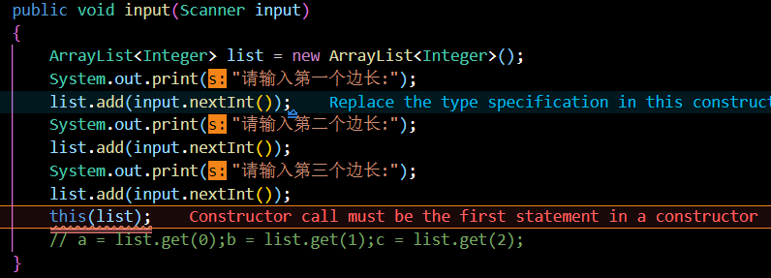
public class Lesson {
public Lesson(int x){}
public Lesson(int x,int y)
{
this(x);
}
}
构造函数需要在构造函数头部调用

Slide 7
import java.util.ArrayList;
import java.util.Scanner;
public class AreaAndLength {
static Triangle t = new Triangle();
static Circle circle = new Circle();
static Scanner input = new Scanner(System.in);
public static void main(String[] args) {
Scanner input = new Scanner(System.in);
int id = -1;
while(id != 0)
{
System.out.println("输入数据，0: exit, 1: Triangle, 2: Circle");
id = input.nextInt();
if (id == 1)
{
t.input(input);
t.print();
}
else if (id == 2)
{
circle.input(input);
circle.print();
}
}
}
}
Why static?

Slide 8
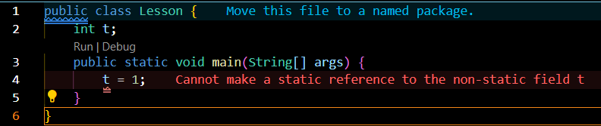
main 是一个静态方法。它不能引用 t，这是一个非静态变量
public class Lesson {
int t;
public static void main(String[] args)
{
Lesson obj = new Lesson();
obj.t = 1;
}
}
public class Lesson {
static int t;
public static void main(String[] args)
{
t = 1;
}
}

Slide 9
在 Java 中，静态方法是属于类的，而不是属于类的实例。而非静态成员是属于类实例的。—— generated by GPT-3.5
public class Lesson {
public static void main(String[] args) {
try_static.print();
}
}
class try_static {
public static void print()
{
System.out.println("114");
}
}

Slide 10
class Circle {
double radius;
static final double PI = 3.14;
public Circle() {}
public Circle(double r) {
radius = r;
}
double area() {
return PI * radius * radius;
}
double circumference(){
return 2 * PI * radius;
}
public void print() {
System.out.println("圆的半径为:"+radius);
System.out.println("圆的面积为:"+area());
System.out.println("圆的周长为:"+circumference());
}
public void input(Scanner input) {
System.out.print("请输入圆的半径:");
radius = input.nextDouble();
}
}
github.com/lxl66566

