Slide 1
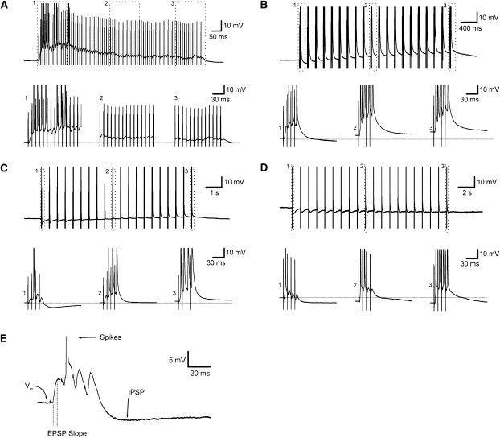
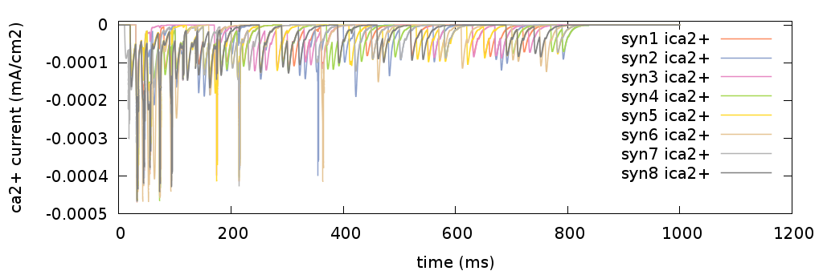
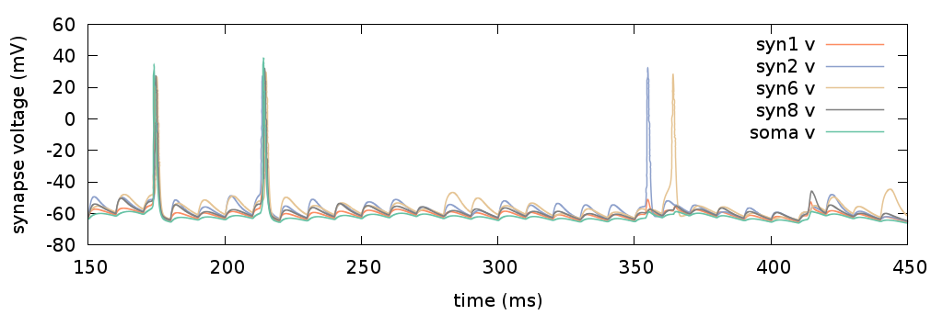
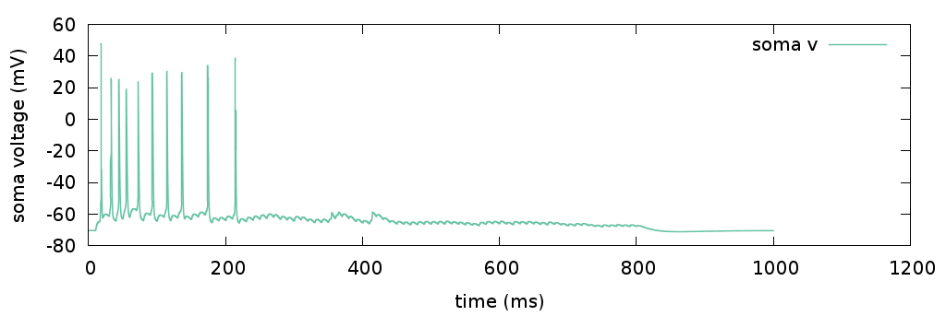
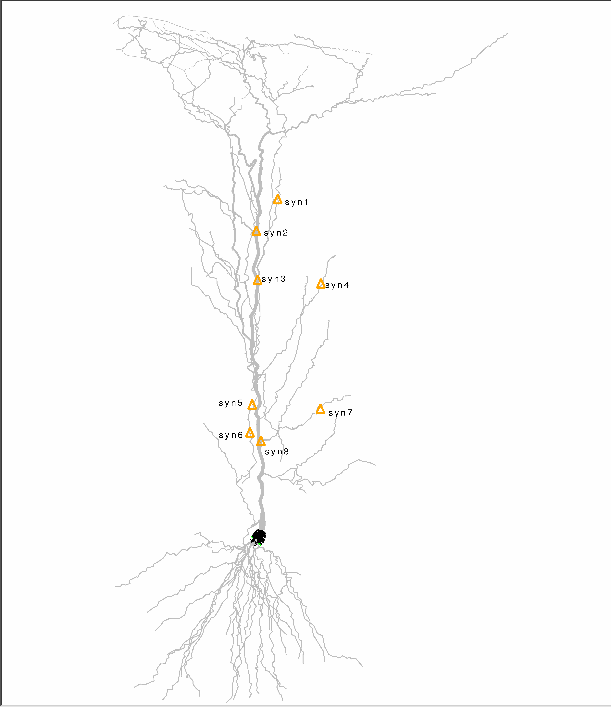
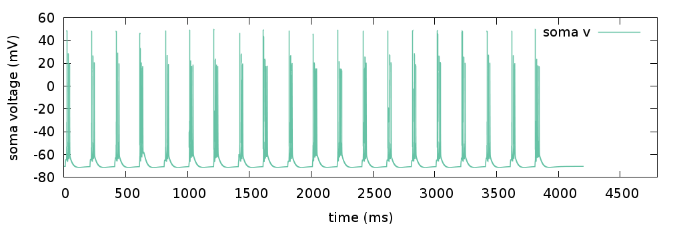
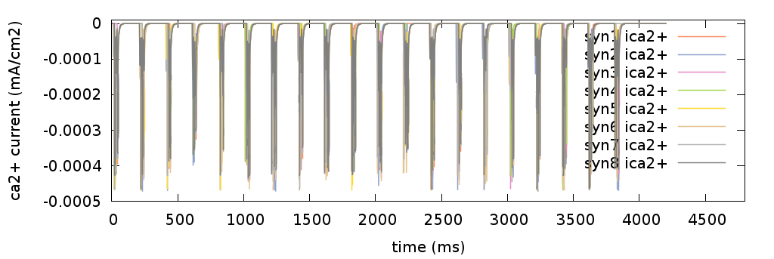
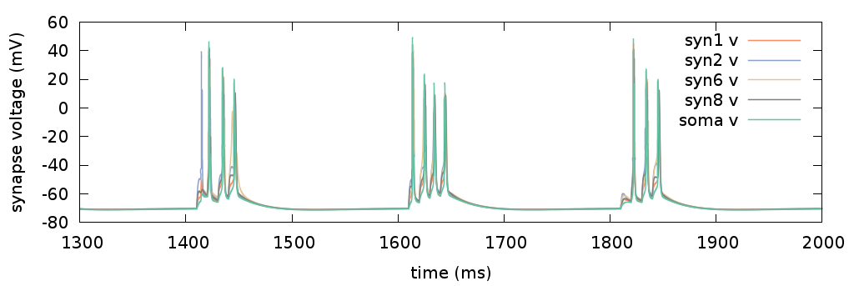
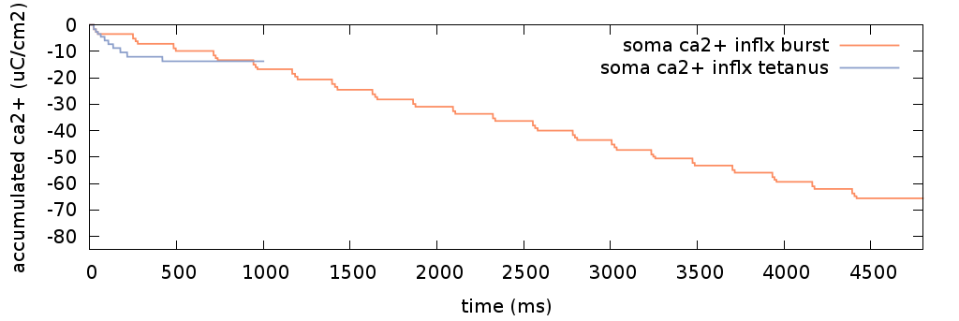
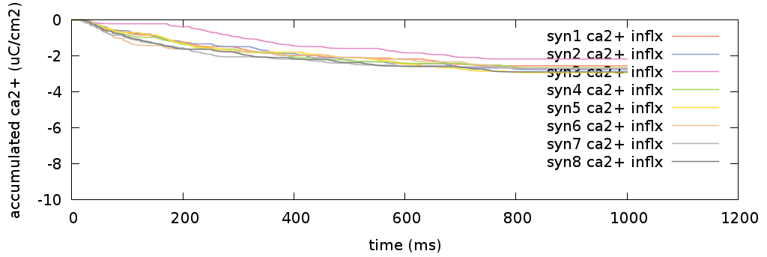
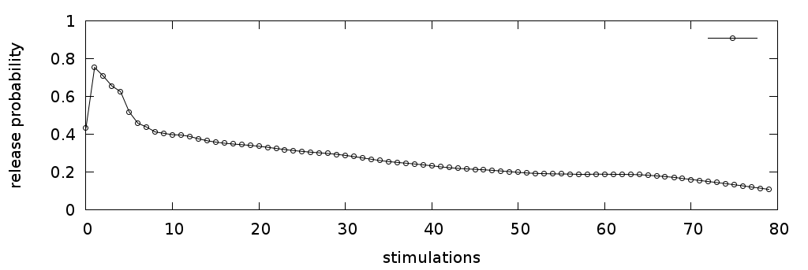
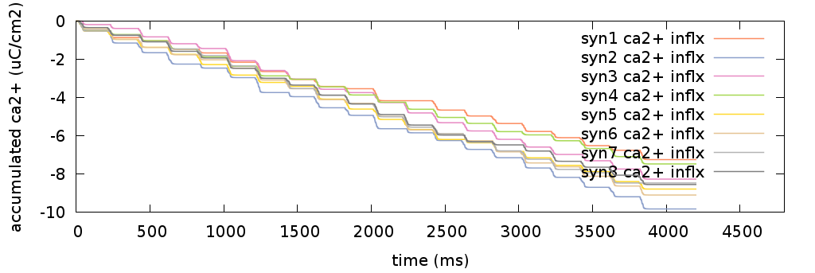
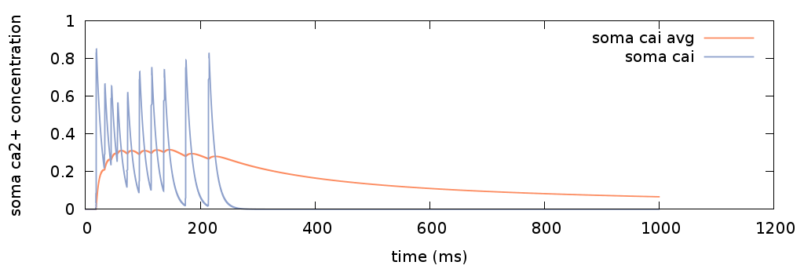
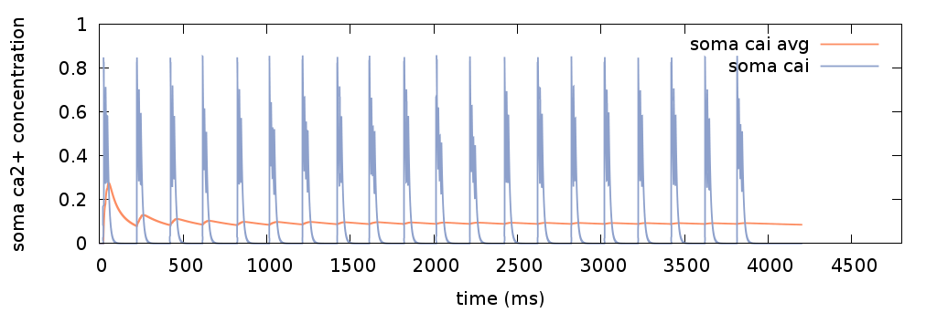
Comparing calcium influx with high-frequency stimulation and burst stimulation LTP protocols
Ximing Li, William R. Holmes
Department of Biological Sciences, Neurosciences Program, Ohio University, Athens, 45701, USA
Introduction
Results
Two popular protocols for inducing LTP in CA1 pyramidal cells are high-frequency stimulation (HFS), typically continuous 100 Hz tetanization for 1 second, and burst stimulation with 4 pulses at 100 Hz repeated at 200 ms intervals. NMDA blockers prevent LTP with burst stimulation, but some NMDA-independent LTP remains with HFS. Conversely, the L-channel antagonist nifedipine strongly inhibits LTP following HFS, but has a relatively small effect on LTP induced by burst stimulation [1]. These different effects are likely to be produced by different levels of calcium influx from different sources caused by different voltage responses generated with the two protocols. Here we sought to compare calcium influx at spines and the cell body produced by these two protocols quantitatively by using computational models of a CA1 pyramidal cell with full morphology.
Soma voltages during HFS and burst stimulation
Calcium current through NMDAR at selected spines
Spikelets
HFS stimulation (top) and burst stimulation (bottom). Model results are compared to experimental data from [1] (insets on the right). With HFS there is a burst of action potentials early in the train, but few or no action potentials later in the train, although voltage remains elevated. Burst stimulation reliably produces 1-4 action potentials in each burst.
We occasionally saw spikelets of 10s of mV generated in the dendrites with continuous tetanization, but these did not propagate successfully to affect soma voltage. Initial spikes or spikes generated after a quiet period tended to be generated at the initial segment, but the site of action potential generation of subsequent spikes moved into the dendrites.
HFS stimulation (top) and theta burst stimulation (bottom). Spines are located in the cell as indicated on the cell figure. Note the smaller currents that continue to be generated with HFS when there are no action potentials.
Methods
We built a CA1 pyramidal neuron model with detailed morphology and voltage-dependent conductances and subjected it to HFS or theta burst stimulation. For synapses, the probability of vesicle release at each position in a long HFS (80 pulse) train was taken from experimental data (see below).
Total calcium influx at the soma is greater with burst stimulation
Total calcium influx at spines is greater with burst stimulation
Conclusion
The larger total calcium influx seen with burst stimulation is consistent with the observation that this is a more effective protocol than continuous tetanization for inducing LTP. How the differences in calcium signals observed at spines and the soma with these two different protocols affect LTP induction or explain the different actions of L-channel and NMDA blockers on LTP induction with these protocols awaits further study.
Probability of release as a function of position in an HFS train (adapted from [2])
Accumulated calcium influx at the soma is initially higher with HFS but becomes much larger with burst stimulation. Total influx is correlated with number of action potentials fired.
Average soma [Ca] is greater with HFS stimulation
Calcium transients and average calcium concentration computed at the soma for HFS (top) and burst stimulation (bottom). Average soma [Ca] for the first few hundred milliseconds is much larger with HFS stimulation.
References
For burst stimulation (20 bursts, 80 total pulses) the probability of release for the four pulses in a burst was taken as the probability of release for the first four pulses in the HFS train. Calcium influx through NMDA receptor channels was computed at several dendritic spines and calcium influx through L-type calcium channels was computed at the soma.
Accumulated calcium influx at labeled spines. HFS (top), burst (bottom). Total influx was greater with HFS at early times, but became larger with burst stimulation at later times.
1. Grover LM, Kim E, Cooke JD, Holmes WR: LTP in hippocampal area CA1 is induced by burst stimulation over a broad frequency range centered around delta. Learn Mem 2009, 16:69-81.
2. Kim E, Owen B, Holmes WR, Grover LM: Decreased afferent excitability contributes to synaptic depression during high-frequency stimulation in hippocampal area CA1. J Neurophysiol 2012, 108:1965-1976.

