Slide 1
Bus Stop Assistant

Slide 2
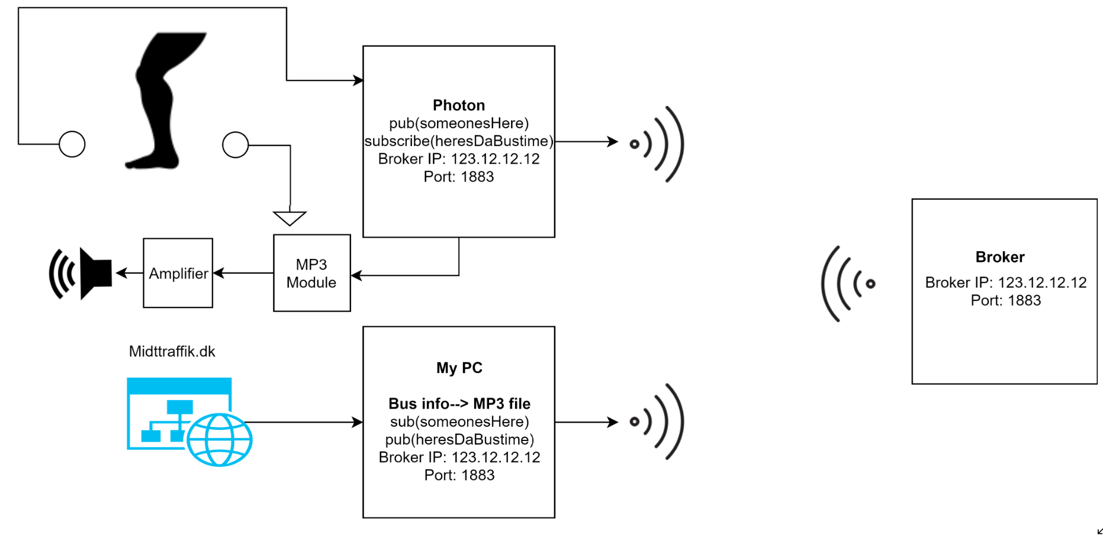
Introduction
Read out the next bus info when someone enters a bus stop

Slide 3
Introduction
Human presence detected
Photon publishes topic
Client- My PC subscribes to topic
Responds by getting data from middtraffik.dk and converting it into mp3
Publishes this topic with data
Photon subscribes to this data
Plays mp3 on speakers

Slide 4
Requirements
Permission from midttraffik.dk to access real time data
A PC connected to internet
Text to voice converter in the PC
Availability of WIFI to IOT device on the bus stop
Power supply for the speakers

Slide 5
Technical Challenges
Converting bus information data into an audio file

Slide 6
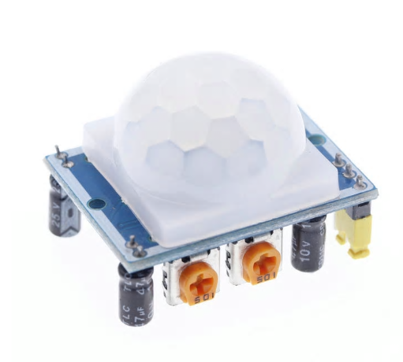
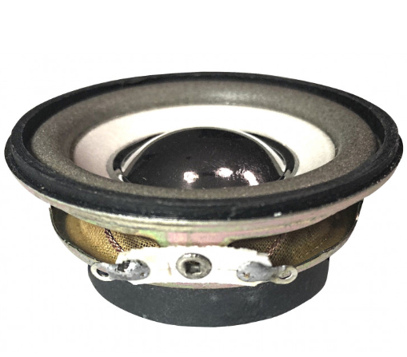
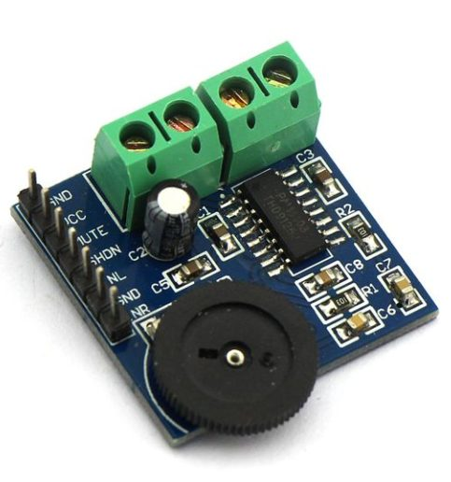
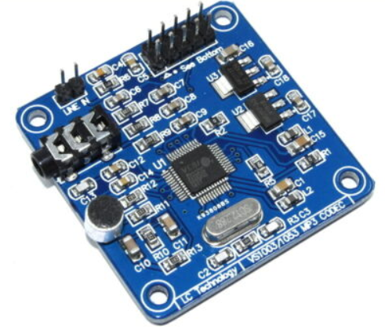
Sensors/Actuators/Web data sources
PIR sensor- https://jentronic.dk/diverse-moduler/119-infrarod-pir-sensor-modul-hc-sr501.html
SPI MP3 MODULE-https://www.u-buy.dk/en/search/index/view/product/B01JCI23JG/s/aideepen-yx5300-uart-control-serial-mp3-music-player-module-for-arduino-avr-arm-pic/store/store
Audio amplifier- https://arduinoshoppen.dk/produkt/pam8403-volume-adjustment-2-channel-digital-audio-amplifier-module/
3W speaker- https://jentronic.dk/audio/73-hojttaler-4-3w.html

Slide 7
Test
Initially on breadboard
Tester waves arm in front of IR detector
Speaker should play the latest bus status with respect to Birk Centerpark bus stop

Slide 8
Github Repo
https://github.com/lxmii/IOT

