Slide 1

DEPN: Detecting and Editing Privacy Neurons in Pretrained Language Models（arxiv23）
Xinwei Wu, Junzhuo Li, Minghui Xu, Weilong Dong, Shuangzhi Wu, Chao Bian, Deyi Xiong
Xiuming Liu | 2112492 | Information Security
Yuchen Zhou | 2111408 | Information Security
Mingjie Qi | 2113997 | Information Security
Xiaoyang Ji | 2110611 | Cryptographic Science and Technology
2024.5

Slide 2
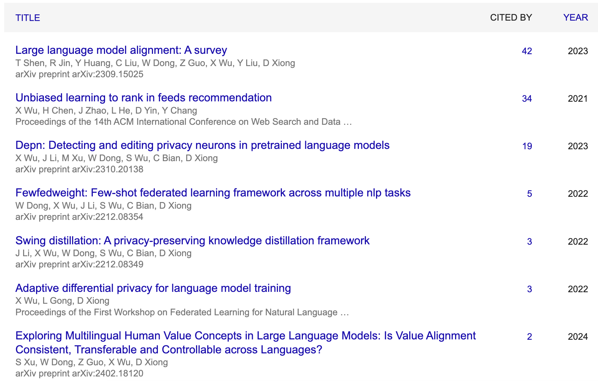
Authors
Tianjin University
Xinwei Wu, Junzhuo Li, Minghui Xu, Weilong Dong, Deyi Xiong
Focus on the NLP, Privacy Attack and Protection

Slide 3
Background
Pretrained Language Models (LLMs)
GPT-3, BERT, etc.
Vast data training
Rich knowledge capture
Privacy and Security Concerns
Memorization of training data
employ the context of private information as the input to the language model
calculate the risk of private information leakage
classify the information with a leakage risk exceeding predefined thresholds as having been memorized by the language model
Sensitive information leakage

Slide 4
Background
Privacy Risks
Extracting personal info from outputs
Inducing generation of personal info
Training data memorization
Existing Methods
Data processing stage: remove sensitive info
Training stage: differential privacy, adversarial training
Post-processing stage: parameter retraining, keyword filtering
Limitations
High computational cost
Ineffectiveness post-training

Slide 5
Contributions
DEPN
Explore model editing into privacy protection of pretrained language models, propose DEPN to eliminate model memorization.
Propose the privacy neuron detector to localize privacy neurons based on gradient attribution, and the privacy neuron editor to dememorize privacy information.
Experiments to demonstrate that the proposed framework is capable of protecting privacy leakage form pretrained language models.

Slide 6
Preliminary
Privacy Definition
great concern in the era of pretrained language models
closely related to its context and discourse
a narrow definition of privacy

Slide 7
Preliminary
Model Editing
a key-value memory（Transformer:FFN)
Key：a text pattern
Value：a distribution over the vocabulary
edit factual knowledge encoded by locating neurons related to the entities of factual knowledge
change the parameters of neurons, observe the changes
greater influence, more closely
Limitations: only observe the probability change of one token at a time

Slide 8
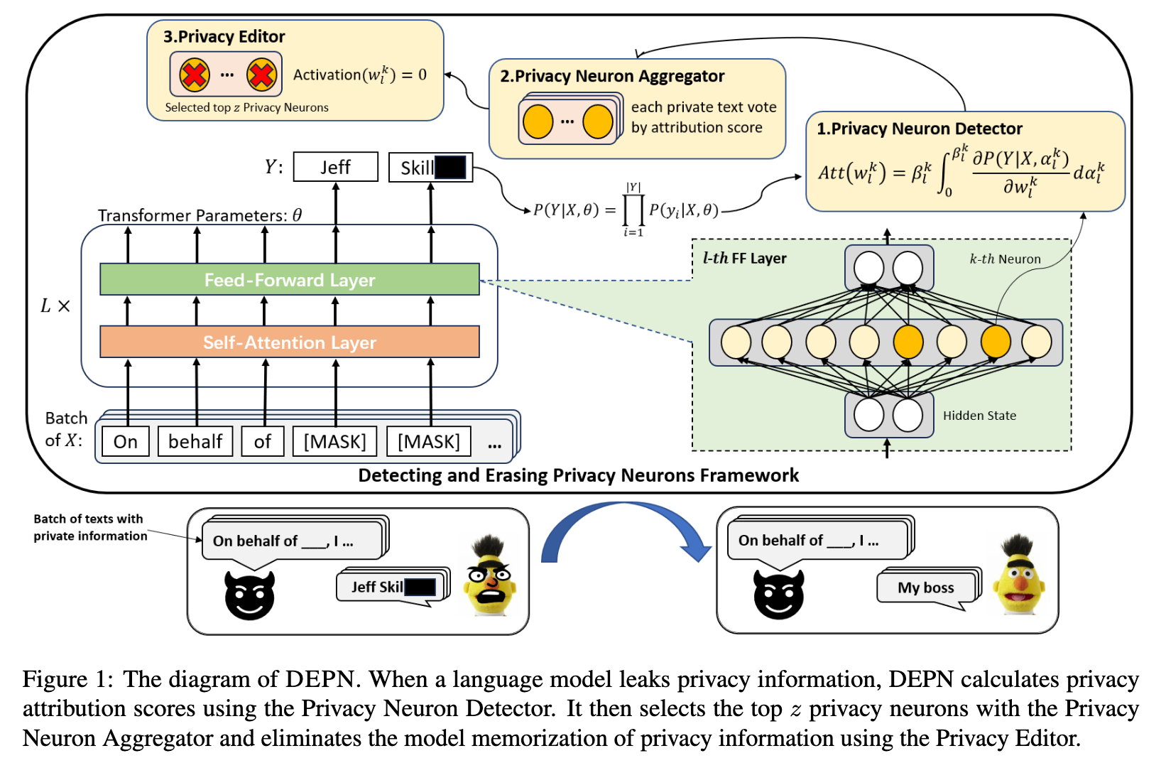
Methodology
DEPN
Privacy Neurons Detector: Locate neurons associated with private information
Privacy Neuron Aggregator: Process privacy information in batches
Privacy Editor: Set the activation values of these neurons to zero

Slide 9
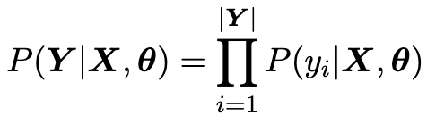
Methodology
Privacy Prediction Task
"An■Ka■ is a senior writer at ESPN.com", a private sentence containing a person's name "An■Ka■".
"_ _ is a senior writer at ESPN.com" reduce the probability of privacy leakage
minimizing the probability of predicting "An■" and "Ka■"

Slide 10
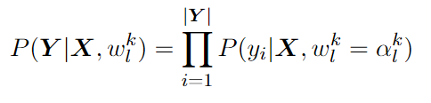
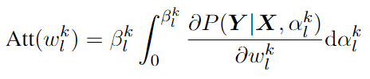
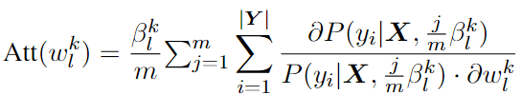
Methodology
Privacy Neuron Detector
speculate that private information might be encoded in specific neurons
propose a privacy attribution method based on gradient integration
the probability of the model outputting private information：
the privacy attribution score：
the greater the privacy attribution score, the greater the privacy sensitivity of the neuron

Slide 11
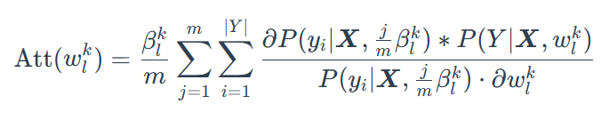
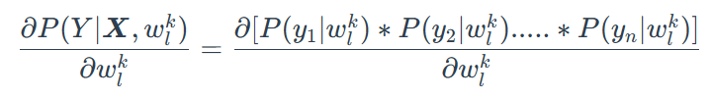
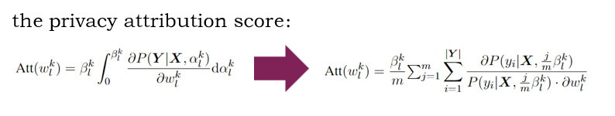
Methodology
Is it true？

Slide 12
Methodology
Privacy Editor
setting the activation values of the corresponding neurons to 0

Slide 13
Methodology
Privacy Neuron Aggregator
erase privacy information encoded in the language model
propose the privacy neuron aggregator
calculate the privacy attribution score matrix of each sequence in the batch
let each sequence vote for neurons according to their privacy attribution scores
select the top z neurons with the most votes

Slide 14
Experiments
Setup
Dataset：Enron
Private Information Sampling
private phrases, for the narrow definition of privacy
Names: 20 unique names that are memorized by language models
Phone Numbers: 20 unique LM-memorized phone numbers
a batch of randomly sampled sentences to be edit
Private texts: 100 sentences that are not semantically overlapping with each other

Slide 15
Experiments
Setup
Model Settings：BERT-base, 12 transformer layers
Baseline
BERT-O: No Enron, an oracle for assessing the risk of privacy leakage
BERT-F: Enron + BERT, best predictive performance on the Enron, has the greatest risk of privacy leakage
BERT-DP: Enron + BERT + differential privacy gradient descent
BERT-FE: Enron + BERT + DEFN

Slide 16


Experiments
Setup
Metrics
Exposure: measure the exposure risk of phone numbers
Mean Reciprocal Rank (MRR): measure the model's memorization of names
Perplexity (PPL): measure the model memorization

Slide 17
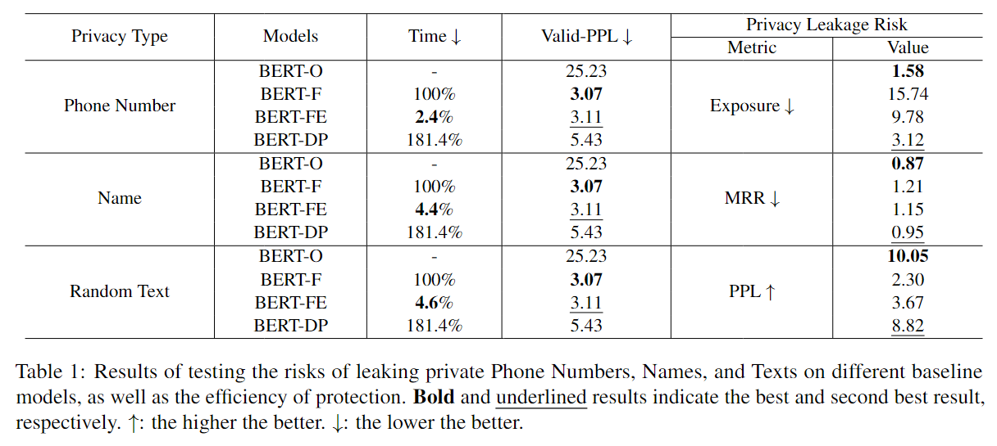
Experiments
Main Results

Slide 18
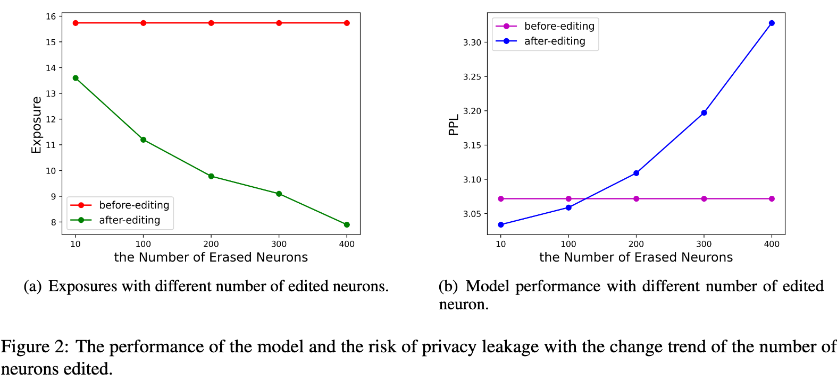
Analysis
Effect of the Hyperparameter

Slide 19
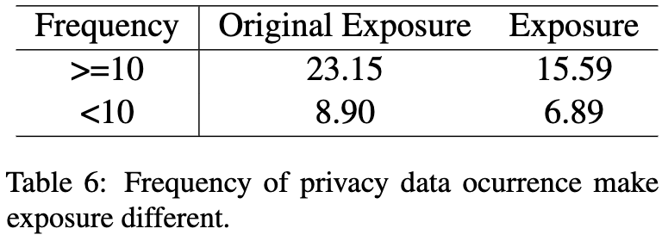
Analysis
Effect of the Frequency of Privacy Data Ocurrence

Slide 20
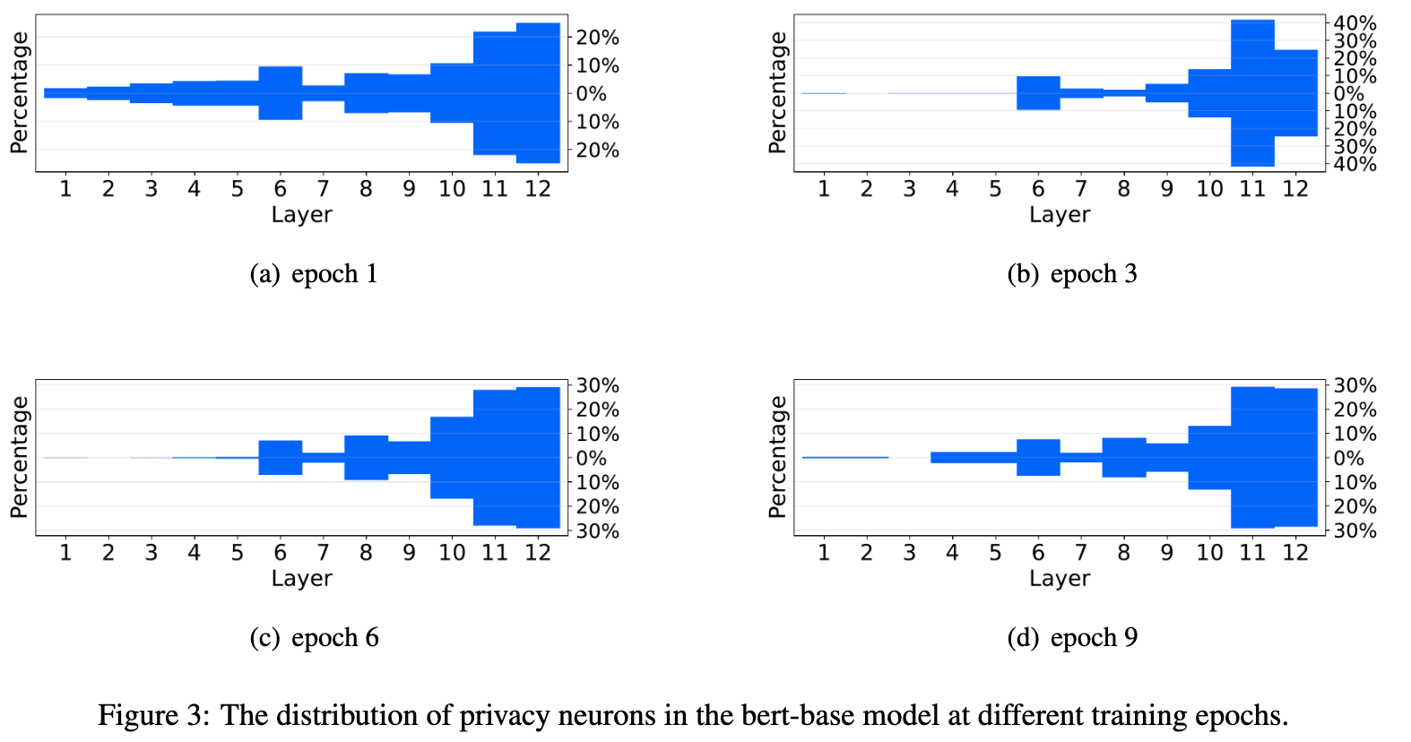
Analysis
Relationship between Memorization And Privacy Neurons
Impact of Training Time on Privacy Neuron Distribution over Layers

Slide 21
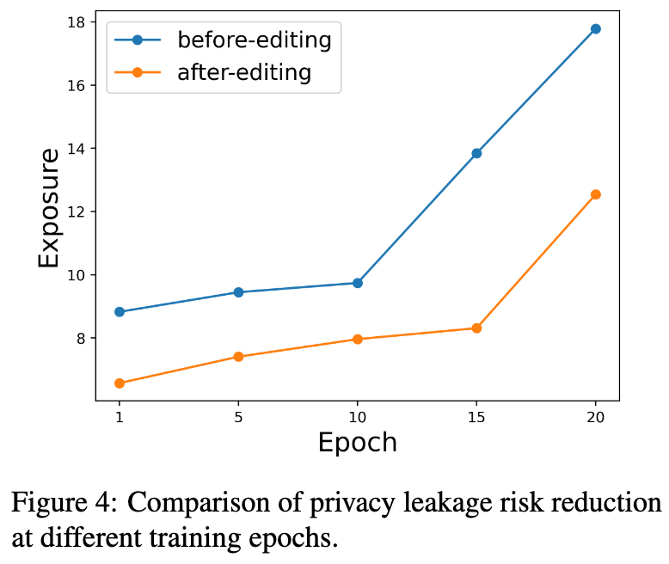
Analysis
Relationship between Memorization And Privacy Neurons
Impact of Training Time on Privacy Neuron Distribution over Layers
the changes in exposure before and after erasing privacy neurons in models with different training epochs

Slide 22
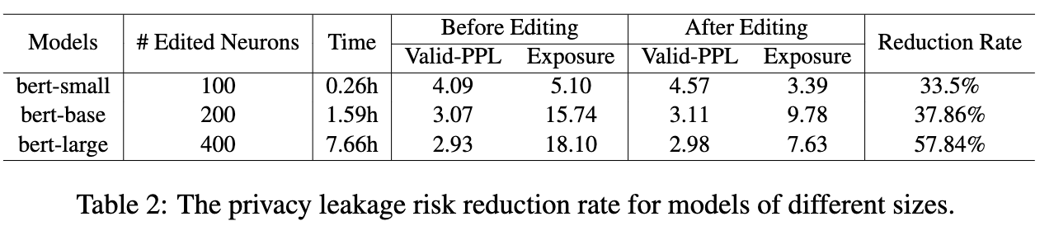
Analysis
Relationship between Memorization And Privacy Neurons
Impact of Training Time on Privacy Neuron Distribution over Layers
Effect of the Model Size
10 epochs
the optimal hyperparameter settings

Slide 23
Analysis
Relationship between Memorization And Privacy Neurons
Impact of Training Time on Privacy Neuron Distribution over Layers
Effect of the Model Size
Summary：As the model memorization of privacy data deepens, the aggregation of privacy neurons associated with privacy data becomes more pronounced

Slide 24
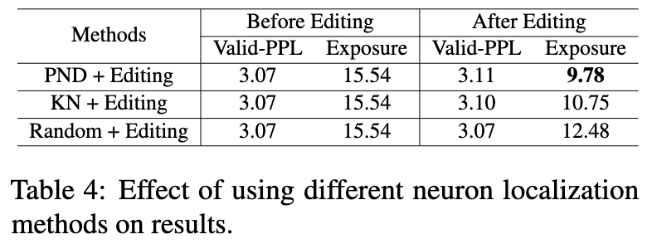
Analysis
Robustness Analysis
Ablation Study
compare its performance with different neuron localization methods on phone number data

Slide 25
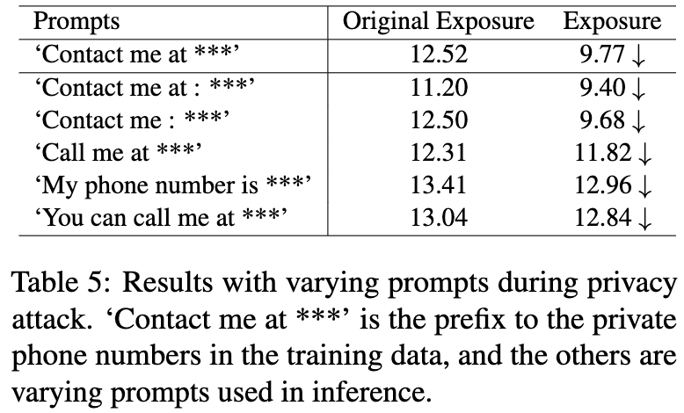
Analysis
Robustness Analysis
Ablation Study
Robustness to Different Prompts
perform privacy attacks during inference using different prompts

Slide 26
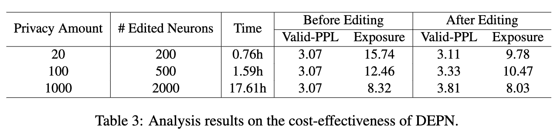
Analysis
Analysis on the Cost-Effectiveness of DEPN
its dependency on the amount of private data to be erased

Slide 27
Conclusion
DEPN
the privacy neuron detector based on the privacy attribution scoring method
the privacy neuron detector based on the privacy attribution scoring method
privacy neuron editor
eliminate model memorization of private data
Limitations
too many instances in a batch will reduce the effect of memorization erasure
a few types of private information for experiments

Slide 28
Thanks
Xiuming Liu | 2112492 | Information Security
Yuchen Zhou | 2111408 | Information Security
Mingjie Qi | 2113997 | Information Security
Xiaoyang Ji | 2110611 | Cryptographic Science and Technology
2024.5

