Slide 1

DEPN: Detecting and Editing Privacy Neurons in Pretrained Language Models（arxiv23）
Xinwei Wu, Junzhuo Li, Minghui Xu, Weilong Dong, Shuangzhi Wu, Chao Bian, Deyi Xiong
刘修铭 2112492 信息安全专业
周钰宸 2111408 信息安全专业
齐明杰 2113997 信息安全专业
纪潇洋 2110611 密码科学与技术专业

Slide 2
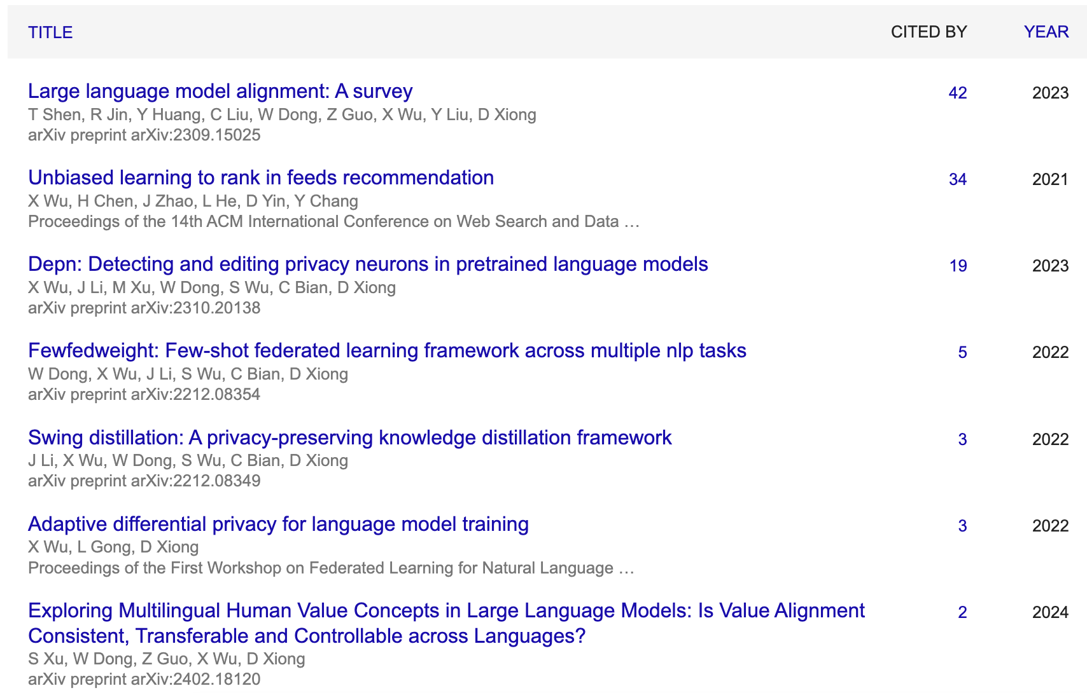
Authors
Tianjin University
Xinwei Wu, Junzhuo Li, Minghui Xu, Weilong Dong, Deyi Xiong
Focus on the NLP, Privacy Attack and Protection

Slide 3
Background
Pretrained Language Models (LLMs)
GPT-3, BERT, etc.
Vast data training
Rich knowledge capture
Privacy and Security Concerns
Memorization of training data
Sensitive information leakage
Privacy Risks
Extracting personal info from outputs
Inducing generation of personal info
Training data memorization

Slide 4
Background
Existing Methods
Data processing stage: remove sensitive info
Training stage: differential privacy, adversarial training
Post-processing stage: parameter retraining, keyword filtering
Limitations
High computational cost
Ineffectiveness post-training

Slide 5
Contributions
DEPN
Explore model editing into privacy protection of pretrained language models, propose DEPN to eliminate model memorizatio.
Propose the privacy neuron detector to localize privacy neurons based on gradient attribution, and the privacy neuron editor to dememorize privacy information.
Experiments

Slide 6
Preliminary
Privacy Definition
great concern in the era of pretrained language models
closely related to its context and discourse
a narrow definition of privacy

Slide 7
Preliminary
Model Editing
a key-value memory
Key：a text pattern
Value：a distribution over the vocabulary
edit factual knowledge encoded by locating neurons related to the entities of factual knowledge
change the parameters of neurons, observe the changes
greater influence, more closely
Limitations: only observe the probability change of one token at a time

Slide 8
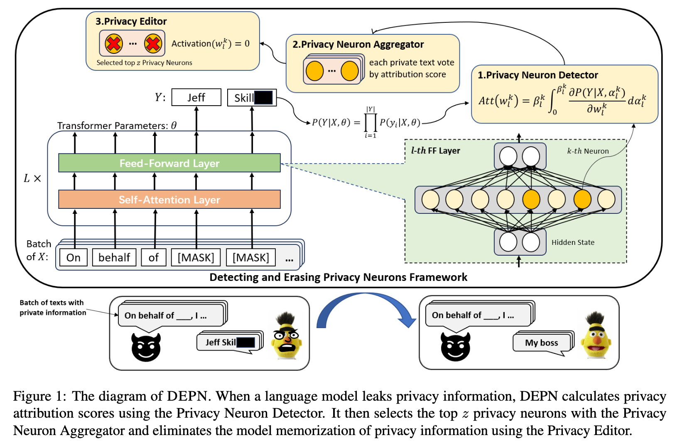
Methodology
DEPN
Privacy Neurons Detector: Locate neurons associated with private information
Privacy Neuron Aggregator: Process privacy information in batches
Privacy Editor: Set the activation values of these neurons to zero

Slide 9
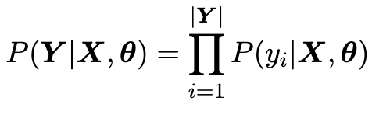
Methodology
Privacy Prediction Task
"An■Ka■ is a senior writer at ESPN.com", a private sentence containing a person's name "An■Ka■".
"_ _ is a senior writer at ESPN.com", reduce the probability of privacy leakage
minimizing the probability of predicting "An■" and "Ka■"

Slide 10
Contributions
DEPN
Explore model editing into privacy protection of pretrained language models, propose DEPN to eliminate model memorizatio.
Propose the privacy neuron detector to localize privacy neurons based on gradient attribution, and the privacy neuron editor to dememorize privacy information.
Experiments

Slide 11
Thanks

