Slide 1
WriteDown
Android application.

Slide 2
What is WriteDown?
Focus / Domain / Area
For our application, we want to focus on the students who study abroad. When the student taking notes in class, they can use our product to taking notes. Our product can translate what students write in the class. It is helpful for international students to study.
Libraries / Frameworks /
We want to using android studio to create our application.
Platform (Mobile, Desktop, Gaming, Etc).
We want to use our application in the android devices. Mobile or pad.
Genre (Game, Application, etc)
application

Slide 3
Functional ： Our project is focus on handwriting recognition to words,and Translate the handwriting words to other languages.

Slide 4
-UI: the UI interface will have a login and register function.It will have a username ,password bar and a register icon.
-Database interface: the interface system for user account will need to be included a method to save information such as the words translated,and get another method to get the saved information
-Hardware interfaces :the application must take input from any generic touch screen in order for the user to navigate the menus and output to any current generic monitor compatible with Android cellphone.

Slide 5
Performance: Recognition handwriting
Transform the handwriting words to text words
Translate the text words to other language
Save and get the history information

Slide 6
System:
Write Down project will require a Android operating system on a mobile phone with the minimum requirement specifications to run said operating system. Database based on the SQLite.

Slide 7
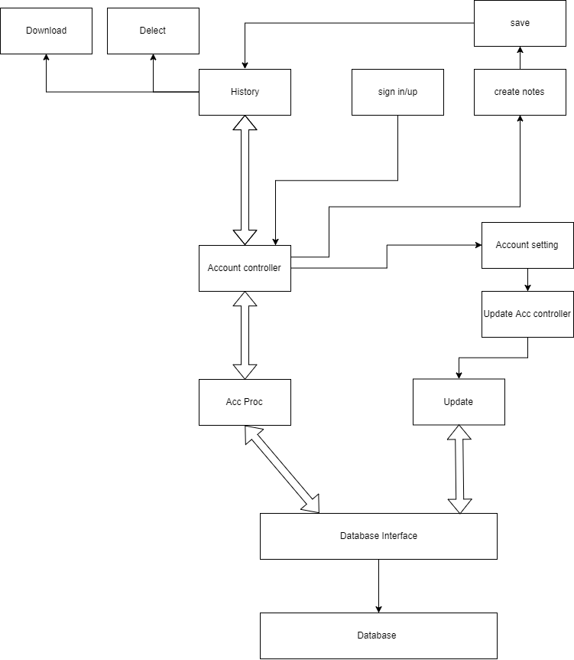

Slide 8
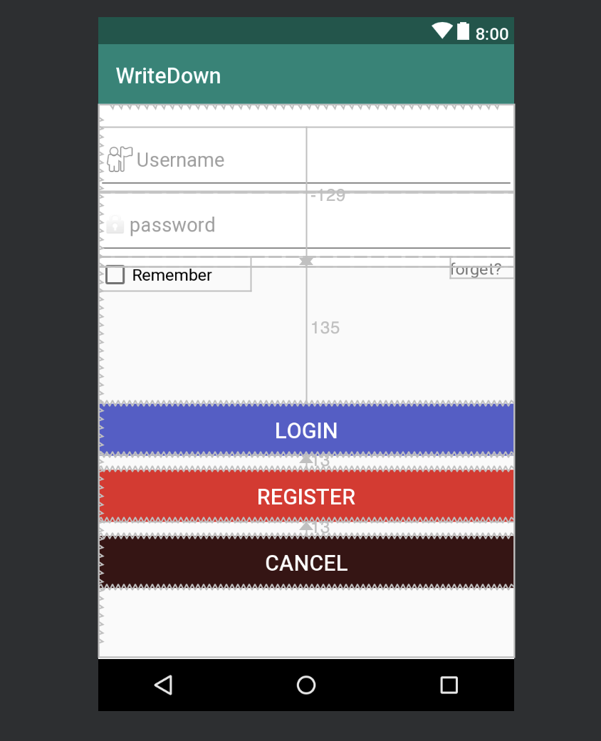
Login page: let users to type their user information, also give them the option to register.

Slide 9
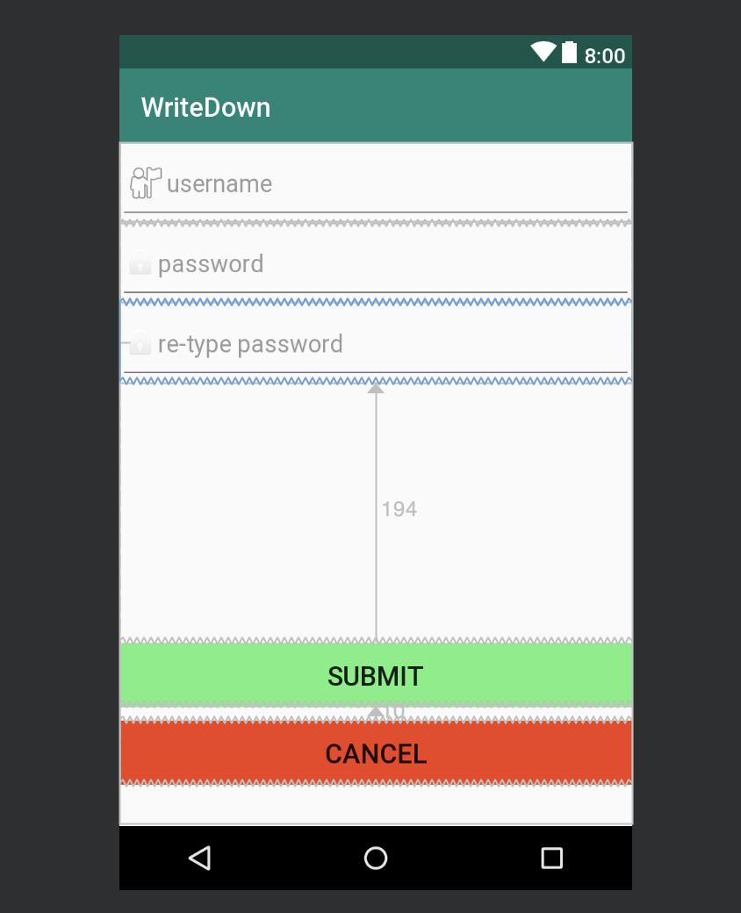
Register page: In this page, users are going to register their own account, by re-type password to reduce the password problems.

Slide 10
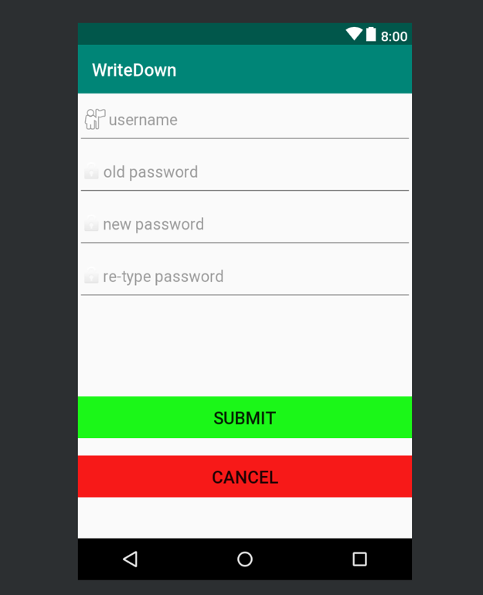
Reset password: Let user type their own information to change the new password. (Will include/change to email check in the future.)

Slide 11
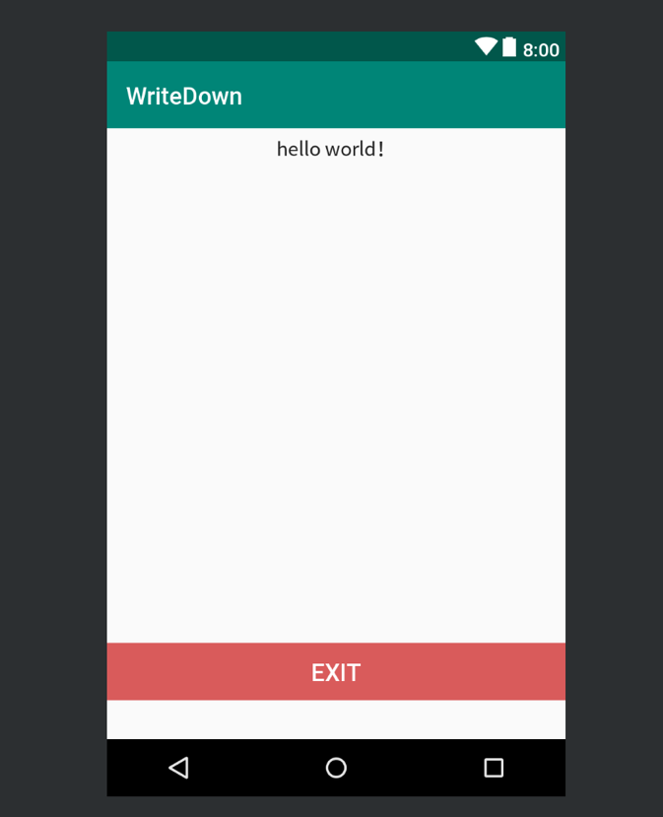
Account: Basic information of user and have the exit option.(will give more information).(ex. May add change password in this page too.)

Slide 12
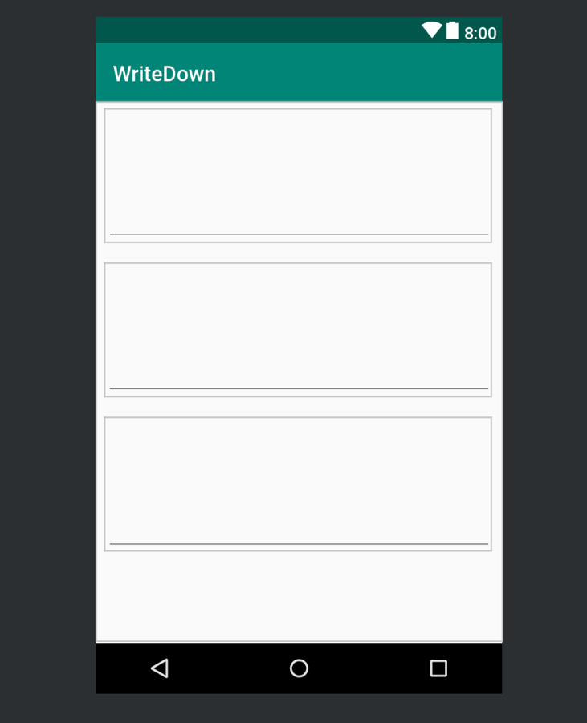
Note page: This is the page to start make handwriting.(will have the save option)

Slide 13
Reference
API source for translation:
https://cloud.google.com/translate/?utm_source=google&utm_medium=cpc&utm_campaign=na-US-all-en-dr-bkws-all-all-trial-e-dr-1003905&utm_content=text-ad-none-any-DEV_c-CRE_297670895032-ADGP_Hybrid%20%7C%20AW%20SEM%20%7C%20BKWS%20%7C%20US%20%7C%20en%20%7C%20EXA%20~%20ML%2FAI%20~%20Translation%20API%20~%20translate%20google%20api-KWID_43700037004364762-kwd-62662196764&utm_term=KW_translate%20google%20api-ST_translate%20google%20api&gclid=Cj0KCQiA1sriBRD-ARIsABYdwwHVXetWmus69FmNXDHzzplhhyB112e_CeBWnLkAs0jlpXGwZojor1caAupiEALw_wcB
Google(ocr):
https://cloud.google.com/vision/docs/handwriting

