Slide 1

Analysis of Delivery Timeliness and Prediction of Delays
A Comprehensive Data-Driven Approach to Enhancing Logistic Operations
Name: Leeroy Njiva

Slide 2

Introduction
Objective: This presentation aims to provide insights into the timeliness of deliveries within our logistics operations, identify potential delays, and predict future occurrences to improve service reliability.
Scope: Analysis covers data from GPS tracking, shipment bookings, and prospective booking predictions.
Approach: Utilizing advanced data analytics techniques including data merging, datetime parsing, and predictive modeling.
Notes:
The goal of this presentation is to deep dig into how our deliveries perform against scheduled times, identify patterns of delays, and explore predictive models to anticipate future delays.
This will help us not only to improve our service reliability but also to enhance our operational decision-making process.

Slide 3

Data Overview
Data Sources:
GPS Data: Tracks real-time vehicle locations.
Shipment Bookings: Records details about each shipment.
New Bookings: Contains future bookings to analyze prospective delays.
Preprocessing Steps:
Parsing datetime fields with timezone awareness.
Merging GPS and bookings data for comprehensive analysis.
Notes:
We sourced our data from three main streams: real-time GPS tracking data, historical shipment bookings, and future shipment bookings.
Special attention was given to accurate datetime parsing to align data across different time zones, ensuring our analysis is as precise as possible.

Slide 4

Analysis of On-Time Deliveries
Key Findings:
"75.20% of deliveries met the on-time delivery threshold."
Visualization: [Include a bar graph of on-time delivery percentage]
Discussion:
The high percentage of on-time deliveries indicates effective logistics operations for most shipments.
Factors influencing timeliness include vehicle type, route chosen, and external conditions such as traffic.
Notes:
We found that 75.20% of our deliveries were on time, which is a testament to our efficient logistics management.
However, understanding the 24.80% that weren't on time is crucial for us to identify any underlying issues and address them effectively.

Slide 5
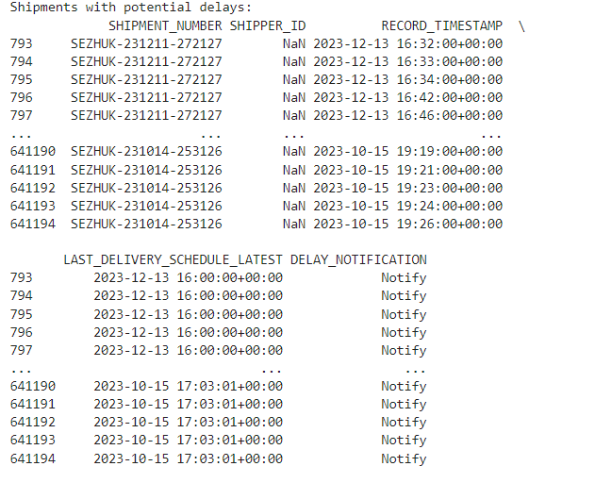
Potential Delays Identification
Overview of Findings:
Several potential delays were identified, where shipments exceeded their scheduled delivery windows.
Data Snippet:
Note:
"No potential delays were detected within certain periods, indicating effective adjustments and responses to logistic challenges."
Notes:
By closely monitoring shipments that exceeded their delivery windows, we can pinpoint inefficiencies and potential problems within specific routes or times.
Note the periods with no recorded delays, which likely reflect the effectiveness of recent operational improvements.

Slide 6

Predicting Future Delays for Shipments
Model Performance
Model Accuracy: 0.497 (Best Model)
Best Parameters: Learning Rate: 0.1, Max Depth: 4, Estimators: 200
Classification Report:
Precision, Recall, F1-Score for each class demonstrating moderate predictive accuracy.
Discussion:
The model provides a foundational approach to predict delays but indicates potential for further tuning and enhancement.

Slide 7
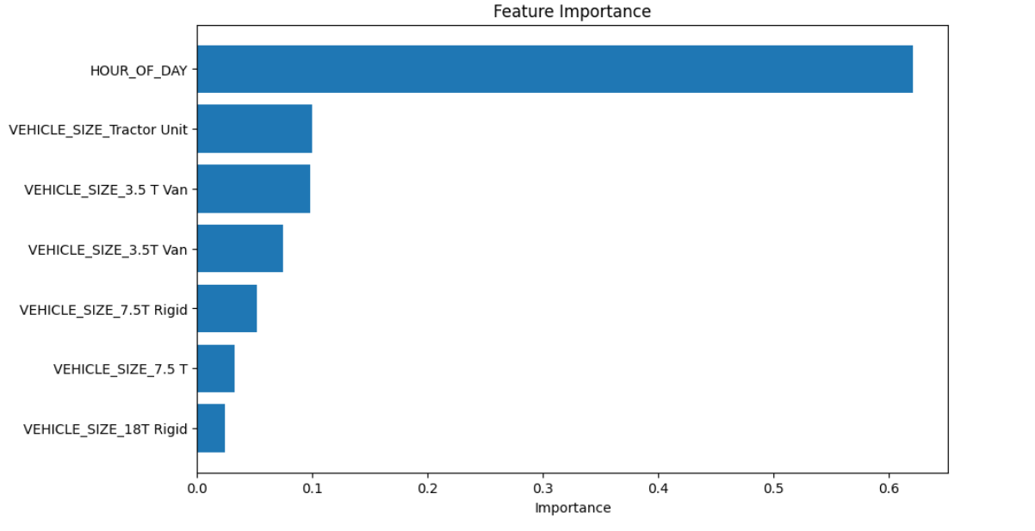
Feature Importance
Explanation:
"Hour of the Day is significantly impactful, suggesting specific times where logistical challenges are heightened."
"Vehicle size affects delay likelihood, with larger vehicles like Tractor Units showing different patterns compared to smaller vans."
Notes:
The 'Hour of Day' turned out to be the most significant predictor. This suggests that there are critical hours during the day where our operations could be optimized to prevent delays.
Different vehicle sizes impact delivery times differently, highlighting the need for tailored strategies depending on the vehicle type involved.

Slide 8
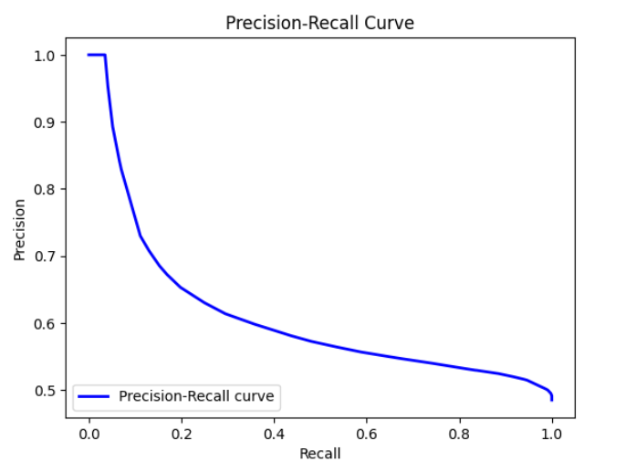
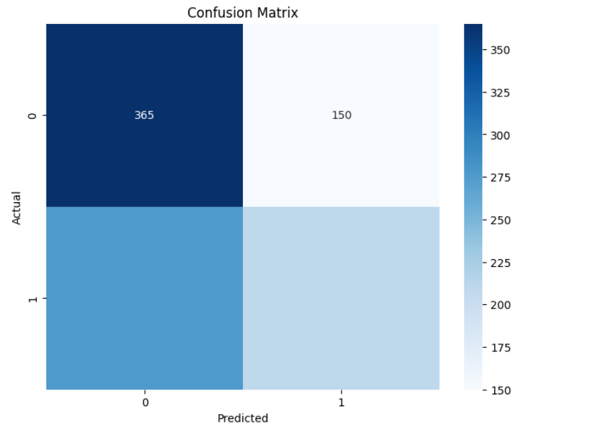
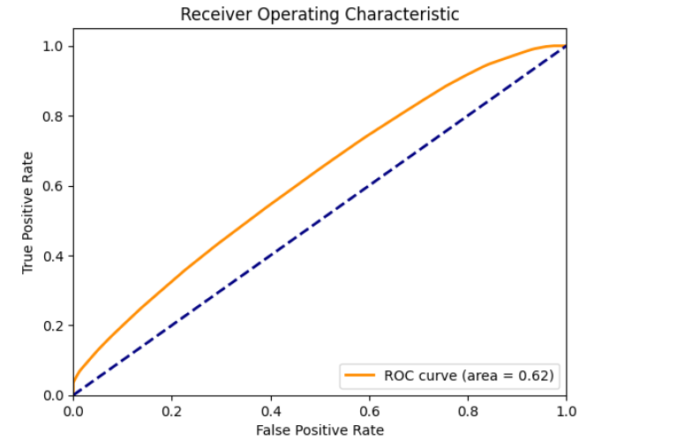
Model Evaluation Graphs
Notes:
Let’s discuss the three key visual tools that helped us understand our predictive model’s performance:
ROC Curve: The area under the curve (AUC) is 0.62, indicating a fair model. The ROC curve illustrates the true positive rate against the false positive rate, showing the trade-off between sensitivity and specificity as the threshold varies.
Confusion Matrix: Here, we see the breakdown of true positives, true negatives, false positives, and false negatives. It shows us not just the errors but the types of errors the model is making. For instance, 365 true negatives and 150 false negatives suggest our model is conservative, missing out on predicting some true delay cases.
Precision-Recall Curve: This curve is especially useful given the imbalanced nature of our data. It focuses on the success of prediction in the positive class. The curve drops, indicating that while our model starts with high precision, it struggles to maintain recall, suggesting a trade-off point that we might want to adjust depending on our operational priorities.

Slide 9
Conclusion
Summary:
Our analysis demonstrates a strong capacity for on-time deliveries with specific areas identified for improvement in delay prediction.
Implications:
Enhanced predictive capabilities can help allocate resources more effectively during critical periods.
Recommendations:
Continued refinement of predictive models.
Increased data collection on external factors affecting delivery times.

