Slide 1
互联网数据获取技术
-Flume

Slide 2
Flume
Flume is a system to collecting, aggregating and moving
large amounts of log data from different source to
centralized data store.

Slide 3
Feature of Flume
Scalable
Reliable
Fault tolerant

Slide 4
Flume Event
A Flume event is defined as a unit of data flow having a byte
payload and an optional set of string attributes.

Slide 5
Flume 简介
Flume Agent
Flume agent is an independent JVM process (JVM) in Apache Flume.
Source
Channel
Sink

Slide 6
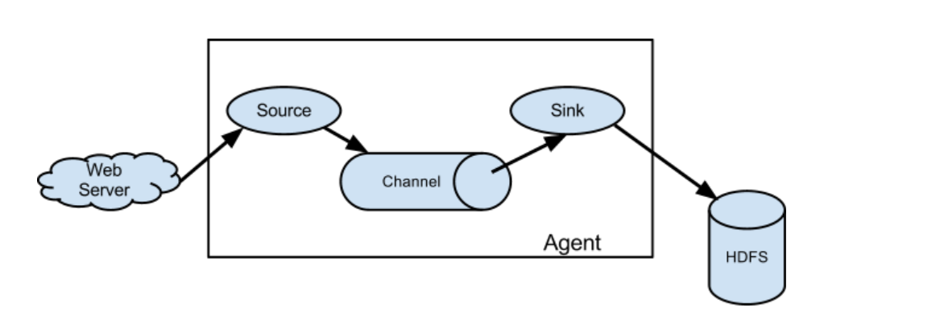

Slide 7
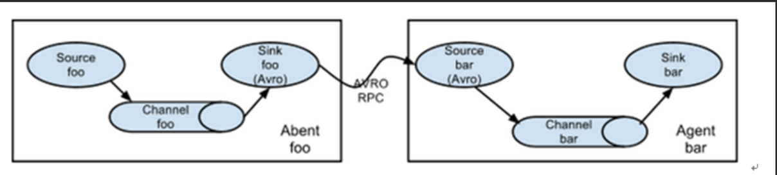
Complex Data Flow

Slide 8
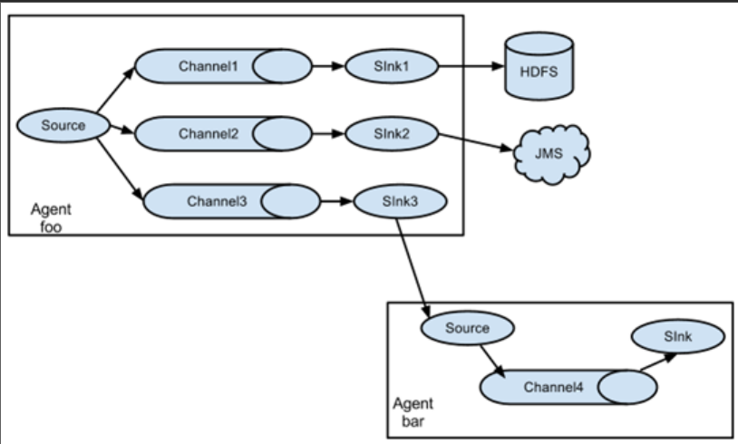
Multiplexing the flow

Slide 9
Flume Command
$flume-ng agent –n name –f filename
Flume-ng command
agent –n :- Flume agent name
-f :- conf file name
-conf :- conf directory location.

Slide 10
Netcat Source
A netcat-like source that listens on a given port and turns each line of text into an event.
type :- netcat
bind:- ip address
Port :- 2222(1 to 65535)

Slide 11
Exec Source
Exec source runs a given Unix command on start-up and expects that process to continuously produce data.
type :- exec
command:- cat and tail -F

Slide 12
Spooldir Source
This source lets you ingest data by placing files to be ingested into a “spooling” directory on disk
This source will watch the specified directory for new files.
When transfer done it marked .COMPLETED in file.
type :- spooldir
spoolDir:- path of directory

Slide 13
Taildir Source
Watch the specified files, and tail them in nearly real-time once detected new lines appended to the each files.
If the new lines are being written, this source will retry reading them in wait for the completion of the write.
type :- TAILDIR
filegroups :- f1 f2
filegroups.f1 = file location
Filegroups.f2 = file location

Slide 14
HTTP Source
HTTP requests are converted into flume events by a pluggable “handler” which must implement the HTTPSourceHandler interface.
type :- http
bind:-ip address
port = port number

Slide 15
Kafka Source
Kafka Source is an Apache Kafka consumer that reads messages from Kafka topics.
type :- org.apache.flume.source.kafka.KafkaSource
kafka.bootstrap.servers:- server address
Kafka.topics = topic_name
kafka.consumer.group.id = consumer id

Slide 16
Memory Channels
The events are stored in an in-memory queue with configurable max size.
It lose data when the process or machine shuts down or crashes.
when we can take risk to loose data.
type :- memory

Slide 17
File Channels
File channel writes out all the flume events to the disk.
It does not lose data even when the process or machine shuts down or crashes .
can not loose data.
type :- file
checkpointdir :- checkpoint location
dataDirs = data logs

Slide 18
HDFS sinks
This sink writes events into the Hadoop Distributed File System (HDFS).
type :- hdfs
hdfs.path :- location of hdfs
hdfs.fileType :- Datastream

Slide 19
Hbase sinks
This sink writes data to Hbase.
type :- hbase2
table:- table name
columnfamily = family name

