Slide 1
Een geautomatiseerde investeringsstrategie
Promotor: prof. dr. ir. Benjamin Schrauwen
Begeleiders: dr. ir. Francis wyffels, ir. Aäron van den Oord

Slide 2
Inhoud presentatie
Doel van thesis
Strategie ontwikkelen
Beleggingsportefeuille
Data
Resultaten voorspelling
Resultaten allocatie
Conclusie
Verdere onderzoeksstappen

Slide 3
Doel van thesis
Zelfstandige beleggingsstrategie:
Winstgevend
Risicoblootstelling beperken

Slide 4
Strategie ontwikkelen
Supervised regression
Financial time series prediction
Weekly portfolio allocation

Slide 5
Gesuperviseerde regressie
Gaussian Processes:

Slide 6
Portfolio allocatie
Black-Litterman

Slide 7
Beleggingsportefeuille

Slide 8
Data
Bron: Reuters Datastream
Determinanten:
Vnl. macro-economisch
Nationaal en globaal
Dagelijkse, wekelijkse, maandelijkse en kwartaal publicatie
Transformatie naar wekelijks: cubic-spline interpolatie
Abs. data + rel. verandering: genormaliseerd

Slide 9
Data
Train- en validatieset: 15/02/1993 t.e.m. 15/05/2012
Testset: 22/05/2012 tot heden
Splitsing train-validatie: sliding window
Train (520w)
Validatie (13w)
Train (520w)
Validatie (13w)

Slide 10
Gesuperviseerde regressie
Gaussian Processes:

Slide 14
Resultaten voorspellingen
Naieve voorspelling
Ridge Regressie
Gaussian Processes

Slide 15
Benchmarks voor Gaussian Processes
Benchmark | Voorspelling
1 | 0%
2 | Rendement vorige week
3 | Ridge regressie

Slide 16
Evaluatie voorspellingen
Normalized Mean Square Error (NMSE):
Hitrate:
Score = geometrisch gemiddelde (Hitrate, NMSE⁻¹)

Slide 17
Resultaten voorspellingen (validatie)

Slide 18
Evaluatie voorspelling

Slide 23
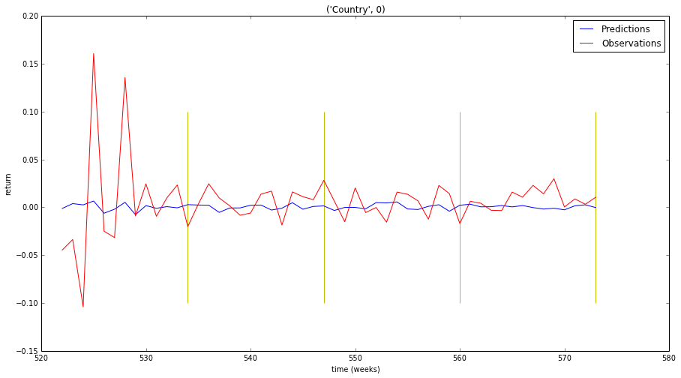
Ridge Regressie (RR) 15 det – Belgium

Slide 24
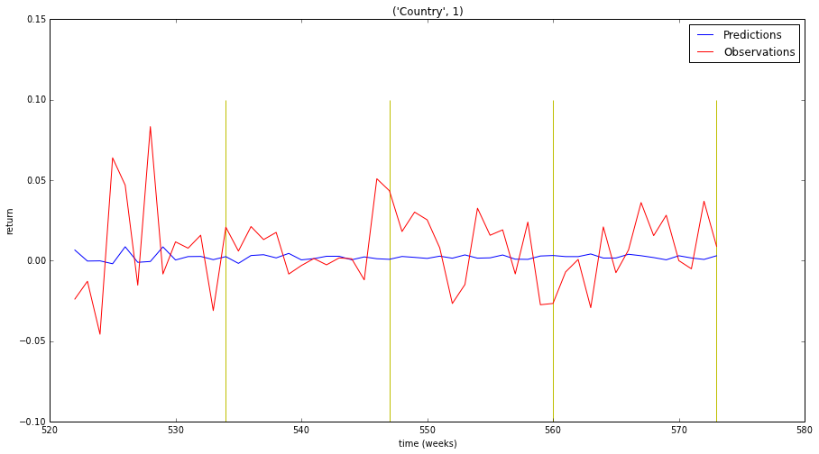
Ridge Regressie (RR) 15 det – Denmark

Slide 25
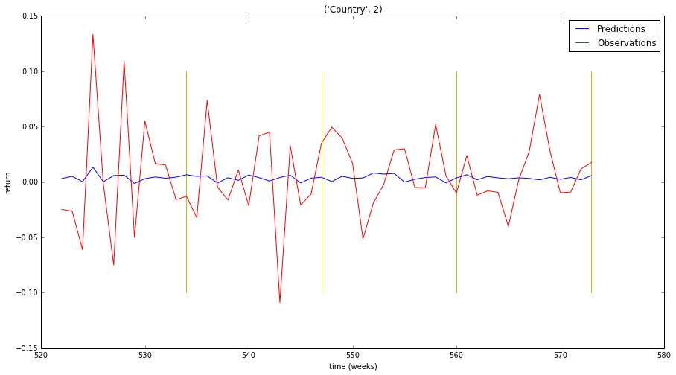
Ridge Regressie (RR) 15 det – Finland

Slide 26
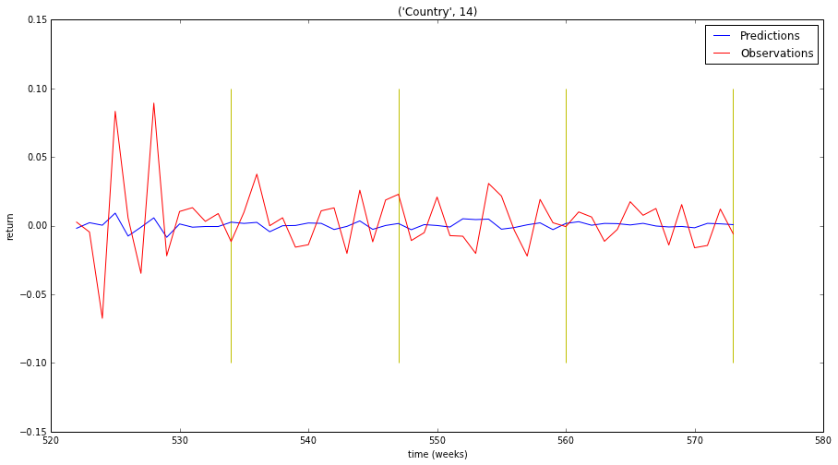
Ridge Regressie (RR) 15 det – UK

Slide 27
Ridge Regressie (RR λ=1) 15 det – Summary
Country 0 NMSE : 0.987406915498 Country 0 hitrate : 0.519230769231
Country 1 NMSE : 1.08828945993 Country 1 hitrate : 0.615384615385
Country 2 NMSE : 0.97173582922 Country 2 hitrate : 0.5
Country 3 NMSE : 0.906553588444 Country 3 hitrate : 0.673076923077
Country 4 NMSE : 1.01232458939 Country 4 hitrate : 0.538461538462
Country 5 NMSE : 0.992788905536 Country 5 hitrate : 0.692307692308
Country 6 NMSE : 1.04177136598 Country 6 hitrate : 0.576923076923
Country 7 NMSE : 0.992653827795 Country 7 hitrate : 0.519230769231
Country 8 NMSE : 0.964978333376 Country 8 hitrate : 0.557692307692
Country 9 NMSE : 1.30245463751 Country 9 hitrate : 0.615384615385
Country 10 NMSE : 1.13787097243 Country 10 hitrate : 0.576923076923
Country 11 NMSE : 0.997267648124 Country 11 hitrate : 0.557692307692
Country 12 NMSE : 0.981648767145 Country 12 hitrate : 0.480769230769
Country 13 NMSE : 0.959364943908 Country 13 hitrate : 0.653846153846
Country 14 NMSE : 0.928785585482 Country 14 hitrate : 0.519230769231
total NMSE : 15.2658953698 total hitrate : 0.573076923077

Slide 28
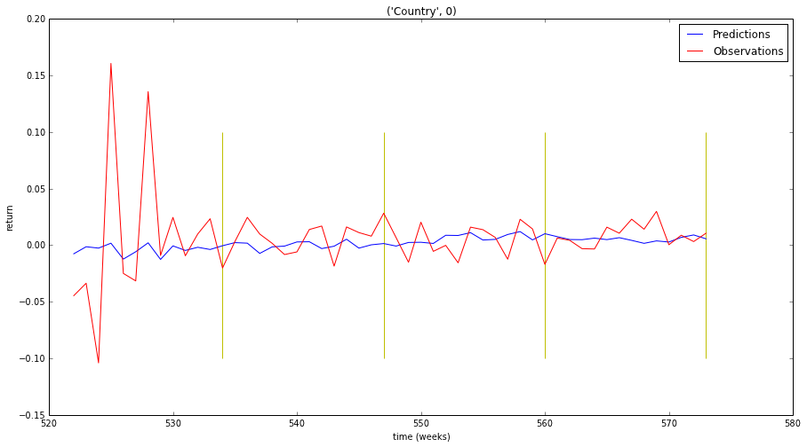
Ridge Regressie (RR) 99 det – Belgium

Slide 29
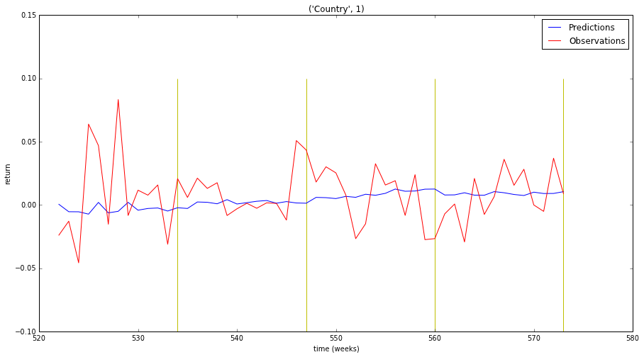
Ridge Regressie (RR) 99 det – Denmark

Slide 30
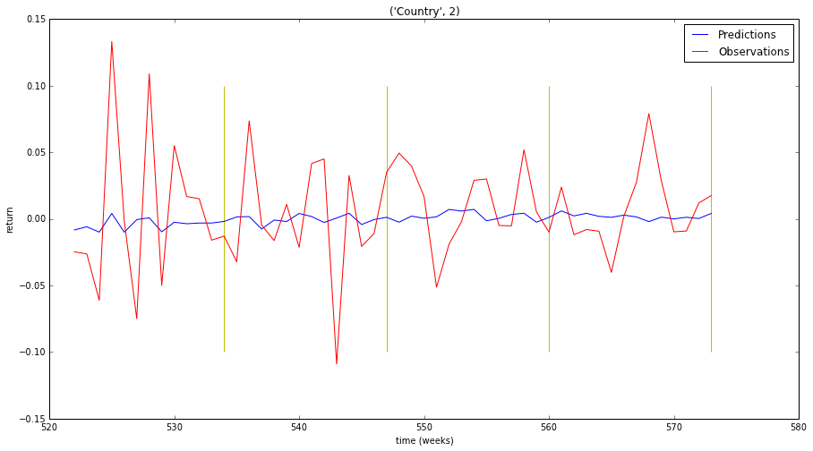
Ridge Regressie (RR) 99 det – Finland

Slide 31

Ridge Regressie (RR) 99 det – UK

Slide 32
Ridge Regressie (RR λ=1) 99 det – Summary
Country 0 NMSE : 0.979882183226 Country 0 hitrate : 0.673076923077
Country 1 NMSE : 1.11989983829 Country 1 hitrate : 0.557692307692
Country 2 NMSE : 0.982034751009 Country 2 hitrate : 0.557692307692
Country 3 NMSE : 0.91783055894 Country 3 hitrate : 0.576923076923
Country 4 NMSE : 1.02983156212 Country 4 hitrate : 0.596153846154
Country 5 NMSE : 1.04829896033 Country 5 hitrate : 0.615384615385
Country 6 NMSE : 1.06855210571 Country 6 hitrate : 0.596153846154
Country 7 NMSE : 1.07099057163 Country 7 hitrate : 0.634615384615
Country 8 NMSE : 0.968900479389 Country 8 hitrate : 0.538461538462
Country 9 NMSE : 1.30039264602 Country 9 hitrate : 0.692307692308
Country 10 NMSE : 1.05231541787 Country 10 hitrate : 0.615384615385
Country 11 NMSE : 0.97684983991 Country 11 hitrate : 0.596153846154
Country 12 NMSE : 0.976719226483 Country 12 hitrate : 0.596153846154
Country 13 NMSE : 0.965357436798 Country 13 hitrate : 0.596153846154
Country 14 NMSE : 0.938213085891 Country 14 hitrate : 0.576923076923
total NMSE : 15.3960686636 mean hitrate : 0.601282051282

Slide 33
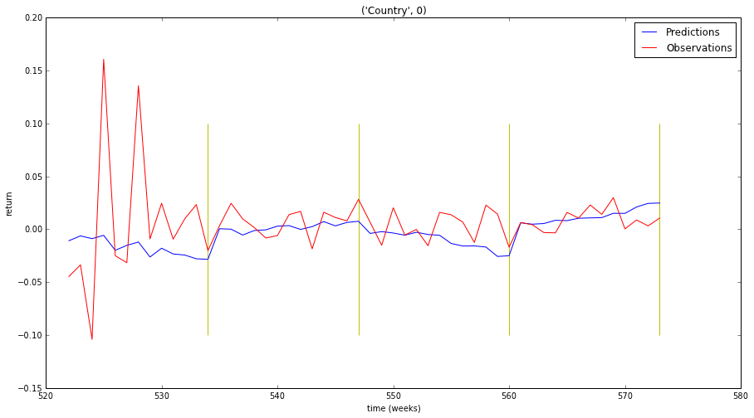
Ridge Regressie (RR) 525 det – Belgium

Slide 34
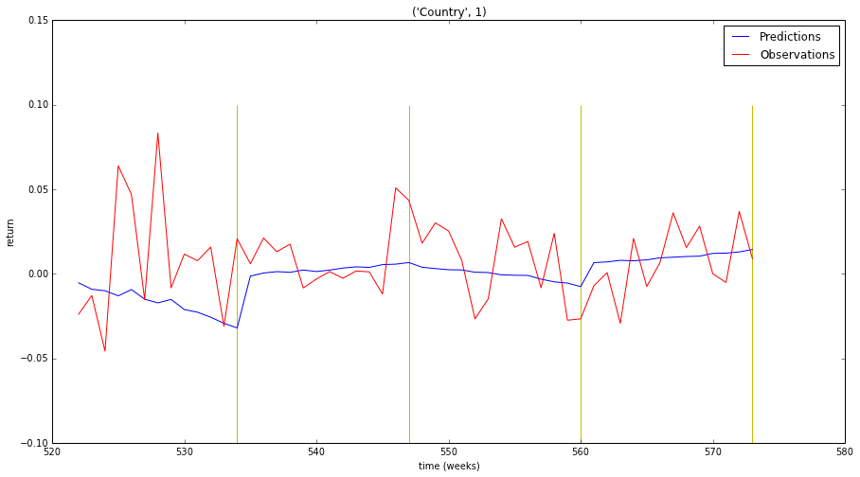
Ridge Regressie (RR) 525 det – Denmark

Slide 35
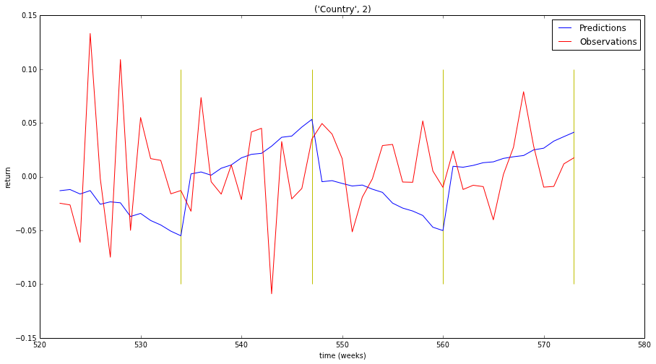
Ridge Regressie (RR) 525 det – Finland

Slide 36
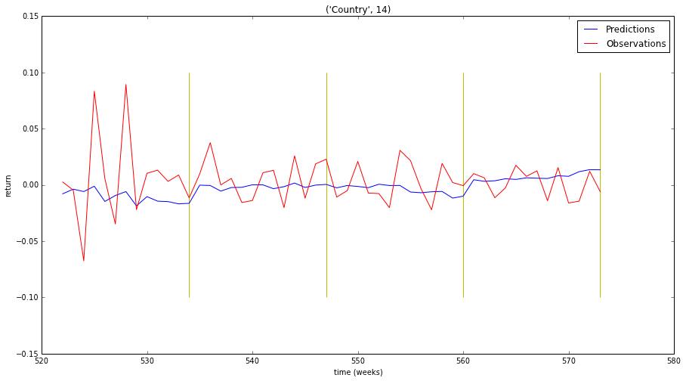
Ridge Regressie (RR) 525 det – UK

Slide 37
Ridge Regressie (RR λ=5) 525 det – Summary
Country 0 NMSE : 1.14384707873 Country 0 hitrate : 0.634615384615
Country 1 NMSE : 1.30282070212 Country 1 hitrate : 0.557692307692
Country 2 NMSE : 1.45528363376 Country 2 hitrate : 0.519230769231
Country 3 NMSE : 1.1036430781 Country 3 hitrate : 0.557692307692
Country 4 NMSE : 1.41320728205 Country 4 hitrate : 0.538461538462
Country 5 NMSE : 1.10203166265 Country 5 hitrate : 0.596153846154
Country 6 NMSE : 1.24288757809 Country 6 hitrate : 0.596153846154
Country 7 NMSE : 1.30100822682 Country 7 hitrate : 0.480769230769
Country 8 NMSE : 1.08608387243 Country 8 hitrate : 0.576923076923
Country 9 NMSE : 1.68880705643 Country 9 hitrate : 0.653846153846
Country 10 NMSE : 1.28630031746 Country 10 hitrate : 0.557692307692
Country 11 NMSE : 1.17967118147 Country 11 hitrate : 0.653846153846
Country 12 NMSE : 1.23947992371 Country 12 hitrate : 0.557692307692
Country 13 NMSE : 1.25762843649 Country 13 hitrate : 0.5
Country 14 NMSE : 1.11875275231 Country 14 hitrate : 0.5
total NMSE : 18.9214527826 mean hitrate : 0.565384615385

Slide 38
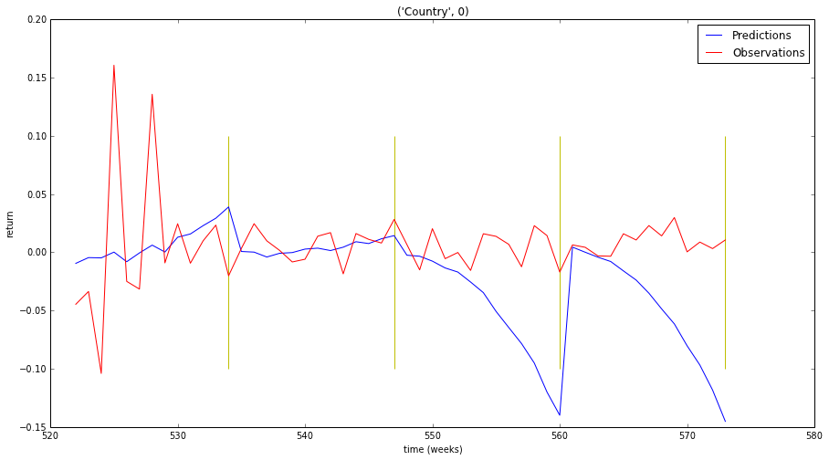
Ridge Regressie (RR λ=10) 1505 det – Belgium

Slide 39
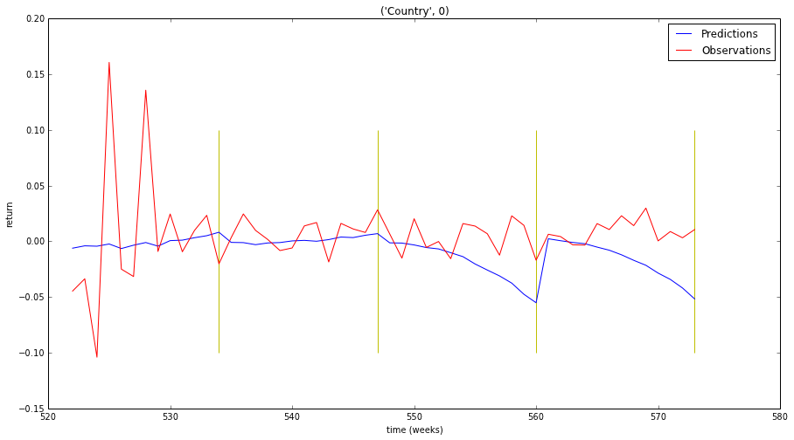
Ridge Regressie (RR λ=30) 1505 det – Belgium

Slide 40
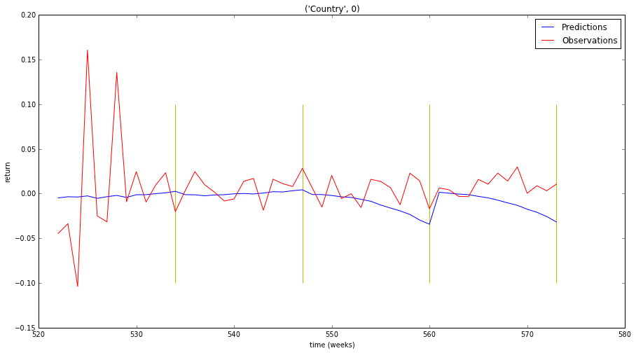
Ridge Regressie (RR λ=50) 1505 det – Belgium

Slide 41
Ridge Regressie 1505 det – Summary
Difficult to regularize: if λ too small: overfitting
If λ larger: trend eliminating

