Slide 1
Todo Terminal Manager Explore

Slide 2
Project Genesis
Assignment Requirements
What I Actually Built
Multipanel terminal UI todo manager
Production-ready dual-interface system
Blessed library with TypeScript
Rich terminal UI with 4 interactive panels
Proper MVC architecture
Comprehensive CLI with help system
LLM collaboration demonstration
Atomic data persistence
Three-layer testing strategy
Key Question: How do you transform a simple todo assignment into an enterprise-grade terminal application?

Slide 3
Problem 1: Dual Interface Architecture
"How to support both CLI and Terminal UI without maintaining two codebases?"
CLI Requirements
Terminal UI Requirements
Shared Needs
Argument parsing
Real-time interaction
Business logic
Batch operations
Visual panels
Data validation
Scriptability
Keyboard navigation
Persistence
Formatted output
Event handling
Consistency

Slide 4
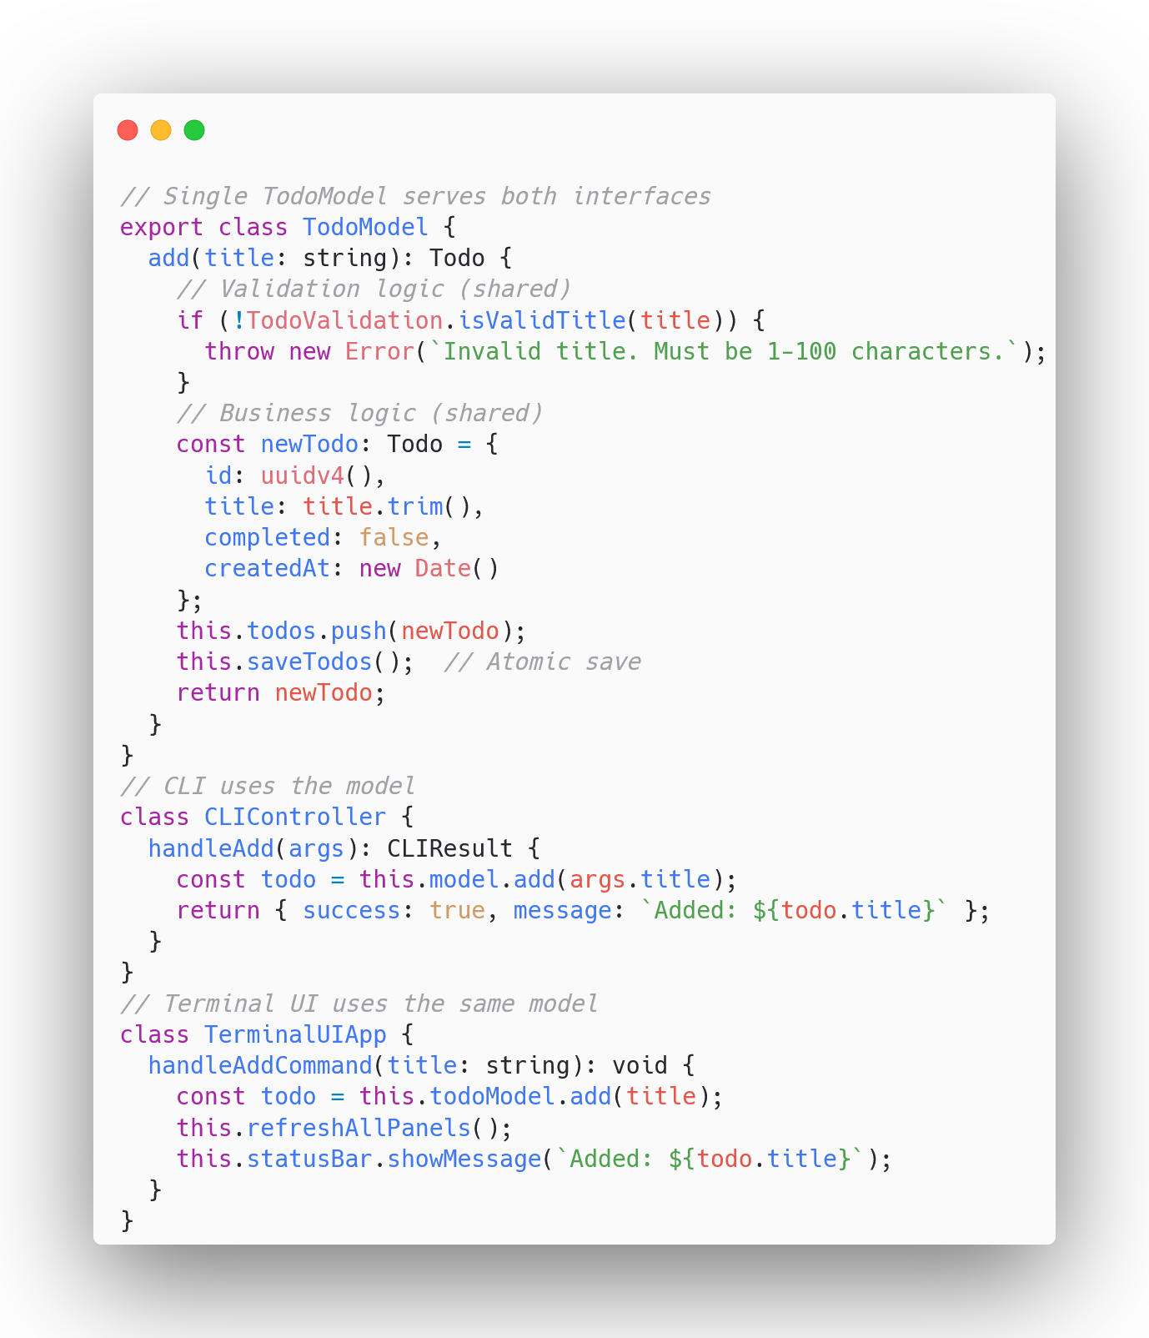
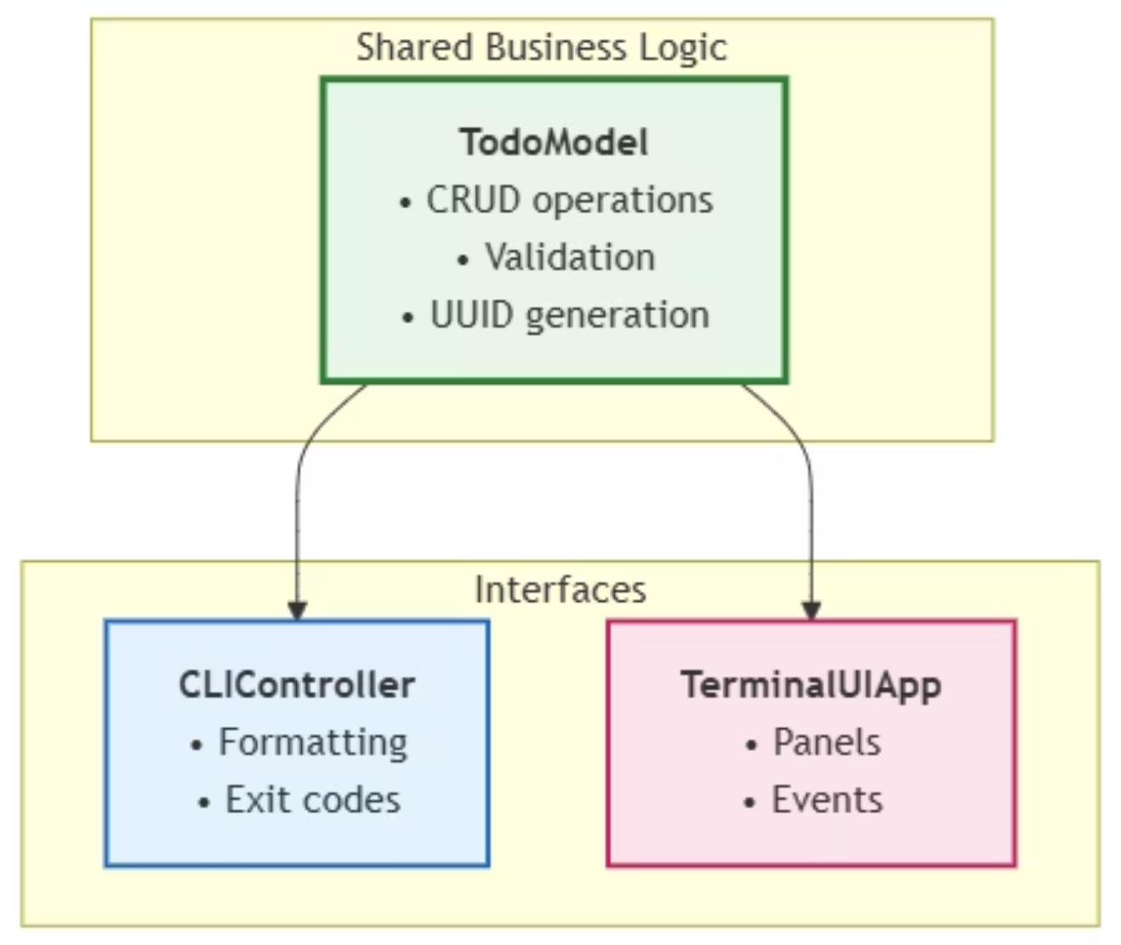
Solution: Shared Model Layer with MVC

Slide 5

Problem 2: Terminal UI Complexity
The Challenge
"How to coordinate 4 interactive panels in a terminal?"
Complexity Factors: Focus management, keyboard navigation, event routing, consistent lifecycle management

Slide 6
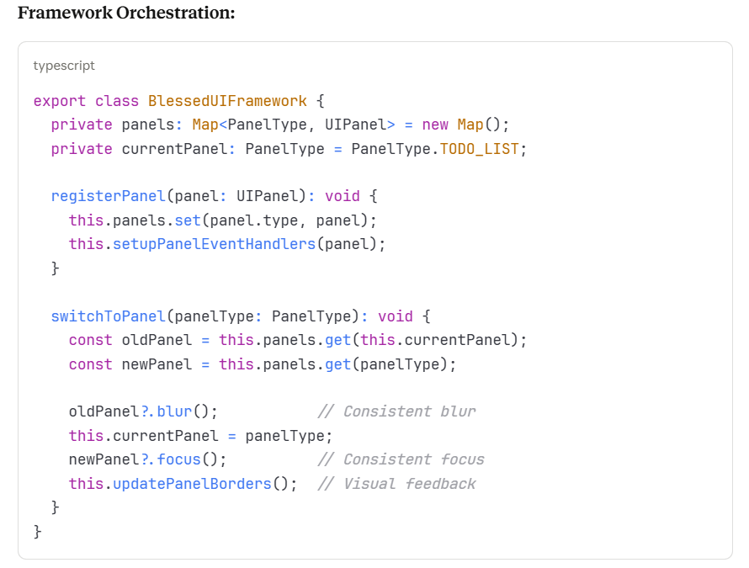
Solution: BlessedUIFramework with UIPanel Interface
01
02
03
Extensible
Consistent
Maintainable
Add new panels by implementing UIPanel
All panels follow same lifecycle
Framework handles complexity

Slide 7
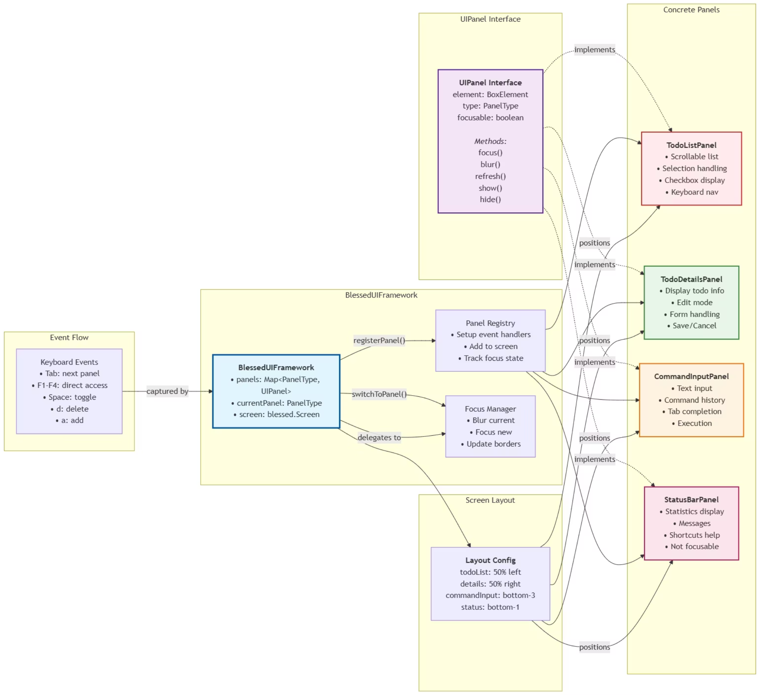

Slide 8
Problem 3: Command Architecture
The Challenge
"How to build a self-documenting, extensible command system?"
Multiple Commands
Help System
Different arguments and validation needs
Auto-generated documentation with examples
Dual Interface
Dual Interface
Works in both CLI and Terminal UI
Works in both CLI and Terminal UI

Slide 9
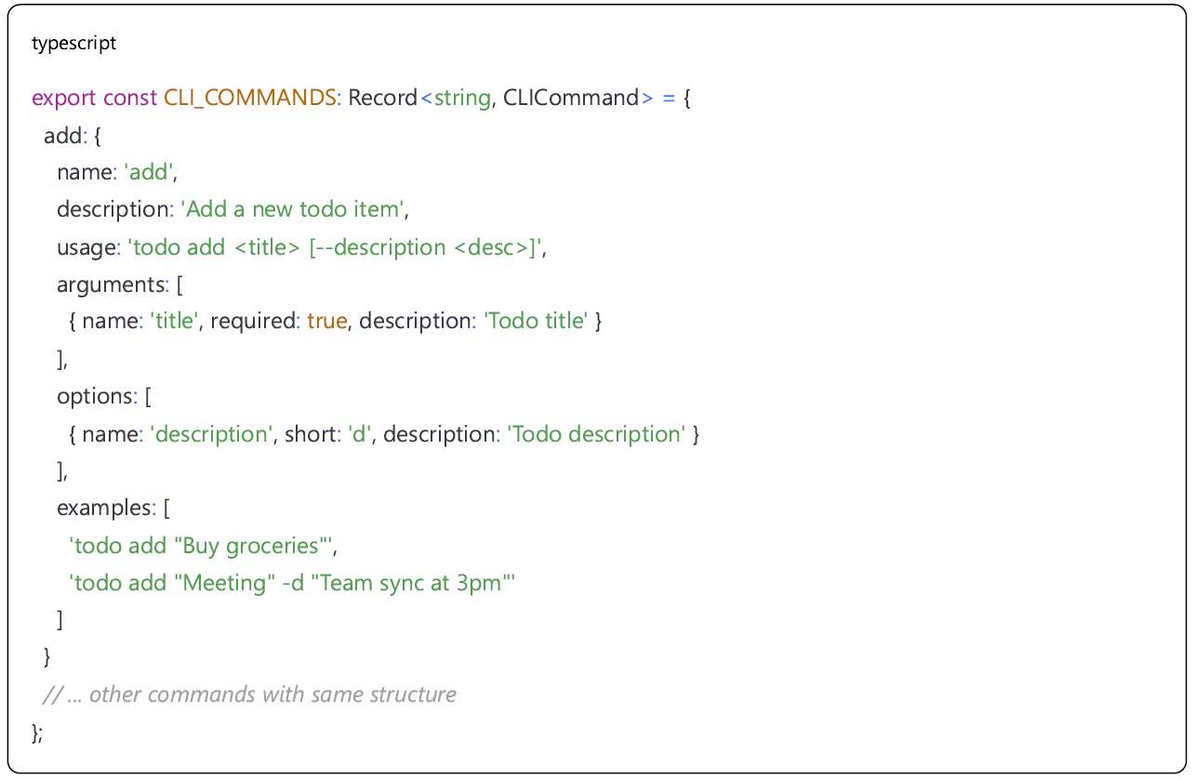
Solution: Command Pattern with Schema
Schema as single source of truth, defining structure and behavior of all commands
Automated generation of validation, help, error handling and other functionality
Declarative configuration replacing imperative programming, improving development efficiency
Highly extensible, adding new commands only requires configuring the Schema

Slide 10

Problem 4: Data Integrity
The Challenge
"How do you guarantee zero data loss in a file-based system?"
Process Killed During Save
Power Outage
System Crash
Results in corrupted JSON file
Causes partial write operations
Leads to lost todo items

Slide 11
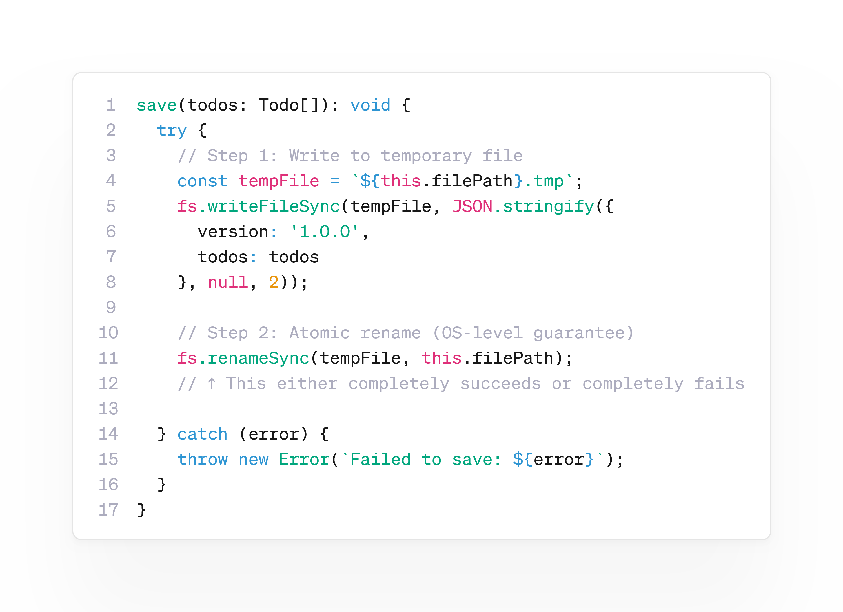
Solution: Atomic Save Operations
Atomic Save Options: is a data persistence technique that ensures a file write operation either completes fully or fails entirely, preventing partial writes.

Slide 12
Key Takeaways
Atomic Operations: Production systems need crash resilience
Interface Abstraction: UIPanel interface enables extensibility
Shared Business Logic: DRY principle across multiple UIs
Deliberate Pattern Choices: Not using a pattern can be the right choice

