Slide 1
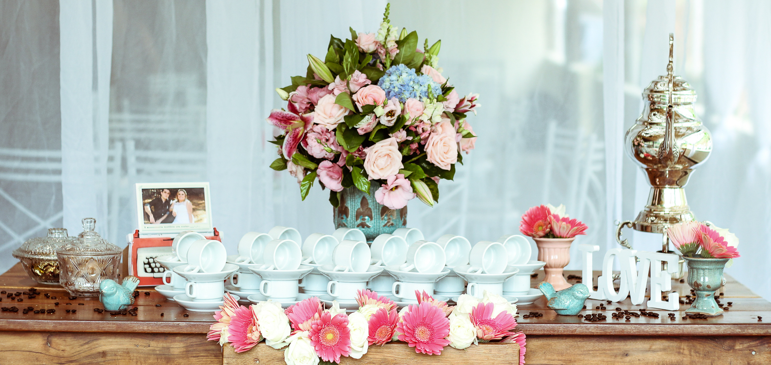
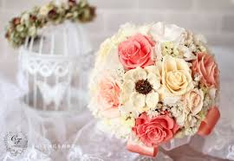
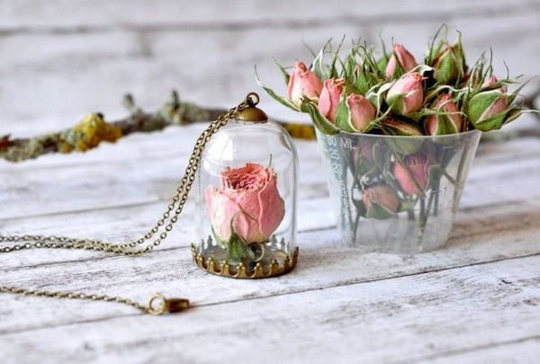
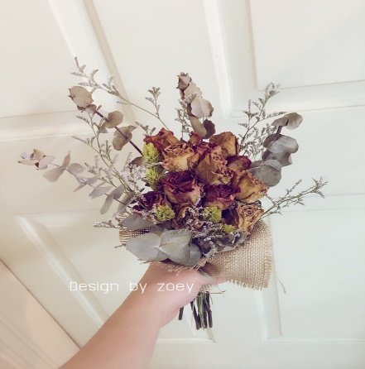
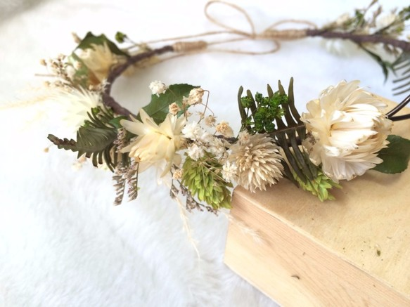
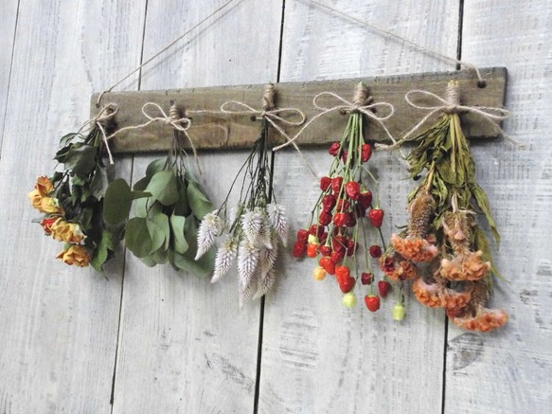
News
Home
About
Contact
Married
Interest
Decoration
Today made a bouquet of bouquets Maybe only talk in private messages This is a lifetime of her wedding . We want to send at the same time when we spand this mind
Our floral design perhaps not the best of the best, but we are willing, More carefully to do every guest like the packaging design
Copyrights CSIE 台北市忠孝東路三段一號 Tel:(886-2)2771-2171

