Slide 1
Data Structure and Algorithms

Slide 2
Chapter 4 Binary Tree
Recursion :
Implementation: Divide & conquer; Traverse
Divide & Conquer:
Traverse

Slide 3
Recursion :
Implementation: Divide & conquer; Traverse
Divide & Conquer:
Traverse

Slide 4
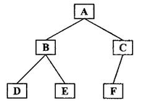
Traversal
Level order (Breadth First Search; BFS), level by level, from left to right. ABCDEF
Pre order (Depth First Search; DFS): root node→left tree→ right tree. Traverse the left/right trees in the similar order. ABDECF
In order (DFS): first left tree, root node, then right tree. DBEAFC
Example: design an iterator over a binary search tree
Post order (DFS): first left tree, then right tree, at last root node. DEBFCA

Slide 5
Traversal example
Level order, BFS, example: binary tree level order traversal. Use queue for non-recursion
Pre order traversal: use stack for non-recursion

Slide 6
Queue interface
queue.offer(obj) // add one element at the end of the queue
TreeNode a = queue.poll() // get the first element in the queue
queue.isEmpty()
Queue<TreeNode> queue = new LinkedList<TreeNode>();

Slide 7
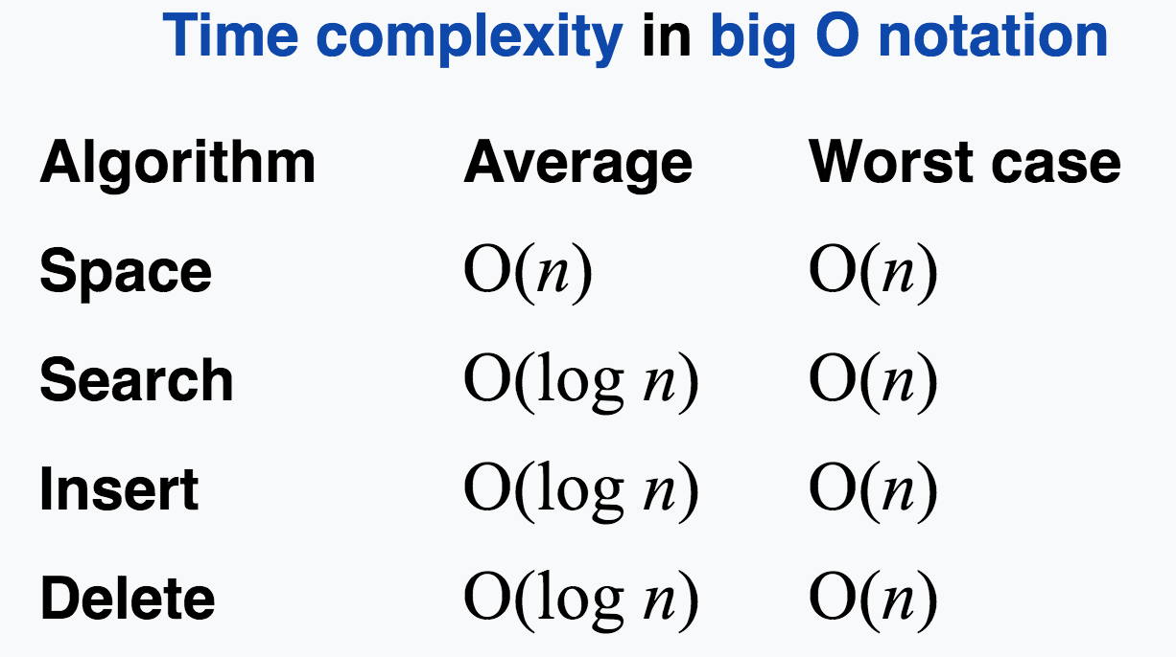
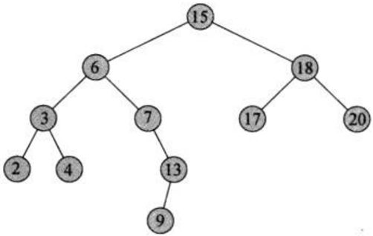
Binary Search Tree (BST, sorted/ordered binary trees)
Binary tree with root == null or
If left subtree is not null, all the tree node values are less or equal to the root node value
If right subtree is not null, all the tree node values are more than the root node value
Left and right subtrees are BST
The inorder traversal of a BST will print a sorted/ordered values of all the tree node

Slide 8
Stack class
List<TreeNode> stack = new Stack<TreeNode>()
stack.empty()
stack.pop()
stack.push(obj)

