Slide 1
LevelDB Notes

Slide 2
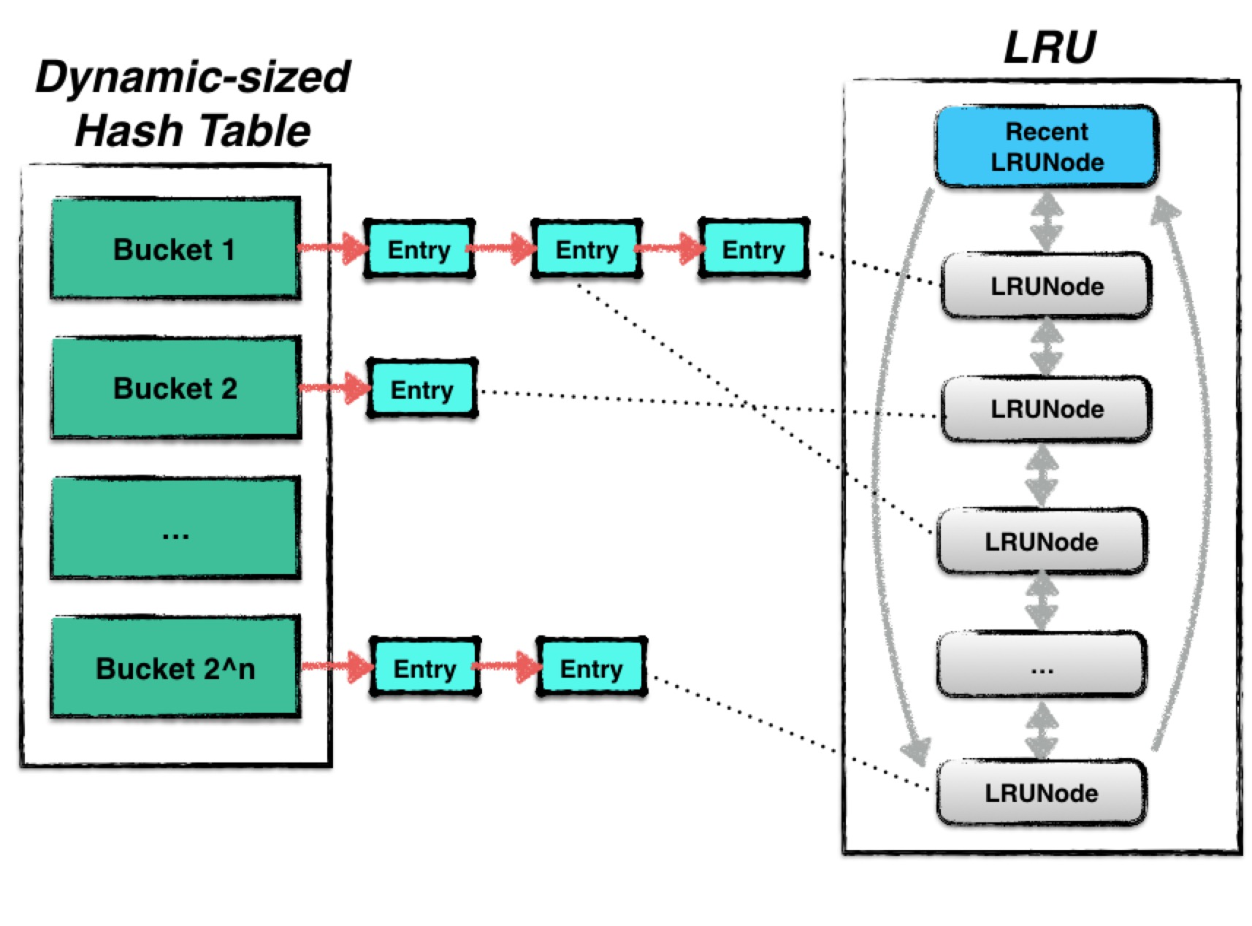
Cache

Slide 3
Dynamic-Sized Nonblocking Hash Table
Hash table: Insert, delete, and search ~ O(1)
Resize hash table when data size grows.
Expand bucket number and re-hash keys.

Slide 4
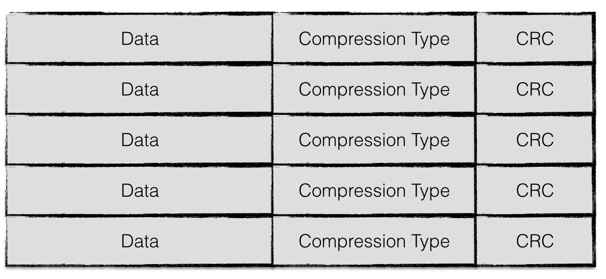
SSTable
Physical structure
f

Slide 5
dfd

Slide 6
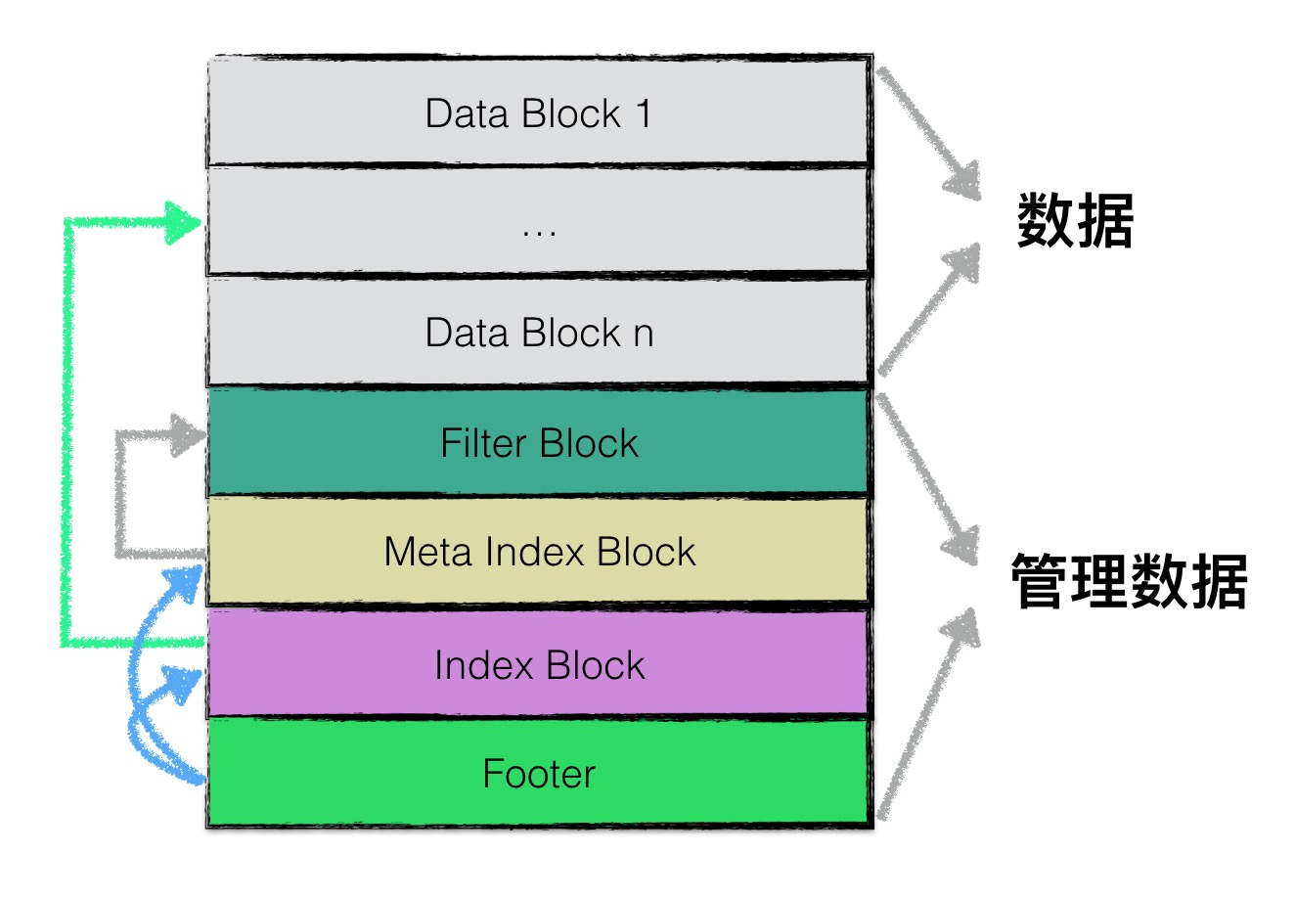
SSTable
Logical structure

Slide 7
<beginning_of_file>
[data block 1]
[data block 2]
...
[data block N]
[meta block 1: filter block] (see section: "filter" Meta Block)
[meta block 2: stats block] (see section: "properties" Meta Block)
[meta block 3: compression dictionary block] (see section: "compression dictionary" Meta Block)
[meta block 4: range deletion block] (see section: "range deletion" Meta Block)
...
[meta block K: future extended block] (we may add more meta blocks in the future)
[metaindex block]
[index block]
[Footer] (fixed size; starts at file_size - sizeof(Footer))
<end_of_file>

Slide 8
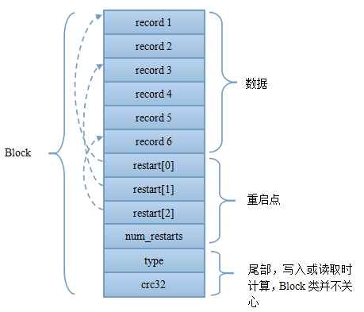
Data Block
options.block_size: set block size,
default value: 4k
options.block_interval:
set key restart point intervel
default value: 16
Prefix compression restart for every 16 keys
First: Data section: store key-value. Keys are sorted sequentially.
In order to save space, not every key is stored completely. It only saves the part that is not shared with last key.
For keys in interval of options.block_interval, a whole key is stored. This is called a restart point.
Restart points section: This section stores the offset of every key restart point. And the total number of the restart points at last.

Slide 9
Data Block Entry
For each key-value pair, in sst-table, it saves as an entry: shared key length, unshared key length, value length, unshared key content, and value.
uint32_t shared, non_shared, value_length;
Shared, non-shared, and value_length are compressed as varint32.

Slide 10
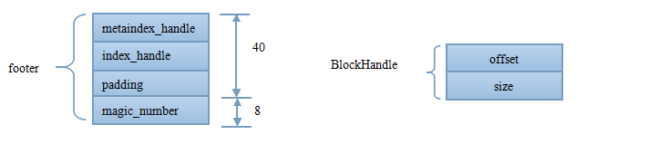
Footer
Total length is fixed: 48 bytes
Stores the offset and length for Meta index block and index block

Slide 11
293 // Binary search in restart array to find the first restart point that
294 // is either the last restart point with a key less than target,
295 // which means the key of next restart point is larger than target, or
296 // the first restart point with a key = target
297 bool BlockIter::BinarySeek(const Slice& target, uint32_t left, uint32_t right,
298 uint32_t* index) {
299 assert(left <= right);
300
301 while (left < right) {
302 uint32_t mid = (left + right + 1) / 2; // mid is the index of the restart_point array
303 uint32_t region_offset = GetRestartPoint(mid); // region_offset is the offset of the record entry with key that has restart point index “mid”. (Offset: the byte number from the beginning of the current data block); the offset of the mid-th record group in the current data block.
304 uint32_t shared, non_shared, value_length;
305 const char* key_ptr = DecodeEntry(data_ + region_offset, data_ + restarts_,
306 &shared, &non_shared, &value_length);
307 if (key_ptr == nullptr || (shared != 0)) {
308 CorruptionError();
309 return false;
310 }
Goal: find index i with Key(restart_point[i-1]) < target <= Key(restart_point[i])
Input:
Const Slice& target: searching target key
uint32_t left: index of restart_point array, binary search left size index
uint32_t right: index of restart_point array, binary search right size index
uint32_t* index: pointer, point to the index of restart_point[i]
const char* data_; // underlying block contents; a pointer
uint32_t restarts_; // Offset of restart array (list of fixed32), integer

Slide 12
BlockIter::BinarySeek continue
311 Slice mid_key(key_ptr, non_shared); // slice: create a struct that stores the address (a pointer) of the content of non-shared key(string), and the length of this content.
312 int cmp = Compare(mid_key, target); // compare the value of the content of unshared key (stored in mid_key struct) and target.
313 if (cmp < 0) {
314 // Key at "mid" is smaller than "target". Therefore all
315 // blocks before "mid" are uninteresting.
316 left = mid;
317 } else if (cmp > 0) {
318 // Key at "mid" is >= "target". Therefore all blocks at or
319 // after "mid" are uninteresting.
320 right = mid - 1;
321 } else {
322 left = right = mid;
323 }
324 }
325
326 *index = left;
327 return true;
328 }

Slide 13
29 // Helper routine: decode the next block entry starting at "p",
30 // storing the number of shared key bytes, non_shared key bytes,
31 // and the length of the value in "*shared", "*non_shared", and
32 // "*value_length", respectively. Will not derefence past "limit".
33 //
34 // If any errors are detected, returns nullptr. Otherwise, returns a
35 // pointer to the key delta (just past the three decoded values).
36 static inline const char* DecodeEntry(const char* p, const char* limit,
37 uint32_t* shared,
38 uint32_t* non_shared,
39 uint32_t* value_length) {
40 if (limit - p < 3) return nullptr;
41 *shared = reinterpret_cast<const unsigned char*>(p)[0];
42 *non_shared = reinterpret_cast<const unsigned char*>(p)[1];
43 *value_length = reinterpret_cast<const unsigned char*>(p)[2];
44 if ((*shared | *non_shared | *value_length) < 128) {
45 // Fast path: all three values are encoded in one byte each
46 p += 3;
47 } else {
48 if ((p = GetVarint32Ptr(p, limit, shared)) == nullptr) return nullptr;
49 if ((p = GetVarint32Ptr(p, limit, non_shared)) == nullptr) return nullptr;
50 if ((p = GetVarint32Ptr(p, limit, value_length)) == nullptr) return nullptr;
51 }
52
53 if (static_cast<uint32_t>(limit - p) < (*non_shared + *value_length)) {
54 return nullptr;
55 }
56 return p;
57 }
Input:
const char* p: pointer, point to a record entry
const char* limit: the offset of the restart_point section. The record entries are in front of the restart_point section.
Output:
Pointer position that points to non_shared key content.
(Pointer points to the bytes in the order of: shared length, non_shared length, value_length, non_shared key content, and value content. If *shared | *non_shared | *value_length) < 128, then pointer p skips three bytes, and then the pointer points to the address of non_shared key content (Here just corresponds to the content of the key that at mid-th restart point), and the value of shared, non_shared, and value_length are updated too. If the size of shared length, non_shared length, and value_length is longer than one byte, need to call GetVarint32Ptr to determine how many bytes the pointer p to skip to point to the address of non_shared key content. In this case, p = GetVarint32Ptr(ptr, limit, value)) will update the pointer position, and move the pointer to the next address, and update the value (of ).)

Slide 14
storage/rocksdb/rocksdb/table/Block.h
uint32_t GetRestartPoint(uint32_t index) {
// index: index of the restart array (which stores the offset of the restarting keys), in the range of [0, num_restarts_ ]
assert(index < num_restarts_);
return DecodeFixed32(data_ + restarts_ + index * sizeof(uint32_t));
}
const char* data_; // underlying block contents; a pointer
uint32_t restarts_; // Offset of restart array (list of fixed32), integer
uint32_t num_restarts_; // Number of uint32_t entries in restart array, integer
Output: uint32_t, an integer, the value at restarts array with index “index”.
The value is the offset (byte numbers from the beginning of the current data blocks) of the index-th restarting key.
For example, restart_point[0], the offset is 0.

Slide 15
storage/rocksdb/rocksdb/util/coding.h
89 inline uint32_t DecodeFixed32(const char* ptr) {
90 if (port::kLittleEndian) {
91 // Load the raw bytes
92 uint32_t result;
93 memcpy(&result, ptr, sizeof(result)); // gcc optimizes this to a plain load
94 return result;
95 } else {
96 return ((static_cast<uint32_t>(static_cast<unsigned char>(ptr[0])))
97 | (static_cast<uint32_t>(static_cast<unsigned char>(ptr[1])) << 8)
98 | (static_cast<uint32_t>(static_cast<unsigned char>(ptr[2])) << 16)
99 | (static_cast<uint32_t>(static_cast<unsigned char>(ptr[3])) << 24));
100 }
101 }
102
Output: uint32 in the range of [0, 2^32-1].
https://en.cppreference.com/w/cpp/string/byte/memcpy

Slide 16
Encode Varint32
storage/rocksdb/rocksdb/util/coding.cc
23 char* EncodeVarint32(char* dst, uint32_t v) {
24 // Operate on characters as unsigneds
25 unsigned char* ptr = reinterpret_cast<unsigned char*>(dst);
26 static const int B = 128;
27 if (v < (1 << 7)) {
28 *(ptr++) = v;
29 } else if (v < (1 << 14)) {
30 *(ptr++) = v | B;
31 *(ptr++) = v >> 7;
32 } else if (v < (1 << 21)) {
33 *(ptr++) = v | B;
34 *(ptr++) = (v >> 7) | B;
35 *(ptr++) = v >> 14;
36 } else if (v < (1 << 28)) {
37 *(ptr++) = v | B;
38 *(ptr++) = (v >> 7) | B;
39 *(ptr++) = (v >> 14) | B;
40 *(ptr++) = v >> 21;
41 } else {
42 *(ptr++) = v | B;
43 *(ptr++) = (v >> 7) | B;
44 *(ptr++) = (v >> 14) | B;
45 *(ptr++) = (v >> 21) | B;
46 *(ptr++) = v >> 28;
47 }
48 return reinterpret_cast<char*>(ptr);
49 }
Detail: http://mingxinglai.com/cn/2013/01/leveldb-varint32/

Slide 17
Decode Varint32
Value < 128, ie. varint is only one byte, call GetVarint32Ptr, and return
Value > = 128, varint occupies more than one byte, call GetVarint32Ptr, which further calls GetVarint32PtrFallback.

Slide 18
Decode Varint32
115
116 // Internal routine for use by fallback path of GetVarint32Ptr
117 extern const char* GetVarint32PtrFallback(const char* p,
118 const char* limit,
119 uint32_t* value);
120 inline const char* GetVarint32Ptr(const char* p,
121 const char* limit,
122 uint32_t* value) {
123 if (p < limit) {
124 uint32_t result = *(reinterpret_cast<const unsigned char*>(p)); // take one byte at pointer p
125 if ((result & 128) == 0) { // result & 10000000 = 0 means the top first bit of result is 0. value <128. 7 bits enough to store the value.
126 *value = result;
127 return p + 1; // so the pointer can move to the next byte. For result & 128 /= 0, ie. value >= 128,
128 } // then the varint is longer than one byte. Need to call GetVarint32PtrFallback to figure out where to stop the pointer p.
129 }
130 return GetVarint32PtrFallback(p, limit, value);
131 }
storage/rocksdb/rocksdb/util/coding.h

Slide 19
storage/rocksdb/rocksdb/util/coding.cc
54 const char* GetVarint32PtrFallback(const char* p, const char* limit,
55 uint32_t* value) {
56 uint32_t result = 0;
57 for (uint32_t shift = 0; shift <= 28 && p < limit; shift += 7) {
58 uint32_t byte = *(reinterpret_cast<const unsigned char*>(p));
59 p++;
60 if (byte & 128) {
61 // More bytes are present
62 result |= ((byte & 127) << shift);
63 } else {
64 result |= (byte << shift);
65 *value = result;
66 return reinterpret_cast<const char*>(p);
67 }
68 }
69 return nullptr;
70 }

Slide 21
Slice
http://cighao.com/2016/08/16/leveldb-source-analysis-04-slice/
https://zhuanlan.zhihu.com/p/35134533

