Slide 1


IEEE/ACM IWQoS 2018
SDNKeeper: Lightweight Resource Protection and Management System for SDN-based Cloud
Xue Leng*
Kaiyu Hou#, Yan Chen*#, Kai Bu*, Libin Song#
Zhejiang University* Northwestern University#
Notes:
Good morning everyone，I’m Leng Xue from Zhejiang University. It is my pleasure to present our research here.
This work concentrates on protecting and managing resources for SDN-based Cloud.
And it’s a joint work with Kaiyu and Libin from Northwestern University.

Slide 2


Background
SDN ?
What is
SDN-based Cloud ?
Application
Application
Application
Plugin
Plugin
Plugin
Plugin
Plugin
Core Project
Notes:
First, What is SDN?
Typically, different from traditional network architecture, SDN divides the network into three planes, namely, data plane, control plane and application plane.
Then, What is SDN-based Cloud?

Slide 3
Background
What is
SDN-based Cloud ?
Cloud Application
Cloud Platform
Northbound Interface (NBI)
Plugin
Plugin
Plugin
Plugin
Plugin
Core Project
Notes:
Remaining the data plane and SDN controller, SDN-based Cloud uses SDN to provide network service for upper layer applications.
And the bridge connecting applications and SDN controller is Northbound Interface, which is exactly the point of our work.
We would like to investigate the access requests sent to SDN controller through Northbound Interface.

Slide 4

Problem 1: Absence of Effective Access Control
Inaccurate requests from applications
Requests are tampered with in transit
Malicious requests sent through NBI directly
Application
SDN Controller
Notes:
We found two problems here. First is Absence of Effective Access Control on requests.
Usually, users, as the originator, will send requests to SDN controller via applications.
However, due to lack of access control, there exists three malicious scenarios.
First, the registered user sends inaccurate requests via applications.

Slide 5

Problem 1: Absence of Effective Access Control
Inaccurate requests from applications
Requests are tampered with in transit
Malicious requests sent through NBI directly
Application
Application
SDN Controller
Notes:
Second, the requests sent from applications are benign, but were tampered with in transit before arriving at the controller.
Third, the registered user is hijacked by the attacker, then sends malicious requests directly to the controller through NBI.

Slide 6
Problem 2: Absence of Unified Management
Application
Plugin
Plugin
Plugin
Plugin
Plugin
SDN Controller
Notes:
The other problem is Absence of Unified Management on both APIs and Resources.
There are many plugins inside the controller to provide specific functionalities,
and they open thousands of APIs to upper layer applications.
However, there is a lack of unified tools for managing these APIs, which may causes two problems:

Slide 7
Problem 2: Absence of Unified Management
Inflexible control of resources¹
Error prone during network configuration
Application
Plugin
Plugin
Plugin
Plugin
Plugin
SDN Controller
¹ Resource is anything that can be utilized to provide services in response to client requests.
Notes:
First, it is inflexible and tedious to control these APIs and resources.
Second, network configuration relies on administrator,
and without inspection mechanism, this process is error prone.

Slide 8
Current solutions
Access control on requests [JNSM’18], AAA Project in ODL
Verify the legitimacy of user’s identity
Omit the legitimacy of user’s operation, Coarse-grained
Reconciliating inside the plugin
Redesigning API and controller architecture
Notes:
Current solutions solve these problems from different perspectives.
Some work perform access control on requests, to be specific, they mainly verify the legitimacy of user’s identity,
while omit the legitimacy of user’s operation.
And the role-based access control is coarse grained to analyze the behavior of requests.

Slide 9
Current solutions
Access control on requests [JNSM’18], AAA Project in ODL
Verify the legitimacy of user’s identity
Omit the legitimacy of user’s operation, Coarse-grained
Application
Reconciliating inside the plugin (SDNShield[DSN’16])
Code modification, Inflexible
Plugin
Plugin
Plugin
Redesigning API and controller architecture
Plugin
Plugin
SDN Controller
Notes:
To control and manage requests, some work choose to reconciliate inside the plugin.
They need to modify the code of each plugin to intercept and analyze requests.
But it is inflexible to modify codes for plenty of plugins respectively.

Slide 10
Current solutions
Access control on requests [JNSM’18], AAA Project in ODL
Verify the legitimacy of user’s identity
Omit the legitimacy of user’s operation, Coarse-grained
Reconciliating inside the plugin (SDNShield[DSN’16])
Code modification, Inflexible
Redesigning API and controller architecture [HotSDN’14, SIGCOMM CCR’13]
Poor interoperability
Notes:
Other work redesign the northbound API or controller architecture, which has poor interoperability universality.

Slide 11
SDNKeeper
REST Service
Policy Interpreter
Access Control Filter
Permission Engine
Plugin
Plugin
Plugin
Controller Kernel
Policy Data Store
Notes:
In this paper, we present SDNKeeper, a lightweight access control system to protect and manage resources for SDN-based Cloud.
First, let me introduce you the work flow of SDNKeeper.
These are original modules in the controller. And these three blue modules belong to SDNKeeper.

Slide 12


SDNKeeper
Administrator
Policy
REST Service
Policy Interpreter
Access Control Filter
Permission Engine
Plugin
Plugin
Plugin
Controller Kernel
Policy Data Store
Notes:
First, administrator will make policies according to security and business demands, and send them to the controller.
The Policy Interpreter parses these semantic policies into a tree structure then store them into data store.

Slide 13


SDNKeeper
Application
Administrator
Application
Policy
REST Service
Policy Interpreter
Access Control Filter
Permission Engine
Plugin
Plugin
Plugin
Controller Kernel
Policy Data Store
Notes:
When requests access the controller, whether these requests are legal, they will be intercepted by Access Control Filter, then sent to Permission Engine.
Permission Engine will check the behavior of these requests against the policies in the data store.
The checking result will be returned to the Access Control Filter.
The benign requests will be processed further, while the illegal ones will be rejected and blocked outside the controller.

Slide 14
SDNKeeper
Application
Administrator
Application
Policy
Applicability
Administrator Friendliness
Centralized Management
Hot Update
REST Service
Policy Interpreter
Access Control Filter
Permission Engine
Plugin
Plugin
Plugin
Controller Kernel
Policy Data Store
Notes:
SDNKeeper can work smoothly with existing controllers and applications.
It provides a convenient and formalized way for administrators to express their intentions.
It is able to manage all Northbound Interfaces provided by plugins.
And, the policies can be updated on the fly to adapt to dynamic requirements.

Slide 15
Detailed Designs
Policy Language – flexible permission abstractions
Policy Interpreter – parsing semantic policies
Permission Engine – performing access control on requests
Notes:
For details, first I will introduce Policy Language.

Slide 16
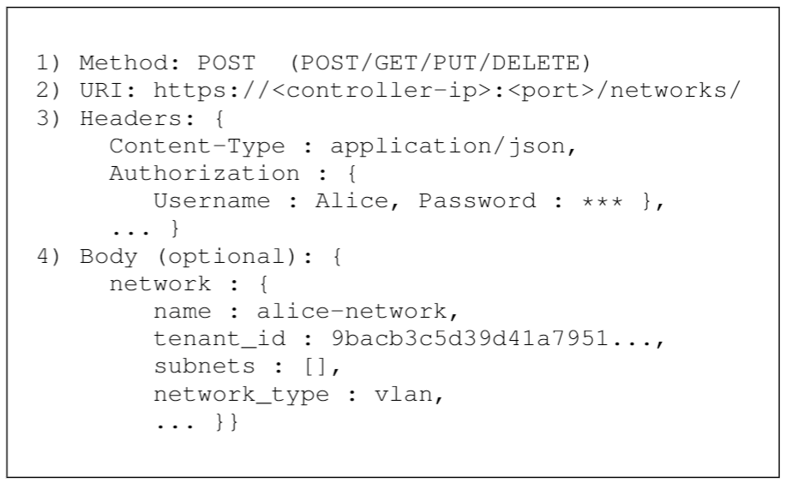
Policy Language
Attribute Based Access Control
P(S, O, E) <- Logic Expression(ATTR(S), ATTR(O), ATTR(E))
REST Request
Subject
(Requester)
Object
(Resource)
Environment
(Time)
Notes:
SDNKeeper adopts attribute based access control, and extracts the attributes of Subject (requester), Object (resource) and environment (time).
REST API is the most common NBI to access the controller, and it is used by mainstream controllers.
Here is an example of a REST Request. It consists of four parts, Method, URI, Headers and Body.

Slide 17
Policy Language
Attribute Based Access Control
P(S, O, E) <- Logic Expression(ATTR(S), ATTR(O), ATTR(E))
Policy: A set of assertion expressions
Composition: Iteration of if-statements and logical operators
Return: ACCEPT / REJECT
Notes:
A policy is a set of assertion expressions, combined with the iteration of if-statements and AND/OR logical operators.
And the return value is ACCEPT or REJECT.

Slide 18
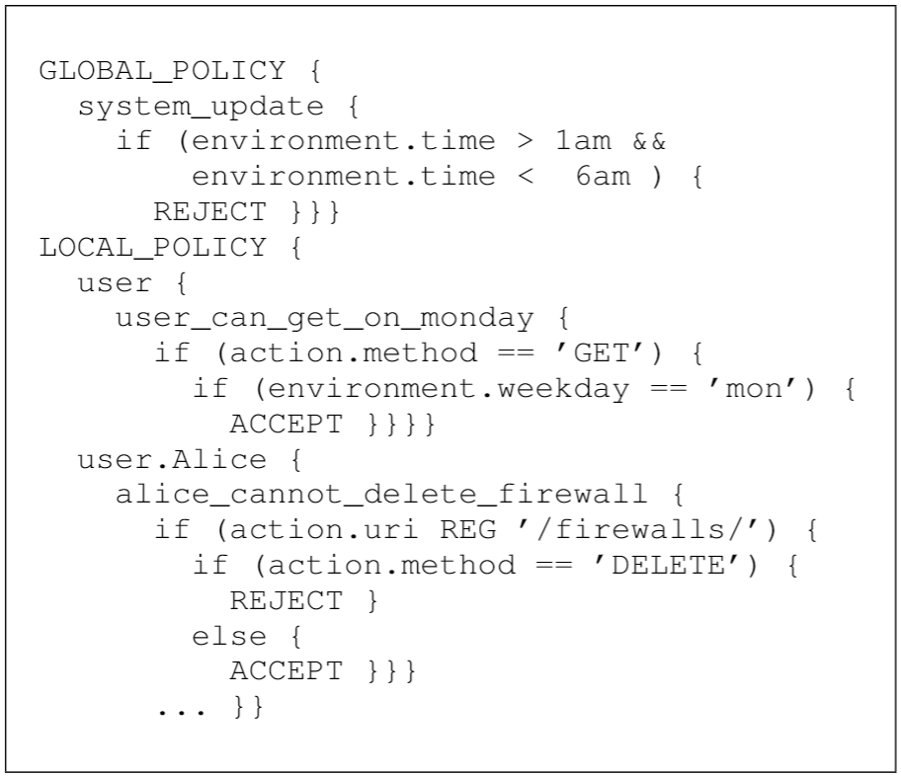
Policy
Global Policy
all requests
Local Policy
individual user group and user
for
for
Notes:
This is a complete policy file. It consists of global policy and local policy.
Global policies are intended for all requests. When a request comes in, it will be checked against all global policies first.
Local polies are intended for individual user group and user. Only the related local policies with the matching role and user name will be checked.

Slide 19
Policy
Global Policy
all requests
Local Policy
individual user group and user
for
for
Performance
Expressiveness and simplicity
Notes:
There are two reasons for designing these two separated policy sets.
One is for performance. Only related policies need to be checked, this will significantly reduce the checking time when the policy set is large.
The other one is for Expressiveness and simplicity. Administrators can make group policies and individual policies for particular users to control their resources.

Slide 20
Detailed Designs
Policy Language – flexible permission abstractions
Policy Interpreter – parsing semantic policies
Permission Engine – performing access control on requests
Notes:
Then is Policy Interpreter.

Slide 21
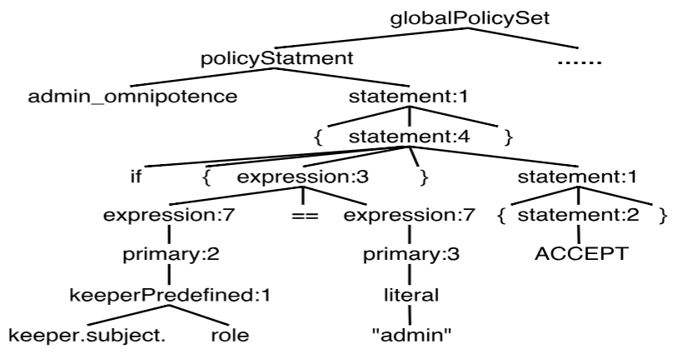
Policy Interpreter
&
Checking result
A
||
Logical operators
B
C
An attribute or a comparing value
(A && (B || C))
Notes:
Policy Interpreter is used to parse semantic policies. These policies will be stored in the data store in a tree structure. Here is the example.
A leaf node represents an attribute or a comparing value. And other nodes represent logical operators.
Each expression can be expressed by a subtree.
After recursively evaluating the left child and right child, we can get checking result from the root node.
Here is the semantic tree of a global policy.

Slide 22
Detailed Designs
Policy Language – flexible permission abstractions
Policy Interpreter – parsing semantic policies
Permission Engine – performing access control on requests
Notes:
Permission Engine is the core component of SDNKeeper.
The flowchart of permission checking is as follows.

Slide 23
Permission Engine
Step 1: Checking with Global Policies
Global policy
Y
Matched?
N
Local policy
N
REJECT ?
Y
REJECT
Checking Result
Notes:
When a request comes in, it will be checked against Global policies first.
If there is no matching policy, it will be further checked with Local policies.
If matched and the result is REJECT, the checking result can be returned.
If not, it will also be checked with Local policies.

Slide 24
Permission Engine
Step 1: Checking with Global Policies
Step 2: Checking with Local Policies
Global policy
Step 3: Returning Checking Result
Y
Matched?
N
Local policy
N
REJECT ?
N
Y
Finish ?
Y
N
N
Y
Y
Matched?
REJECT ?
Matched?
N
Y
ACCEPT
REJECT
Checking Result
Notes:
If it is not the last policy, we would judge the result.
If the match fails, continue to check.
If successful and the result is REJECT, the checking result will be returned.
If not, continue to check with rest of local policies.
After all policies have been checked already, if the match is successful, ACCEPT will be returned as the checking result.
If no policies are matched, the checking result will be REJECT.

Slide 25
Implementation
Filter-based, independent bundle
Realizing the system on OpenDaylight controller
No modification is required to the controller and applications
Support for dynamic management
CLI command: SDNKeeper: load/cache
Notes:
We implement SDNKeeper as an independent bundle located at the top of the controller to filter northbound access requests.
And no modification is required to the controller and applications.
What’s more, SDNKeeper supports for dynamic management.
Administrators can update the policies on the fly, and new policies will take effect after being loaded into the data store.
We implement these two CLI commands for administrators to load and look up policies in the data store.

Slide 26
Effectiveness
Type | # API | # Attribute | Type | # API | # Attribute
Networking | 6 | 220 | Meter | 2 | 13
Firewall | 3 | 83 | QoS | 2 | 31
Security | 2 | 24 | Load Balance | 2 | 81
VPN | 4 | 104 | BGP VPN | 1 | 22
SFC | 4 | 60 | L2 Gateway | 2 | 26
30 policies – all kinds of APIs
185 policies – all kinds of actions in API
2789 policies
664 policies – all kinds of attributes
1910 policies – all possible combinations of two attributes
2789 illegal requests
Notes:
We choose Neutron Northbound as the test case.
It provides 30 kinds of REST APIs, ranging from networking, firewall to load balance, with 185 kinds of requests including POST, PUT, GET and DELETE, and 664 related attributes.
We make 2789 policies, consisting of 30 policies for all kinds of APIs, 185 policies for all kinds of actions in API, 664 policies for all kinds of attributes and 1910 policies for all possible combinations of two attributes.
Correspondingly, we generate the same number of illegal requests to violate these policies.

Slide 27
Effectiveness
Type | # API | # Attribute | Type | # API | # Attribute
Networking | 6 | 220 | Meter | 2 | 13
Firewall | 3 | 83 | QoS | 2 | 31
Security | 2 | 24 | Load Balance | 2 | 81
VPN | 4 | 104 | BGP VPN | 1 | 22
SFC | 4 | 60 | L2 Gateway | 2 | 26
User A
User B
2789 illegal requests
Notes:
To understand the illegal requests intuitively, let’s take an example.
User A has resource A, B and C.
And he can create and delete resource A and B, can get all these three resources.
User B has resource C and D.
He can also get resource C and create, update get and delete resource D.
Thus, If user A sends requests to update resource B, it is illegal.
If user A sends requests to delete resource D, which belongs to User B, it is illegal.
Experiments show that all illegal requests can be recognized and blocked outside the controller by SDNKeeper effectively.

Slide 28
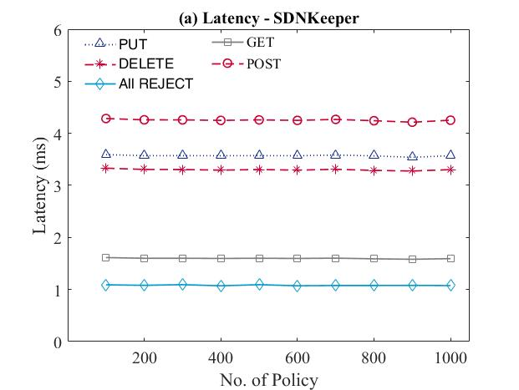
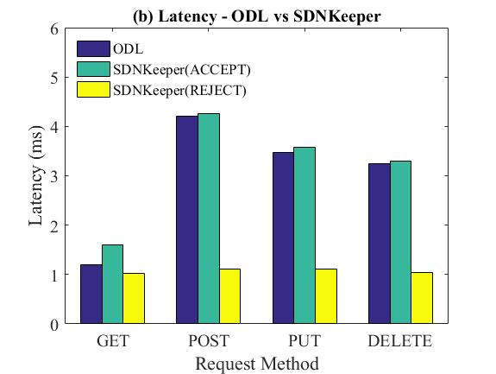
Processing Delay
Latency - SDNKeeper
Latency – SDNKeeper VS OpenDaylight
4.2536
3.5703
3.3008
1.5974
1.0809
No significant increase in latency
Notes:
In SDNKeeper, matching policies and checking permissions may introduce extra delay when processing a request.
We evaluate this delay by measuring the latency in user from sending a request to receiving the corresponding response.
With different numbers of policies up to 1000, there is no significant increase in latency.

Slide 29
Processing Delay
Latency - SDNKeeper
Latency – SDNKeeper VS OpenDaylight
4.2536
3.5703
0.039
0.101
0.061
3.3008
0.391
1.5974
1.0809
No significant increase in latency
An average delay of 0.15ms
Notes:
When compared with original OpenDaylight with 1000 policies, SDNKeeper introduces an average delay of 0.15 milliseconds.
If the checking result is REJECT, the request won’t be processed in the controller, thus the processing time will be minimal.
In practice, the decision ACCEPT and REJECT are mixed, thus the actual delay will be less than 0.15ms, and almost has no impact on the performance.

Slide 30
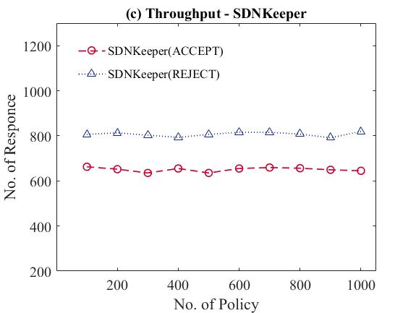
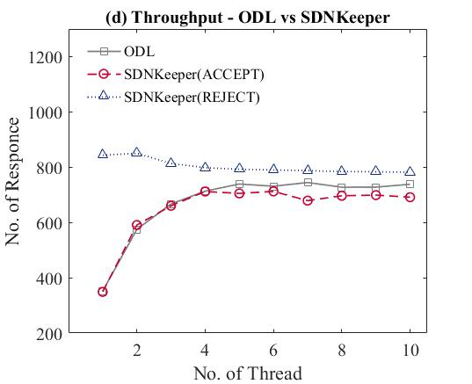
Throughput
Throughput - SDNKeeper
Throughput – SDNKeeper VS OpenDaylight
807
650
No significant effect in throughput
Notes:
In the throughput evaluation, we send a large number of requests to fulfill the capacity of the controller,
then measure the number of requests processed per second.
The throughput is not significantly affected when increasing the number of policies to 1000.
The result is consistent with latency evaluation.
In the scenario of being compared with original OpenDaylight,
With the decision REJECT, the system always achieves maximum throughput.

Slide 31
Throughput
Throughput - SDNKeeper
Throughput – SDNKeeper VS OpenDaylight
807
650
5.09% degradation
3.05% degradation overall
No significant effect in throughput
Notes:
When the number of threads is greater than 4, the processing capability is no longer significantly affected by thread’s number.
The results show, when the thread’s number is greater than 4, the reduction of performance introduced by SDNKeeper is only 5.09% on average.
While the overall throughput degradation is only 3.05%.
In practice, an average delay of 0.15 milliseconds and throughput reduced by 5.09% are acceptable computation overhead.

Slide 32
Conclusions
SDNKeeper: a lightweight access control system
Defending against malicious requests
Assisting in managing resources
Real-time protection and policy hot-update
Reliable enforcement with good performance
Thank you
lengxue_2015@outlook.com
Notes:
In conclusion, SDNKeeper is a lightweight access control system for protecting and managing resources for SDN-based Cloud.
By means of flexible policy language,
it can defend against malicious requests and assist administrator in managing resources,
also support policy hot update.
Based on our evaluation, we can find that SDNKeeper can achieve good performance.
That’s all, thank you! Any questions?

Slide 33
Back Up Page
Notes:
Then, here is the formal description of a policy.
A policy is a set of assertion expressions, combined with the iteration of if-statements and AND/OR logical operators.
And the return value is ACCEPT or REJECT.
Here are two policy examples.
Alice can not delete firewall.
It is not allowed to operate between 1am and 6am.

Slide 34
Policy Language
Attribute Based Access Control
P(S, O, E) <- Logic Expression(ATTR(S), ATTR(O), ATTR(E))
REST Request
Subject
(Requester)
Object
(Resource)
Environment
(Time)
Predefined Data Structure
Notes:
SDNKeeper adopts attribute based access control, and extracts the attributes of Subject (requester), Object (resource) and environment (time).
REST API is the most common NBI to access the controller, and it is used by mainstream controllers.
Here is an example of a REST Request. It consists of four parts, Method, URI, Headers and Body.
To fetch these attributes, we predefine some data structures.

Slide 35
Policy Language
Attribute Based Access Control
P(S, O, E) <- Logic Expression(ATTR(S), ATTR(O), ATTR(E))
REST Request
Subject
(Requester)
Object
(Resource)
Environment
(Time)
Predefined Data Structure
subject.role subject.user
action.uri action.method
$.{object_name}.attribute
$.network.network_type
Notes:
We can use them to get roles and user name of the requester, and the URI and method of the request.
To get content inside Body, we can use this format.
For example, this can get the attribute network type, vlan.

Slide 36
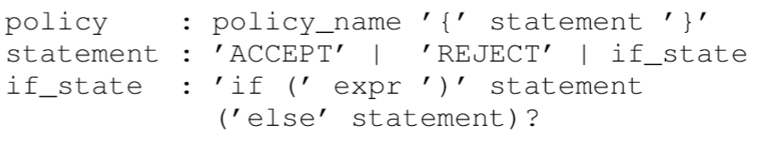
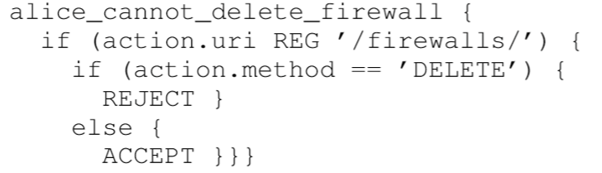
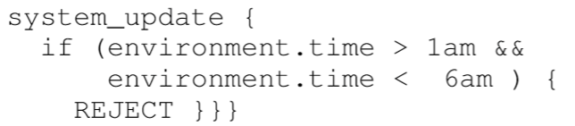
Policy
Policy: A set of assertion expressions
Composition: Iteration of if-statements and logical operators
Return: ACCEPT / REJECT
Notes:
Then, here is the formal description of a policy.
A policy is a set of assertion expressions, combined with the iteration of if-statements and AND/OR logical operators.
And the return value is ACCEPT or REJECT.
Here are two policy examples.
Alice can not delete firewall.
It is not allowed to operate between 1am and 6am.

