Slide 1
A Decision Feedback Channel Estimation Approach of The Satellite Mobile Communication System
汇报人：李欣

Slide 2
INTRODUCTION
Channel Estimation:
LS(Least Square),MMSE(minimum mean-square error), LMMSE(linear minimum mean-squared-error)
In order to improve the bit error performance in mobile satellite communication system, the paper proposes a decision feedback channel estimation way based on LS channel estimation.

Slide 3
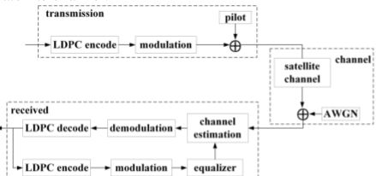
MOBILE SATELLITE COMMUNICATION DECISION FEEDBACK CHANNEL ESTIMATION SCHEME
Fig.1 satellite mobile communication system based on decision feedback channel estimation block diagram

Slide 4
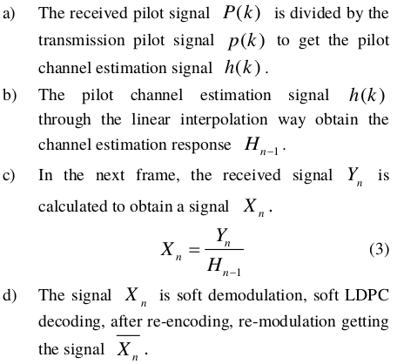
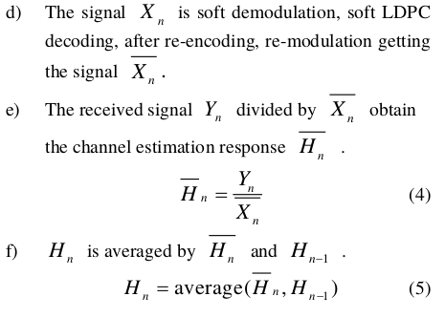

Slide 5
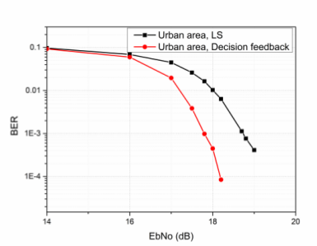

SIMULATION ANALYSIS

Slide 6
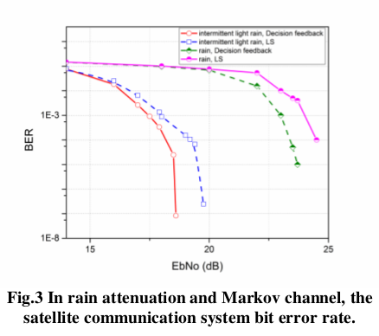

Slide 7
