Slide 1







Detecting Data Breaches
Accenture 3A - Georgina Woo

Slide 2
The Problem
As a data scientist with Accenture, you work with a top international healthcare company. Develop an ML algorithm that can identify how the next data breach will occur.
Key Metric 1
Write the measure of success for your business product
or service.

Slide 3
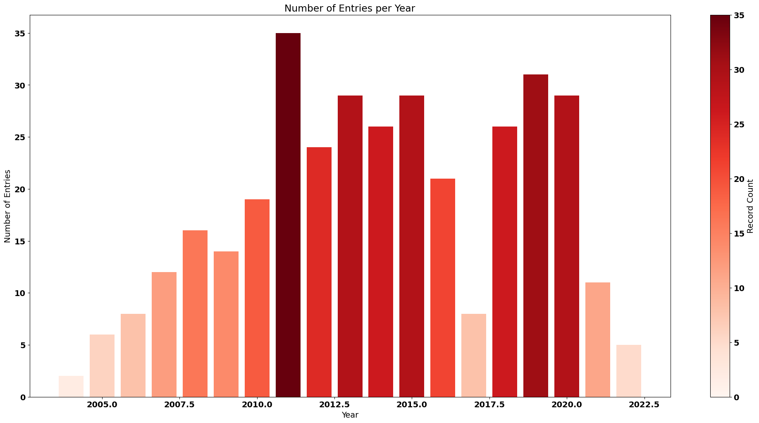
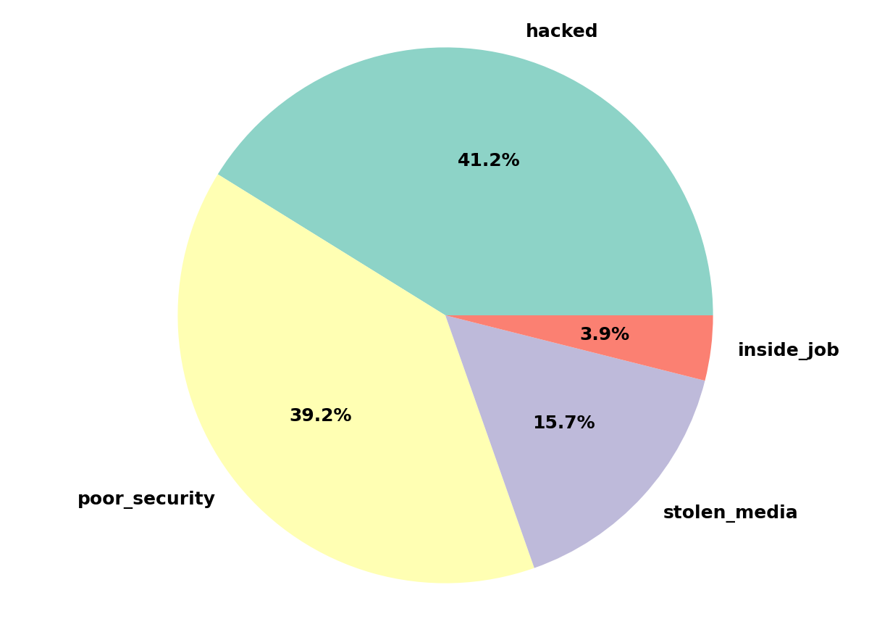
Our Data

Slide 4
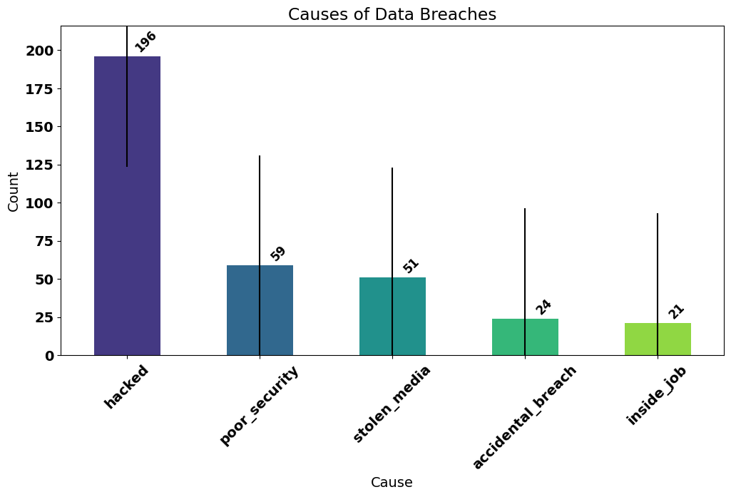
The Classes

Slide 5
The Results
The Model
81.82%
0.29
Accuracy Score
Validation Loss

Slide 6



Thank you!
Resources:
Cost of a Data Breach
Healthcare Data Breach Statistics
Health and medical data compromises
Github:
https://github.com/lxwooxy/detectingdatabreach

