Slide 2
Read the file as numpy array
Use bytearray
Use CV2 to read the numpy array
Convert BGR to RGB
Display the photo inline
Use pyplot

Slide 3
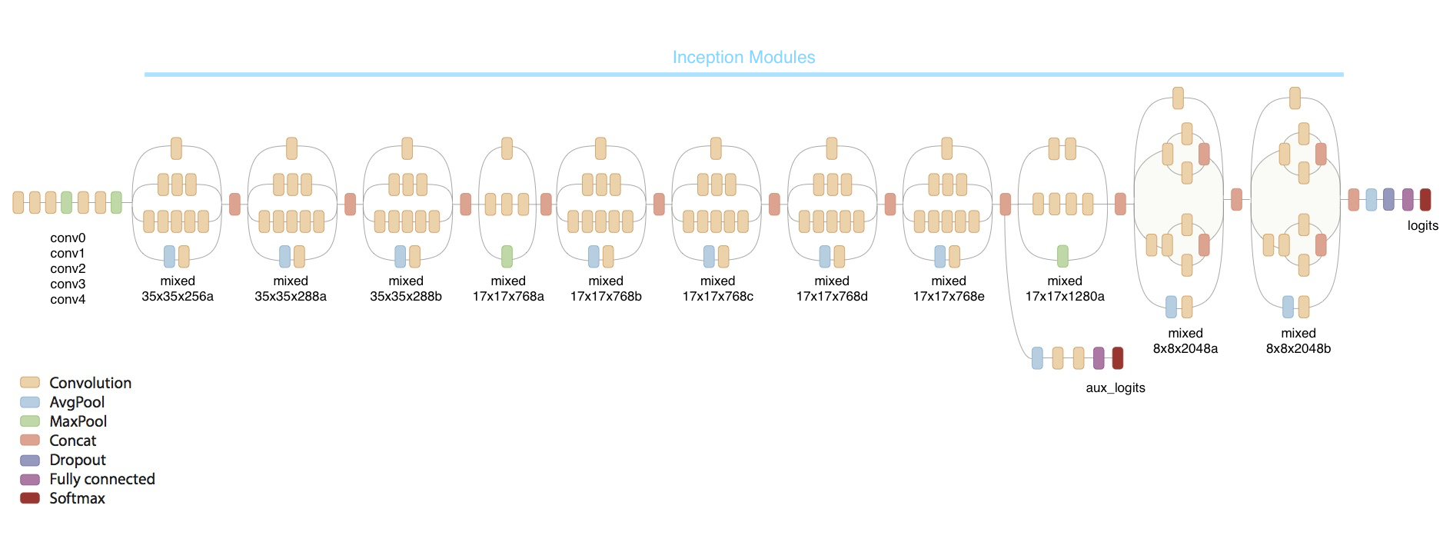
Target Layer
Inception Module

Slide 4
Read all the face images
Read reach file as 3D numpy array
Convert to 4D tensors
Stack all the numpy arrays to 4D tensors
Normalize the value
Normalize the value to fulfil the model input

