Slide 1
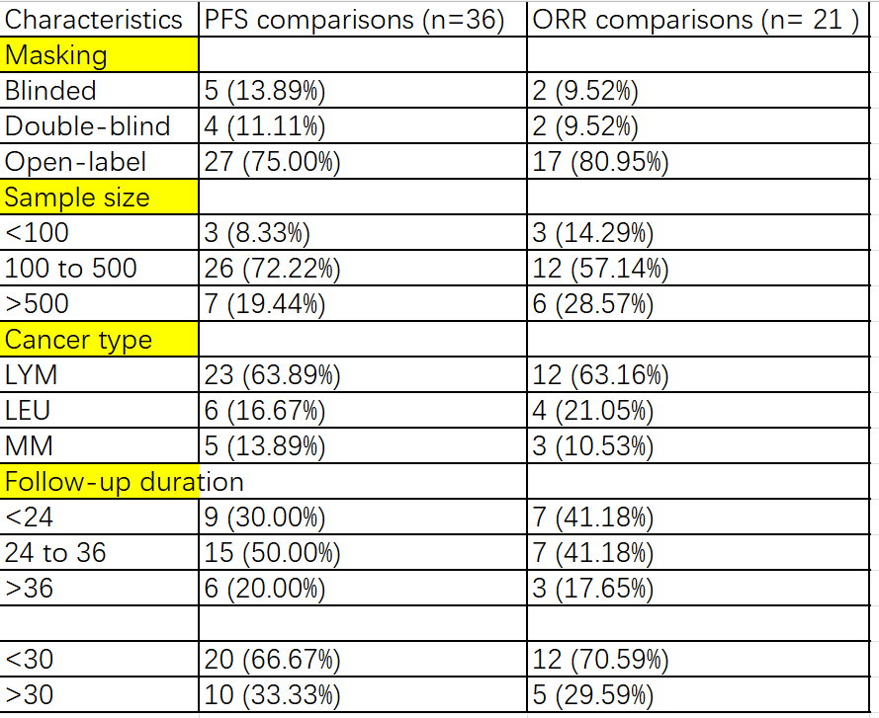
Table 1

Slide 2
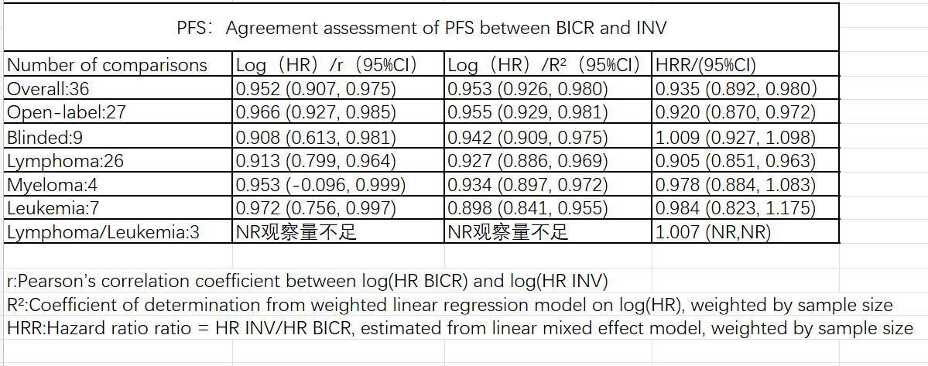
Table 2

Slide 3
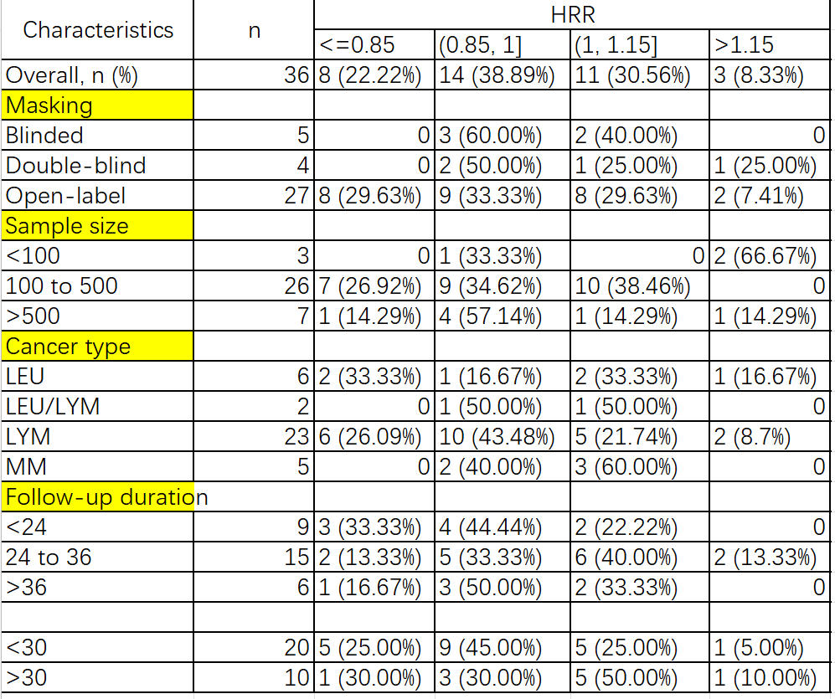
Table 3

Slide 4
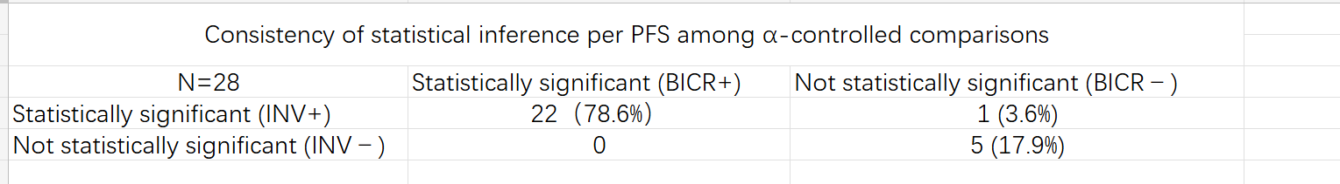
Table 4
1.原N=29 30305280 primary endpoint notPFS

Slide 5
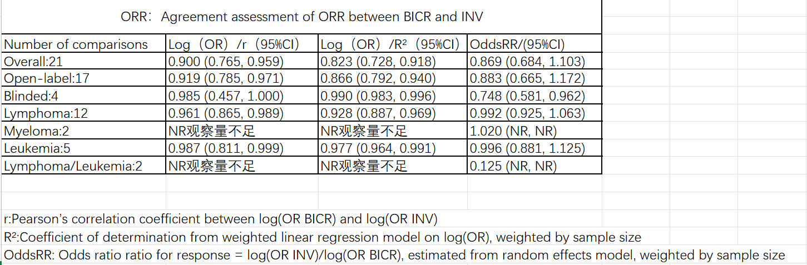
Table 5

Slide 6
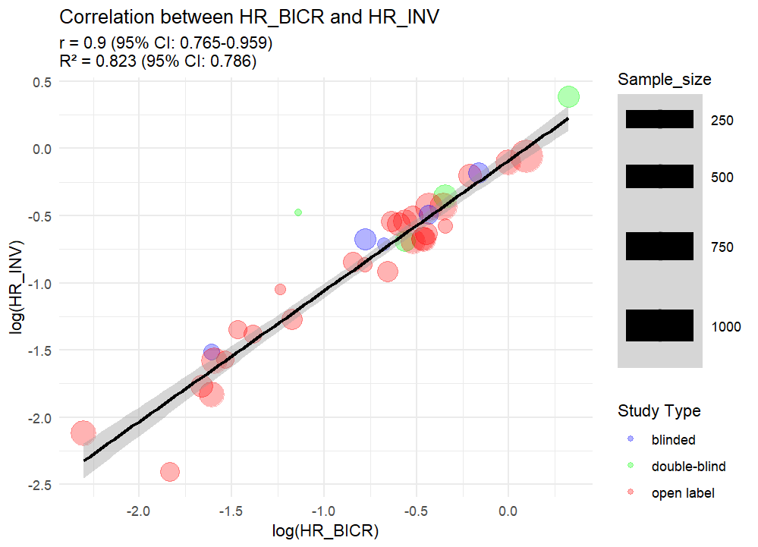
Figure.1 BICR vs. LE log(PFS HR) by blinding status of trial.

Slide 7
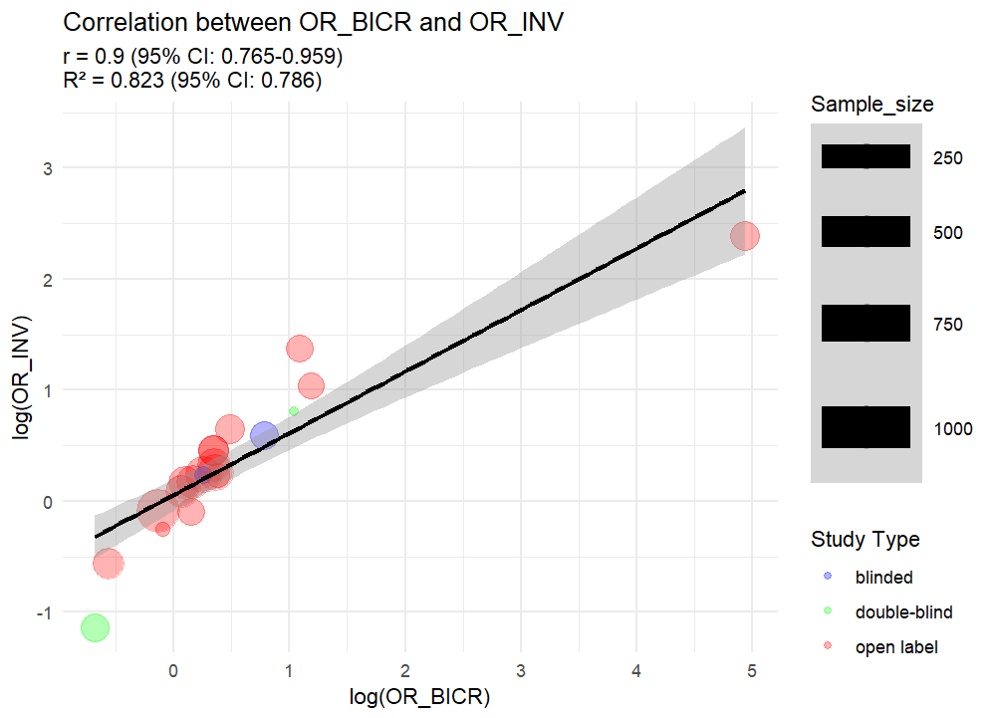
Figure.2 BICR vs. LE log(OR of ORR) by blinding status of trial.

