Slide 1
COMP 472 assignment 1 demo
Xiyue Li (40048161)

Slide 2
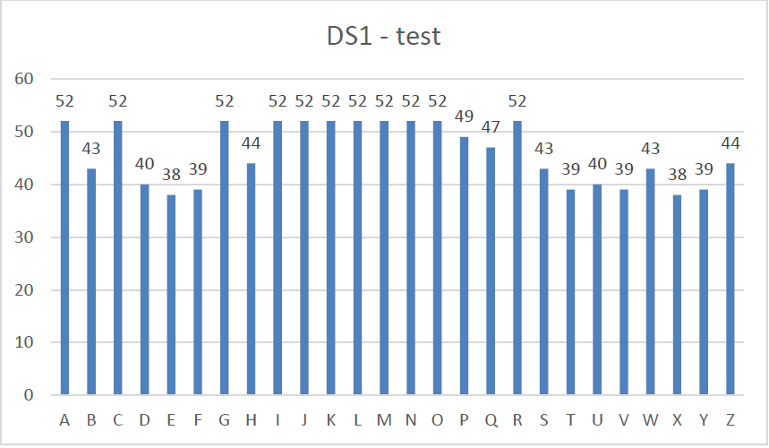
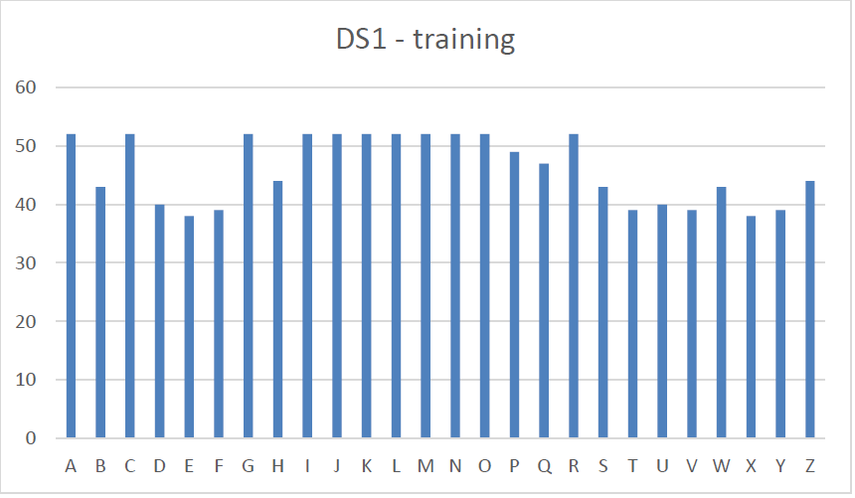
Analysis on original DS
DS1
Smaller data set (80 sets of data, 26 classes)
Mostly uniformly distributed for each class

Slide 3
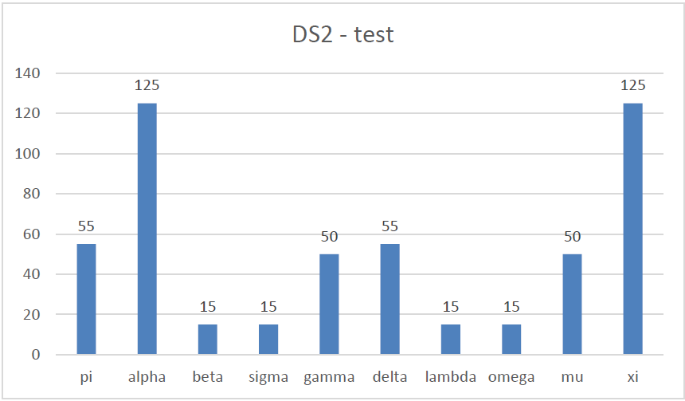
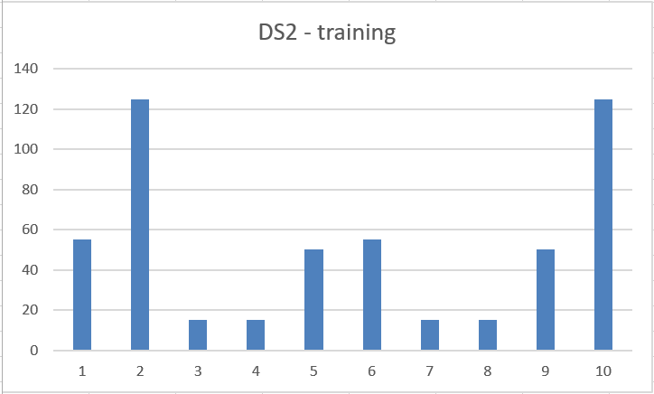
Analysis on original DS
DS2
Larger data set (520 sets of data, 10 classes)
Alpha and Xi have larger weight

Slide 4












Model Comparison
DS1
Perceptron
GNB
Best MLP
Base DT
Best DT
Base MLP
DS2
Best MLP
Perceptron
Base DT
GNB
Best DT
Base MLP

Slide 5
Model Comparison
Perceptron (~0.78): linearly separable
GNB: (~0.65) conditionally independent
Base MLP (worst): 1 hidden layer with 100 nodes by default
Base DT: small number of instances, large number of classes (under-fitted)

Slide 6
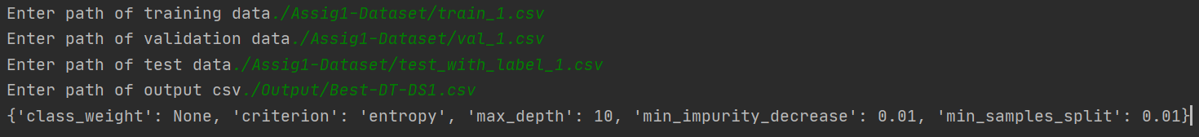
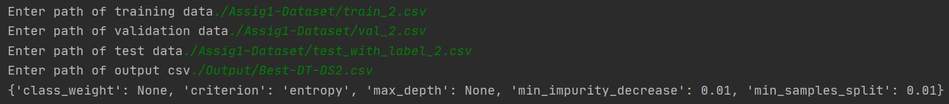
Hyper parameters
Best DT
DS1: {'class_weight': None, 'criterion': 'entropy', 'max_depth': 10, 'min_impurity_decrease': 0.01, 'min_samples_split': 0.01}
DS2: {'class_weight': None, 'criterion': 'entropy', 'max_depth': None, 'min_impurity_decrease': 0.01, 'min_samples_split': 0.01}

Slide 7
Hyper parameters
Best MLP
DS1: {'activation': 'identity', 'hidden_layer_sizes': (30, 50), 'solver': 'adam'}
DS2: {'activation': 'identity', 'hidden_layer_sizes': (30, 50), 'solver': 'adam'}

