Slide 1
Gen93 IMS AP SQA/SV training
Gen93 IMS AP team:
WSD/ACF
AF1 / AF9 / AF12 / AF13 / AF19

Slide 2
Agenda
Design principle of Gen93 MD
Gen90-92/Gen93 IMS SW architecture
Major change of software architecture
IMS test strategy and affected scenario

Slide 3
Design principle of Gen93 IMS solution
Design principle:
Highly leveraged IOT accomplishment
Better cross-platform capability
Unified AT interface for long-term IMS solution
More compliant for AOSP design
Major features of Gen93 MD:
3GPP RAT(GSM/C2K) integration
3GPP RAT and non-3GPP RAT(WiFi) integration
One RILD

Slide 4
(Gen90-92) Legacy IMS solution
IMS solution is designed to adapt
[AOSP and MTK proprietary part]
based on
[Two RILD / MAL / IMS Stack]
architecture.
AOSP framework / application
IMS solution
GSM RILD
C2K RILD
IMS stack
MAL
AP
MD
GSM MD
C2K MD

Slide 5
Gen93 IMS solution
IMS solution is designed to adapt
[AOSP and MTK Gen93 MD]
based on
[One RILD / IMS Stack] architecture.
AOSP framework / application
IMS solution
One RILD
IMS Stack
MAL
AP
MD
MD (3GPP + Non-3GPP RAT integration)

Slide 6
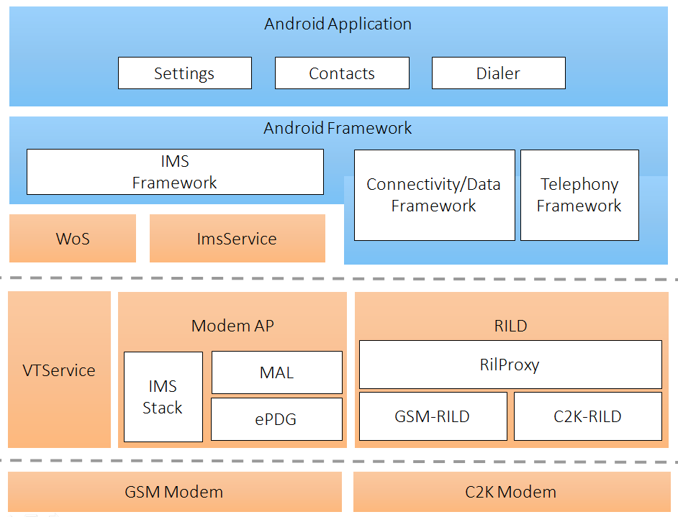
(Gen90-92) Legacy IMS SW arch.

Slide 7
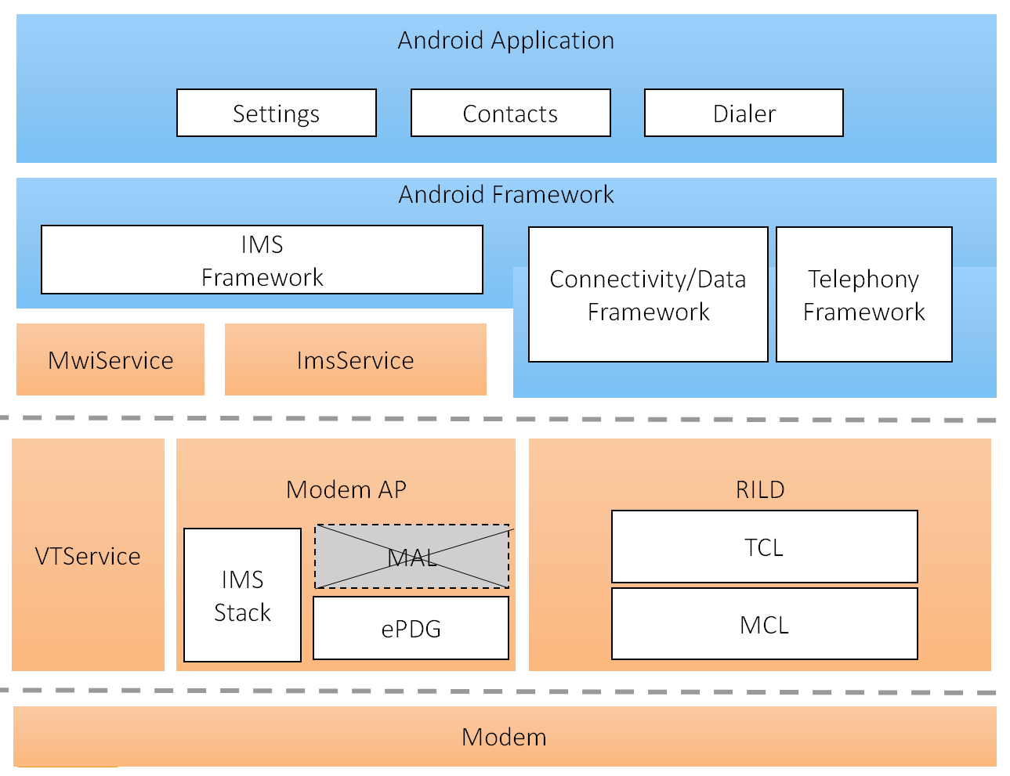
Gen93 IMS SW arch.
Notes:
MwiService = Mobile Wifi Interactive Service

Slide 8
Major change of software architecture - IMS infrastructure change #1
IMS AP/MD interface unification
Background:
In the long run, to prepare the pure IMS modem solution. AT interface has more compatibility than socket interface
93 implementation:
Unify AP/MD interface by AT command and remove the socket communication.

Slide 9
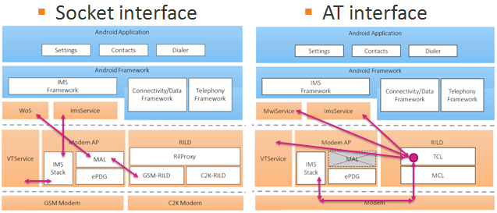
Major change of software architecture - IMS infrastructure change #1

Slide 10
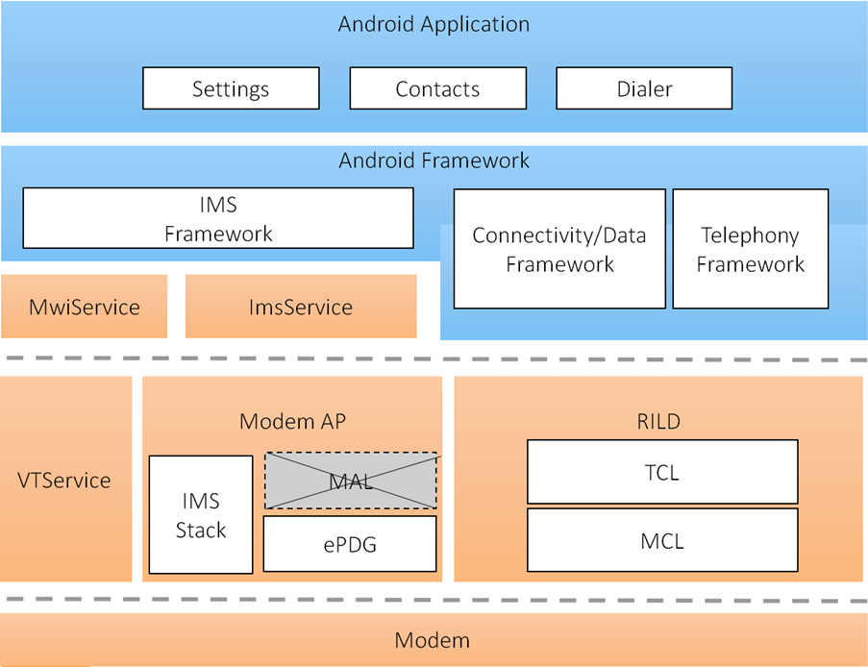
Major change of software architecture - IMS infrastructure change #1
IMSA destruction
Background:
Due to AP/MD interface is unified by AT command, there is no need to relay IMCB message(e.g. PDN activation) for IMSA.
93 implementation:
IMSA is destructed and domain dispatchers are changed to use AT command/URC through IMS-RIL for modem communication.
ImsService
Domain dispatchers
IMSA
IMS-RIL
socket
RILD
AT command

Slide 11
Major change of software architecture - IMS infrastructure change #2
MAL destruction
Background:
Gen93 MD is designed to merge 3GPP RAT GSM/C2K and non-3GPP RAT WiFi.
93 implementation:
Therefore, all MAL function(e.g. domain selection/IMS parameter relay) is moved to MD from AP.
Only modem aware and complete the handover procedure

Slide 12
Major change of software architecture
MAL destruction
Gen93 MD is equipped with RAT selection capability, including GSM/C2K/WiFi.
RAT selection in MAL
RAT selection in Gen93 MD IWLAN
IWLAN

Slide 13
Major change of software architecture
IMS data re-arch.
Background:
IMS data RIL part is also re-factored based on
ONE RIL arch.
MAL removal
IMSA removal
93 Implementation:
MD establishes IMS PDN first, and then notify AP to reuse
IMS PDN activation/deactivation is triggered by AT/URC
Data framework is re-factored to comply AOSP
Remove “Ignore roaming check for IMS PDN”
Remove “Ignore retry for IMS PDN”

Slide 14
Major change of software architecture
Activation/Deactivation procedure:
Gen93 MD has the capability to activate the IMS PDN and complete the domain selection before AP involve.
Legacy design:
trigger => FWK setup => domain selection => establish PDN
Gen93 design:
trigger => domain selection => establish PDN => FWK setup to reuse

Slide 15
Major change of software architecture
Legacy flow
93 flow
reuse
IMS PDN
IMS PDN
Operator Network
Operator Network

Slide 16
Major change of software architecture
IMS-RIL re-factory
Background:
IMS-RIL originally connects ImsService and GSM-RIL before Gen93
In VzW project, IMS-RIL is re-factored to connect ImsService and RilRroxy in order to centrally control GSM/C2K RILD.
93 Implementation:
Due to GSM/C2K is merged and to align ONE RIL arch., the VzW design is implemented which connects ImsService and TCL

Slide 17
Major change of software architecture
IMS-CC
Background:
“Conference SRVCC” and “380 redial” are not AOSP compliant solution before Gen93.
It’s necessary to add some workaround in AP to restore the call number before conference SRVCC.
When UE receives the 380 error response, CS/ECC redial is necessary. Part of solution in VDM, the other is in AP.
93 implementation:
Remove the AP part modification to fulfill AOSP compliant design
Common part only need to align ONE RIL arch. change.

Slide 18
Major change of software architecture
In Gen93, a lots of logic are refactored to and implement in MD side.
Refactored logic in MD:
WiFi / LTE handover (Signal/Preference change)
3GPP1/3GPP2/non-3GPP RAT selection
MD auto setup IMS PDN, including ePDG connection
380 redial

Slide 19
IMS Test strategy and affected scenario
Test strategy:
Gen93 is equipped with the AS-IS feature set (VoLTE/VoWiFi/ViLTE). Therefore, all UI and user behavior is kept the same as before.
We suggest SQA/SV can keep the original verification procedure to secure the software quality.

Slide 20
IMS Test strategy and affected scenario
All UI keep original display
VoLTE/VoWiFi registration icon
IMS setting entries
Dialer icon
All scenarios keep original design
IMS registration shows the same icon on status bar
IMS call (VoLTE/VoWiFi/ViLTE)
IMS call SRVCC
IMS Conference call
Handover for WiFi/LTE switch
VoWiFi call during flight mode
SMS over IMS

Slide 21
VoLTE test suite
IMS registration on LTE
IMS setting on/off, IMS registration is OK
Flight mode on/off , IMS registration is OK
SIM switch, IMS registration is OK
VoLTE MO/MT call
VoLTE conference call
SRVCC
Conference call SRVCC
Emergency call over IMS

Slide 22
VoWiFi test suite
IMS registration on WiFi
Flight mode, IMS registration on WiFi
Flight mode, VoWiFi call
Handover trigger combination
RAT change
User preference change

Slide 23
ViLTE test suite
ViLTE MO/MT call
Local downgrade from video to voice call
Remote downgrade from video to voice call
Local upgrade from voice to video call and remote accepted
Remote upgrade

Slide 24
System-wise test suite
TRM
Telephony process die then recover.
ImsService process die then recover.
MwiService process die then recover.
VTService process die then recover
RIL process die then recover
IPO
After IPO, IMS registration successfully

Slide 25
END

