Slide 1
[Gen93] IWLAN Introduction

Slide 2
Outline
Introduction
Architecture
Design & Procedure
Test Procedure
Case Study (Jen-Ping)

Slide 3
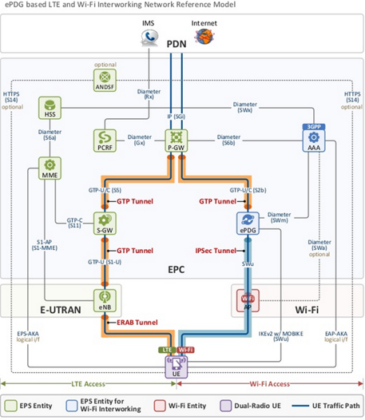
Introduction - Interworking WLAN
IWLAN Functionality
Setup data call RAT selection
Traffic steering PDN connection b/t WLAN and MD
MP0.25/MP0.5 WFC operators
India/RJIL
Taiwan/APTG, FET
Thailand/AIS, True, DTAC
IWLAN service is NOT yet activated in China

Slide 4
Outline
Introduction
Architecture
Design & Procedure
Test Procedure
Case Study

Slide 5
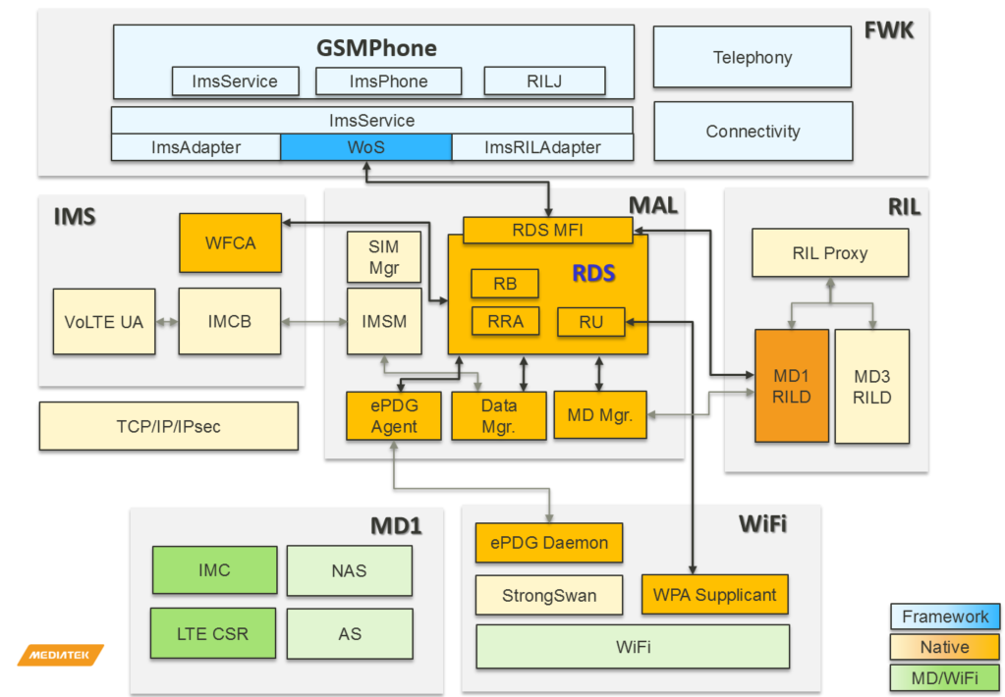
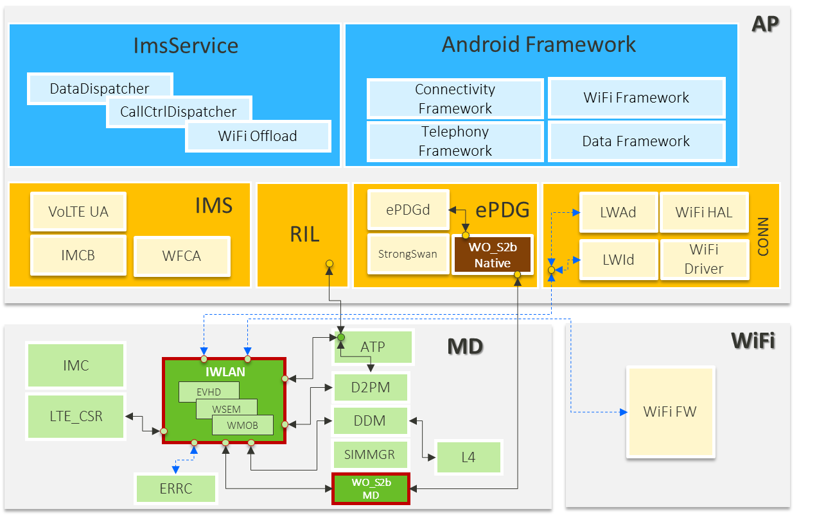
[Gen93] IWLAN/ePDG Architecture
Gen 90/91/92 MD
Gen 93/95 MD
AP RDS supports WFC/WiFi offload
MD IWLAN/WO supports WFC/WiFi offload
Supporting R12/R13 WLAN interworking features
Notes:
MWIS

Slide 6
Outline
Introduction
Architecture
Design & Procedure
High Level Design
RJIL WANS
Gen93 Modification: DSBP/IMS Configuration
Test Procedure
Case Study

Slide 7
[Gen93] IWLAN Block Diagram
IMS/MWIS Services
WiFi Interworking
(LWAd, LWId)
WIPC
D2PM
ATP
AT-CMD
ILM
ILM
IWLAN - EVHD
WMOB
Session Status
WANS/RPLG
Operator policy
LWX
WANS/MEAS
WSEM
WLAN offloading user settings
Call status monitoring
WLAN offload ability policy
WLAN access network selection
LWI/RCLWI RAN steering command
LWA WLAN control function
LWA/LWIP WLAN meas report
WLAN/MD meas. report
WLAN/MD register status report
Service quality meas. report
WLAN/MD traffic steering
PDN CONNECTIVITY REQUEST HOI
HOI=1/ePDG error handling
WIPC
ILM
ILM
ILM
ILM
WiFi FW
IMC
LTE_CSR
WO/MD
DDM

Slide 8
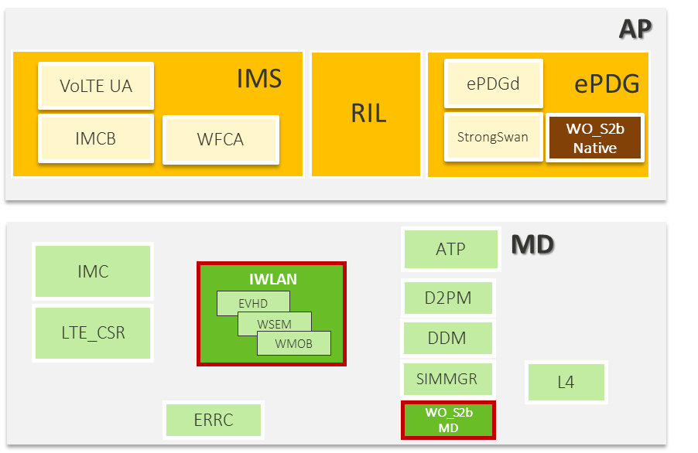

[Gen93] IWLAN HLD
<Activate Data Call>
RIL→D2: ACT_DATA_CALL
D2→IWLAN: ACT_DATA_CALL
<RAT selection by RPL>
3.1. IWLAN →DDM: ACT_DATA_CALL
3.2. IWLAN →WO: ACT_DATA_CALL
<Traffic Steering WLAN to MD>
RPL_UPDATE_IND
IWLAN →DDM: ACT_DATA_CALL_REQ
WO→IWLAN: DEACT_DATA_CALL_IND
DDM→IWLAN: ACT_DATA_CALL_CNF
<Traffic Steering MD to WLAN>
RPL_UPDATE_IND
IWLAN→WO: ACT_DATA_CALL_REQ
DDM→IWLAN: DEACT_DATA_CALL_IND
WO→IWLAN: ACT_DATA_CALL_CNF
1
2
1
2
3
3

Slide 9
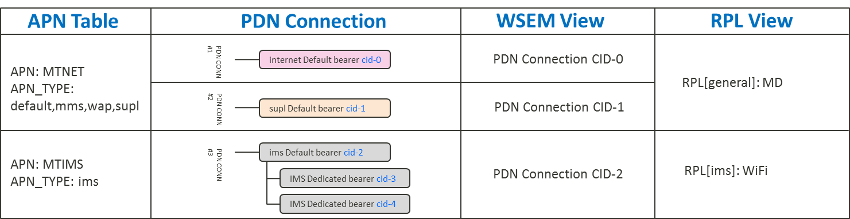
Gen93 IWLAN RPL_{(RAT Preference List)}
RPL is a mapping table of PDN connection v.s. RAT
RPL generation flow
RAT Status Monitoring
RAT Ranking
RAT Barring
APN Based Access Network Selection

Slide 10
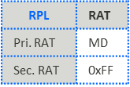
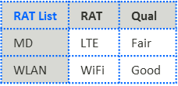
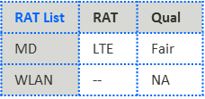
[WANS] RPL Generation Flow
RAT Status Monitor
Rat Ranking
RAT Barring
APN based ANS
WO UI enable
MD network register status
MD RAT Ranking
e.g., LTE/Fair
APN based rule handling
WLAN Access Barring
WLAN association status
WiFi RAT Ranking
e.g., WiFi/Good
RPL
User Preference
e.g., Cellular/WiFi only
WLAN IKE8192
RAT Ranking List
OP Customized
RAT Barring
WLAN offload enable
Available RAT List
Notes:
wans_rpl_gen

Slide 11
[WANS] RAT Ranking
Rat Ranking
Check RAT signal quality status
Signal quality are categorize as 5 levels
NA/poor/fair/good/excellent
Excellent current are reserved in OM
Thresholds are selected by current registration RAT and service status (e.g., PDN on WLAN)
MD RAT Ranking
e.g., LTE/Fair
WiFi RAT Ranking
e.g., WiFi/Good
OM Example
LTE
Not Available
Poor LTE RSRP
Bellow -116 dbm
Fair LTE RSRP
-116~-106 dbm
Good LTE RSRP
Above -106 dbm
RAT Ranking List
WANS_LTE_RSRP_POOR_TH
-116 dbm
WANS_LTE_RSRP_FAIR_TH
-106 dbm
RAT list
WLAN
Not Available
Poor WLAN RSRP
Bellow -85 dbm
Fair WLAN RSRP
-85~-75 dbm
Good WLAN RSRP
Above -75 dbm
 | RAT | Qual
MD | LTE | Fair
WLAN | WiFi | Good
WANS_WLAN_RSSI_ROVE_POOR_TH
-85 dbm
WANS_WLAN_RSSI_ROVE_FAIR_TH
-75 dbm
Notes:
WANS_WLAN_RSSI_ROVE_POOR_TH

Slide 12
[WANS] RAT Barring
RAT Barring
WO UI enable
RAT Access Barring
WI_{(WLAN Interworking)} UI enable
AT+EIMSCFG: vowifi/viwifi
WLAN Access Barring
WANS_IKE8192_ERR_SUPPORT
User Preference
E.g., Cellular only = disable WLAN
OP customized RAT Barring
WANS_MD_RAT_SUPPORT
WLAN Access Barring
User Preference
e.g., Cellular/WiFi only
OP Customized
RAT Barring
Available RAT List
RAT list
 | RAT | Qlt
MD | LTE | Fair
WLAN | -- | NA
e.g., WiFi Disabled

Slide 13
[WANS] APN Based Access Network Selection
APN based ANS
ANS solutions are specified for each APN
APN Based ANS
Service specific Barring
RAT Preference Selection
WANS relies on RAT selection LUT for
E.g., Cellular prefer LUTkal_uint32
IMS ANS?
Yes
ims_ans
No
MMS ANS?
Yes
mms_ans
No
ECC ANS?
Yes
ecc_ans
Cellular Prefer LUT | WiFi Good | WiFi Fair | WiFi Poor | WiFi NA
LTE Good | MD | MD | MD | MD
LTE Fair | WiFi | MD | MD | MD
LTE Poor | WiFi | WiFi | MD | MD
LTE NA | WiFi | WiFi | WiFi | None
No
ADM APN?
Yes
adm_ans
No
general_ans

Slide 14
[WANS] IMS Access Network Selection
IMS PDN Access Network Selection
PDN RAT Barring
IMS_UI_STA
volte_en/vilte_en
IMS_VOPS_STA
IMS_MD_RAT
MD RAT which can used to setup IMS PDN.
[0]: LTE [1]: UMTS [2]: GSM [3]: C2K
IMS_ROAMING_STA
PDN RAT Preference
Current RAT preference
UI preference mode: cellular/wifi prefer
RAT throttling
WiFi preference service
In scope service on WiFi
ims_ans
IMS_UI_STA
PDN RAT Preference
e.g., UI preference, WiFi Prefer, in scope service
IMS_VOPS_STA
PDN RPL
IMS RPL
IMS_MD_RAT
 | RAT
Pri. RAT | MD
Sec. RAT | 0xFF
IMS_ROAMING_STA

Slide 15




[WANS] Current RAT Preference Configuration
Current RAT Preference (WiFi Prefer Mode)
Prevent ping pong in the WLAN boundary condition
E.g., WiFi Prefer, UE moving condition
WiFi Prefer C-RAT LTE | WiFi Good | WiFi Fair | WiFi Poor
LTE Good | WiFi | LTE | LTE
LTE Fair | WiFi | LTE | LTE
LTE Poor | WiFi | WiFi | LTE
4
3
Good WLAN RSSI
Above -75 dbm
Fair WLAN RSSI
-85~-75 dbm
Poor WLAN RSSI
Bellow -85 dbm
2
Wi-Fi Signal Stregth
WiFi Prefer C-RAT WiFi | WiFi Good | WiFi Fair | WiFi Poor
LTE Good | WiFi | LTE | LTE
LTE Fair | WiFi | WiFi | LTE
LTE Poor | WiFi | WiFi | WiFi
Stop1: WiFi
1
Stop2: LTE
Stop3: LTE
2
3
Stop4: LTE
1
Stop5: WiFi
4
3GPP Signal Strength
Poor LTE RSRP
Bellow -116 dbm
Fair LTE RSRP
-116~-106 dbm
Good LTE RSRP
Above -106 dbm
Notes:
WiKi: Hysteresis is the dependence of the state of a system on its history

Slide 16
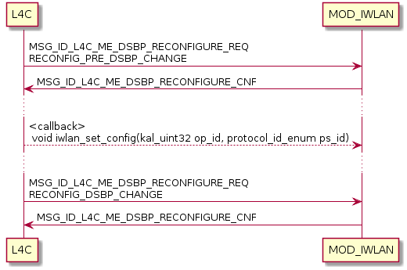
Gen93 IWLAN DSBP Configuration
Gen90~Gen92:
DSBP information provided by AP DSBP module through system property key
Gen93 Objectives
DSBP module re-arch from AP to MD/L4C in Gen93
MOD_IWLAN operator setting configuration triggered by DSBP update flow

Slide 17
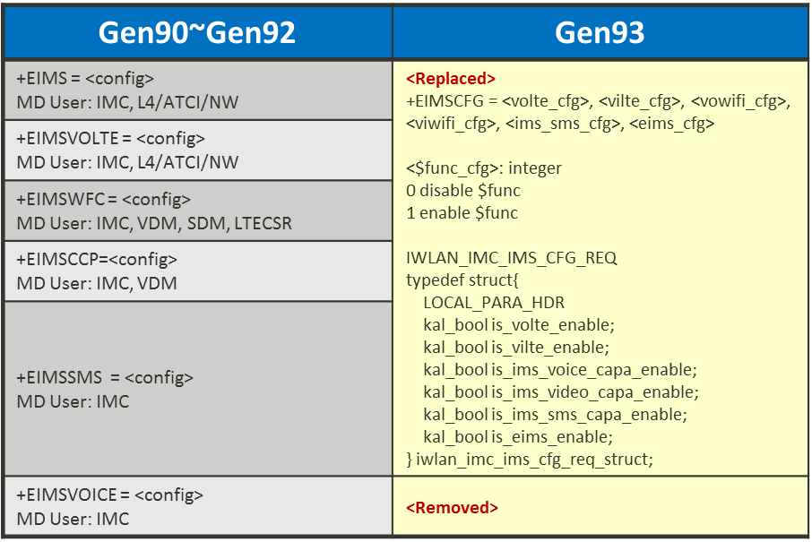
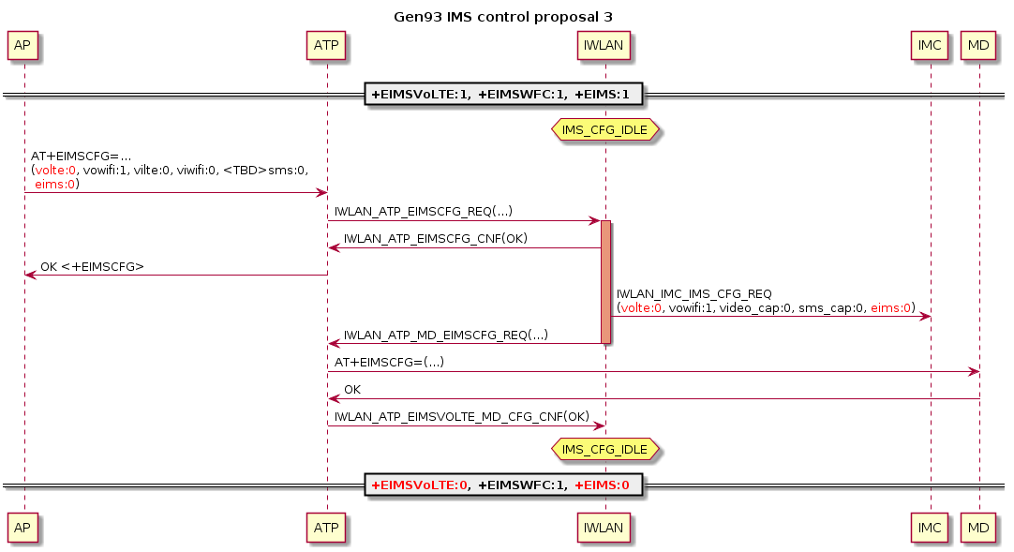
Gen93 IWLAN IMS Configuration
Gen93 IMS Configuration Objectives
Maintain service continuity when IMS capability switched
AP consolidates UI_CHANGE and EIMS in single AT-CMD

Slide 18
Outline
Introduction
Architecture
Design & Procedure
Test Procedure
Highlight modifications
RD IT test cases
Case Study

Slide 19
Highlight Modifications
PDN connection setup flow
WFC RAT selection techniques
IMS/MMS PDN connection handover b/t 3GPP/WLAN
Operator specific hysteresis & throttling techniques
SIM hot-plug DSBP
IMSCFG flow (+EIMSCFG)

Slide 20
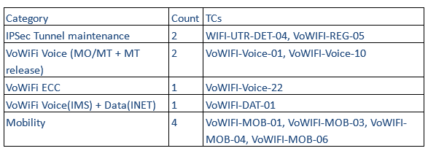
RD IT Test Cases
E/// IOT RD IT basic test cases
Gen93 M3 RD IT test cases

Slide 21
Outline
Introduction
Architecture
Design & Procedure
Test Procedure
Case Study
PDN Connection Activation/Deactivation
PDN Connection Handover

Slide 22
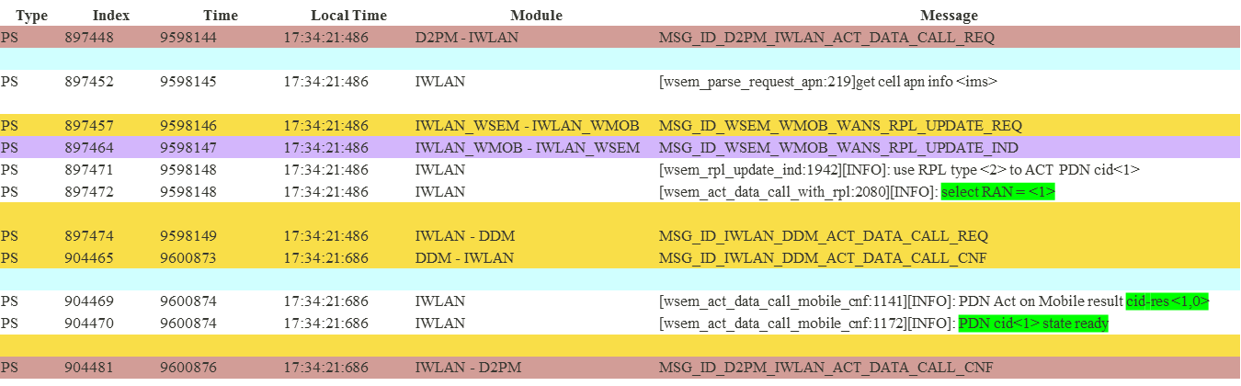
PDN Connection Activation - Success
Setup PDN connection successfully on MD

Slide 23
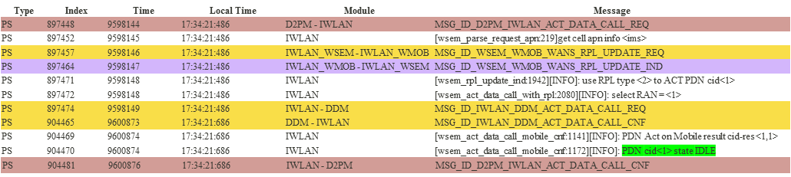
PDN Connection Activation - Failure
Setup PDN connection Failure on MD
Dispatch to DDM for Analysis

Slide 24
PDN Connection Deactivation
Deactivate PDN connection successfully on MD
Type | Index | Time | Local Time | Module | Message
PS | 1170027 | 10986024 | 17:35:50:292 | D2PM - IWLAN | MSG_ID_D2PM_IWLAN_DEACT_DATA_CALL_REQ
PS | 1170029 | 10986025 | 17:35:50:292 | IWLAN | [wsem_deact_data_call_req:1435][INFO]: deact req on cid<0>
PS | 1170033 | 10986026 | 17:35:50:292 | IWLAN - DDM | MSG_ID_IWLAN_DDM_DEACT_DATA_CALL_REQ
PS | 1172068 | 10987236 | 17:35:50:292 | DDM - IWLAN | MSG_ID_IWLAN_DDM_DEACT_DATA_CALL_CNF
PS | 1172073 | 10987237 | 17:35:50:292 | IWLAN_WSEM - IWLAN_EVHD | MSG_ID_EVHD_WSEM_DEACT_DATA_CALL_CNF
PS | 1172074 | 10987237 | 17:35:50:292 | IWLAN - D2PM | MSG_ID_D2PM_IWLAN_DEACT_DATA_CALL_CNF

Slide 25
PDN Connection Activation - Success
Setup PDN connection successfully on WiFi
Type | Index | Time | Local Time | Module | Message
PS | 1035913 | 721962 | 09:44:23:575 | D2PM - IWLAN | MSG_ID_D2PM_IWLAN_ACT_DATA_CALL_REQ
PS | 1035919 | 721963 | 09:44:23:575 | IWLAN | [wsem_parse_request_apn:186]get Wifi apn info <ims>
PS | 1035922 | 721963 | 09:44:23:575 | IWLAN_WSEM - IWLAN_WMOB | MSG_ID_WSEM_WMOB_WANS_RPL_UPDATE_REQ
PS | 1035932 | 721965 | 09:44:23:575 | IWLAN_WMOB - IWLAN_WSEM | MSG_ID_WSEM_WMOB_WANS_RPL_UPDATE_IND
PS | 1035934 | 721965 | 09:44:23:575 | IWLAN | [wsem_act_data_call_with_rpl:1891][INFO]: select RAN = <2>
PS | 1035936 | 721966 | 09:44:23:575 | IWLAN - WO | MSG_ID_IWLAN_WO_ACT_DATA_CALL_REQ
PS | 1045627 | 804103 | 09:44:29:082 | WO - IWLAN | MSG_ID_IWLAN_WO_ACT_DATA_CALL_CNF
PS | 1045629 | 804103 | 09:44:29:082 | IWLAN | [wsem_act_data_call_wifi_cnf:1138][INFO]: PDN ACT on Wifi result cid-res<1,1>
PS | 1045630 | 804103 | 09:44:29:082 | IWLAN | [wsem_act_data_call_wifi_cnf:1167][INFO]: PDN cid<1> state ready
PS | 1045634 | 804104 | 09:44:29:082 | IWLAN - D2PM | MSG_ID_D2PM_IWLAN_ACT_DATA_CALL_CNF

Slide 26
PDN Connection Activation - Failure
Setup PDN connection Failure on WiFi
Type | Index | Time | Local Time | Module | Message
PS | 309124 | 4389013 | 19:47:07:939 | D2PM - IWLAN | MSG_ID_D2PM_IWLAN_ACT_DATA_CALL_REQ
PS | 309135 | 4389015 | 19:47:07:939 | IWLAN | [wsem_parse_request_apn:182]get Wifi apn info <ims>
PS | 309138 | 4389016 | 19:47:07:939 | IWLAN_WSEM - IWLAN_WMOB | MSG_ID_WSEM_WMOB_WANS_RPL_UPDATE_REQ
PS | 309150 | 4389018 | 19:47:07:939 | IWLAN | [wsem_act_data_call_with_rpl:1855][INFO]: select RAN = <2>
PS | 309152 | 4389018 | 19:47:07:939 | IWLAN - WO | MSG_ID_IWLAN_WO_ACT_DATA_CALL_REQ
PS | 310987 | 4456080 | 19:47:12:432 | WO - IWLAN | MSG_ID_IWLAN_WO_ACT_DATA_CALL_CNF
PS | 310989 | 4456080 | 19:47:12:432 | IWLAN | [wsem_act_data_call_wifi_cnf:1116][INFO]: PDN ACT on Wifi result cid-res<1,0>
PS | 310991 | 4456080 | 19:47:12:432 | IWLAN | [wsem_act_data_call_wifi_cnf:1168][INFO]: PDN cid<1> state IDEL
PS | 311011 | 4456083 | 19:47:12:432 | IWLAN - D2PM | MSG_ID_D2PM_IWLAN_ACT_DATA_CALL_CNF

Slide 27
PDN Connection Deactivation
Deactivate PDN connection successfully on WiFi
Type | Index | Time | Local Time | Module | Message
PS | 2612243 | 2749594 | 21:57:21:361 | D2PM - IWLAN | MSG_ID_D2PM_IWLAN_DEACT_DATA_CALL_REQ
PS | 2612248 | 2749594 | 21:57:21:361 | IWLAN | [wsem_deact_data_call_req:1350][INFO]: deact req on cid<1>
PS | 2612252 | 2749595 | 21:57:21:361 | IWLAN - WO | MSG_ID_IWLAN_WO_DEACT_DATA_CALL_REQ
PS | 2614668 | 2752428 | 21:57:21:361 | WO - IWLAN | MSG_ID_IWLAN_WO_DEACT_DATA_CALL_CNF
PS | 2614670 | 2752429 | 21:57:21:361 | IWLAN_WSEM - IWLAN_EVHD | MSG_ID_EVHD_WSEM_DEACT_DATA_CALL_CNF
PS | 2614671 | 2752429 | 21:57:21:361 | IWLAN - D2PM | MSG_ID_D2PM_IWLAN_DEACT_DATA_CALL_CNF

Slide 28
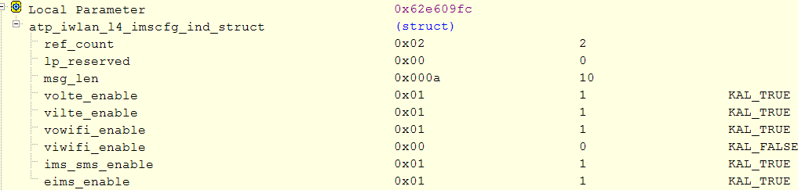
PDN Connection Activation Rejection
IWLAN might reject PDN activation request in following condition
No available cellular or WLAN network
<IMS PDN> UI disable IMS Capability
Type | Index | Time | Local Time | Module | Message
PS | 1267718 | 11436235 | 17:36:19:096 | D2PM - IWLAN | MSG_ID_D2PM_IWLAN_ACT_DATA_CALL_REQ
PS | 1267731 | 11436236 | 17:36:19:096 | IWLAN_WSEM - IWLAN_WMOB | MSG_ID_WSEM_WMOB_WANS_RPL_UPDATE_REQ
PS | 1267741 | 11436238 | 17:36:19:096 | IWLAN_WMOB - IWLAN_WSEM | MSG_ID_WSEM_WMOB_WANS_RPL_UPDATE_IND
PS | 1267743 | 11436238 | 17:36:19:096 | IWLAN | [wsem_rpl_update_ind:1926]PDN RPL for type(2) is <0>:1st(254)2nd(254)//<1>:1st(254)2nd(254)//<2>:1st(254)2nd(254)
PS | 1267744 | 11436239 | 17:36:19:096 | IWLAN | [wsem_rpl_update_ind:1942][INFO]: use RPL type <2> to ACT PDN cid<1>
PS | 1267745 | 11436239 | 17:36:19:096 | IWLAN | [wsem_act_data_call_with_rpl:2080][INFO]: select RAN = <254>
PS | 1267746 | 11436239 | 17:36:19:096 | IWLAN | [wsem_act_data_call_with_rpl:2128] reject RAN selection
PS | 1267751 | 11436239 | 17:36:19:096 | IWLAN - D2PM | MSG_ID_D2PM_IWLAN_ACT_DATA_CALL_REJECT_CNF
Type | Module | Message
PS | ATP - IWLAN | MSG_ID_ATP_IWLAN_L4_CELLTECH_URCRPT_REQ
PS | IWLAN | [wans_update_cellinfo:210]recv Cell reg state info:1, tech info:4096
Type | Module | Message
PS | ATP - IWLAN | MSG_ID_ATP_IWLAN_EWIFIEN_REQ
PS | IWLAN | [wans_set_wifiui_state:1049]recv wifi UI On/OFF info: 1
PS | ATP - IWLAN | MSG_ID_ATP_IWLAN_EWIFIASC_REQ
PS | IWLAN | [wans_set_wifisrv_state:699]recv wifi assoc info: 1,566f574946492d415033
Type | Module | Message
PS | IWLAN - ATP | MSG_ID_ATP_IWLAN_L4_IMSCFG_IND

Slide 29
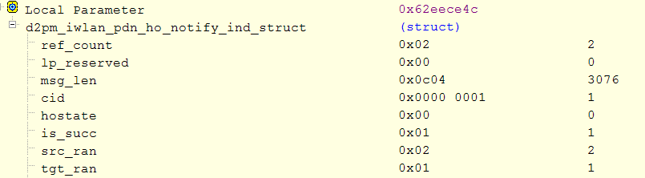
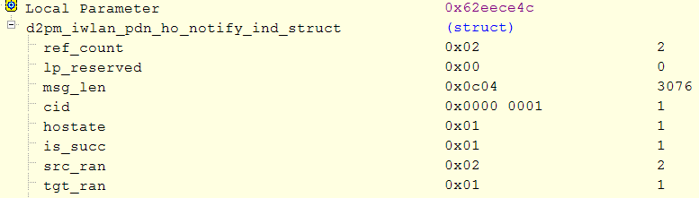
PDN Connection Handover
PDN Handover from Cellular to WiFi
PDN Handover from WiFi to Cellular
Type | Index | Time | Local Time | Module | Message
PS | 1009744 | 2782419 | 11:12:06:658 | IWLAN_WMOB - IWLAN_WSEM | MSG_ID_WSEM_WMOB_WANS_RPL_UPDATE_IND
PS | 1009746 | 2782419 | 11:12:06:658 | IWLAN | [wsem_rpl_update_ind:1860]PDN RPL for type(2) is 1st(2)2nd(1)
PS | 1009747 | 2782420 | 11:12:06:658 | IWLAN | [wsem_rpl_update_ind:1888][INFO]PDN cid<1>policy<2> is not on 1stRPL_POLICY_RAN<2> check if H.O
PS | 1009749 | 2782420 | 11:12:06:658 | IWLAN - D2PM | MSG_ID_D2PM_IWLAN_GET_PDN_PROFILE_IND
PS | 1009754 | 2782421 | 11:12:06:658 | D2PM - IWLAN | MSG_ID_D2PM_IWLAN_GET_PDN_PROFILE_RSP
PS | 1009761 | 2782423 | 11:12:06:658 | IWLAN - D2PM | MSG_ID_D2PM_IWLAN_PDN_HO_NOTIFY_IND
PS | 1009762 | 2782424 | 11:12:06:658 | IWLAN - WO | MSG_ID_IWLAN_WO_PDN_HO_NOTIFY_REQ
PS | 1009763 | 2782424 | 11:12:06:658 | IWLAN - WO | MSG_ID_IWLAN_WO_ACT_DATA_CALL_REQ
PS | 1066516 | 2858655 | 11:12:11:650 | WO - IWLAN | MSG_ID_IWLAN_WO_ACT_DATA_CALL_CNF
PS | 1066526 | 2858660 | 11:12:11:650 | IWLAN | [wsem_act_data_call_wifi_cnf:1230][INFO]: PDN ACT on Wifi result cid-res<1,1>
PS | 1066533 | 2858661 | 11:12:11:650 | IWLAN | [wsem_update_pdninfo_wificnf:518]PDN cid<1> protocol update to <1>//<1><0>
PS | 1066562 | 2858664 | 11:12:11:650 | IWLAN - D2PM | MSG_ID_D2PM_IWLAN_PDN_HO_NOTIFY_IND
PS | 1066564 | 2858664 | 11:12:11:650 | IWLAN - WO | MSG_ID_IWLAN_WO_PDN_HO_NOTIFY_REQ
Handover start indication
Type | Index | Time | Local Time | Module | Message
PS | 1192145 | 3117379 | 11:12:28:176 | IWLAN_WMOB - IWLAN_WSEM | MSG_ID_WSEM_WMOB_WANS_RPL_UPDATE_IND
PS | 1192155 | 3117379 | 11:12:28:176 | IWLAN | [wsem_rpl_update_ind:1888][INFO]PDN cid<1>policy<1> is not on 1stRPL_POLICY_RAN<1> check if H.O
PS | 1192158 | 3117380 | 11:12:28:176 | IWLAN - D2PM | MSG_ID_D2PM_IWLAN_GET_PDN_PROFILE_IND
PS | 1192172 | 3117381 | 11:12:28:176 | D2PM - IWLAN | MSG_ID_D2PM_IWLAN_GET_PDN_PROFILE_RSP
PS | 1192175 | 3117382 | 11:12:28:176 | IWLAN | [wsem_get_pdn_profile_rsp:2095]recv H.O profile for cid<1>
PS | 1192188 | 3117385 | 11:12:28:176 | IWLAN - D2PM | MSG_ID_D2PM_IWLAN_PDN_HO_NOTIFY_IND
PS | 1192189 | 3117385 | 11:12:28:176 | IWLAN - WO | MSG_ID_IWLAN_WO_PDN_HO_NOTIFY_REQ
PS | 1192190 | 3117386 | 11:12:28:176 | IWLAN - DDM | MSG_ID_IWLAN_DDM_ACT_DATA_CALL_REQ
PS | 1201873 | 3120536 | 11:12:28:176 | DDM - IWLAN | MSG_ID_IWLAN_DDM_ACT_DATA_CALL_CNF
PS | 1201878 | 3120537 | 11:12:28:176 | IWLAN | [wsem_act_data_call_mobile_cnf:1122][INFO]: PDN Act on Mobile result cid-res <1,0>
PS | 1201879 | 3120537 | 11:12:28:176 | IWLAN | [wsem_update_pdninfo_cellcnf:481]PDN cid<1> protocol update to <1>//<1><0>
PS | 1201887 | 3120539 | 11:12:28:176 | IWLAN - D2PM | MSG_ID_D2PM_IWLAN_PDN_HO_NOTIFY_IND
PS | 1201888 | 3120540 | 11:12:28:176 | IWLAN - WO | MSG_ID_IWLAN_WO_PDN_HO_NOTIFY_REQ
Handover end indication
Handover success: 1,
Handover failure: 0

Slide 30
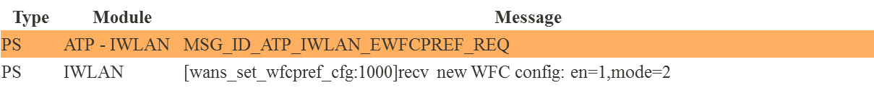
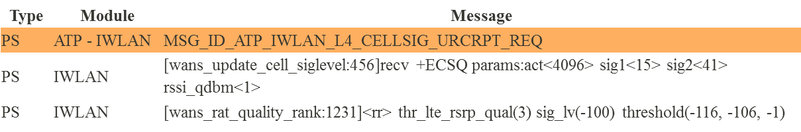
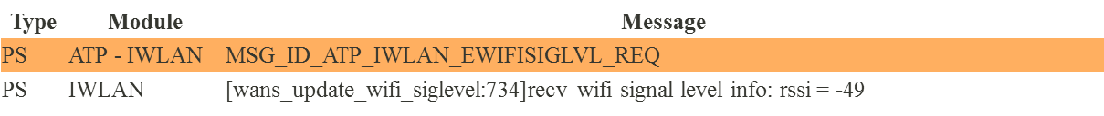
PDN Connection Handover
Misc Log Information
Handover Metrics | Log information
WFC preference mode
WFC/VoLTE UI on/off
Cellular Quality
WiFi Signal Quality
Type | Module | Message
PS | IWLAN - ATP | MSG_ID_ATP_IWLAN_L4_IMSCFG_IND

Slide 31
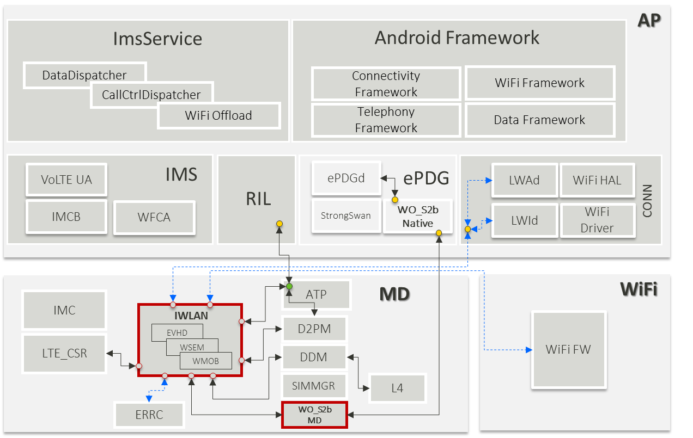
L4 Re-arch R&R
Stella.Yang
IMS: Kaiwen.Liu
Non-IMS: Ben.Liao
Yuhhua.Hu
Mingchun.Cheng
Kevin.Tseng
Tim-YW.Liu

Slide 33
AP
ImsService
Android Framework
DataDispatcher
Connectivity
Framework
WiFi Framework
CallCtrlDispatcher
WiFi Offload
Telephony
Framework
Data Framework
VoLTE UA
IMS
ePDGd
ePDG
LWAd
WiFi HAL
RIL
CONN
IMCB
WFCA
StrongSwan
WO_S2b
Native
LWId
WiFi Driver
ATP
MD
WiFi
IMC
IWLAN
WiFi FW
EVHD
D2PM
LTE_CSR
WSEM
WMOB
DDM
Framework
SIMMGR
L4
Native
ERRC
WO_S2b
MD
MD/WiFi
Notes:
TS23.261

Slide 34
L4 Re-arch R&R
AP
ImsService
Android Framework
DataDispatcher
Connectivity
Framework
WiFi Framework
CallCtrlDispatcher
WiFi Offload
Telephony
Framework
Data Framework
VoLTE UA
IMS
ePDGd
ePDG
LWAd
WiFi HAL
RIL
CONN
IMCB
WFCA
StrongSwan
WO_S2b
Native
LWId
WiFi Driver
ATP
MD
WiFi
IMC
IWLAN
WiFi FW
EVHD
D2PM
LTE_CSR
WSEM
WMOB
DDM
SIMMGR
L4
ERRC
WO_S2b
MD

Slide 35
Gen93 IWLAN RPL_{(RAT Preference List)}
APN Table
PDN Connection
WSEM View
RPL View
PDN CONN
#1
internet Default bearer cid-0
PDN Connection CID-0
APN: MTNET APN_TYPE: default,mms,wap,supl
RPL[general]: MD
PDN CONN
#2
supl Default bearer cid-1
PDN Connection CID-1
APN: MTIMS
APN_TYPE: ims
ims Default bearer cid-2
PDN CONN
#3
PDN Connection CID-2
RPL[ims]: WiFi
IMS Dedicated bearer cid-3
IMS Dedicated bearer cid-4

