Slide 1
D2/DDM
17 April 2017

Slide 2
Agenda
D2/DDM Overview
Architecture
Module introduction
Function Flow
APN table
PS Attach/Detach
Combine attach / FOP
Attach PDN
LTE attach
IA selection
Activate/Deactivate a data call
PDN Activation
Network interface configuration
PDN Deactivation
RA fail
Case Study & Log Analysis
LTE Attach
Activating a data call

Slide 3
D2/DDM Overview

Slide 4
Android Framework
AP branch
RIL Request
IMS
MD Application
NetAgent
RILD
VOLTE stack/UA
Vendor-ril
XCAP
IMCB
IMCB_IMSM
Interface
IMSM
AT/URC
(Proprietary )
AT
AP
TTY Dev.
TTY Dev.
MD
IMC
BIP
MOD_IMSM
Common Data Interface
ATP
D2
(task)
SIM
SIMMNGR
TCP/IP
Stack
IWLAN
AT in ILM
L4
ePDGa
DDM
L4BPDN
SIM

Slide 5
TCP/IP
Stack
NetAgent
RILD
MD Application
IMSM
(MD APP@AP)
AT/URC
(Proprietary )
AT
AP
TTY Dev.
TTY Dev.
MD
BIP
(MD APP@MD)
D2Adapter
D2IMSM
D2AT
ATP
Common Data Interface
D2CM
TCP/IP
Stack
D2AM
D2PM
D2 Task
IWLAN
AT in ILM
DDM
ePDGa
L4
L4BPDN
L4BNW

Slide 6
Modules
TASK | Modules | Features
D2 | D2AT | AT command interface support (from AP) PDP context cache (Legacy AT command) e.g., AT+CGDCONT, AT+CGDSCONT CID remapping Post CID allocation for legacy AT command
 | D2CM | Common data interface Multi-user support AP users use the AP TCP/IP stack MD users use the MD TCP/IP stack MD users use the AP TCP/IP stack Network interface manager AP CCMNI MD TCP/IP stack device IP address manager IPv4/IPv6 address RS/RA IP changed
 | D2PM | APN information CID allocation PDN activation/deactivation/reuse
 | D2AM | IA selection IA definition IA cache PS attach/detach control EDALLOW for MPS/SPS
DDM | DDM | IPv4v6 fallback PDN-layer data retry

Slide 7
Function Flow

Slide 8
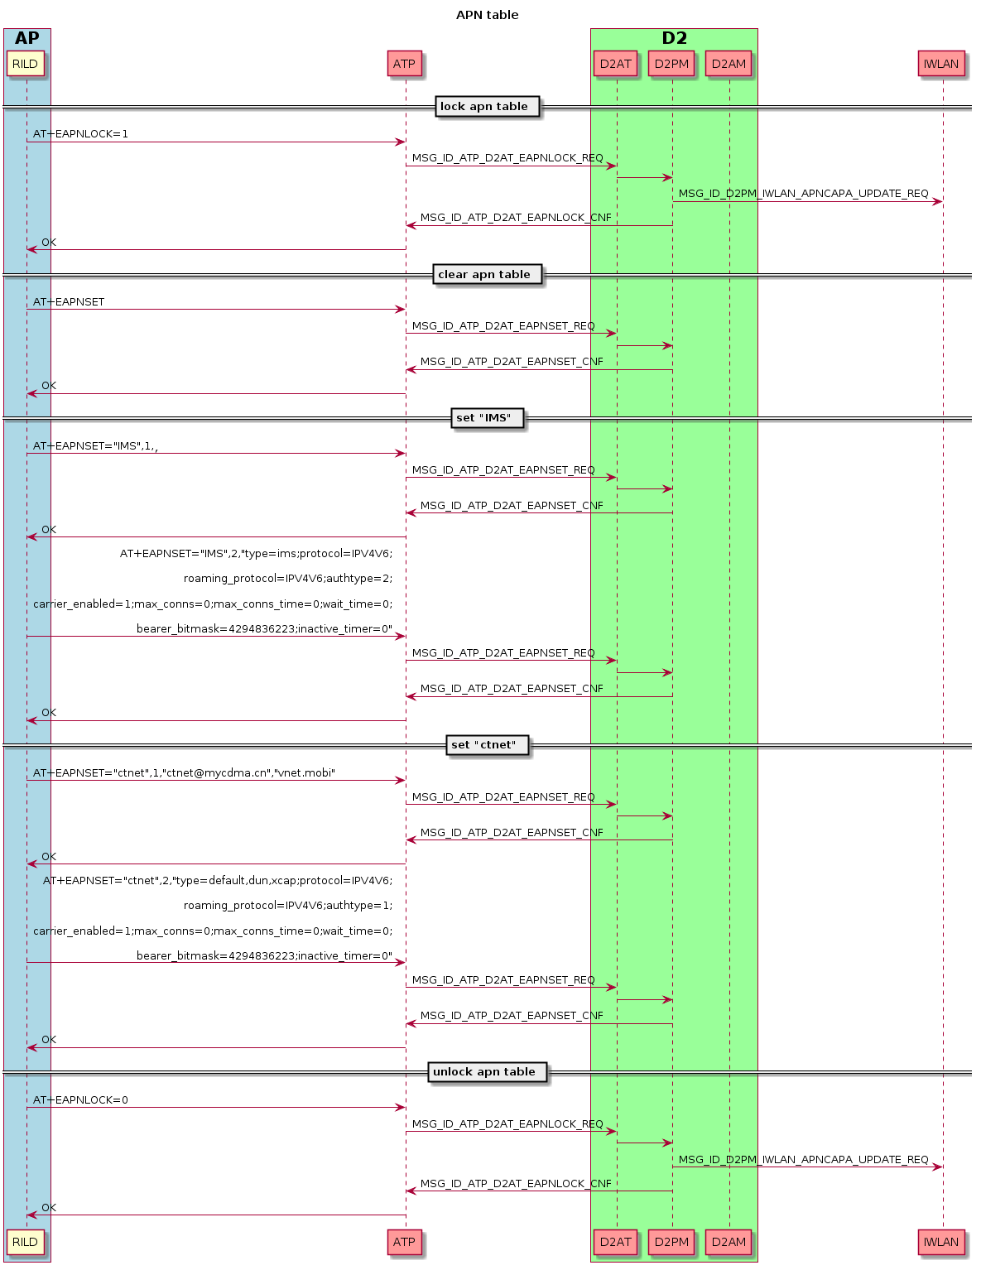
APN Table

Slide 9
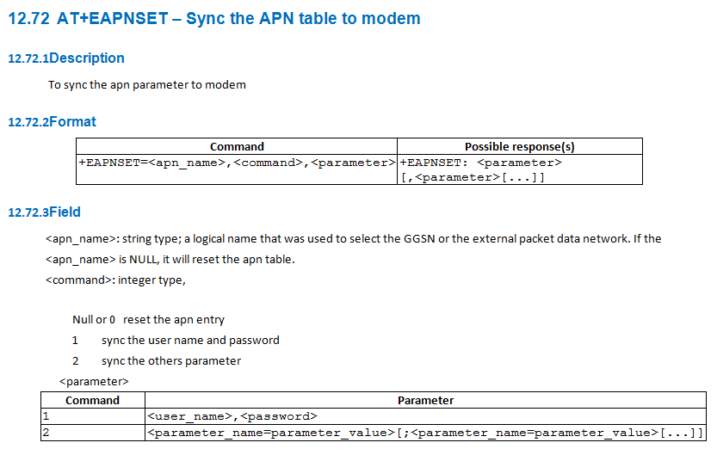
APN Table
AT+EAPNSET="IMS",1,"","“
AT+EAPNSET="IMS",2,"type=ims;protocol=IPV4V6;roaming_protocol=IPV4V6;authtype=2;carrier_enabled=1;max_conns=0;max_conns_time=0;wait_time=0;bearer_bitmask=4294836223;inactive_timer=0"

Slide 10
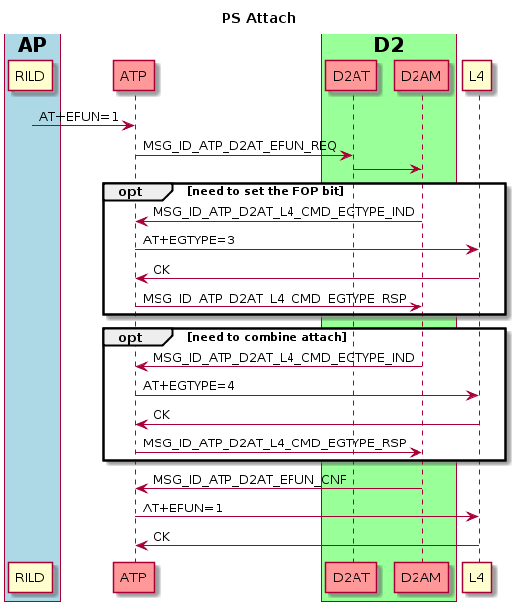
PS Attach

Slide 11
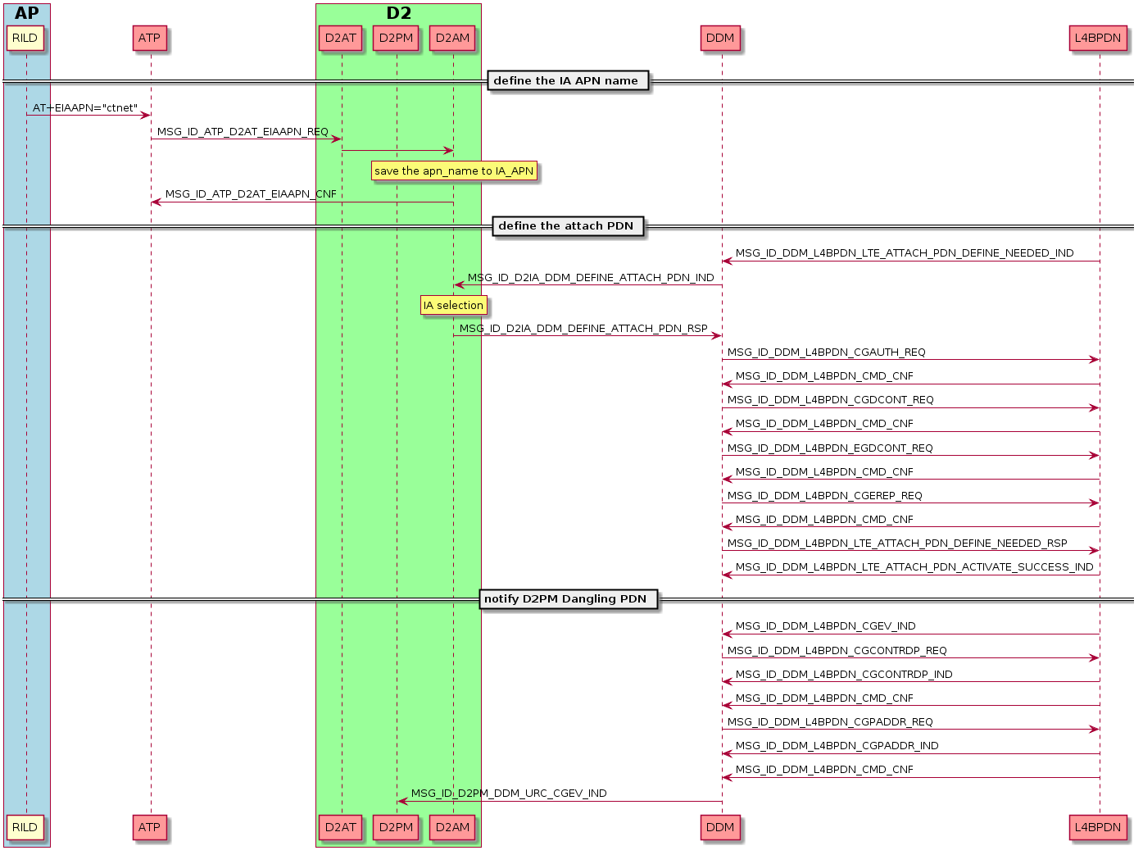
LTE Attach

Slide 12
IA Selection
Receive the LTE_ATTACH_PDN_DEFINE_NEEDED
yes
Receive the AT+CGDCONT(cid=0) ?
no
yes
UE_SIMULATOR or MODEM_ONLY
no
Send the default context to L4
(AT+CGDCONT)
yes
Define the IA APN from AP ? (AT+EIAAPN)
no
yes
Is test sim ?
no
yes
Get IA APN context from APN table ?
no
yes
Is FTA mode ?
no
different
Check the ICCID
the same
no
Get IA APN context from NVRAM ?
yes
yes
Is FTA mode ?
no
Send the response
(cid=5)
Send the response
(cid=0)
Send the reject response
(APN not found)
Send the reject response
(APN not set)
Send the response
(cid=0)

Slide 13
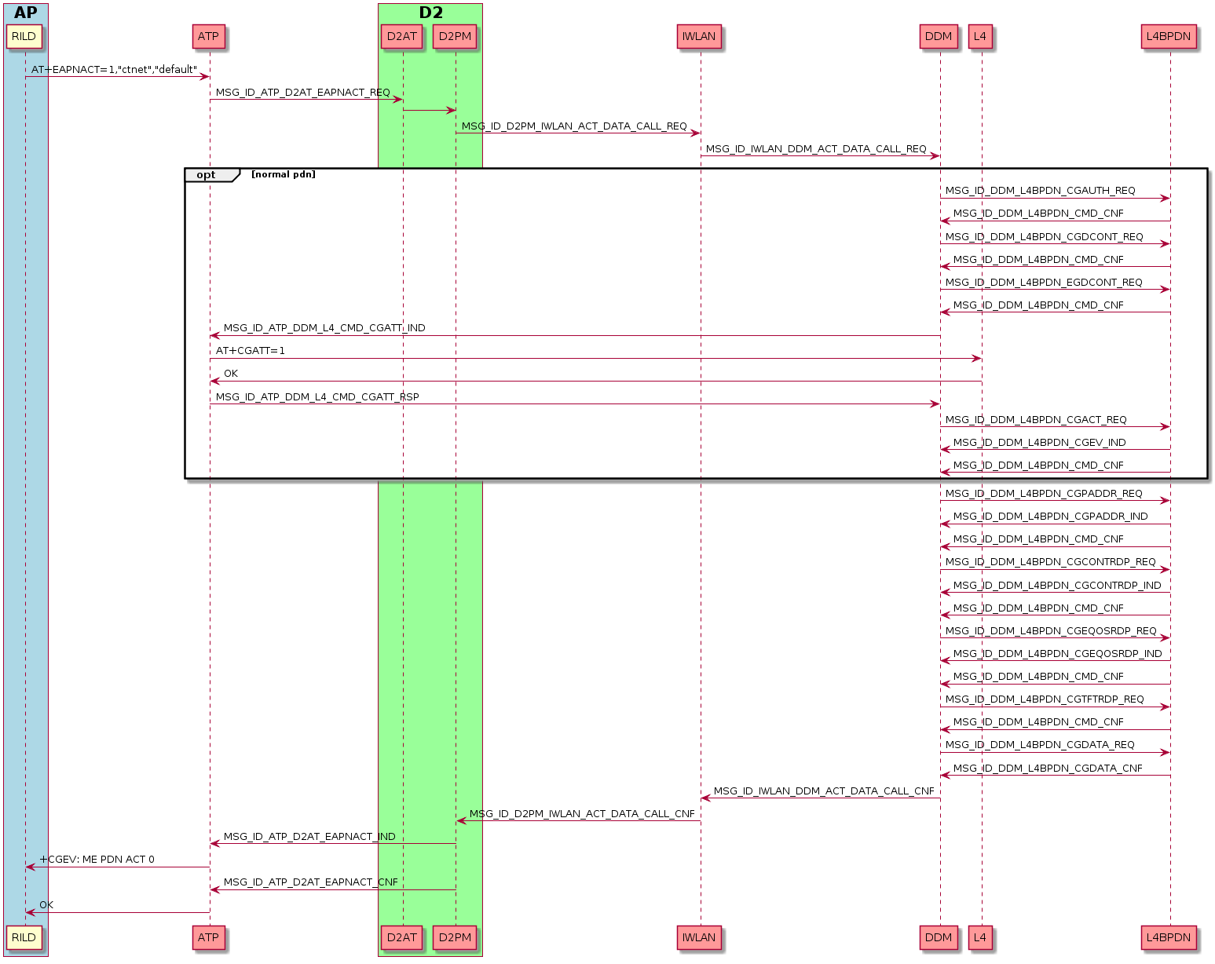
Activating a Data Dall

Slide 14
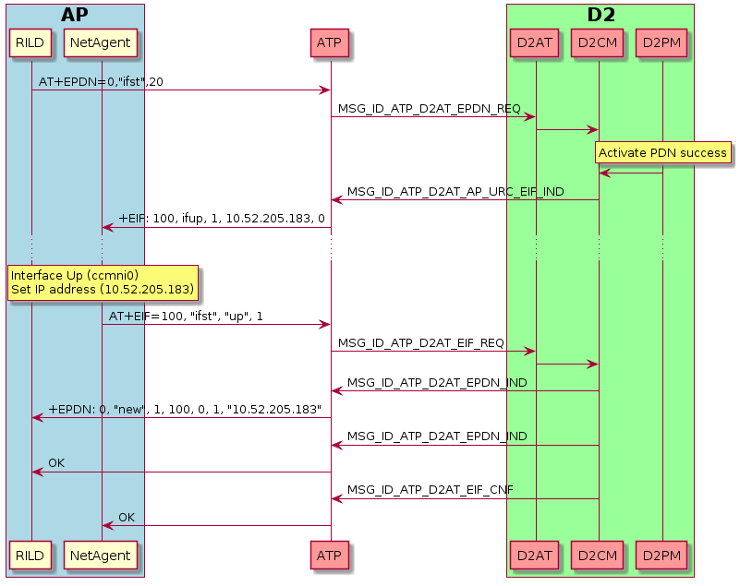
Configuring Network Interface
Interface ID = 100
1 → transaction id
00 -> ccmni interface id

Slide 15
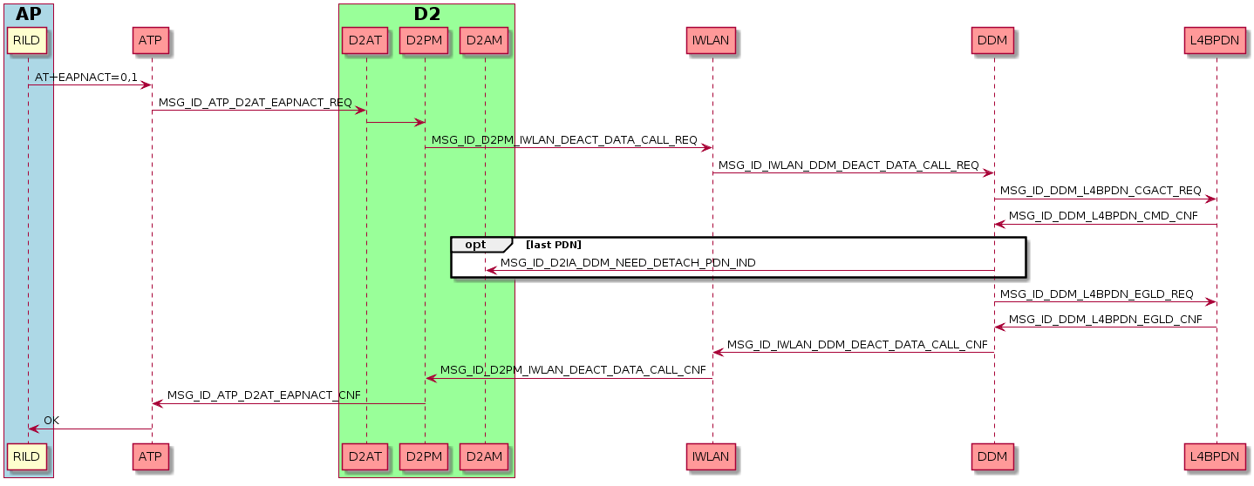
Deactivating a Data Call

Slide 16
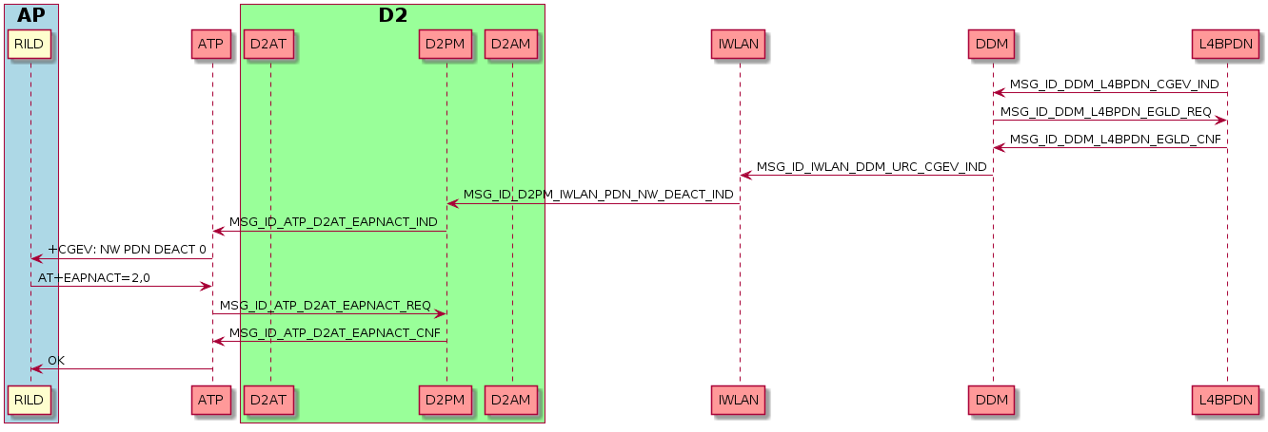
Deactivating a Data Call by Network

Slide 17
Case Study & Log Analysis

Slide 18
LTE Attach – Normal Case
Type | Index | Time | Local Time | Module | Message
PS | 168796 | 123614 | 11:14:50:624 | L4BPDN - DDM | MSG_ID_DDM_L4BPDN_LTE_ATTACH_PDN_DEFINE_NEEDED_IND
PS | 168800 | 123614 | 11:14:50:624 | DDM - D2AM | MSG_ID_D2IA_DDM_DEFINE_ATTACH_PDN_IND
PS | 168861 | 123625 | 11:14:50:624 | D2AM - DDM | MSG_ID_D2IA_DDM_DEFINE_ATTACH_PDN_RSP
PS | 170573 | 124177 | 11:14:50:824 | DDM - L4BPDN | MSG_ID_DDM_L4BPDN_LTE_ATTACH_PDN_DEFINE_NEEDED_RSP
PS | 198373 | 139315 | 11:14:51:625 | L4BPDN - DDM | MSG_ID_DDM_L4BPDN_LTE_ATTACH_PDN_ACTIVATE_SUCCESS_IND
MSG_ID_D2IA_DDM_DEFINE_ATTACH_PDN_RSP
d2ia_ddm_define_attach_pdn_rsp_struct = (struct)
ref_count = 0x01
lp_reserved = 0x00
msg_len = 0x00d4
src_id = 0x0000001a
is_success = KAL_TRUE (enum 1)
err_cause = 0 (enum 0)
cid = 0x00000000
req_type = ATCMD_REQUEST_TYPE_INITIAL (enum 2)
apn = "3gnet"
pdp_type = "IPv4v6"
roam_prot = "IP"
auth_type = 0x00000002
username = ""
passwd = ""
is_cid_allocated = KAL_TRUE (enum 1)

Slide 19
LTE Attach – D2AM_IA_APN_NOT_SET
MSG_ID_D2IA_DDM_DEFINE_ATTACH_PDN_RSP
d2ia_ddm_define_attach_pdn_rsp_struct = (struct)
ref_count = 0x01
lp_reserved = 0x00
msg_len = 0x00d4
src_id = 0x0000001a
is_success = KAL_FALSE (enum 0)
err_cause = D2AM_IA_APN_NOT_SET (enum 5729)
cid = 0x00000000
req_type = ATCMD_REQUEST_TYPE_INITIAL_OR_HANDOVER (enum 0)
apn = ""
pdp_type = ""
roam_prot = ""
auth_type = 0x00000000
username = ""
passwd = ""
is_cid_allocated = KAL_TRUE (enum 1)
MSG_ID_D2IA_DDM_DEFINE_ATTACH_PDN_RSP
d2ia_ddm_define_attach_pdn_rsp_struct = (struct)
ref_count = 0x01
lp_reserved = 0x00
msg_len = 0x00d4
src_id = 0x0000001a
is_success = KAL_FALSE (enum 0)
err_cause = D2AM_IA_APN_NOT_FOUND (enum 5730)
cid = 0x00000000
req_type = ATCMD_REQUEST_TYPE_INITIAL_OR_HANDOVER (enum 0)
apn = ""
pdp_type = ""
roam_prot = ""
auth_type = 0x00000000
username = ""
passwd = ""
is_cid_allocated = KAL_TRUE (enum 1)
Check “System Trace”
Type | Index | Time | Local Time | Module | Message
SYS | 465164 | 158462 | 14:11:39:234 | NIL | [AT_RX p25,ch0]AT+EAPNSET
SYS | 465296 | 158541 | 14:11:39:234 | NIL | [AT_RX p25,ch0]AT+EAPNSET="IMS",1,"",""
SYS | 465419 | 158610 | 14:11:39:234 | NIL | [AT_RX p25,ch0]AT+EAPNSET="IMS",2,"type=ims;protocol=IPV4V6;roaming_protocol=IPV4V6;authtype=2; carrier_enabled=1;max_conns=0;max_conns_time=0;wait_time=0;bearer_bitmask=4294836223;inactive_timer=0"
SYS | 465551 | 158681 | 14:11:39:234 | NIL | [AT_RX p25,ch0]AT+EAPNSET="ctnet",1,"ctnet@mycdma.cn","vnet.mobi"
SYS | 465679 | 158735 | 14:11:39:234 | NIL | [AT_RX p25,ch0]AT+EAPNSET="ctnet",2,"type=default,dun,xcap;protocol=IPV4V6;roaming_protocol=IPV4V6;authtype=1; carrier_enabled=1;max_conns=0;max_conns_time=0;wait_time=0;bearer_bitmask=4294836223;inactive_timer=0"
SYS | 466224 | 159012 | 14:11:39:234 | NIL | [AT_RX p25,ch0]AT+EIAAPN="ctnet"

Slide 20
Activating a Data call –PDN Activation (Attach PDN Reuse)
Type | Index | Time | Local Time | Module | Message
SYS | 513773 | 211443 | 14:11:42:736 | NIL | [AT_RX p25,ch0]AT+EAPNACT=1,"ctnet","default"
PS | 513797 | 211446 | 14:11:42:736 | ATP - D2AT | MSG_ID_ATP_D2AT_EAPNACT_REQ
PS | 513814 | 211450 | 14:11:42:736 | D2PM - IWLAN | MSG_ID_D2PM_IWLAN_ACT_DATA_CALL_REQ
PS | 513816 | 211453 | 14:11:42:736 | IWLAN - DDM | MSG_ID_IWLAN_DDM_ACT_DATA_CALL_REQ
PS | 513825 | 211455 | 14:11:42:736 | DDM - L4BPDN | MSG_ID_DDM_L4BPDN_CGPADDR_REQ
PS | 513864 | 211460 | 14:11:42:736 | L4BPDN - DDM | MSG_ID_DDM_L4BPDN_CGPADDR_IND
PS | 513867 | 211460 | 14:11:42:736 | L4BPDN - DDM | MSG_ID_DDM_L4BPDN_CMD_CNF
PS | 513869 | 211461 | 14:11:42:736 | DDM - L4BPDN | MSG_ID_DDM_L4BPDN_CGCONTRDP_REQ
PS | 513907 | 211468 | 14:11:42:736 | L4BPDN - DDM | MSG_ID_DDM_L4BPDN_CGCONTRDP_IND
PS | 513912 | 211468 | 14:11:42:736 | L4BPDN - DDM | MSG_ID_DDM_L4BPDN_CGCONTRDP_IND
PS | 513916 | 211469 | 14:11:42:736 | L4BPDN - DDM | MSG_ID_DDM_L4BPDN_CGCONTRDP_IND
PS | 513918 | 211469 | 14:11:42:736 | L4BPDN - DDM | MSG_ID_DDM_L4BPDN_CMD_CNF
PS | 513921 | 211469 | 14:11:42:736 | DDM - L4BPDN | MSG_ID_DDM_L4BPDN_CGEQOSRDP_REQ
PS | 513995 | 211478 | 14:11:42:736 | L4BPDN - DDM | MSG_ID_DDM_L4BPDN_CGEQOSRDP_IND
PS | 514042 | 211484 | 14:11:42:736 | L4BPDN - DDM | MSG_ID_DDM_L4BPDN_CMD_CNF
PS | 514044 | 211484 | 14:11:42:736 | DDM - L4BPDN | MSG_ID_DDM_L4BPDN_CGTFTRDP_REQ
PS | 514133 | 211493 | 14:11:42:736 | L4BPDN - DDM | MSG_ID_DDM_L4BPDN_CMD_CNF
PS | 514136 | 211494 | 14:11:42:736 | DDM - L4BPDN | MSG_ID_DDM_L4BPDN_CGDATA_REQ
PS | 514266 | 211512 | 14:11:42:736 | L4BPDN - DDM | MSG_ID_DDM_L4BPDN_CGDATA_CNF
PS | 514268 | 211515 | 14:11:42:736 | DDM - IWLAN | MSG_ID_IWLAN_DDM_ACT_DATA_CALL_CNF
PS | 514269 | 211516 | 14:11:42:736 | IWLAN - D2PM | MSG_ID_D2PM_IWLAN_ACT_DATA_CALL_CNF
SYS | 514310 | 211525 | 14:11:42:736 | NIL | [AT_TX p25,ch0]+CGEV: ME PDN ACT 0
SYS | 514362 | 211532 | 14:11:42:736 | NIL | [AT_TX p25,ch0]OK

Slide 21
Activating a Data call –PDN Activation
Type | Index | Time | Local Time | Module | Message
SYS | 103930 | 2792356 | 14:40:09:615 | NIL | [AT_RX p25,ch0]AT+EAPNACT=1,"cmnet","default"
PS | 103954 | 2792358 | 14:40:09:615 | ATP - D2AT | MSG_ID_ATP_D2AT_EAPNACT_REQ
PS | 103970 | 2792360 | 14:40:09:615 | D2PM - IWLAN | MSG_ID_D2PM_IWLAN_ACT_DATA_CALL_REQ
PS | 103989 | 2792361 | 14:40:09:615 | IWLAN - DDM | MSG_ID_IWLAN_DDM_ACT_DATA_CALL_REQ
PS | 103995 | 2792363 | 14:40:09:615 | DDM - L4BPDN | MSG_ID_DDM_L4BPDN_EGFB_REQ
PS | 104068 | 2792366 | 14:40:09:615 | L4BPDN - DDM | MSG_ID_DDM_L4BPDN_CMD_CNF
PS | 104069 | 2792366 | 14:40:09:615 | DDM - L4BPDN | MSG_ID_DDM_L4BPDN_CGAUTH_REQ
PS | 104174 | 2792372 | 14:40:09:615 | L4BPDN - DDM | MSG_ID_DDM_L4BPDN_CMD_CNF
PS | 104175 | 2792372 | 14:40:09:615 | DDM - L4BPDN | MSG_ID_DDM_L4BPDN_CGDCONT_REQ
PS | 104283 | 2792377 | 14:40:09:615 | L4BPDN - DDM | MSG_ID_DDM_L4BPDN_CMD_CNF
PS | 104284 | 2792377 | 14:40:09:615 | DDM - L4BPDN | MSG_ID_DDM_L4BPDN_EGDCONT_REQ
PS | 104393 | 2792382 | 14:40:09:615 | L4BPDN - DDM | MSG_ID_DDM_L4BPDN_CMD_CNF
PS | 104394 | 2792383 | 14:40:09:615 | DDM - L4BPDN | MSG_ID_DDM_L4BPDN_CGEREP_REQ
PS | 104467 | 2792385 | 14:40:09:615 | L4BPDN - DDM | MSG_ID_DDM_L4BPDN_CMD_CNF
PS | 104468 | 2792386 | 14:40:09:615 | DDM - ATP | MSG_ID_ATP_DDM_L4_CMD_CGATT_IND
PS | 104531 | 2792392 | 14:40:09:615 | ATP - DDM | MSG_ID_ATP_DDM_L4_CMD_CGATT_RSP
PS | 104537 | 2792393 | 14:40:09:615 | DDM - L4BPDN | MSG_ID_DDM_L4BPDN_CGACT_REQ
PS | 105814 | 2800461 | 14:40:10:215 | L4BPDN - DDM | MSG_ID_DDM_L4BPDN_CGEV_IND
PS | 105855 | 2800462 | 14:40:10:215 | L4BPDN - DDM | MSG_ID_DDM_L4BPDN_CMD_CNF
PS | 105858 | 2800463 | 14:40:10:215 | DDM - L4BPDN | MSG_ID_DDM_L4BPDN_CGPADDR_REQ
PS | 105896 | 2800464 | 14:40:10:215 | L4BPDN - DDM | MSG_ID_DDM_L4BPDN_CGPADDR_IND
PS | 105899 | 2800464 | 14:40:10:215 | L4BPDN - DDM | MSG_ID_DDM_L4BPDN_CMD_CNF
PS | 105904 | 2800465 | 14:40:10:215 | DDM - L4BPDN | MSG_ID_DDM_L4BPDN_CGCONTRDP_REQ
PS | 105945 | 2800467 | 14:40:10:215 | L4BPDN - DDM | MSG_ID_DDM_L4BPDN_CGCONTRDP_IND
PS | 105948 | 2800467 | 14:40:10:215 | L4BPDN - DDM | MSG_ID_DDM_L4BPDN_CMD_CNF
PS | 105951 | 2800467 | 14:40:10:215 | DDM - L4BPDN | MSG_ID_DDM_L4BPDN_CGEQOSRDP_REQ
PS | 106022 | 2800470 | 14:40:10:215 | L4BPDN - DDM | MSG_ID_DDM_L4BPDN_CGEQOSRDP_IND
PS | 106063 | 2800472 | 14:40:10:215 | L4BPDN - DDM | MSG_ID_DDM_L4BPDN_CMD_CNF
PS | 106064 | 2800472 | 14:40:10:215 | DDM - L4BPDN | MSG_ID_DDM_L4BPDN_CGTFTRDP_REQ
PS | 106148 | 2800475 | 14:40:10:215 | L4BPDN - DDM | MSG_ID_DDM_L4BPDN_CMD_CNF
PS | 106150 | 2800476 | 14:40:10:215 | DDM - L4BPDN | MSG_ID_DDM_L4BPDN_CGDATA_REQ
PS | 106271 | 2800483 | 14:40:10:215 | L4BPDN - DDM | MSG_ID_DDM_L4BPDN_CGDATA_CNF
PS | 106290 | 2800485 | 14:40:10:215 | IWLAN - D2PM | MSG_ID_D2PM_IWLAN_ACT_DATA_CALL_CNF
SYS | 106328 | 2800489 | 14:40:10:215 | NIL | [AT_TX p25,ch0]+CGEV: ME PDN ACT 1
SYS | 106376 | 2800491 | 14:40:10:215 | NIL | [AT_TX p25,ch0]OK

Slide 22
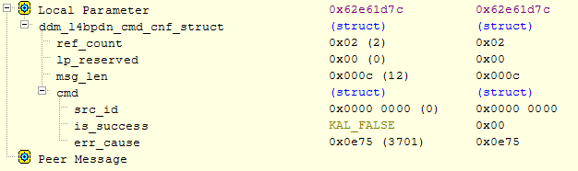
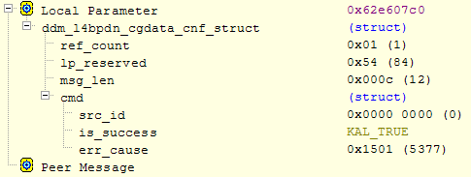
Activating a Data call – Issue Check
PDN activation fail
Step.1 Check message flow
Step.2 Check the response of MSG_ID_DDM_L4BPDN_CGACT_REQ
Network interface un-bind
Check whether there is a user to trigger the “data call activation request”
System Trace ➔ “AT+EAPNACT”
Check whether the MSG_ID_DDM_L4BPDN_CGDATA_REQ sent by DDM
Check the response of MSG_ID_DDM_L4BPDN_CGDATA_REQ

Slide 23
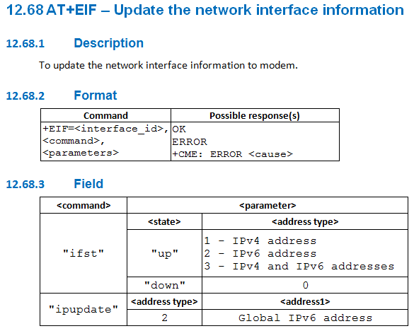
Activating a Data call – AP Network Interface
Interface up with v4 address
Type | Index | Time | Local Time | Module | Message
SYS | 106399 | 2800492 | 14:40:10:215 | NIL | [AT_URC p43,ch21]+EIF: 100, ifup, 1, 10.234.242.4, 0
SYS | 106614 | 2801231 | 14:40:10:215 | NIL | [AT_RX p42,ch20]AT+EIF=100, "ifst", "up", 1
SYS | 106762 | 2801240 | 14:40:10:215 | NIL | [AT_TX p42,ch20]OK
Interface up and get the global v6 address
Type | Index | Time | Local Time | Module | Message
SYS | 203944 | 189989 | 15:53:35:033 | NIL | [AT_URC p43,ch21]+EIF: 100, ifup, 2, FE:80:00:00:00:00:00:00:24:C1:C5:45:64:39:B8:3D, 0
SYS | 204364 | 190415 | 15:53:35:033 | NIL | [AT_RX p42,ch20]AT+EIF=100, "ifst", "up", 2
SYS | 204447 | 190430 | 15:53:35:033 | NIL | [AT_TX p42,ch20]OK
SYS | 204914 | 190952 | 15:53:35:233 | NIL | [AT_RX p42,ch20]AT+EIF=100, "ipupdate", 2, "30:00:00:00:00:00:00:03:24:C1:C5:45:64:39:B8:3D"
SYS | 205004 | 190968 | 15:53:35:233 | NIL | [AT_TX p42,ch20]OK

Slide 24
Backup

